Slide 1


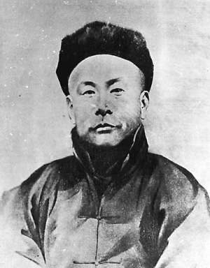
Kung Fu Master
霍元甲
Huo Yuanjia
Presenter: Ouyang Ling 欧阳玲
Handout: Zhou Yiwen 周艺文

Slide 2

Contents
Introduction of Huo Yuanjia
Historical Background
Huo’s Spirit of Wushu
Translation Methods

Slide 3
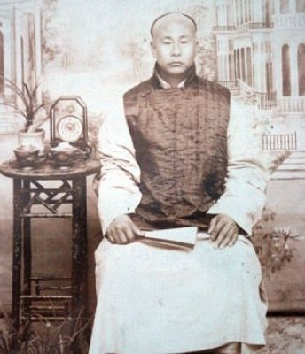
Brief introduction
Huo Yuanjia
Born in 1968 in Tianjin and died in 1910
Chinese martial artist
Practitioner of Mízōngyì (as known as Mízōngquán, “Lost Track Fist”)
Founded the Chin Woo Athletic Association between 1909-1910 in Shanghai

Slide 4
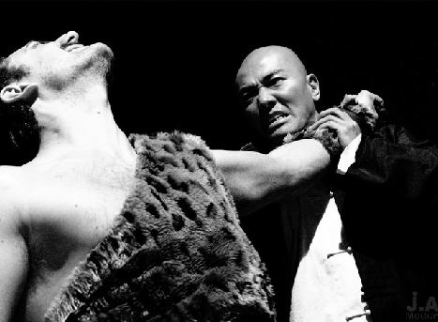
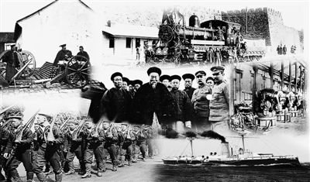
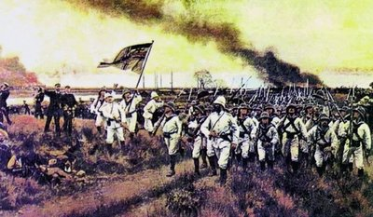
Historical background
foreign aggression
sovereignty crisis

Slide 5
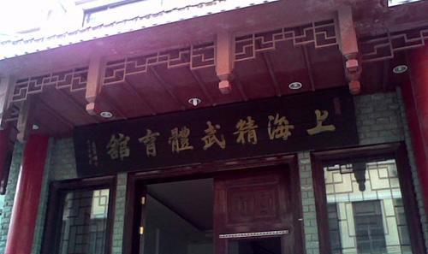
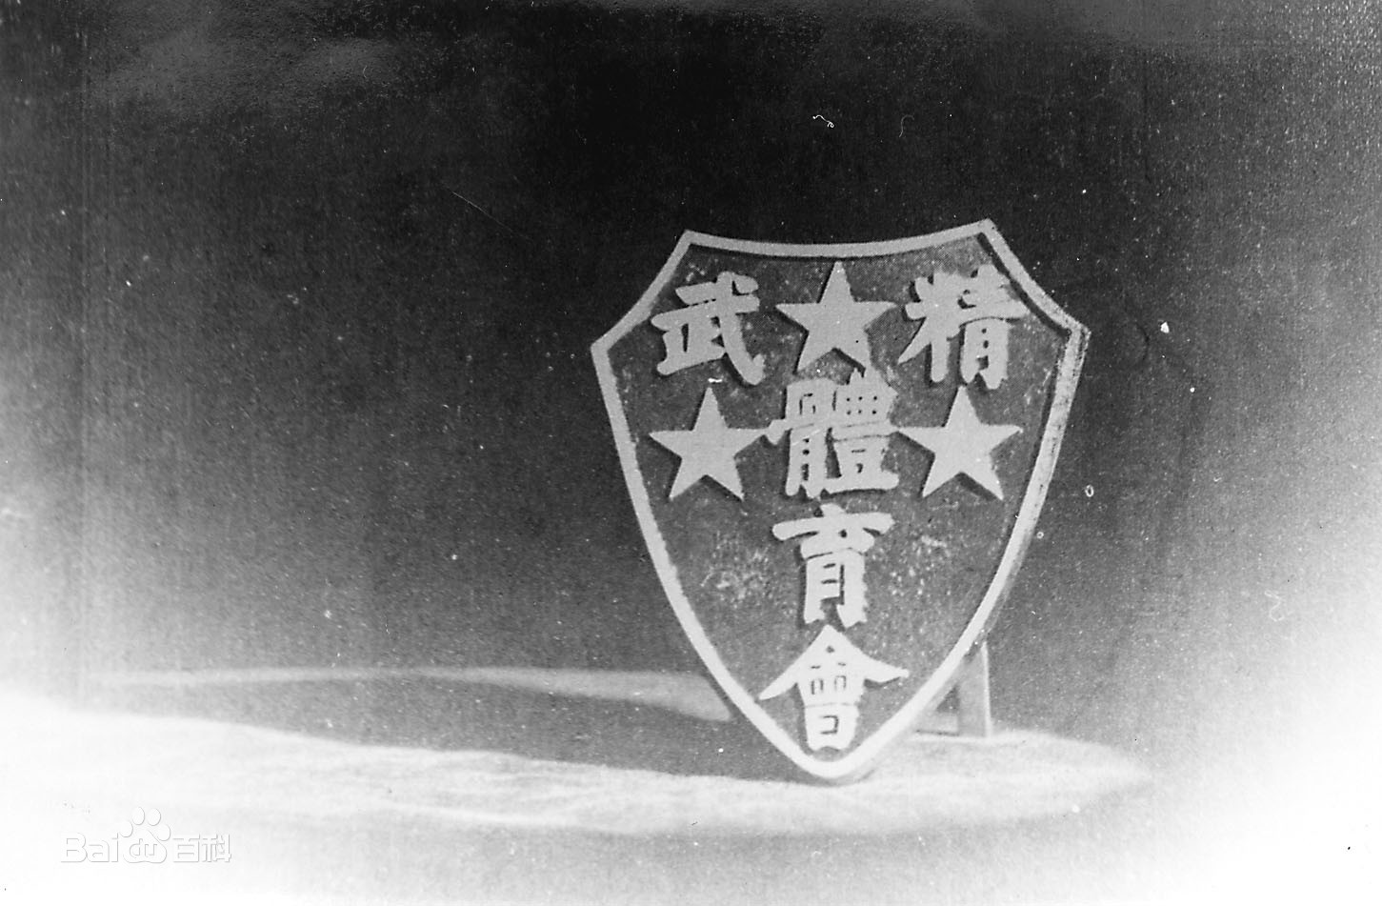
Huo’s spirit of Wushu
Chin Woo Athletic Association
physical, intellectual and moral education
the spirit of patriotism, self-cultivation,
justice and helping others

Slide 6
Translation Methods
1. Translation of Wushu terms
2. Subtitle translation

Slide 7
1. Transliteration or literal translation
Such as“武术” was translated into Wushu or martial arts.
Example:
“气” ：qi or vital energy
“气功” : qigong or breathing system for health and vitality
“长拳” ：Changquan or Long Boxing
“花拳” ： Huaquan or Flower Boxing

Slide 8
2. Interpretation
Example:
青龙偃月刀
black -dragon falchion: a new -moon -shaped broadsword with a long handle.
拗手
twist hands: a posture in Tajiquan with one’s hand touching the rival’s left hand, and one’s right hand touching the rival’s right hand.
八法
eight techniques: the techniques executed with the hands, eyes, trunk and feet as well as the display of spirit, qi, strength and skills.

Slide 9
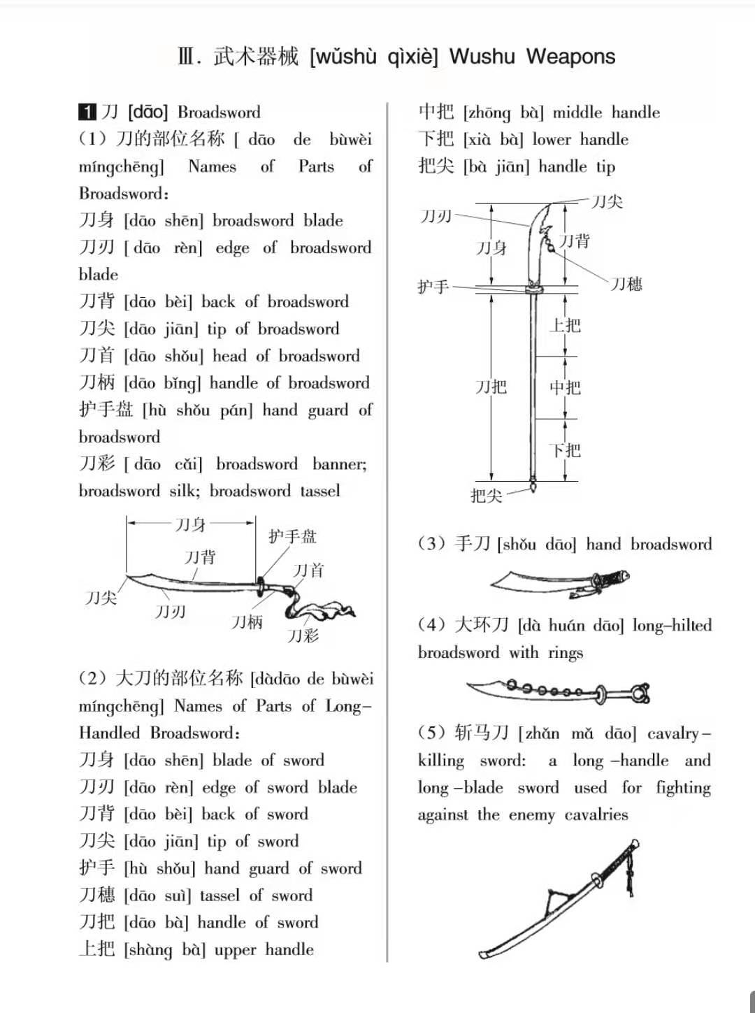
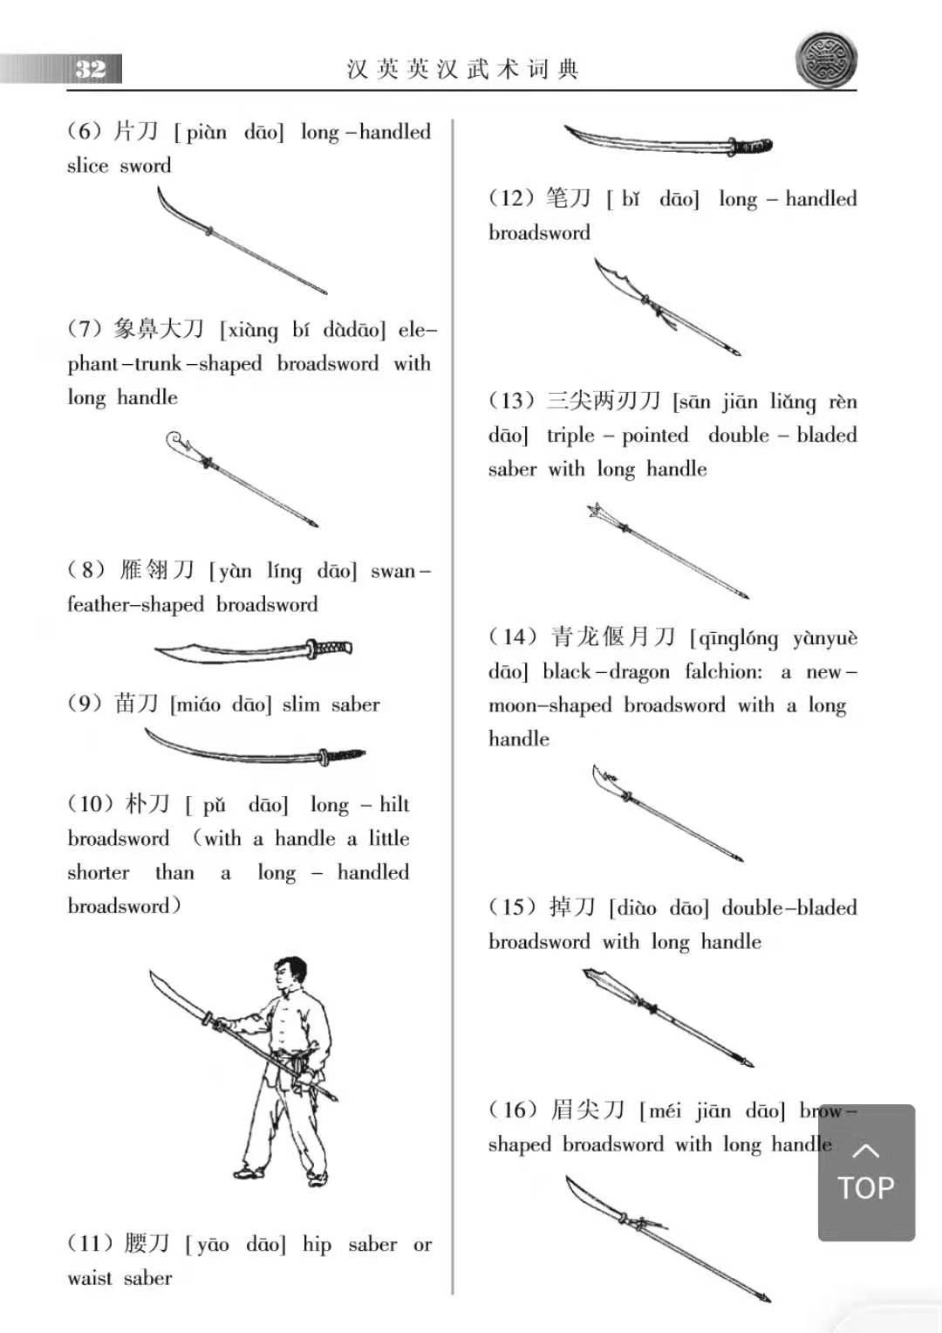
3. Diagram translation
It is difficult for the translator to fully understand its connotation only based on the written expression.
Diagram makes the meaning clearer

Slide 10
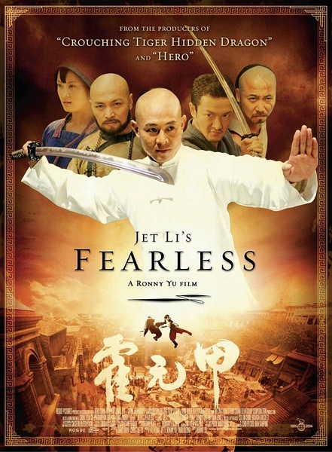
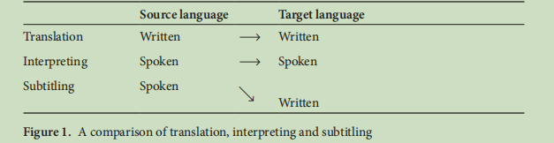

Slide 11
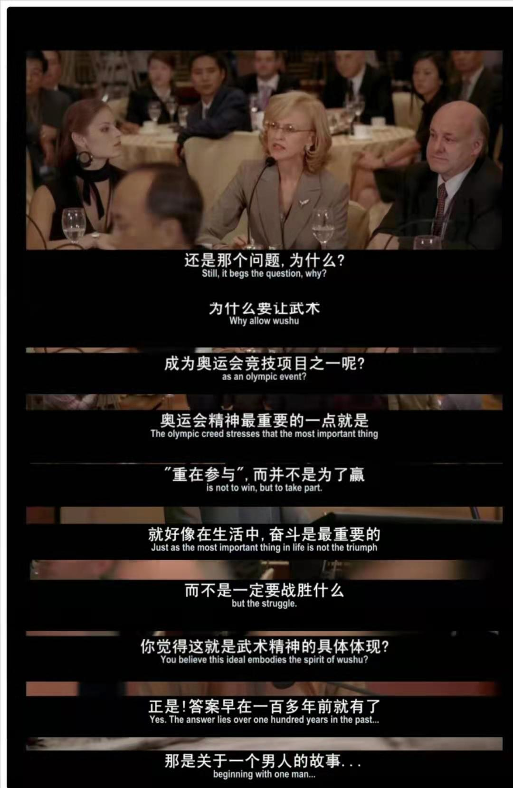
1. Transformation of syntactical structures
spoken mode:
clause-chains
written mode:
sentences

Slide 12
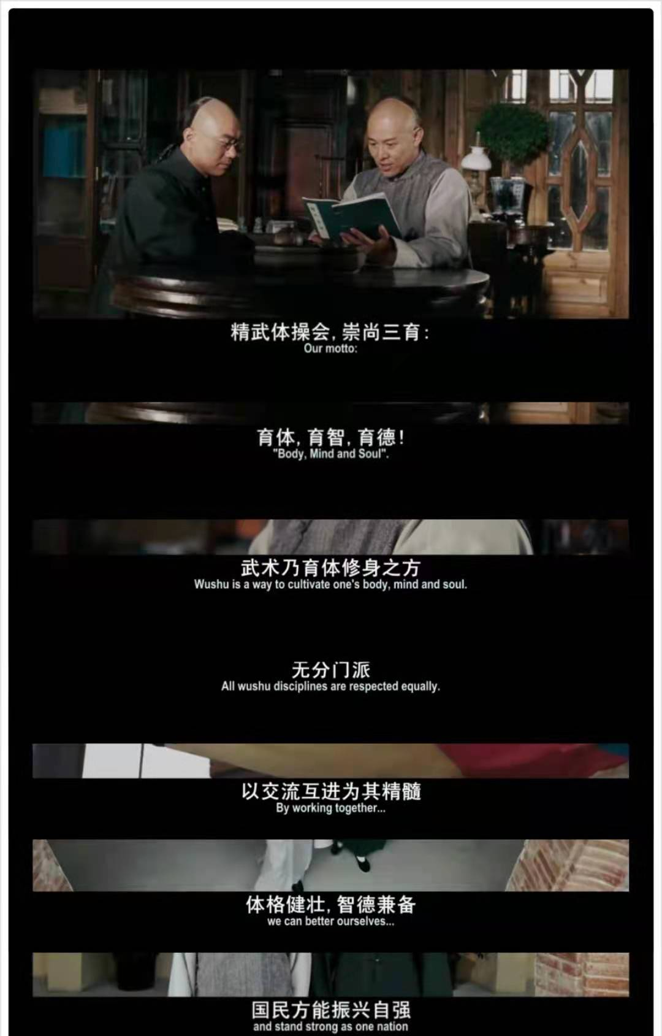
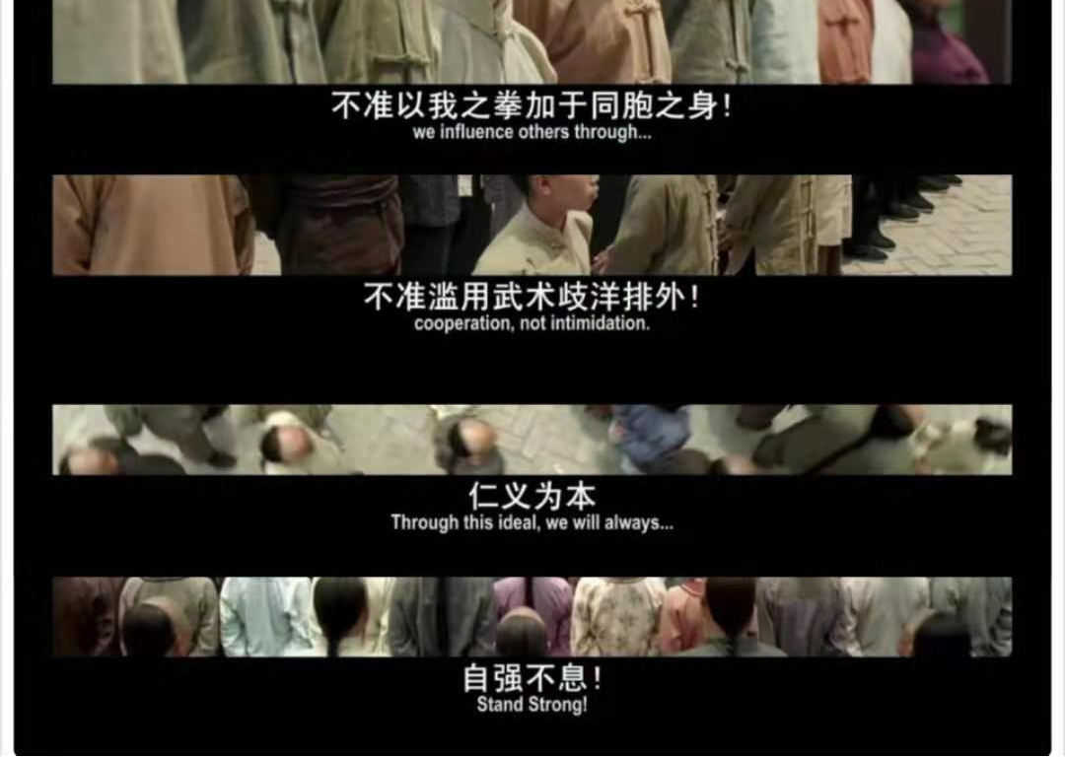
1. Omission or paraphrase
omit something that is not regarded as strictly necessary
for an understanding of the dialogue
paraphrased is to be used when it’s impossible to skip anything

Slide 13
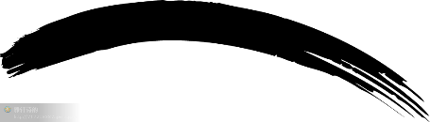
Thank You!

