Slide 1
Proof of early exchange between cultures in china
Culture exchange between the east and the west
Due to limited data, discussions on the exchange between the East and the West focused on the period after Zhang Qian's first visit to the Western Regions in the latter part of the second century BC.
Notes:
Therefore, it remained an open question whether there had been contact between the East and the West in the pre-Qin period and the even earlier prehistoric Bronze Age. If there had been, where did these encounters take place? And by what means did exchange occur?

Slide 2
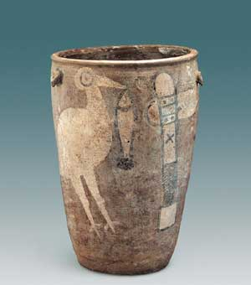
EXCAVATION OF Yangshao Village IN 1921
painted pottery in Yangshao came from the West.
.The Yangshao culture is well-known for its painted pottery. Yangshao artisans created fine painted pottery with human facial, animal, and geometric designs. Excavations found that children were buried in painted pottery jars.
Notes:
In 1921, modern archeology was introduced to China by the Swede, Dr. J. G. Andersson with the excavation at Yangshao Village, and the debate about cultural exchange between the east and the West became more intense. Some Western scholars, among whom Andersson was representative, hypothesized that Chinese painted pottery cultures in the Yellow River Valley during the prehistoric period originated from the region of Central Asia and spread into China through the Central Asian grasslands. Some foreign scholars even conjectured that the shape and pattern of painted pottery in Henan had the same origin as that dating to the Chalcolithic Age in the Near East.

Slide 3
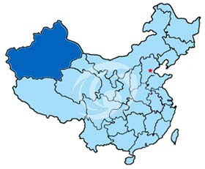
Xinjiang , the frontier zone for culture exchange
Location
Vast area
Cultural
relics,
Including
microliths,
Notes:
From the point of view of Western-Chinese cultural exchange, China's northwest was situated at the crossroads of Central Asian culture and regional cultures of the Yellow River Valley, which was a sensitive and key area of cultural contact. Xinjiang was particularly important, both for its special location and vast area. It can be thought of as a frontier zone of cultural contact between the East and the West. Many cultural relics, including microliths, have been discovered there. Although there are materials that certify human activity in the eastern part of Xinjiang dating back to about 10,000 BP, we do not know much about the prehistoric cultures and racial types in this region.
In 1979, some tombs were excavated beside the Konchi River (Kongquehe), near Lopnur in eastern Xinjiang, that dated to about 3800 BP. The human bones excavated from the site were concluded to be of the Caucasoid race. According to presently available data, these are the earliest Europoid type skeletal remains to have survived so far to the east. In the mid-1980s, there were excavations at Yanbulaq cemetery in Qumul (Rami), Xinjiang. Among the twenty-nine skulls examined, twenty-one were Mongoloid and eight were Europoid. This proved that Europoid people had advanced eastward into the Rami Oasis by 1300 BC, where they met with Mongoloid people.

Slide 4
Possible spread of prehistoric chinese culture to the west
the geographical location and structure caused ancient Chinese culture to have strong native characteristics.
primitive Chinese culture in the west advanced westward and spread continuously from the early to the late periods.
the primitive inhabitants' physical characteristics in Gansu, Qinghai, and elsewhere in the western part of China belonged to the Eastern Asiatic type of Mongoloid race.
Notes:
In Gansu and Qinghai, the local inhabitants' physical characteristics in the prehistoric Bronze Age had not changed markedly through time. Indeed, they played an important role in the process of forming the physical characteristics of the modern inhabitants of North China.
The overall terrain of China is high in the northwest and low in the southeast. It forms three big terraces from west to east. The first terrace is in the west, with an average altitude of 3,000-4,000 meters; the second terrace is in the middle, with an average altitude of around 1,000 meters; the third terrace is in the southeast, with an average altitude below 200 meters. This geographical structure causes China to be relatively open facing the ocean, but relatively closed away from it. Furthermore, this structure has had a great influence on the formation and development of Chinese ancient culture.

Slide 5
Excavations in Linya cemetary in Remi
Group A:The shapes and decorations of ceramics were similar to those of the Siba Culture, and some nearly identical.
Group B : jar with an oval belly and a jar with ball-shaped belly. The body of these forms was painted with a parallel water pattern and shaft-indented line pattern.
Notes:
If we compare the Linya ceramics to those of the Siba cultural period, ceramics in Group A in the Linya cemetery were similar to those of the middle and late period of the Siba culture. So we can confirm that the upper time limit of this cemetery may be dated back to about 3700 BP.
Group B ceramics approach those of the ceramics and stone tools of the Shamirshak (Qiemuerqieke) Culture near Altay, Xinjiang. But the original place of Shamirshak Culture was in Southern Siberia, Russia.
The discovery of the Linya cemetery had great significance. First, it has the earliest known painted pottery in eastern Xinjiang at present; second, the dates of relics from the Linya cemetery fill the time gap between Siba Culture and Yanbulaq Culture; third, the ceramics in Group A show strong characteristics of Siba Culture, which can prove that quite a few of its inhabitants came from the Siba Culture. These inhabitants must have been of the Eastern Asiatic type of the Mongoloid race. The ceramics in Group B came from the Altay region and the residents were probably of the Caucasoid race from Eastern Kazakhstan and southern Siberia. The Konchi River cemetery proves that this was not an isolated cultural phenomenon. So we can infer that there may have been two races represented in the Linya cemetery, just as in the Yanbulaq cemetery .But the quantity of ceramics in Group B was relatively small, and it is estimated that the percentage of the Caucasoid population was also low. Considering that the quantity of ceramics in Group B was relatively small, we inferred that the racial rate of the Linya cemetery was similar to that of the Yanbulaq tombs.
Through the above analysis and previous discoveries, a picture of the cultural exchange between the East and the West has become clearer. At the beginning of the second millennium BCE, some people of the Eastern Asiatic Mongoloid race, who lived at the western end of the Gansu Corridor, crossed the Gobi Desert and emigrated into the Hami Oasis. At the same time, some members of the primitive Europoid race crossed the Altai Mountains, followed the Ertish River Valley , and passed through the Altay Grasslands. Some of them continued to advance southward and entered into eastern Xinjiang, where they then contacted and mixed with the Eastern Asiatic Mongoloid race in Rami. The archeological materials show that some of the Mongoloid race in eastern Xinjiang who made Rami their base proceeded to enter the Barkol Grasslands in the north, then migrated to Urlimchi in the west along the Tangri Tagh (Tianshan); others migrated into the Turpan, Pichan (Shanshan), and Toqsun basins in the west, and had a cultural effect on the Qarashahar (Yanqi) Basin and the valleys of the Tangri Tagh. During the Western Zhou to the Spring and Autumn Period, Ancient Mediten-anean peoples crossed the Pamir Plateau, travelled along the northern and southern edges of the Tarim Basin, and then advanced into Lopnur and the eastern Tangri Tagh. During these waves of emigration, eastern culture coming from the Gansu Corridor met western culture which was advancing eastward into the eastern and central parts of Xinjiang. The different races made frequent contact and stimulated the change and development of various cultures. All these led to the special cultures of central Xinjiang and "the mixing of the races."
The cultural contact and mixing between the East and the West since around 2000 BC prepared the foundation for many small oasis states in this area and it led to the formal birth of the "Silk Roads" which connected Europe with Asia. Undoubtedly all these events had important effects on world history. Also, there were other significant, related archeological discoveries in the Gansu Corridor and eastern Xinjiang. For example, common wheat dating to the early third millennium BC has been found in the central part of the Gansu Corridor and jade materials dating to the late third millennium BC have been found in the eastern part of the Gansu Corridor. All this evidence suggests that the formation of this trade channel can be traced back to the prehistoric period.

Slide 6
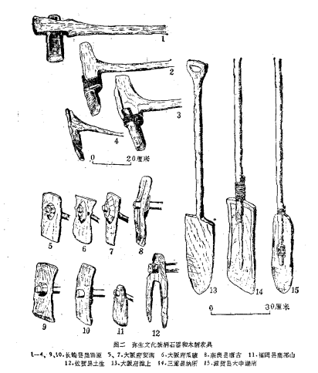
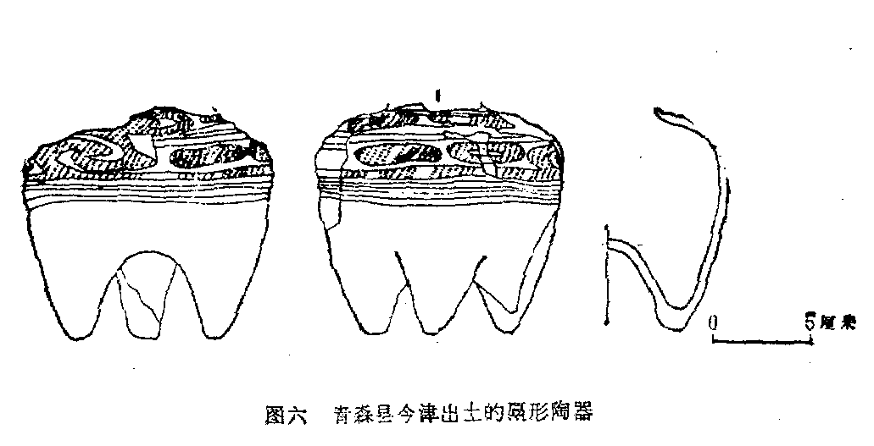
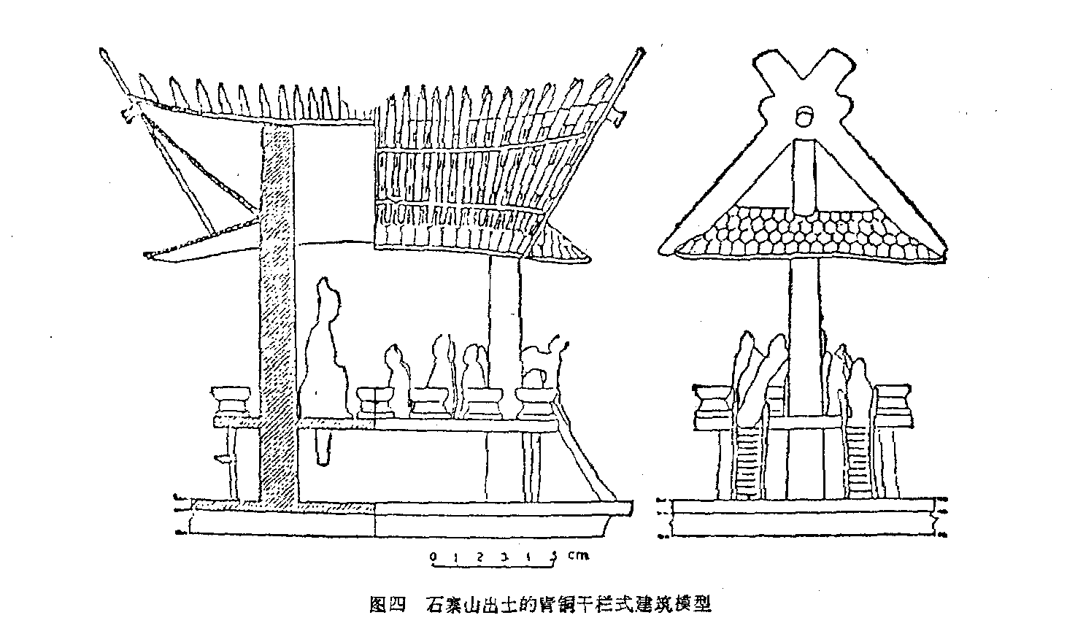
EARLY CULTURE EXCHANGE BETWEEN CHINA AND JAPAN
The Palaeolithic and Neolithic
pottery and agricultural growth,
bronze and metal ware import
BALUSTRADE-STYLE CONSTRUCTION
Balustrade-style construction is an ancient style popular in lower Yangtze basin and is still used in certain areas of Yunnan province
Notes:
It is more or less unanimously accepted that Japanese rice cultivation originated in China, its import route in three possible areas, north, middle or south China^{(5).} The north China route from Hebei and Liaoning by land, or from Shandong by sea via the Korean Peninsula to Japan, was generally believed to be the main route. As it lacks solid evidence of early rice, it was an unlikely starting point for eastbound rice. Currently, the middle China route from lower Yangtze basin via East China Sea to Korea and Japan, is favored in the 10th century BCLate Shengwen period, and developed further in the Misheng (Yayoi) period
Besides rice, the origin of the Japanese stone ax, stone ben, crescent-shaped harvesting knife and other stone and wood cultivation tools are traceable to the lower Yangtze basin.

Slide 7
CULTURE EXCHANGE BETWEEN CHINA AND INDIA/silk roads
india
Silk roads
LIGUISTIC EVIDENDENCE
Example: The nameless fingure: The naming of the forth figure in both cultures.
RELIGION
Buddhism reached china thorough the silk road
Notes:
The Silk Road did not only promote commodity exchange but also cultural. For example, Buddhism as one of the religions of the Kushan kingdom reached China. Together with merchant caravans Buddhist monks went from India to Central Asia and China, preaching the new religion. Buddhist monuments were discovered in numerous cities along the Silk Road.

