Slide 1
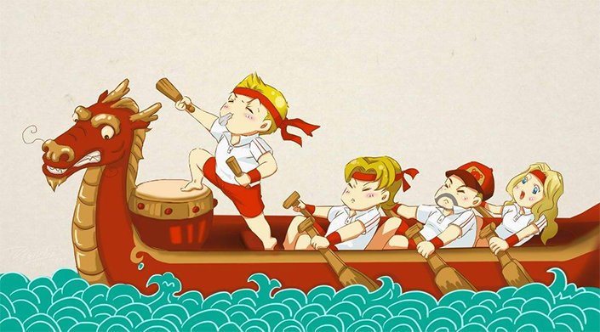
The Dragon Boat Festival
杨子泠 Yang Ziling
汤伊然 Tang Yiran

Slide 2
Part I Customs
Part II Origins of the Customs
Part III Translation Method

Slide 3
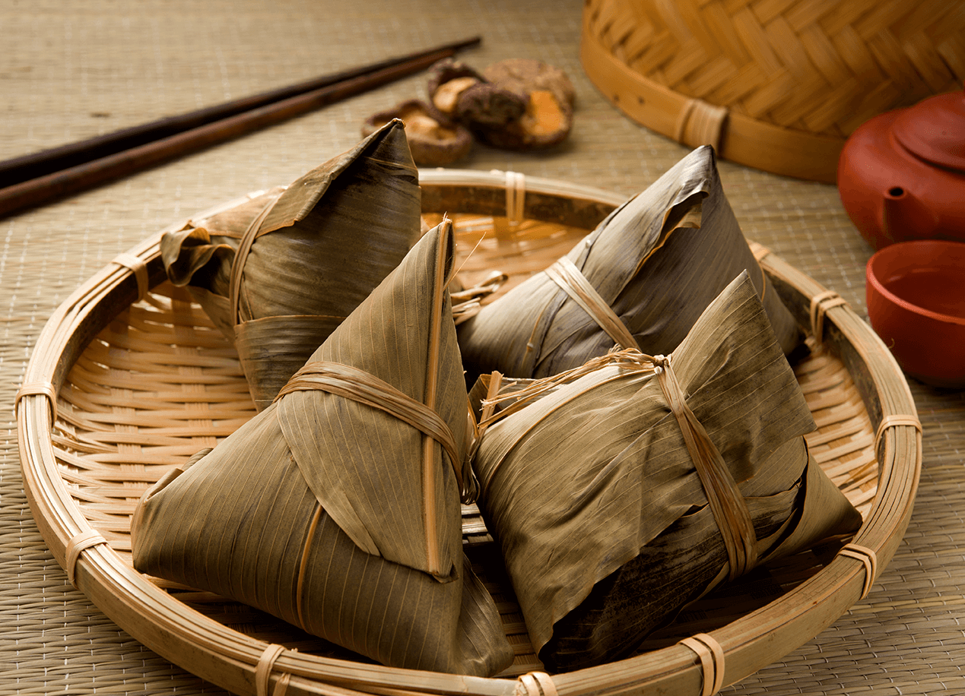
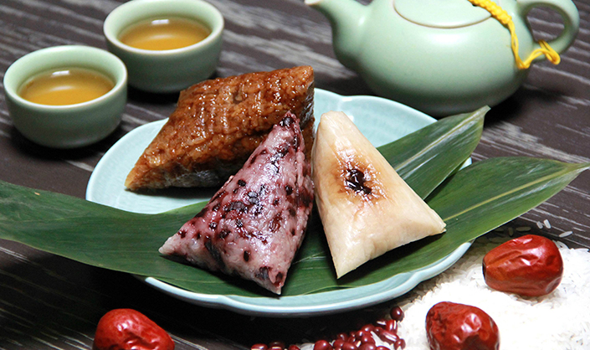
Part I Customs
1. Eating Zongzi

Slide 4
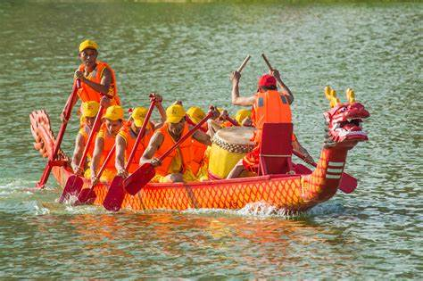
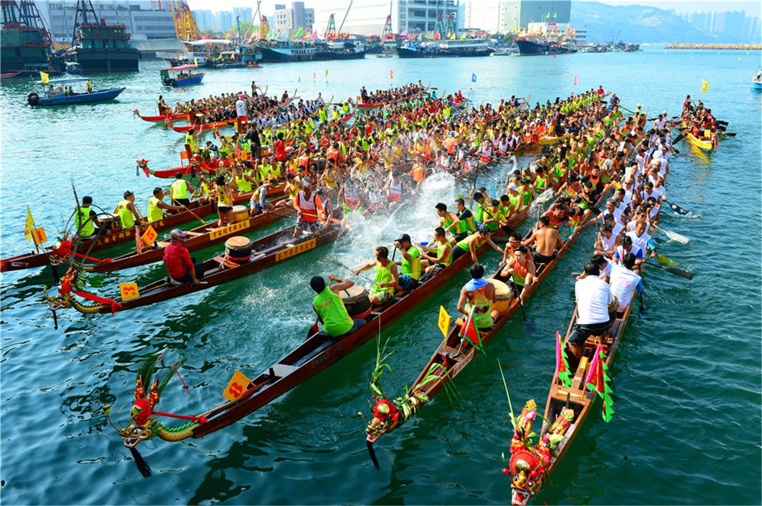
Part I Customs
2. Racing Dragon Boat

Slide 5
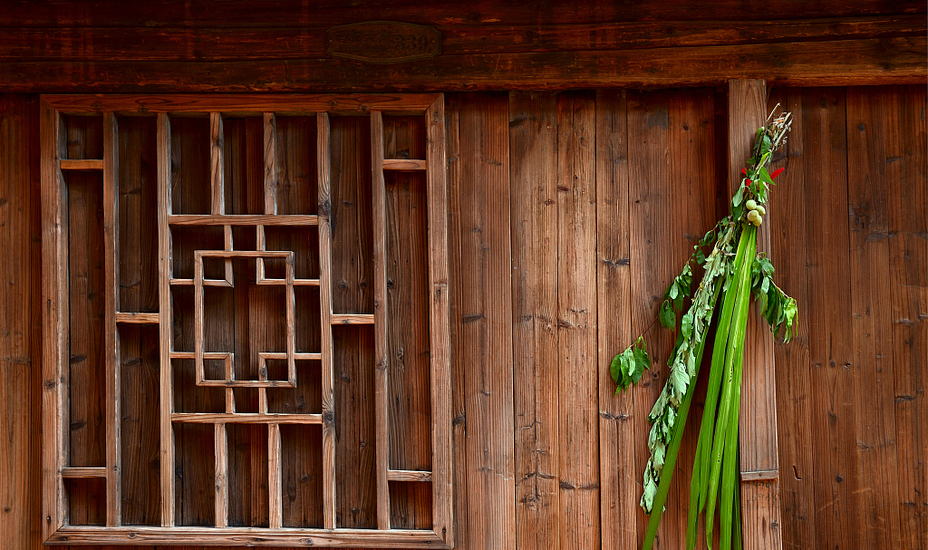
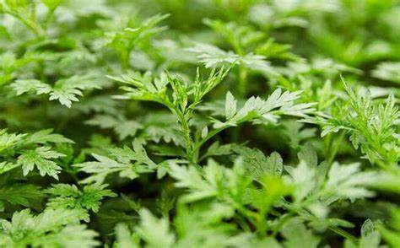
Part I Customs
3. Hanging Mugwort

Slide 6
Part II Origins of the Customs
1. Eating Zongzi
2. Racing Dragon Boat
3. Hanging Mugwort and Calamus Branches
Notes:
Then, let’s see the origins of the customs.

Slide 7
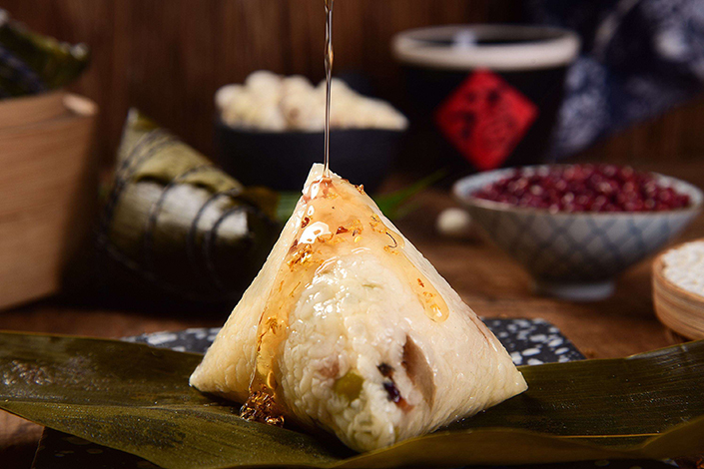
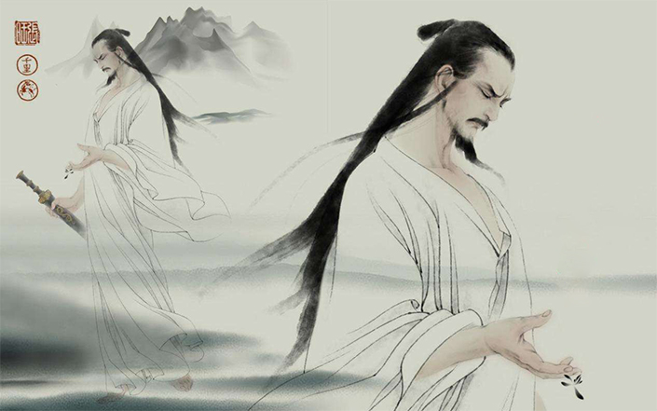
1. Eating Zongzi
Notes:
The tradition of eating Zongzi originated from the death of Quyuan, the patriotic poet in ancient China. People threw balls of sticky rice into the river hoping fish would choose it over his body. Later, people began to eat Zongzi on that day.

Slide 8
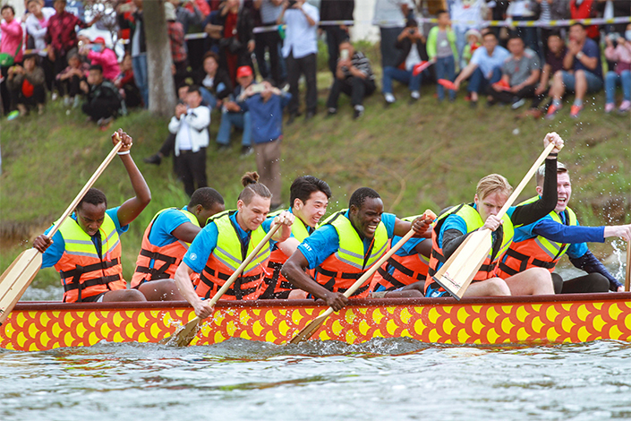
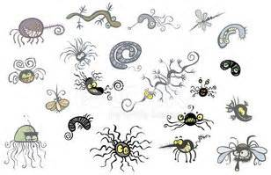

2. Racing Dragon Boat
dreadful climate
insects and bacteria/ infections
unlucky

Slide 9
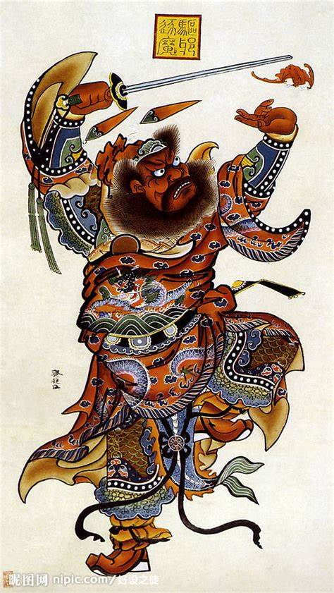
3. Hanging Mugwort and Calamus branches
fall ill easily

Slide 10
Part III Translation Method
Translation of Culture-loaded Words
------ Transliteration plus explanation

Slide 11
Translation of Culture-loaded Words
1. People eat Zongzi on Duanwu Day, a special rice pudding wrapped up with reed leaves.

Slide 12
Translation of Culture-loaded Words
2. commemorate Qu Yuan, China’s great poet of the Warring States Period.

Slide 13
Translation of Culture-loaded Words
3. Qu Yuan was appointed as zuotu, an important post assisting the king in handling internal and diplomatic affairs.

Slide 14
Translation of Culture-loaded Words
4. the Chinese dragon (a legendary creature depicted as having a snake-like body with two talons, fish scales, a tail, and two antlers on its head).

Slide 15
Translation of Culture-loaded Words
5. People drink Xionghuang wine, an alcoholic drink that's made from Chinese cereals.

Slide 16
Thank you !
by Yang Ziling 杨子泠
Tang Yiran 汤伊然

