Slide 1


Aesthetic ideals and social customs: The Culture of Flowers
THIS IS A ART TEMPLATE ,THE TEMPLATE DESIGN BY JERRY.
THANK YU WATCHING THIS ONE.
Speaker:Qiu Ping

Slide 2
Table of Contents
01
The Close Connection between Flowers and Culture
02
Social Ideals Reflected by Flowers
Conclusion and Prospect
03

Slide 3
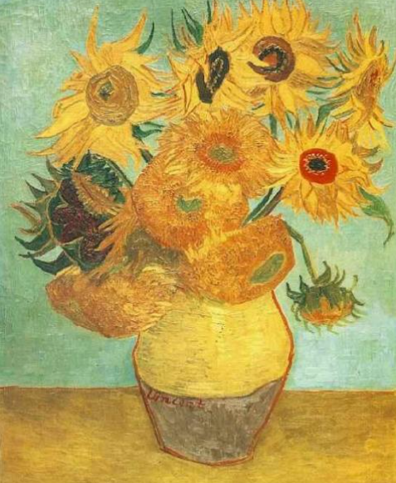
Flowers are the most poetic language of nature." Flowers have played a unique role in the long history of human culture, being present everywhere from artistic creation to daily social interactions.
Van Gogh's "Sunflowers"

Slide 4
01
The Close Connection between Flowers and Culture

Slide 5
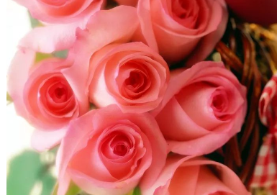
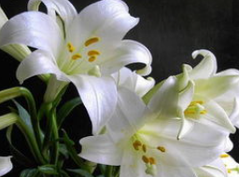
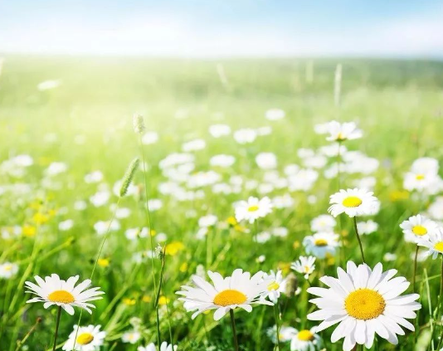
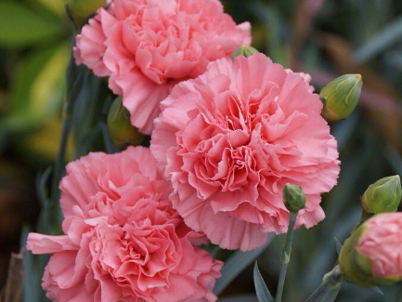
Western Cultures
Rose: A symbol of love and beauty. The legend of the birth of Venus is closely related to the rose.​
Ancient Greek and Roman Cultures:
Lily: Represents purity. It often appears together with the Virgin Mary in religious paintings.
Daisy: Symbolizes innocence. It is often depicted in religious scenes in the hands of children.​
Carnation: In Christian legends, it is related to the crucifixion of Jesus and has meanings such as holiness and motherly love.
Christian Culture:

Slide 6
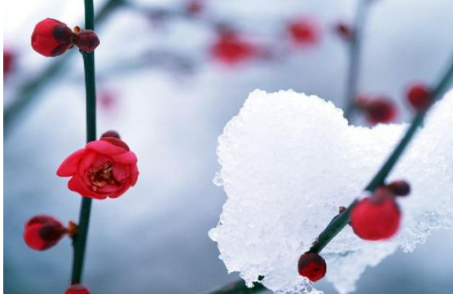
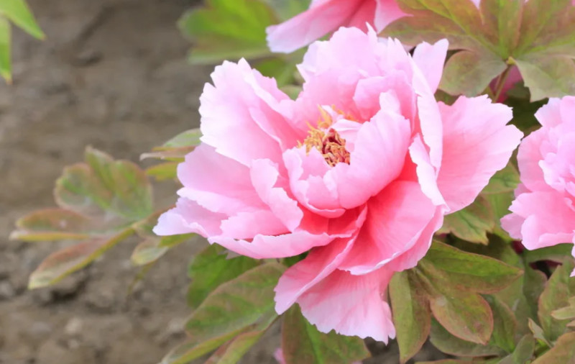
Eastern Culture东方文化
China:
1
Plum Blossom梅花：
2
Peony:牡丹：
Symbolizes perseverance and nobility. It blooms alone in the cold winter, just like a gentleman in the works of literati and scholars.
Implies wealth and prosperity. It is a symbol of flourishing and is often seen in traditional paintings and embroideries.

Slide 7
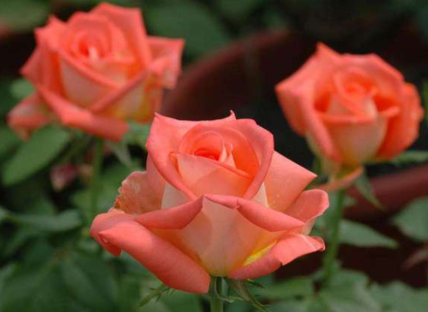
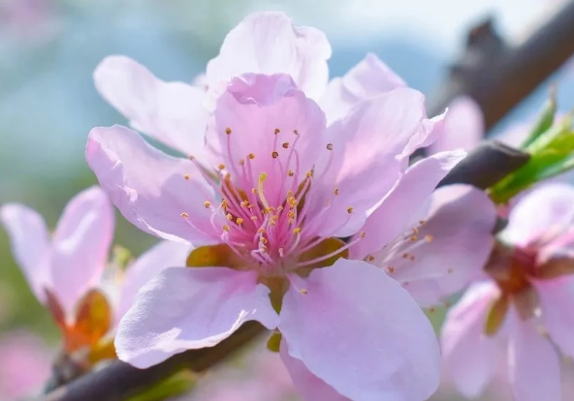
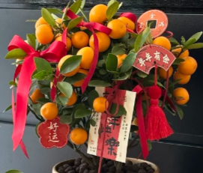
Valentine's Day:
Japanese Girls' Day （ March 3rd） :
Spring Festival:
Roses are the main attraction. Lovers give each other red roses to express their love. The sales of roses in flower shops around the world increase sharply on Valentine's Day.玫瑰是主角，情侣间互赠红玫瑰表达爱意，全球花店在情人节玫瑰销量剧增。
Peach blossom dolls are placed, and a celebration is held when peach blossoms are in bloom, praying for the healthy growth of girls. 日本女孩节又称桃花节：摆放桃花人偶，桃花盛开时举办庆典，祈求女孩健康成长）
。
In southern China, there is a custom of visiting flower markets. Kumquats imply good luck, and peach blossoms symbolize good fortune. People decorate their homes with flowers by buying them to welcome the New Year.
春节：中国南方地区有逛花市的习俗，金桔寓意吉祥，桃花象征好运，人们通过购买花卉装点家居，迎接新年。

Slide 8
02
Social Ideals Reflected by Flowers

Slide 9
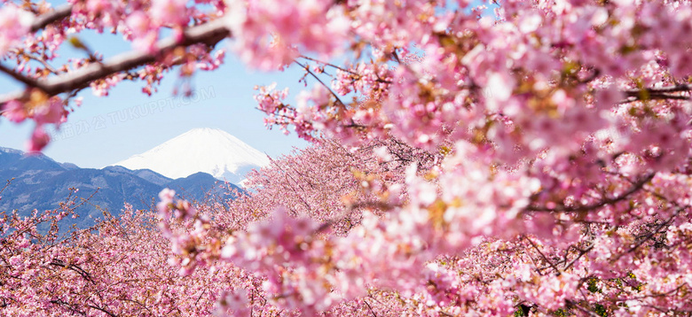
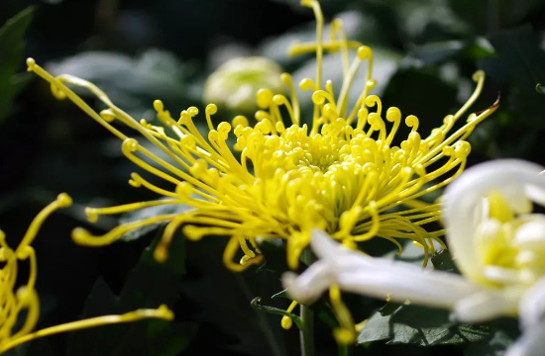
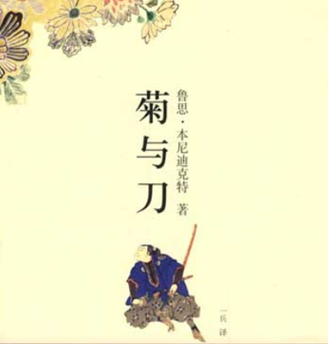
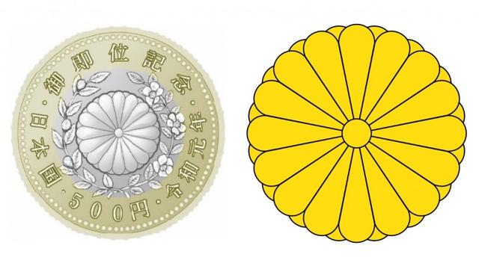
Japan::
Represents the fleeting beauty and impermanence. People enjoy cherry blossoms during the cherry blossom season, reflecting the cherishing of the brevity of life.
Cherry Blossom:
Symbolizes the imperial family and nobility. It is the pattern of the Japanese imperial family crest.
《菊与刀》《The Chrysanthemum and The Sword》It mainly tells the Japanese cultural model and the Japanese national spirit.
Chrysanthemum：

Slide 10
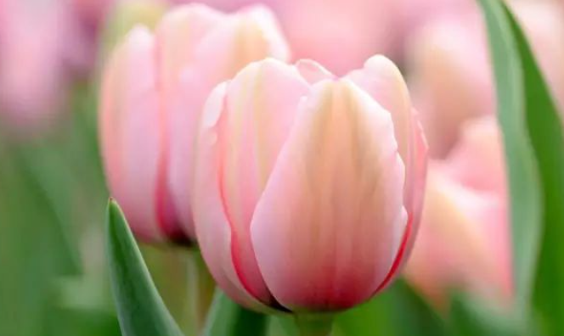
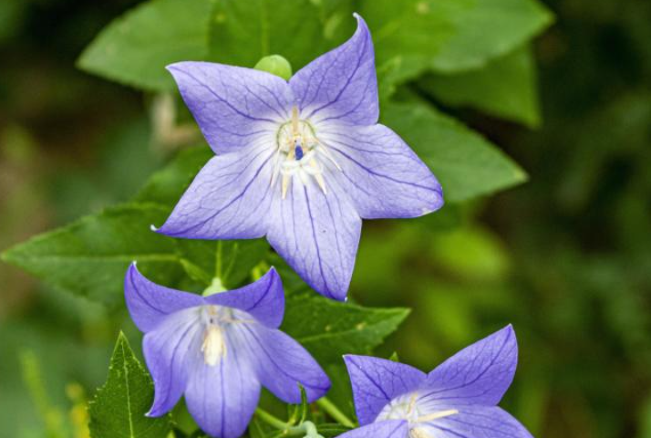
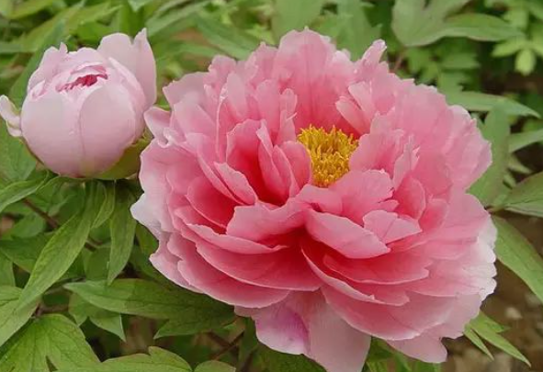
Social Class and Status
Ancient European Courts:
Ancient Japan：
Ancient China:
Specific flowers such as tulips were once symbols of noble status and wealth. During the Dutch tulip mania, high - priced tulips were only accessible to the upper class.
Chrysanthemum ：Symbolizes the imperial family and nobility.
Platycodon grandifloru（桔梗）： The flowers are in the shape of a five-pointed star, symbolizing the loyalty and integrity of the warrior. Many samurai families use the platycodon as a family emblem to show their family honor.
Peonies were widely planted in imperial gardens, and were rarely seen in ordinary people’s homes, reflecting class differences.

Slide 11
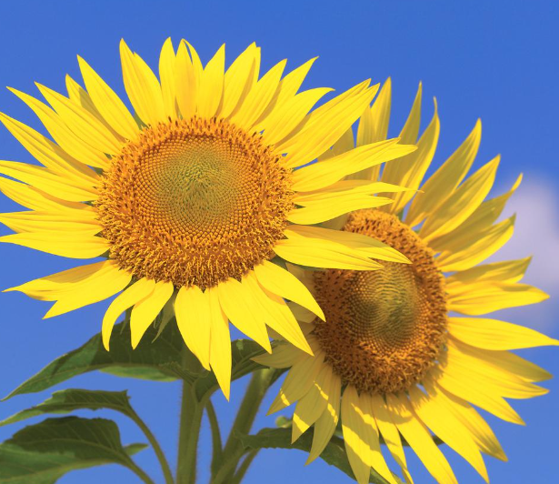
Values
Friendship:
Because of its sunny and warm image, the sunflower is often used to express friendship in modern culture, symbolizing positive emotions.

Slide 12
03
Conclusion and Prospect

Slide 13
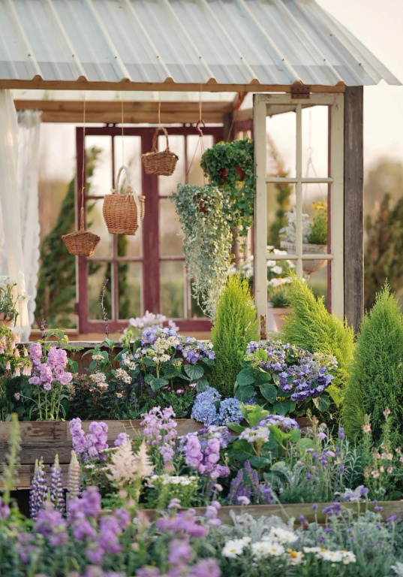
The culture of flowers is deeply rooted in social customs and aesthetic ideals and is an important carrier of cultural inheritance.​
In the future, flower culture will continue to innovate in the global exchange and integration, continuously enriching the human spiritual world.

Slide 14
Thank you for listening

