Slide 1

The Early Translation of the Bible into Chinese
许晶 李凌月

Slide 2

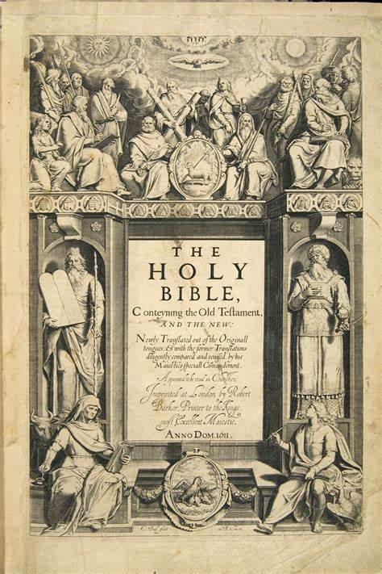
Week4
History
Catholic
Protestant
Conclusion
Unit3
The Early Translation of the Bible into Chinese
Background
Author
The Early Translation of the Bible into Chinese
Text
Discussion
History
The Old Testament Hebrew Aramaic
300 BC
Septuagint Greek
Before the advent of modern printing technology in the 19th century, the full text or parts of the Bible had been translated into 71 languages.

Slide 3
Week4
History
Catholic
Protestant
Conclusion
Unit3
The Early Translation of the Bible into Chinese
Background
Author
The Early Translation of the Bible into Chinese
Text
Discussion
History
The latest statistics (2014) of the Wycliffe Global Alliance show that, including dialects and minority languages, there are nearly 3,000 translated versions of the full text or part of the Bible.

Slide 4
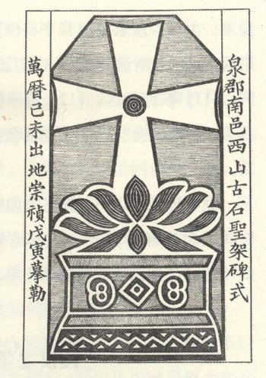
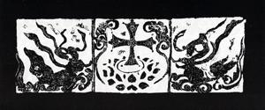
Week4
The Early Translation of the Bible into Chinese
History
Catholic
Protestant
Conclusion
In China, the beginning of the translation of the Bible can be traced back to the Tang Dynasty. In 635 AD, the Syrian Nestorian（景教） missionary Olopen(阿本罗)arrived in Xi'an from Persia to preach, marking the official entry of Christianity into China.
「大秦景教宣元至本经」

Slide 5
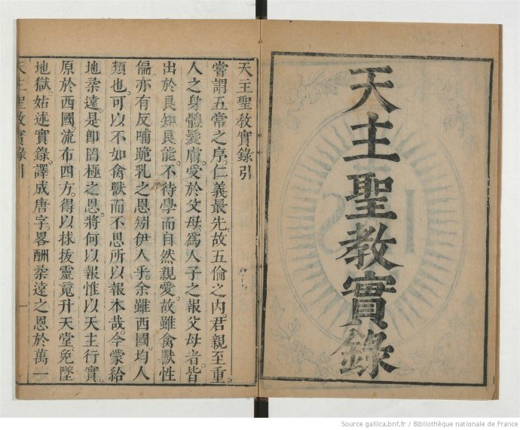
Week4
The Early Translation of the Bible into Chinese
History
Catholic
Protestant
Conclusion
In the 16th century, with Francois Xavier（沙勿略） arriving in Shangchuan Island（上川岛）, Guangdong, Catholicism entered China again. The acculturation strategy of Michele Ruggieri and Matteo Ricci officially introduced Catholicism into the Chinese context. The two published Chinese works such as “Tian Zhu Sheng Jiao Shi Lu”《天主圣教实录》, “Tian Zhu Shi Cheng”《天主十诚》 and “Tian Zhu Shi YI”《天主实义》.

Slide 6
Background
Author
Text
Discussion
Week4
The Spectator’s Account of Himself
History
Catholic
Protestant
Conclusion
Unit3
The Early Translation of the Bible into Chinese
In 1635, the Italian Jesuit Giulio Aleni published “Tian Zhu Jiang Sheng Yan Xing Ji Lue"《天主降生言行纪略》, which is the first account of the life of Jesus compiled based on the Gospels.
«
In 1636, the Portuguese missionary Emmanuel Diaz published the book “Sheng Jing Zhi Jie”《圣经直解》, imitating the style of the Book of Documents（尚书） and translated a large part of the Gospels. It is believed to be the first Chinese work with the title of “Sheng Jing”(圣经).
«
In addition, the doctrines and prayers published by the Jesuits such as Ludovic Bugli and Diego de Pantoja, also collect the translations fragments of the Bible. However, there was no full-text translation of the Bible throughout the 17th century.

Slide 7
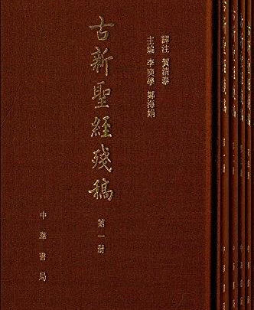
Week4
The Early Translation of the Bible into Chinese
History
Catholic
Protestant
Conclusion
Quatuor Evangelia Sinice《四史攸编耶稣基利斯督福音之会编》
------- Jean Basset(白日升)，Xu Ruohan(徐若翰).
the earliest existing translation of the New Testament.
Old and New Bible 《古新圣经》
----Louis Poirot.
«

Slide 8
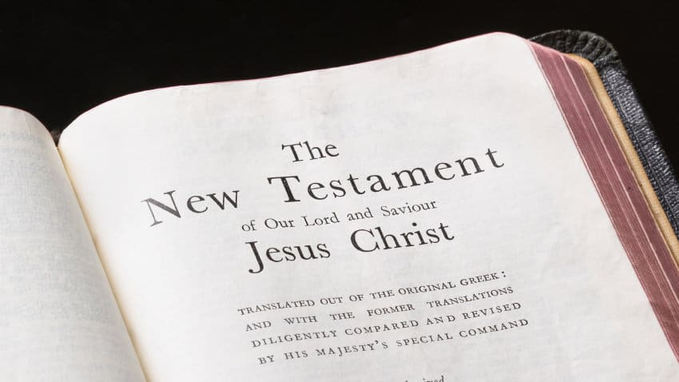
Background
Author
Discussion
Week4
The Spectator’s Account of Himself
History
Catholic
Protestant
Conclusion
Unit3
The Early Translation of the Bible into Chinese
The Catholic Church recognizes the authority of the “Bible”, it places great emphasis on church traditions and organizational structure.
The church controls the interpretation of the scriptures, and ordinary believers cannot read the Bible freely.
The Protestant maintains that the Bible is the supreme authority that transcends all theological writings and church traditions.
"all believers are priests" and "free interpretation of scriptures"

Slide 9
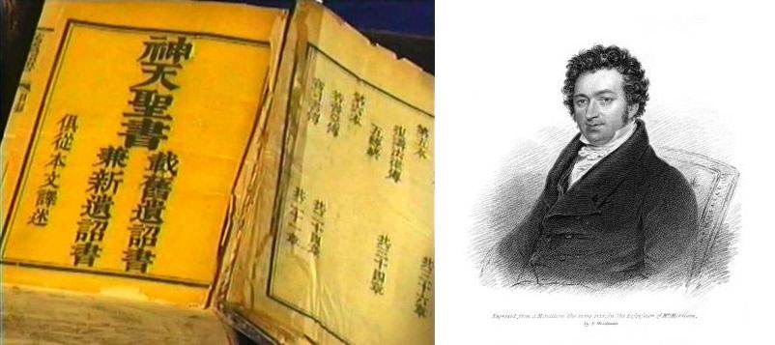
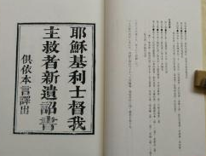
Background
Author
Text
Discussion
Week4
The Spectator’s Account of Himself
History
Catholic
Protestant
Conclusion
Unit3
The Early Translation of the Bible into Chinese
In 1807, Morrison came to China to officially kick off the two centuries of preach of Protestantism in China. Protestant missionaries became the main force in promoting the canonization of the Bible in China.
«
In 1813, he published the full translation of the New Testament, titled "《耶稣基利士督我主救者新遗诏书》". After that, he joined with William Milne, to start translating the Old Testament, which took several years to complete in 1819.
«
In 1823, 21-volume Chinese versions of "New Testament" and "Old Testament" were published in Malacca. 《神天圣书》

Slide 10

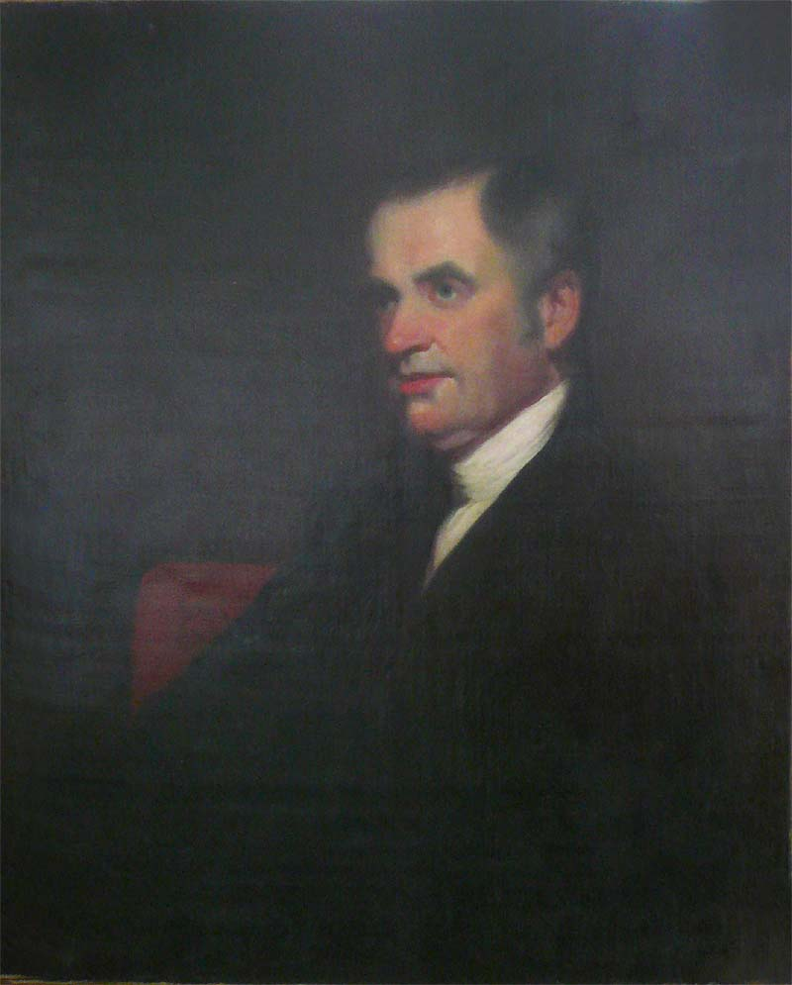
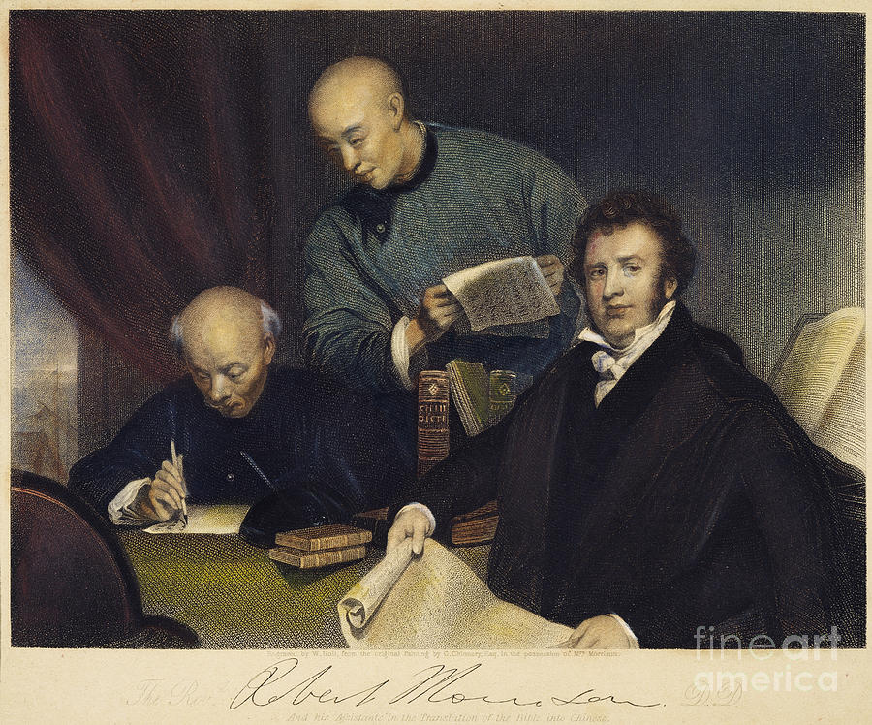
Robert Morrison
Joshua Marshman

Slide 11
Background
Author
Discussion
Week4
The Spectator’s Account of Himself
History
Catholic
Protestant
Conclusion
Unit3
The Early Translation of the Bible into Chinese
The translation of The Gospel According to St. Matthew&The Gospel According to Mark
The translation of Gospel According to John& the Letters of John
《新约全译》
Joshua Marshman

Slide 12
Week4
The Early Translation of the Bible into Chinese
History
Catholic
Protestant
Conclusion
First, the re-canonization of classics in different contexts is a process of cumulative construction. Existing studies have shown that there are obvious inheritance and mutual influences in translation strategies and theological vocabulary between Catholic Chinese translations, Catholic and Protestant Chinese translations, and Protestant Chinese translations in different periods. The translation history of Bible reflects the different understanding of the Bible in different age and reflects different believer’s point of view.
Second, the ways and boundaries of local adaptation, or the entanglement of localization, is a difficult problem that the classics must respond to when they come to another society and culture.

Slide 13

Thanks

