Slide 1

Interpretation from and into Chinese
Wu Bohan
English Interpretation

Slide 2

Modes
01.
Catalog
History
02.
Key factors
03.

Slide 3

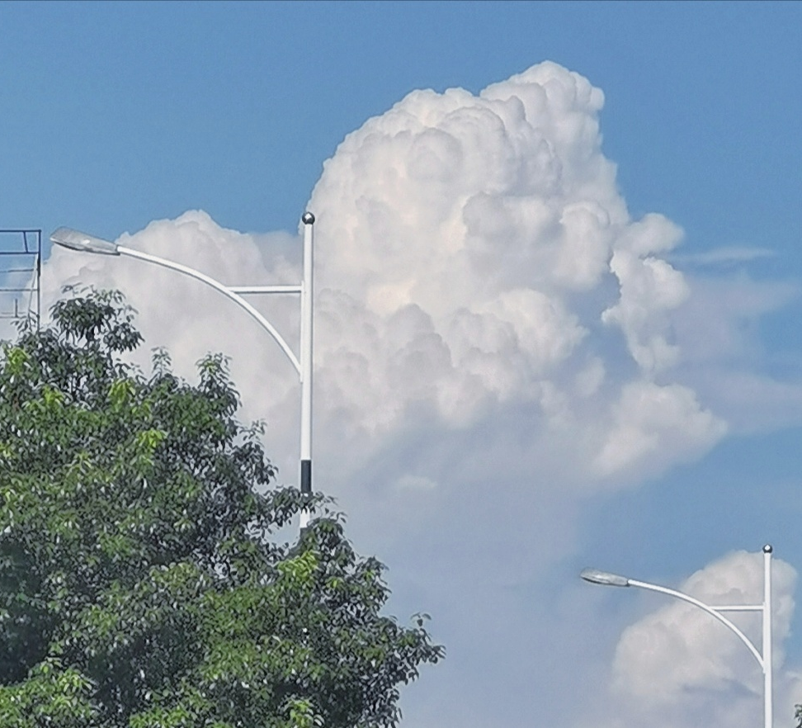
01
Modes

Slide 4
Consecutive Interpretation
Simultaneous Interpretation

Slide 5

Consecutive Interpretation
Starts after the speaker pauses
Sit or stand near the speaker
Rely on memory or note-taking depending on lengths of segments

Slide 6

Simultaneous Interpretation
Starts and finishes interpretation according to the speaker
In a sound-proof booth
Extempore SI (即席同传)

Slide 7
 | Consecutive Interpretation | Simultaneous Interpretation
Time Consumption | More | Time-saving
Accuracy | 90-100% | 60-80%
Disturbance | Disturb the natural flow | Maintain the natural flow

Slide 8


02
History
01

Slide 9


Literature
Turn of 19th & 20th
Wang Tao
Assist foreign missionaries in translating Chinese books in the Mohai Library
Help James Legge translate Chinese classics

Slide 10

Science works
Wanli to Yongzheng Dynasty
170+ kinds of science books
Matteo Ricci, Xu Guangqi, Li Zhizao

Slide 11
Foreign missionaries
Foreign missionaries
Chinese scholar bureaucrats
Interpretation
Writing
Chinese scholar bureaucrats
Proofread
Polished
Final works

Slide 12




03
Key factors

Slide 13

Listening
Highly focused
Everything in detail
Active

Slide 14
Memory
Short-term memory
Storage & extraction
Visualization & connect the information points

Slide 15
Note-taking
Clear
Supplement memory
Cue to help visualize and organize

Slide 16

Thanks ! !

