Slide 1


Rich Businessmen in China
Qin Anni 秦安妮

Slide 2




Contents
1
2
3
An Chinese businessman widely noted in the world
Chinese businessmen well known at home
The way to be a rich businessmen

Slide 3



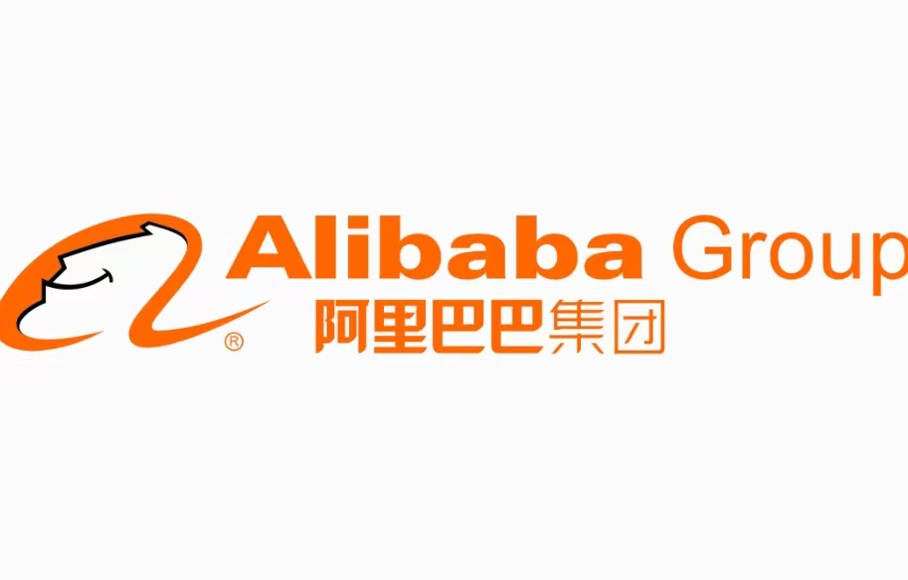

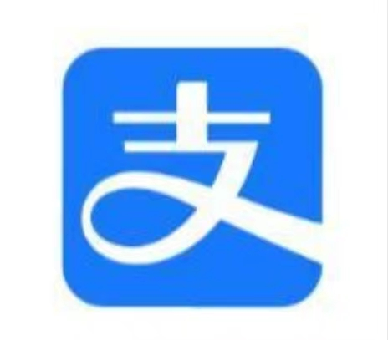
Chinese businessmen widely noted in the world
2
3
Ding Talk
Taobao
Alipay
1
4
Amap

Slide 4

Jack Ma
In 1988, graduated from Hangzhou Normal University Department of Foreign Languages
Been an English teacher for six years
In 2013, resigned as Alibaba Group CEO

Slide 5


Chinese businessmen well known at home
CONT
ENTS
Housing
Shopping
Transportation
Technology & Entertainment

Slide 6
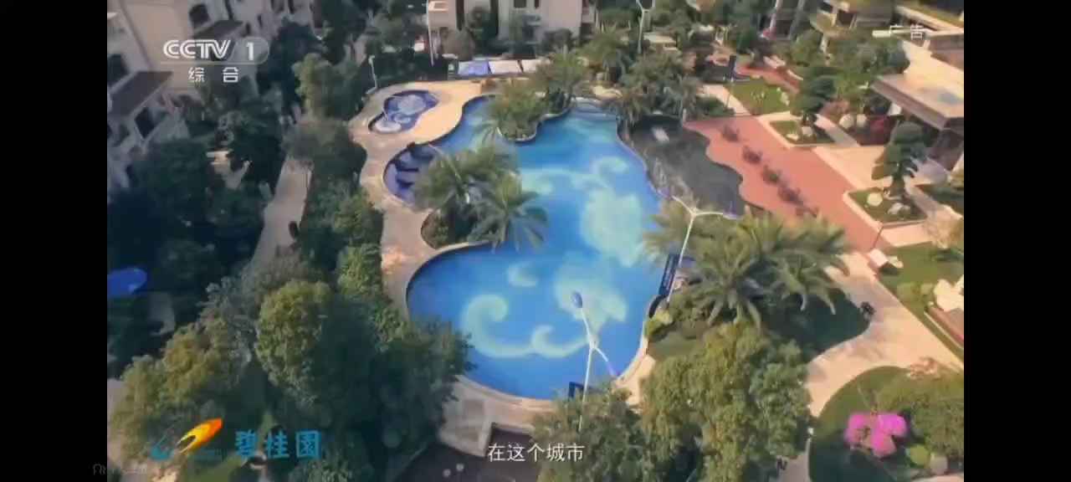
Housing
Yang Huiyan
1. Asia’s richest woman
2. The majority shareholder of Country Garden, a property development company founded by her farmer father, Guoqiang Yang, in Guangdong in 1992.
3. In November 2022, Yang ranked 69th on the Forbes 2022 China Rich List with a fortune of $4.91 billion.

Slide 7
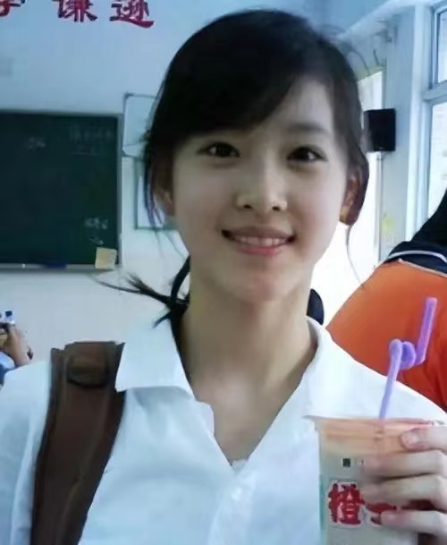
Shopping
Zhang Zetian
Milk tea sister, graduated from THU
An investor serves as chief fashion advisor of JD’s luxury business.
At 24, she became China’s youngest
female billionaire following her marriage
to Liu who is the president of JD.

Slide 8


Transportation
Li Xiang
He is the founder of electric
vehicle-maker Li Auto.
Founded five years ago, the
Beijing-headquartered
manufacturer went public
on the Nasdaq in July 2020
with a valuation of $10 billion,
catapulting Li to billionaire status.
China’ s Elon Musk ?

Slide 9
Technology & Entertainment
ByteDance
Zhang Yiming
He is the co-founder and CEO of ByteDance, the Chinese internet company behind video sharing platform TikTok. The platform has shot to prominence outside of China, now surpassing Facebook-owned Instagram to rank as U.S. teens’ preferred social media app after Snap.
Tik Tok

Slide 10

The way to be a rich businessmen
steady, modest, hardworking, ambitious, independent, brave, optimistic.
personality factors
large domestic market
Social opportunity
the gender ratio imbalance of the premarital cohort
From “Made in China” to “Innovated in China”, the innovation, especially in technology, brings huge profit to those people who seize opportunities.

Slide 11
Thanks !

