Slide 1
Xunzi
Daniel Jensen
HIST 420R
Utah Valley University

Slide 2
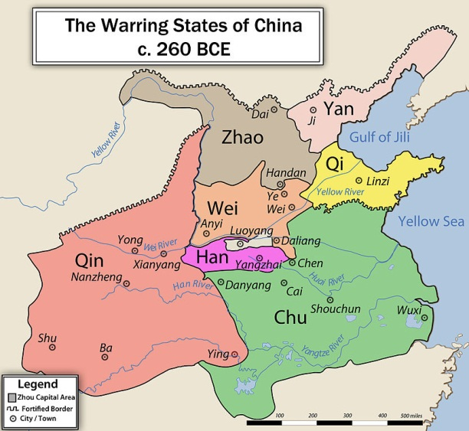
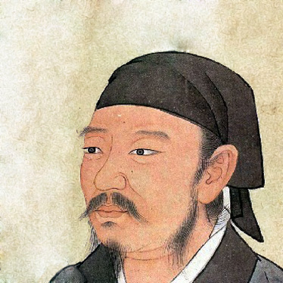
Xunzi = “Master Xun” = Xun Kuang
Born in 310 BCE and died in 221 BCE.
Follower of Confucius and philosophical rival of Mencius.
Has an ambiguous biography.
Born in Zhao Province.
Advisory position in Qi.
Administrative position in Chu.
Lost post in Chu when his sponsor died in 238 BCE.
Supposedly lived to see the establishment of the Chinese Empire. (Qin)
Primary author of the Xunzi text.
Comprised of 32 books, 25 authentic.
Essays, not parables like those of Zhuangzi, nor dialogue like those of Mencius.

Slide 3
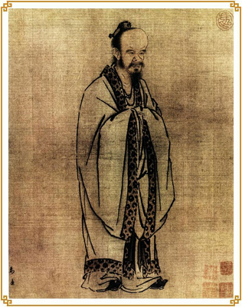
Philosophies
Rational view of Heaven.
Heaven does not reward or punish.
People bring their own fortunes based on their adherence to the Way.
Good harvest is not an answer to prayer, but rather good agricultural policy.
Eclipses, natural disasters, etc. are not from deity, but just natural.
Don’t do good things to please heaven. Do things to be prepared for any situation.

Slide 4
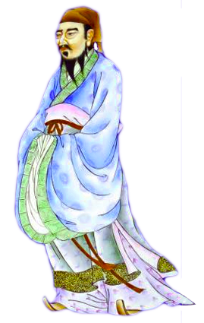
Philosophies - Rituals
Necessary to bind society together.
“You pray for rain and it rains. Why? For no particular reason, I say. It is just as though you had not prayed for rain and it rained anyway.”
The performance of the ritual does not cause the outcome, but it unites the people under a common cause and is therefore necessary.

Slide 5
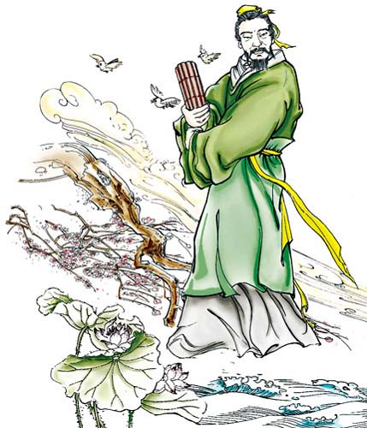
Human Nature is Bad.
Change in Human Nature only comes by means of radical change and control.
Contradicts Mencius.
No pleasure in evil, just no natural moral compass.
All humans begin in original state and cultivate themselves in different ways.
Change must be voluntary and come from oneself, it cannot be forced.
Lifelong learning paired with adherence to ritual lead to the cultivation of good and avoidance of human nature.

Slide 6
Philosophies – Governmental Structure
The philosophical ideal of the Warring States period was monarchy.
Paternal treatment of Government over people in exchange for their loyalty.
Social distinctions establish limits on competition.
Strict hierarchy was meant to prevent conflict. Each in their role.
Equality among citizens or subjects gives license for conflict.
Punishments are necessary but should be minimal.
People will freely subjugate themselves to the best governments.
The worst governments are those that have a basis in military force.

Slide 7
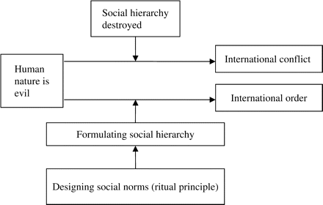
Philosophy of Government

Slide 8
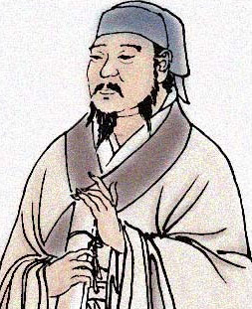
Basic Structure of Hierarchy
Lower classes were overseen by junzi (gentlemen).
Junzi were guided by ru (erudites the educated of status).
The li-yi, (rituals and duties), were carried out by those in authority to do so and were meant to reiterate their position in the hierarchy of society.

Slide 9
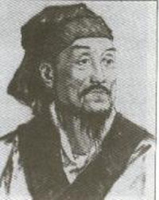
Lasting Legacy
Pupils:
Li Si – one of the intellectual architects of the Qin unification.
Han Feizi – possibly one of his students but not likely.
Though the Xunzi texts were overseen by Xunzi himself during his lifetime, material was added post mortem.
His many other lesser known pupils continued his philosophies.
Xun Kuang

Slide 10
Bibliography
Ebrey, Patricia Buckley. Cambridge Illustrated History China Second Edition. New York: Cambridge University Press, 2010.
Elstein, David. Internet Encyclopedia of Philosophy, "Xunzi (Hsun Tzu, c.310-c.220 BCE)." Last modified 30 August 2004. Accessed February 5, 2013. http://www.iep.utm.edu/xunzi/.
Robins, Dan, "Xunzi", The Stanford Encyclopedia of Philosophy (Fall 2008 Edition), Edward N. Zalta (ed.), URL = http://plato.stanford.edu/archives/fall2008/entries/xunzi/

