Slide 1


NEW
FASHION
About
PRODUCT
Translation: Written Translation from and into Chinese
作者: Zhang Haishan & Wang Zhibi 日期：2022年11月11日

Slide 2
NEW
FASHION
About
PRODUCT
Translation of Western Social Science Classics in China
PART
ONE
Fashion's

Slide 3
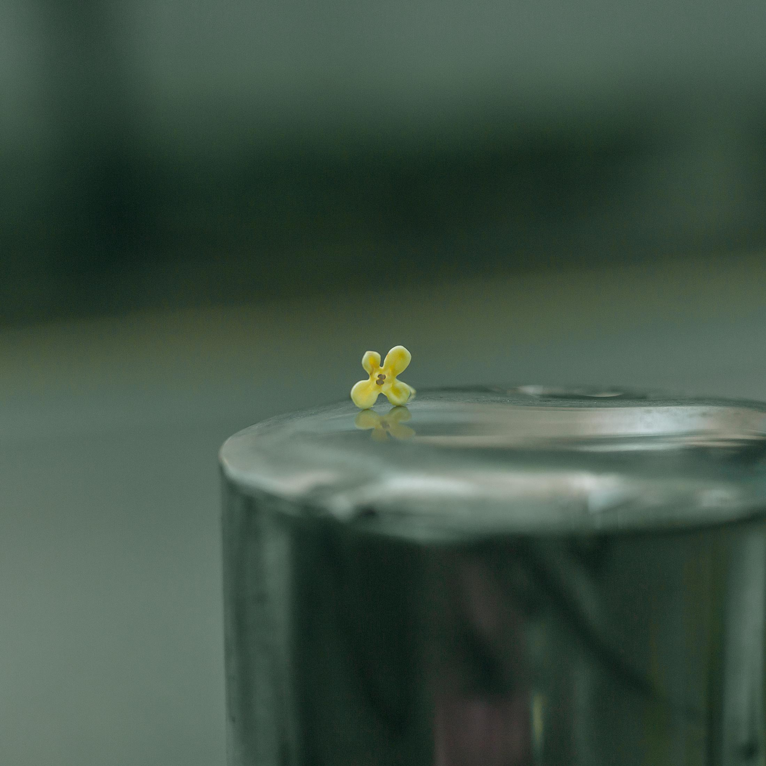
NEW
FASHION
About
PRODUCT
湖南师范大学
目 录
01.
Late Qing Dynasty and the Early Republic of China
02.
New Democratic Revolution Period
03.
In the Early Period of the Foundation of New China
04.
Modern and Contemporary Period
Add your relevant content here.Add your relevant content here.Add your relevant content here.Add your relevant content here.

Slide 4
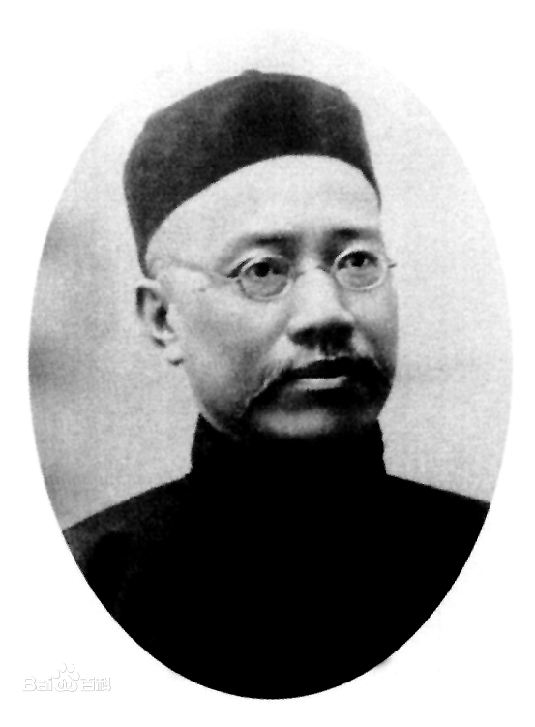
1. Late Qing Dynasty and the Early Republic of China
Add your relevant content here.
Title | Author
Evolution and Ethics and other Essays《天演论》 | Thomas Henry Huxley
The Wealth of Nations 《原富》 | Adam Smith
The Study of Sociology 《群学肄言》 | Herbert Spencer
湖南师范大学

Slide 5
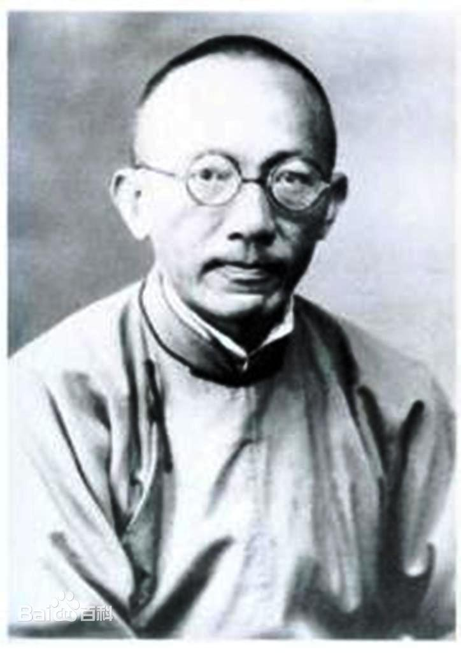
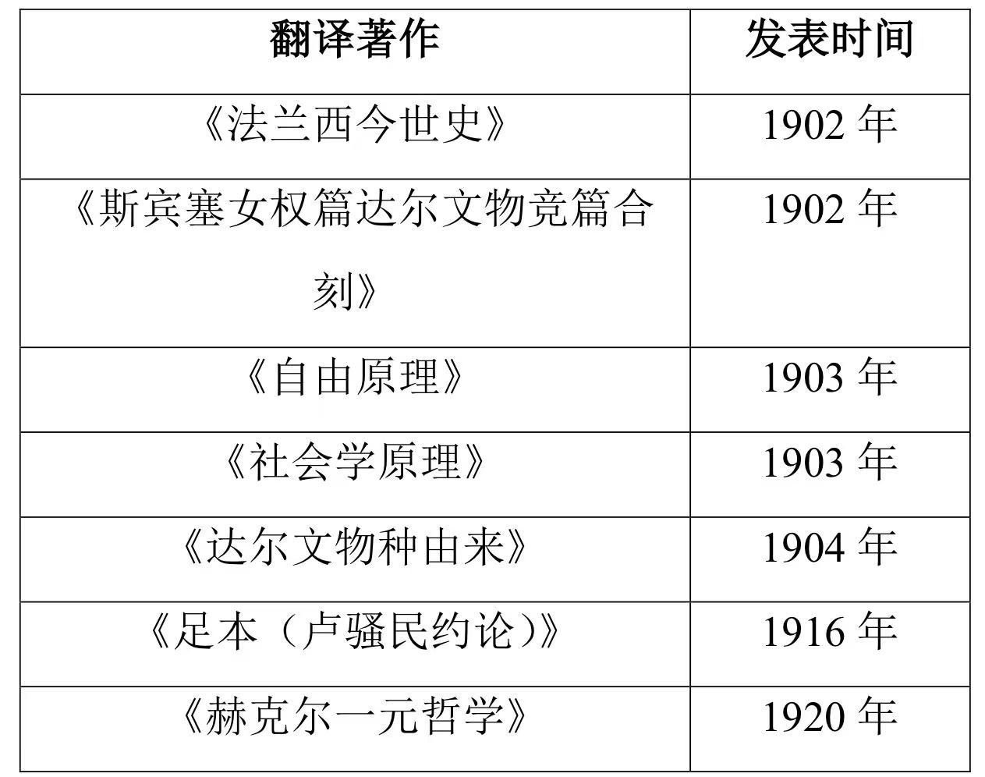

请添加
小标题
Add your relevant content here.Add your relevant content here.Add your relevant content here.Add your relevant content here.Add your relevant content here.Add your relevant content here.
Ma Junwu

Slide 6
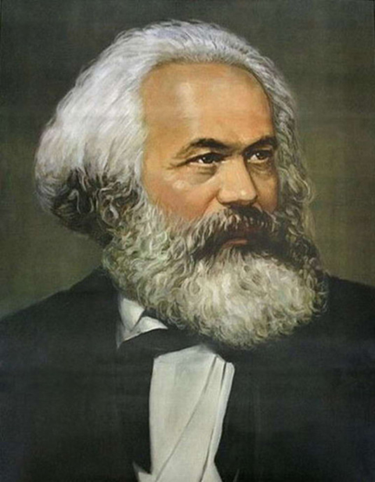
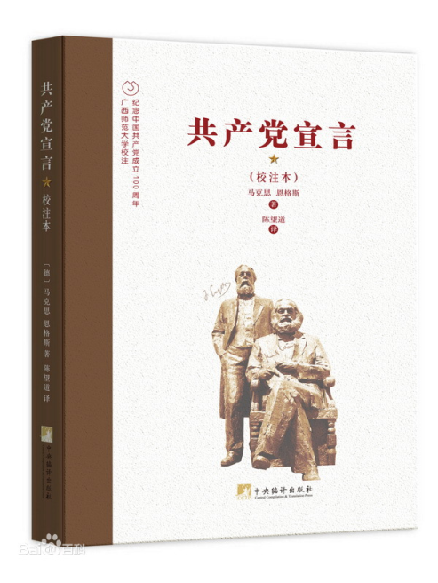
2. New Democratic Revolution Period
Historical materialism
Materialist dialectics
Historical materialism emphasizes that the evolution of social forms is regarded as a historical process which is independent of man's will.
Karl Heinrich Marx

Slide 7
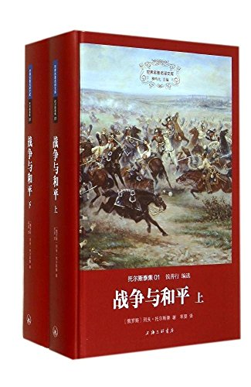
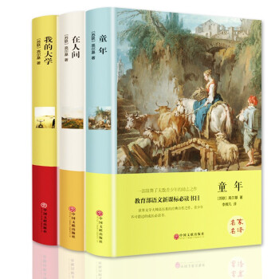
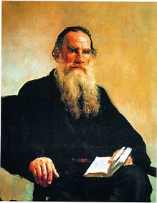
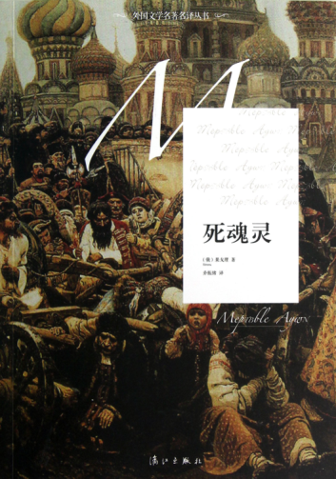
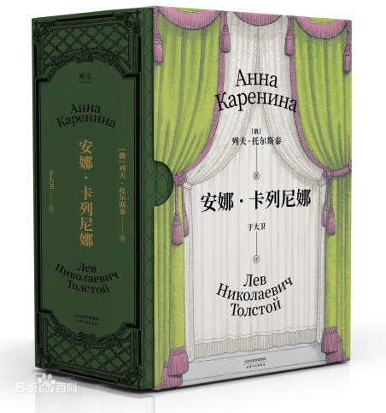
3.In the Early Period of the Foundation of New China
作品 | 作者
《童年》 | 高尔基
《青年近卫军》 | 法捷耶夫
《静静的顿河》 | 肖洛霍夫
《普希金文集》 | 普希金
《死魂灵》 | 果戈里
《战争与和平》 | 列夫·托尔斯泰
《火与剑》 | 显克维支
《变色龙》 | 契科夫
The publication of Soviet literature and socialist literature in China

Slide 8

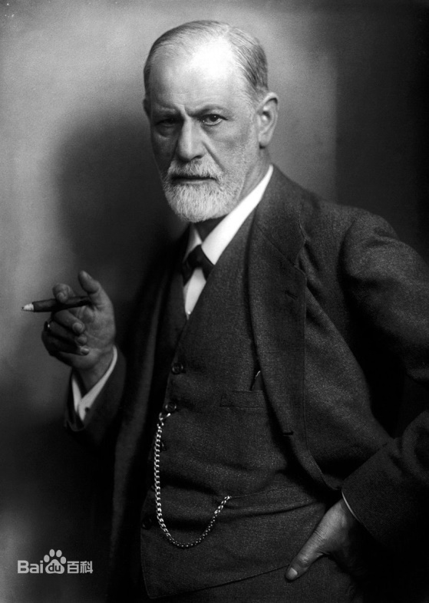
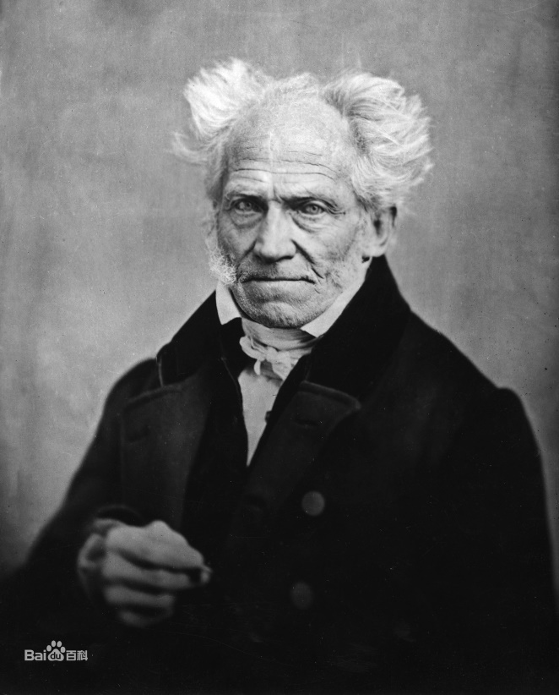
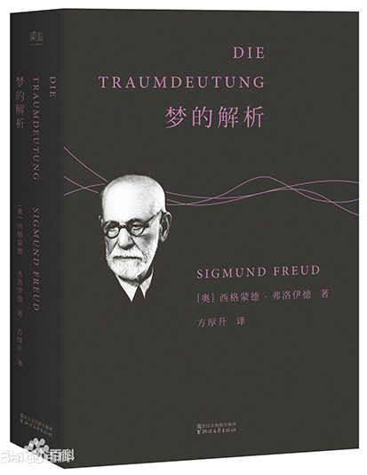
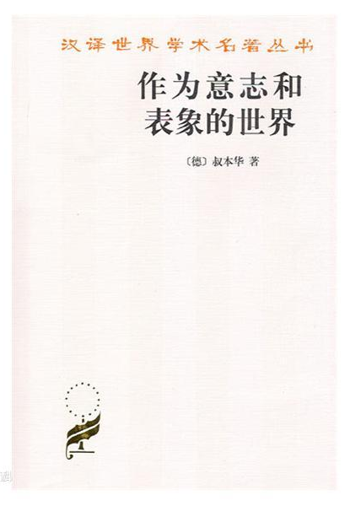
4.Modern and Contemporary Period
Freudian psychoanalysis
Schopenhauer’s Volitionism

Slide 9
NEW
FASHION
About
PRODUCT
Translation of Chinese Classics in Western world
PART
Two
Fashion's

Slide 10
NEW
FASHION
About
PRODUCT
湖南师范大学
目 录
01.
Early Translation of Chinese Classics
19th-Century translation of Chinese Classics in the
Colonial Areas in China
02.
03.
In the First half of 20th Century
04.
An Overview of Translation Since the 1960s

Slide 11
1. Early Translation of Chinese Classics
As for the western translation of Chinese classics, it was first undertaken by missionaries in the late Ming and early Qing Dynasties
Name | Classics
Michele Ruggieri (Italy) | The Great Leraning
Matteo Ricci (Italy) | The Four Books
Nicolas Trugault (France) | The Five Classics
Ohilippe Couplet (Belgium) | Confucius Sinarum

Slide 12
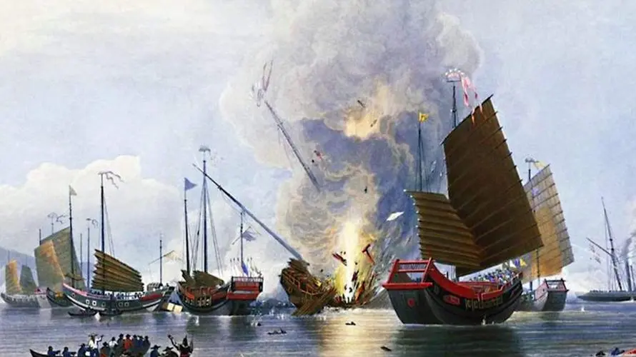
19th-Century translation of Chinese Classics in the
Colonial Areas in China
Background:Opium War
Foreign expatriates increased.
More and more Chinese literary works have begun to be translated.

Slide 13


Professional type
pragmatic type
Authoritative sinologists mainly focused on novels and dramas written in the long past Yuan and Ming Dynasty
Some diplomats, as well as foreign and customs clerks
Examples
Examples
Romance of the three Kingdoms
Dream of the Red Chamber

Slide 14
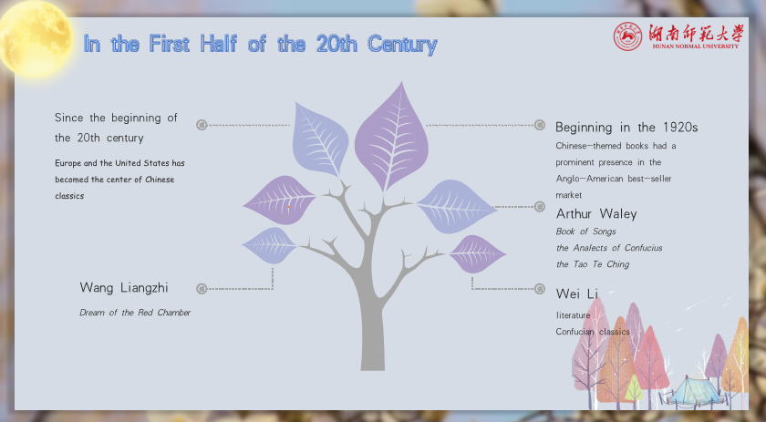

Slide 15
An Overview of Translation Since the 1960s
Background
After entering the 1960s, due to the proliferation of academic institutions and the decrease in market demand, the English translation of Chinese cultural classics has entered a highly academic stage from a commercial stage.

Slide 16
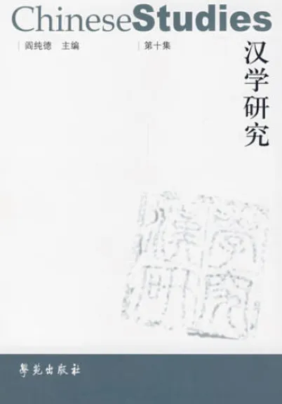
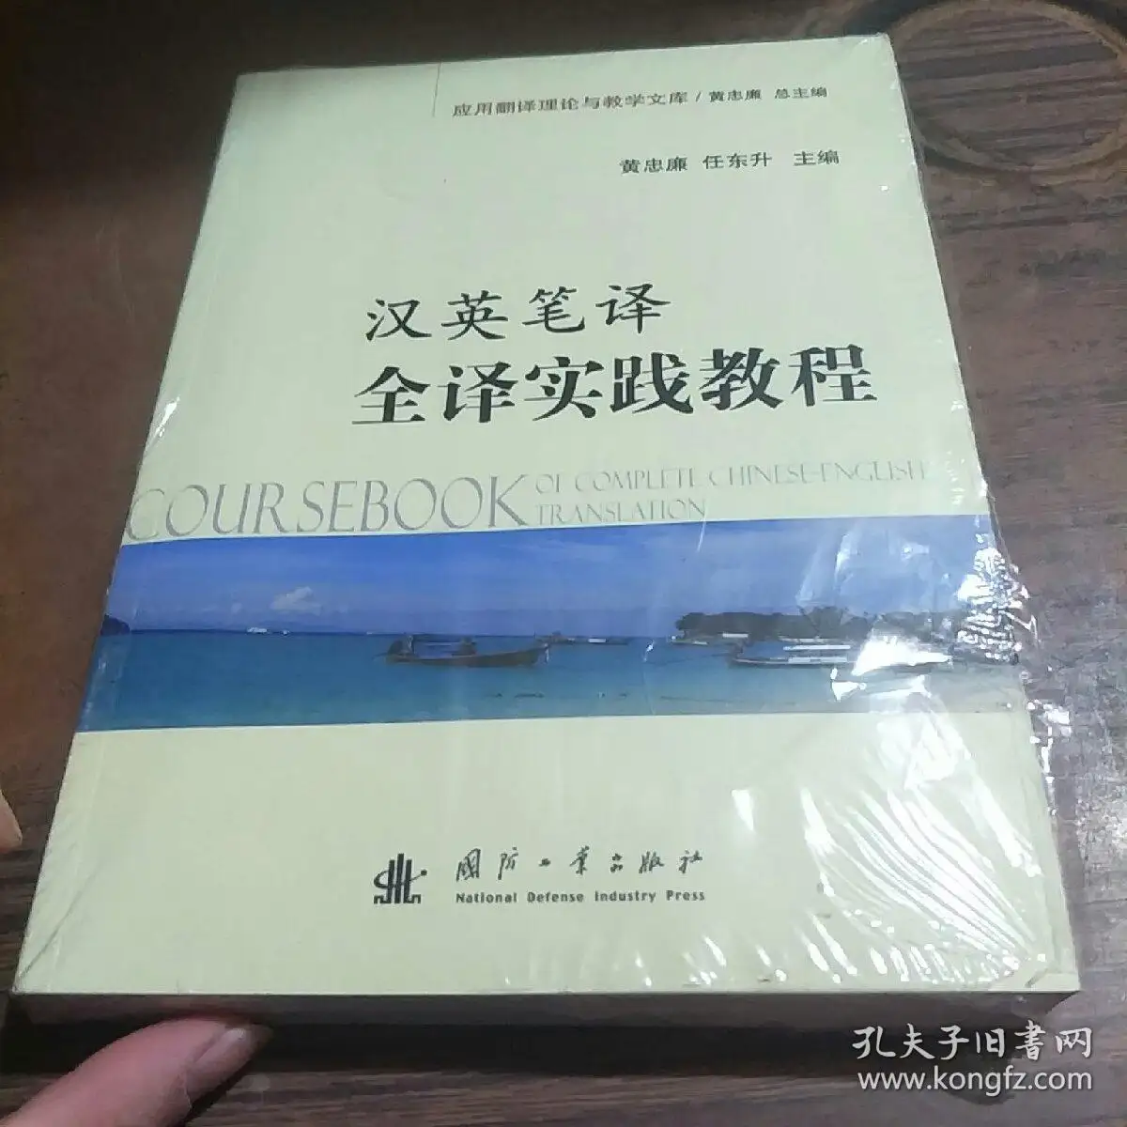

An Overview of Translation Since the 1960s
The changes in the interest of readers
The era of full translation
These Chinese classics translations do not have a wide impact among ordinary readers, and has rarely attracted the interest of mainstream literary critics.

Slide 17
References
1. Lv Xichen＆He Jingwen. 吕希晨、何敬文. (2002) 《中国现代唯物史观》
2. Li Zehou. 李泽厚. (1988) 《马克思主义在中国》
3. Ma Zuyi. 马祖毅. (2006) 《中国翻译通史》
4. Tian Wenjun＆Wu Genyou. (2006) 田文君、吴根有. 《中国辩证法史》
5. Xie Tianzhen. 谢天振. (2009) 《中西翻译简史》
6. Xu Yongxiang＆He Shankan. 徐永祥、贺善侃.(1994) 《现代西方社会思潮》

Slide 18

NEW
FASHION
About
PRODUCT
谢谢观赏

