Slide 1
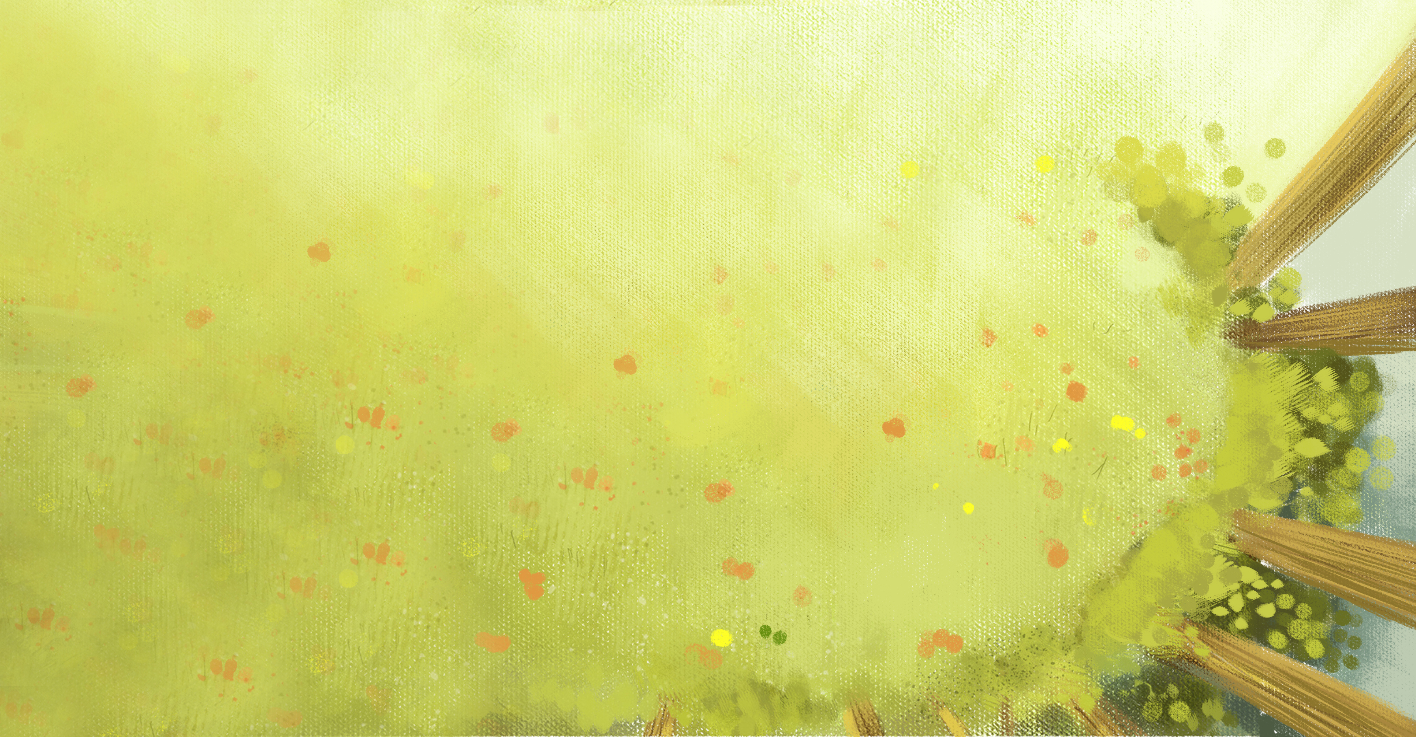
Contrast and Compare
 | In China | In Western countries
Usage | has wide use | has little to do with catering
Symbolizing | harmony, equality tolerance, reunion | equality
Raw materials | wood | marble wood

Slide 2
Contrast and Compare
 | In China | In Western countries
Sitting rules | The one facing the door is the host and guest. The one on the left side is the second, fourth, sixth, etc. , and the one on the right side is the third, fifth, seventh. | The one facing the door is the hostess. When eating, they are facing the opposite sex, and the right and left side should also be the opposite sex.

Slide 3

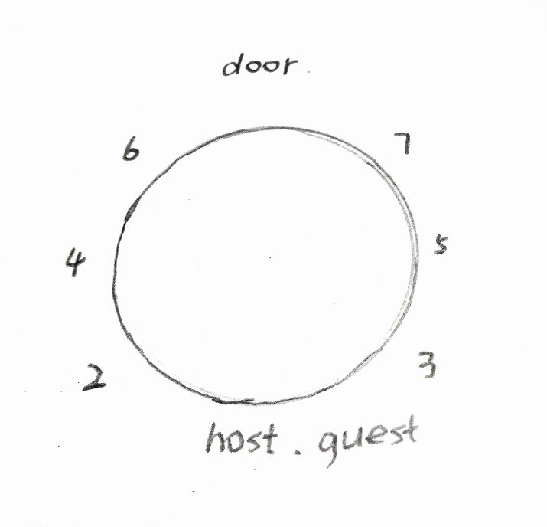
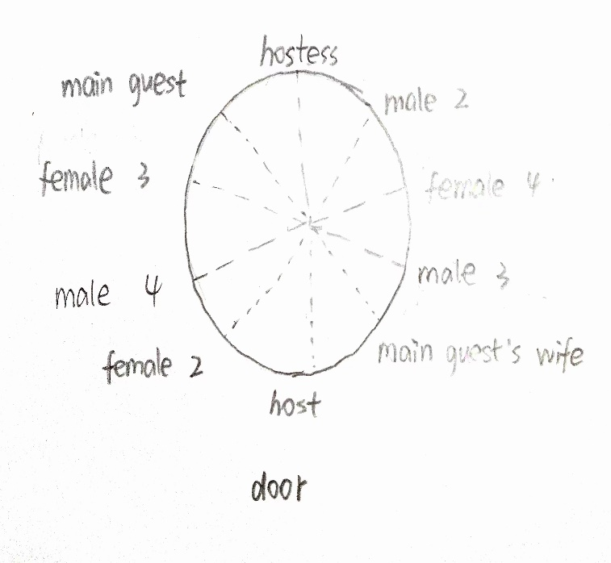
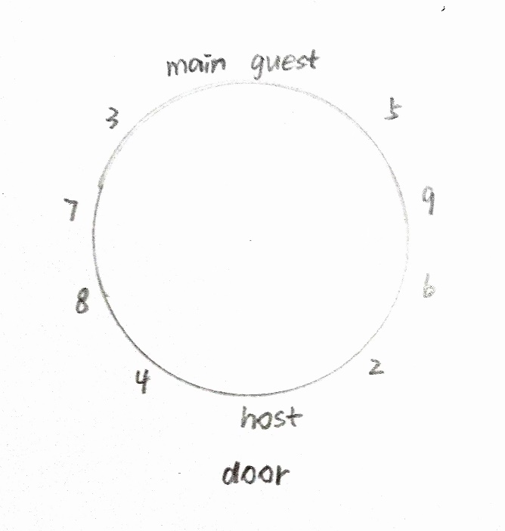
Sitting rules
In China
In Western Countries
with female companions
In Western Countries
without female companions

Slide 4
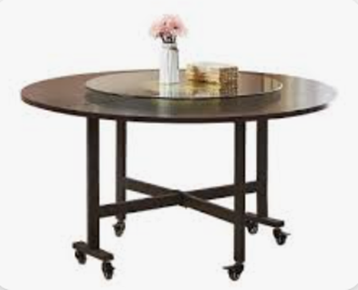
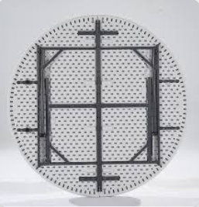
Development of Round Table
Everything is in a never-ending process of movement, change and development. The whole world is a material world of infinite change and eternal development. Development is a process in which new things replace old things.
A
A round table with a turntable
B
A collapsible (可折叠的）round table

Slide 5
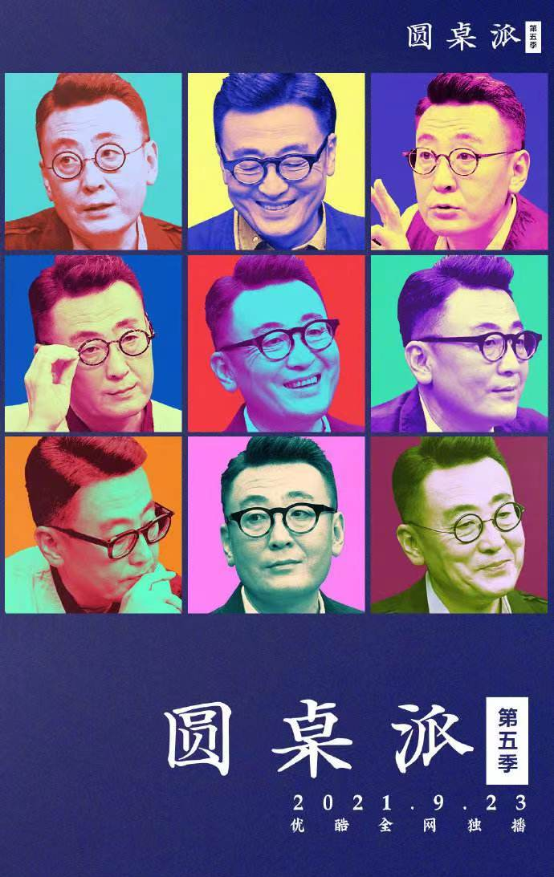
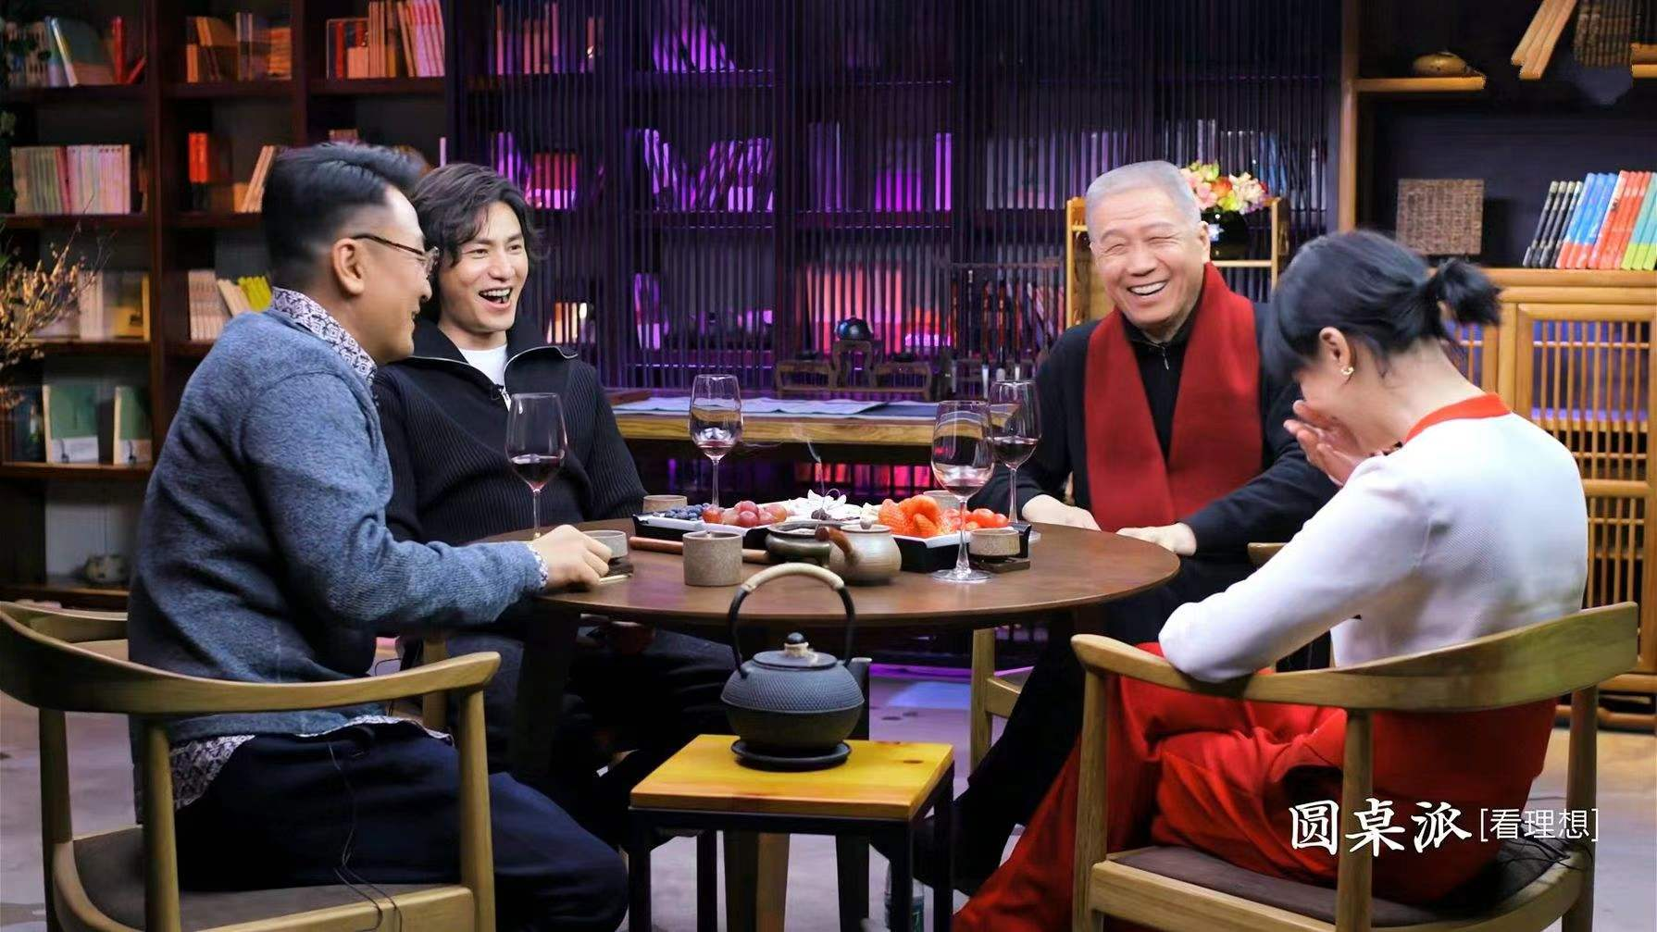
The program takes the name of round table. Without a script, people chat extempore and share wisdom in equality. One thought-provoking topic is discussed each time to exchange value views and ideas.

Slide 6
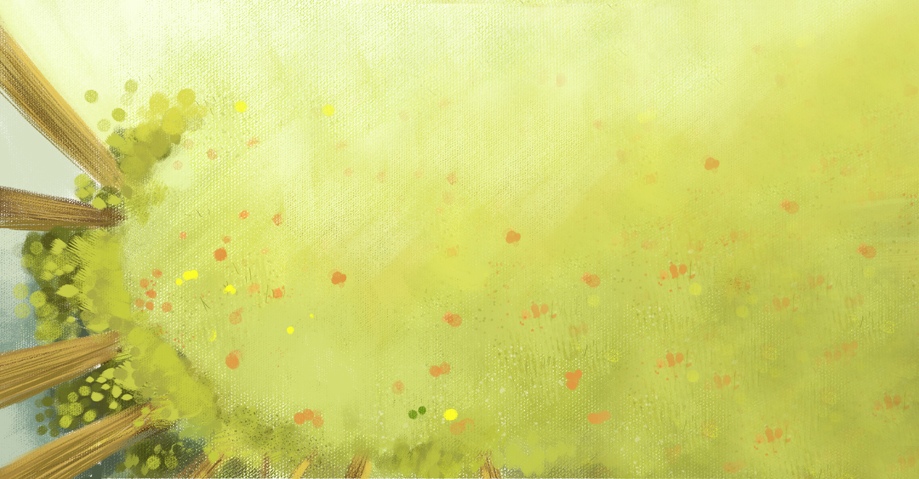
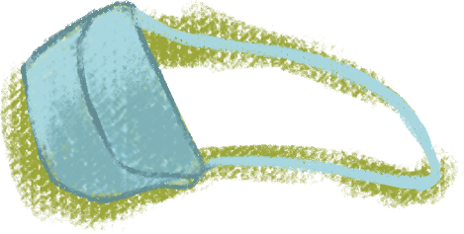
THANK YOU FOR WATCHING

