Slide 1
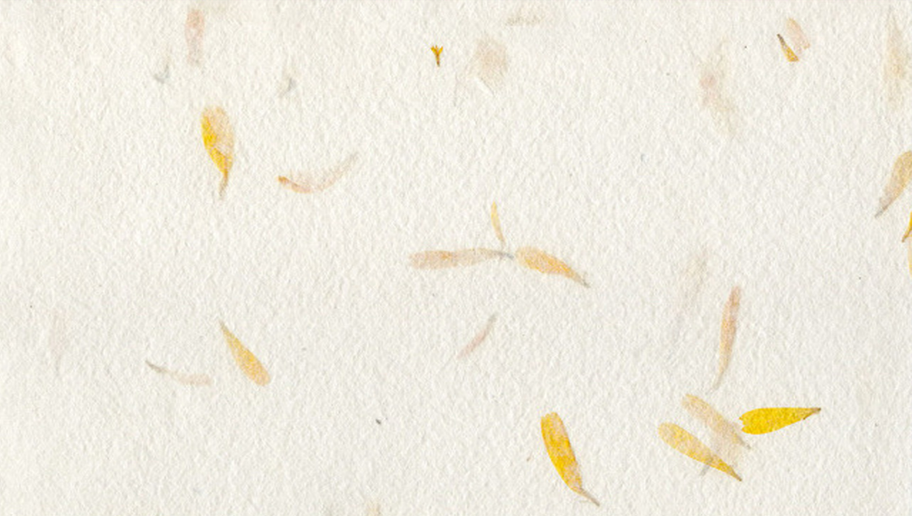
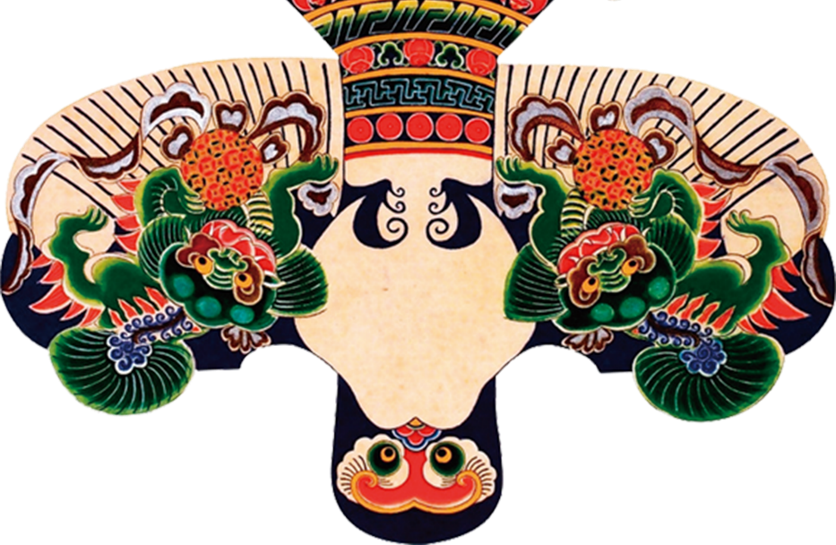



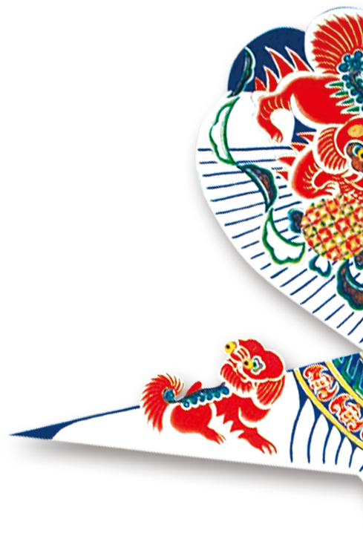

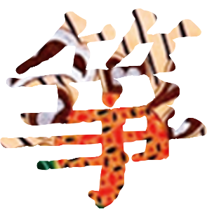
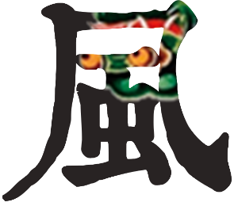

The Kite

Slide 2

The origin and development of the kite
CONTENT
The use of the kite
CHAPTER 1
The production of the kite
The types of kite
CHAPTER 2
CHAPTER 3
CHAPTER 4

Slide 3
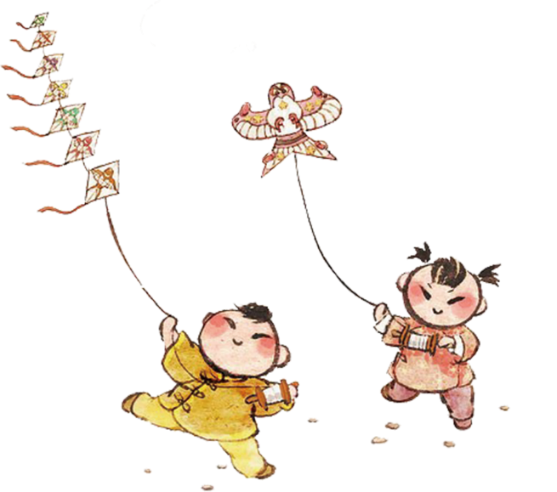
The origin and development of the kite

Slide 4
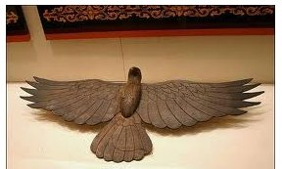
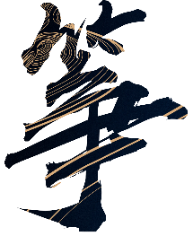
The Spring and Autumn and Warring States period
— Invented by Mozi
wooden kite

Slide 5
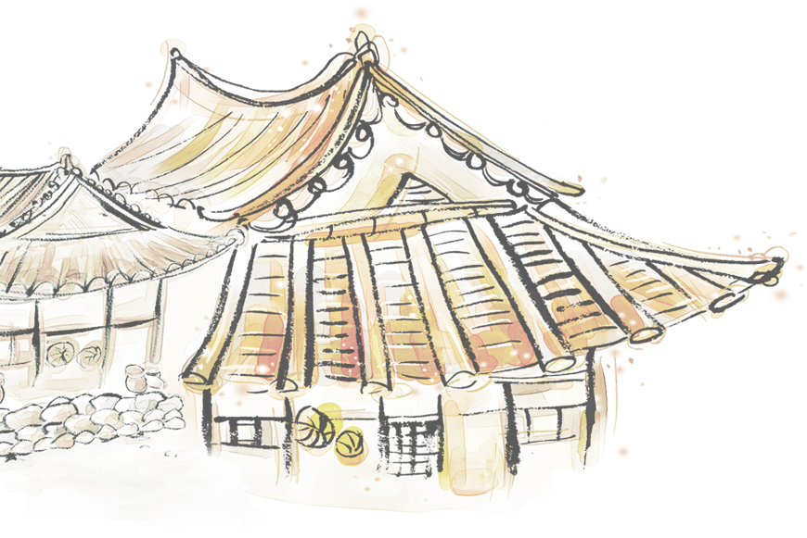
·The Sui and Tang Dynasties -- a stage of development·
1. people began to make kites by paper
2. kite flying became a favorite outdoor activity

Slide 6
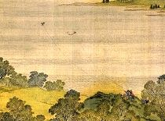
·Sui and Tang Dynasties -- a stage of development·
Along the River During the Qingming Festival

Slide 7

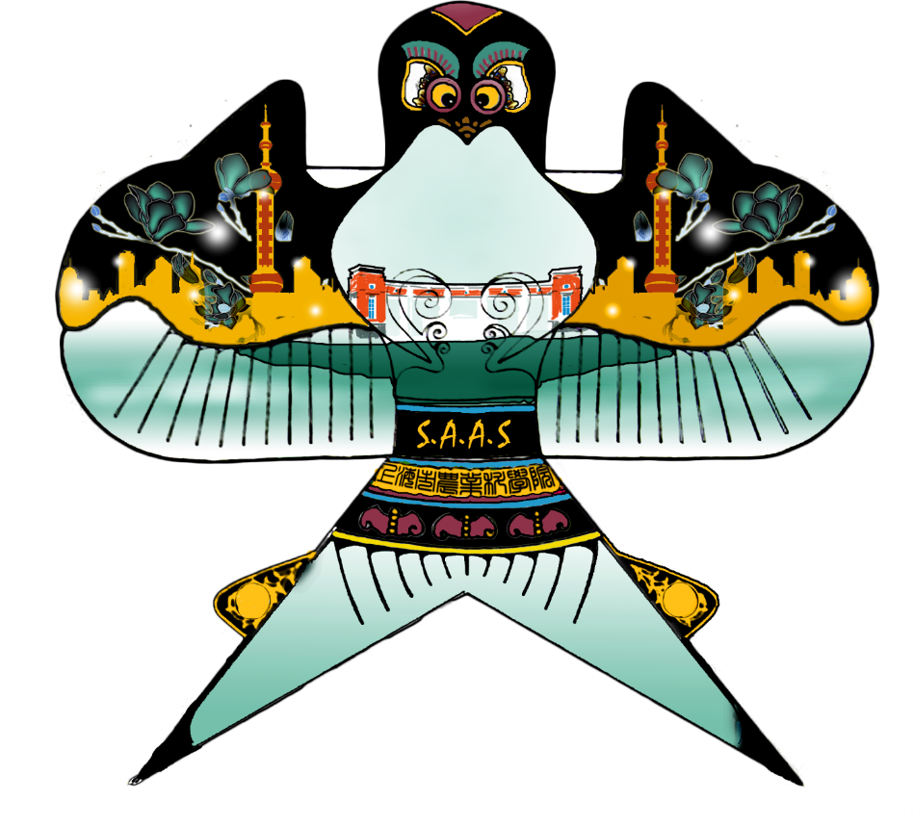
The Ming and Qing Dynasties - the heyday of of kites
風箏
The size, style, making technology, decoration and flying skills of kites made great progress beyond the previous generations.
A very elegant activity

Slide 8
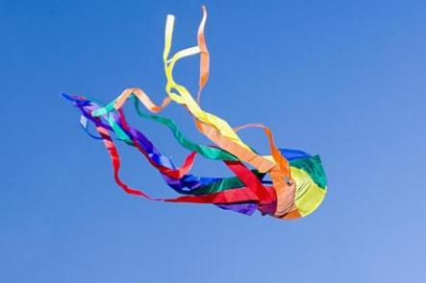
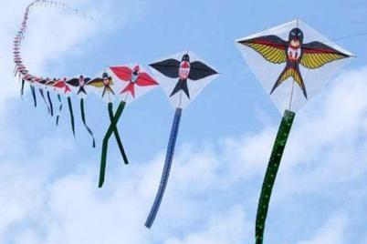
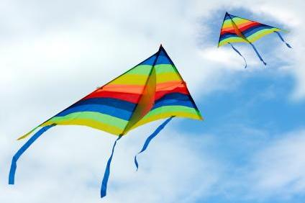
Nowadays - an important traditional Chinese culture
Chinese kite-flying activities play an important role in cultural exchanges with foreign countries, strengthening friendship with people around the world, and developing economy and tourism. They play a significant part in people’s daily life as well.

Slide 9
The use of the kite

Slide 10
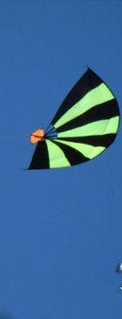
War
Initially, kites were often used as military tools to spread messages and measure the wind direction in the sky.
During the Spring and Autumn Period, Lu Ban made "wooden kite" to spy on Song city.

Slide 11
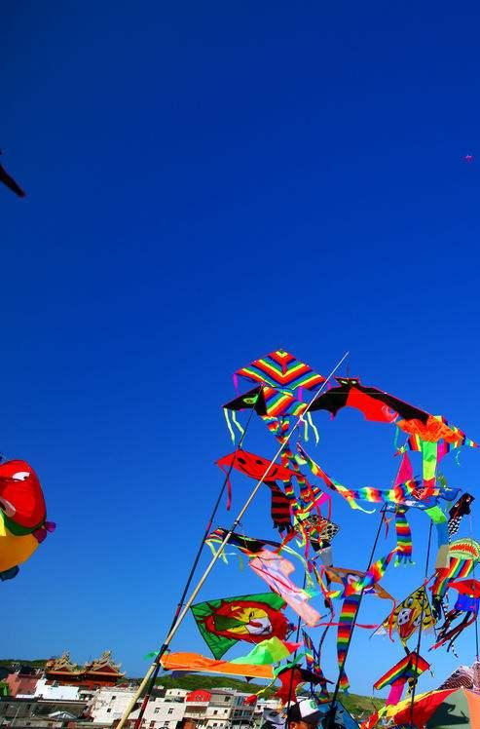
Entertainment
In ancient times, people first flew kites to let go of bad luck and it was an outdoor activity with witchcraft meaning.
Once the game was a cultural necessity to regulate social life, it was born with an entertainment meaning.

Slide 12
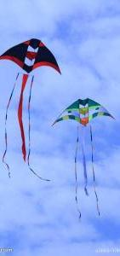
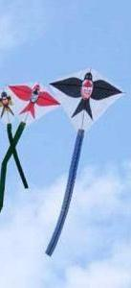
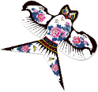
Health
行业PPT模板http://www.1ppt.com/hangye/
Modern health medicine research shows that in the bright spring flying kite, we can stretch the bones, so that the body with the flying kite and keep moving. At the same time, we can promote the metabolism of the human body, improve the state of blood circulation.
Notes:
模板来自于： 第一PPT https://www.1ppt.com/

Slide 13
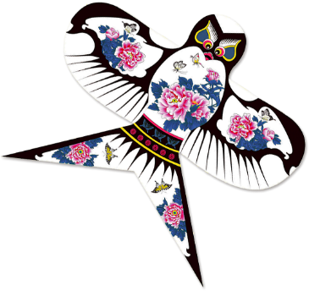
A kind of belief
The auspicious meanings and patterns can be seen everywhere on traditional Chinese kites. In the long years, our ancestors created many patterns that reflect people's pursuit of a better life and good luck. Through the pattern image, it gives people the meaning of happiness, auspiciousness and blessing.
風箏

Slide 14
The production of the kite

Slide 15
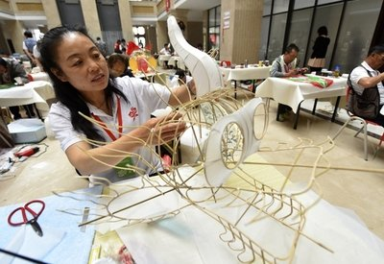
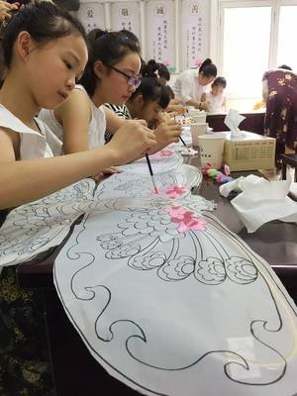
The production of the kite
The traditional Chinese kite flying skills are summarized in four words: tying, gluing, painting and flying, namely, tying the frame, gluing the paper, painting the patterns and flying the kite. In May 2006, kite making skills were listed in the first batch of national intangible cultural heritage.

Slide 16
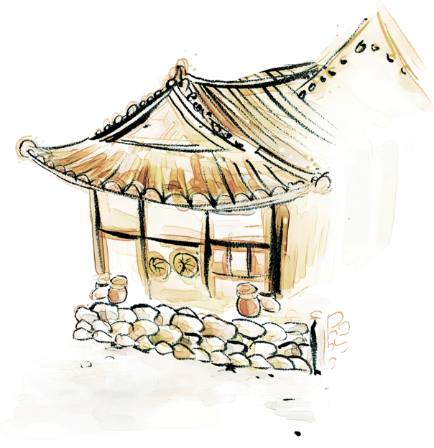
tying
gluing
painting flying

Slide 17
The types of the kite

Slide 18
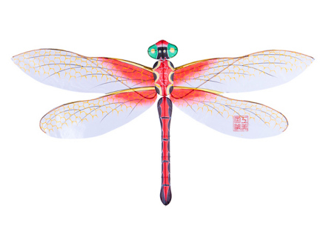
Soft-winged kite
It is one of the most common and popular traditional kites in China. The lifting piece of this kind of kite is composed of a main wing and a wing-shaped material, because there is no hard structure under the two wings, it is called a soft wing kite.

Slide 19
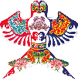
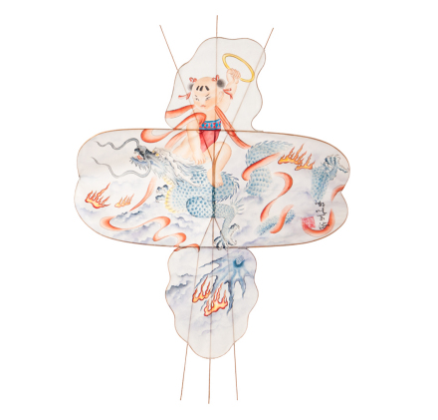
Hard-winged kite
The skeleton structure is different due to the subject matter and content, but both sides are equipped with a lifting piece - composed of two backward curved bamboo strips, arm lines and covered paper, forming a stable structure, which is shaped like wings.

Slide 20
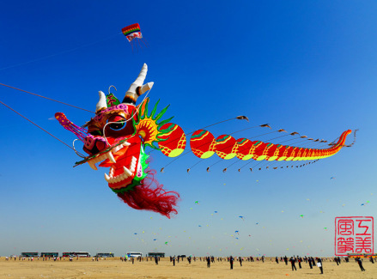
Dragon kite
The Dragon kite combines the characteristics of three-dimensional kites and high-chain kites. It consists of a hand-tied three-dimensional dragon head and a number of waist pieces.

Slide 21
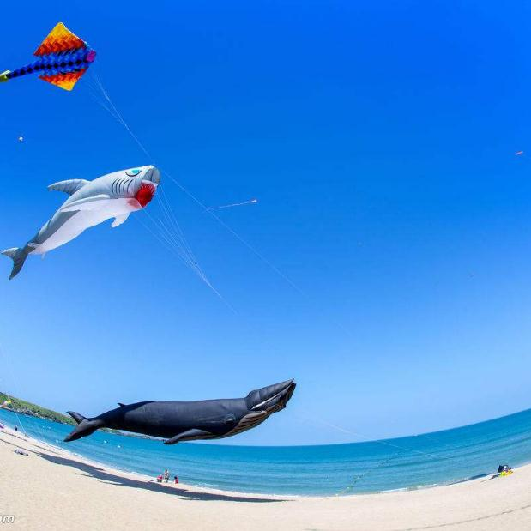
three-dimensional kite
Generally, the skeleton of a folded structure is composed of one or more round barrels or other shaped barrels, such as lanterns, vases, rockets, fish and so on.

Slide 22
Thanks for attention

