Slide 1

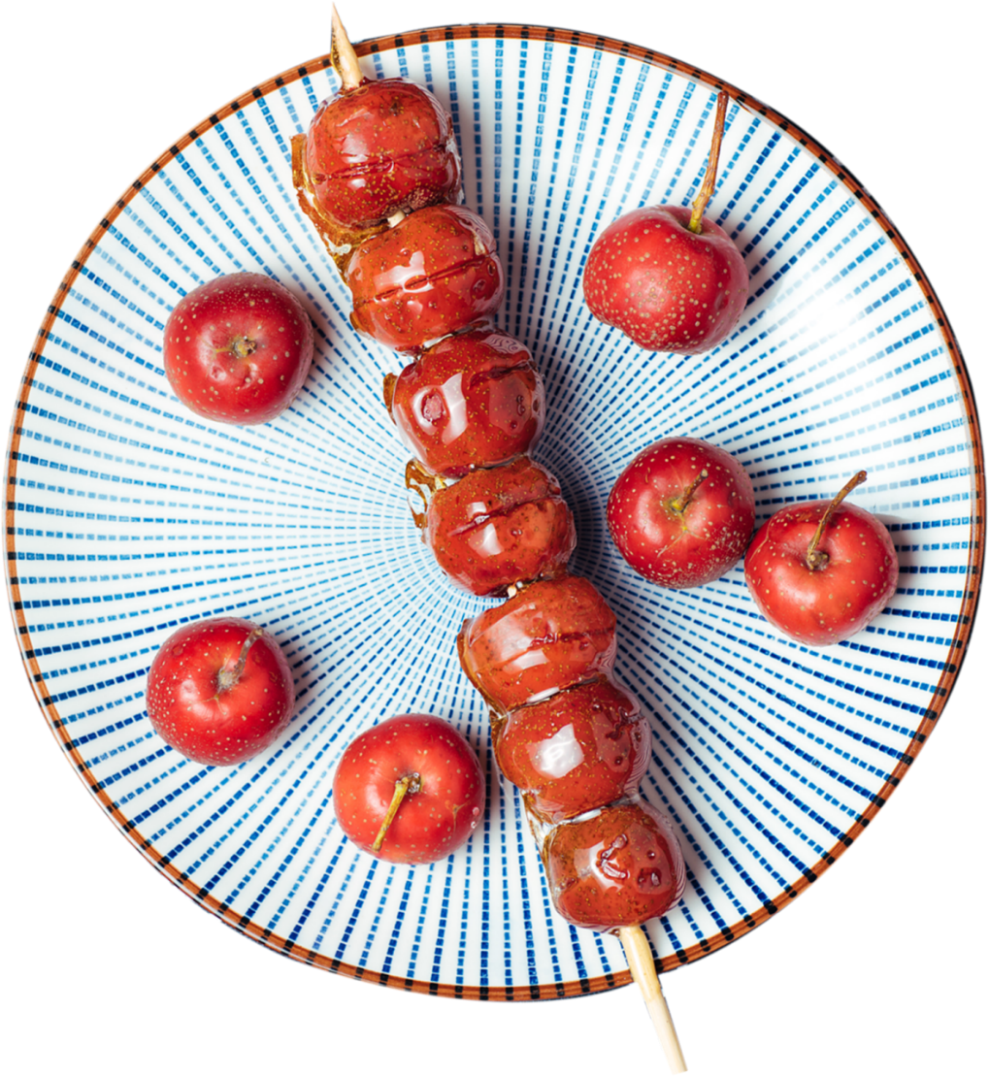
Tanghulu,
Sugar-coated Haws on a Stick
Chen Mengzhu (Chris)

Slide 2
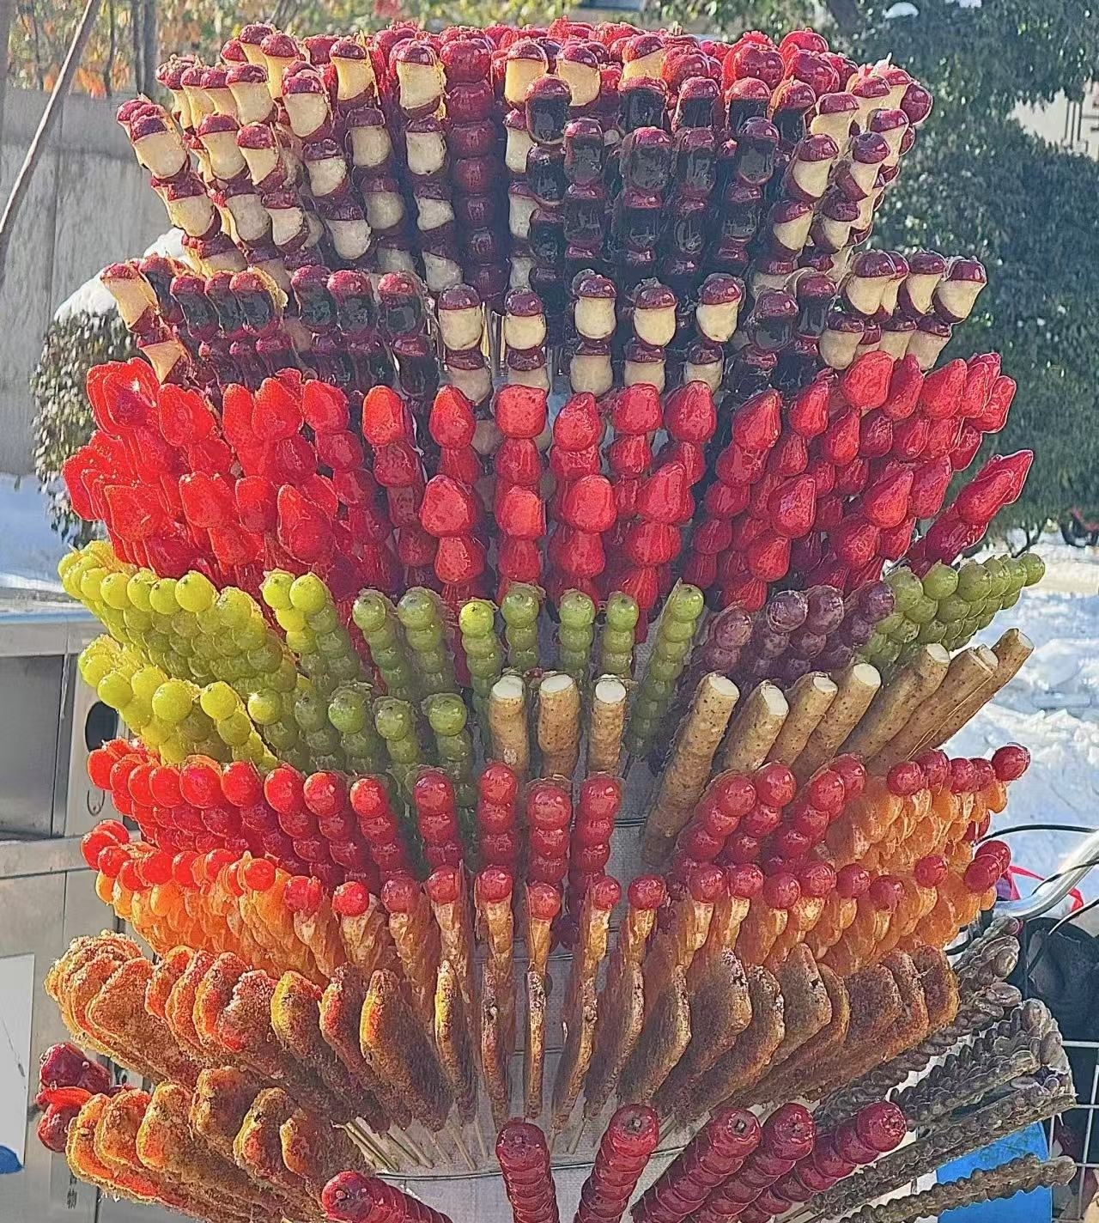
Which is your favorite one?

Slide 3

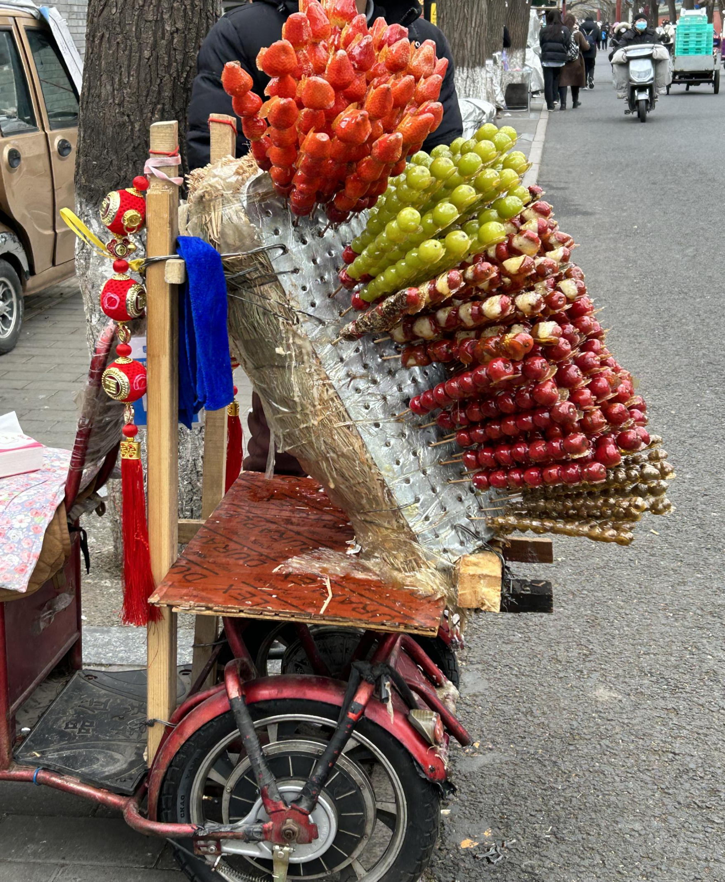
About Tanghulu
Origins of Tanghulu
Production Process
Nutritive Value
Commercialization & Innovation
Cultural Significance

Slide 4
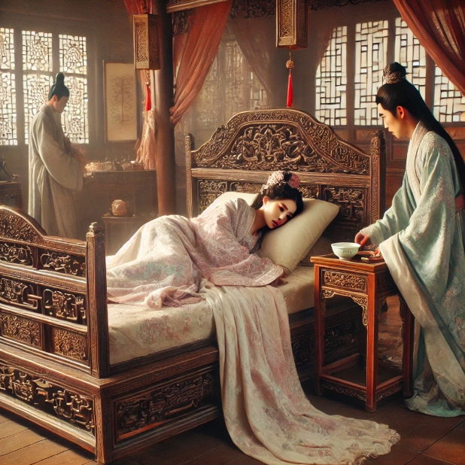
Origins of Tanghulu
In Song Dynasty, Emperor Guangzong's favorite concubine, Huang Guifei, fell ill.
Official phisicians failed to remedy the concubine.

Slide 5
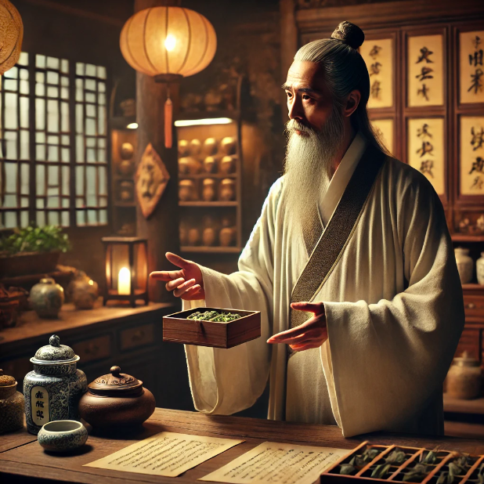
Origins of Tanghulu
A quake (江湖郎中） came to the palace and suggested a remedy.

Slide 6
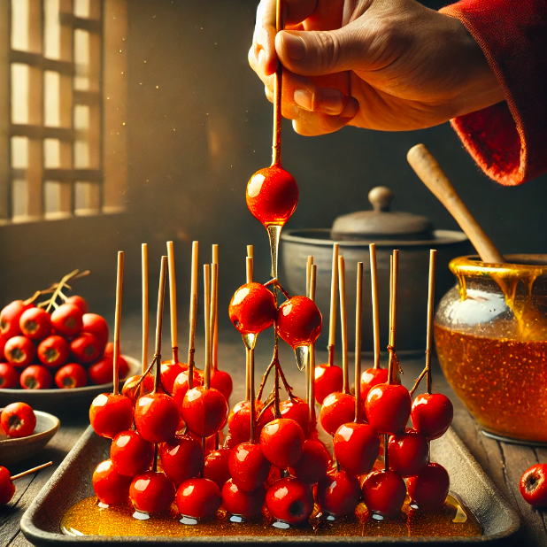
Origins of Tanghulu
Hawthorn + syrup = cure!

Slide 7
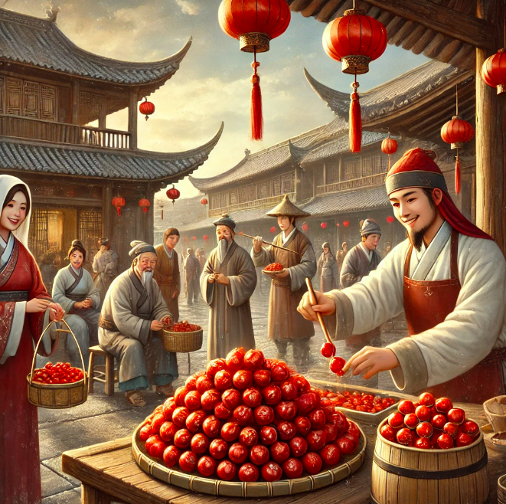
Origins of Tanghulu
Finally, the Tanghulu is revealed.

Slide 8
When did Tanghulu originate?

Slide 9
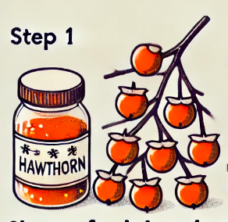
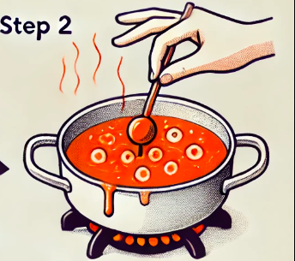
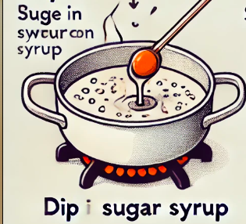
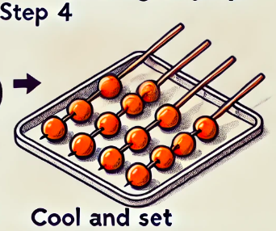
Production Process
Skewering the Fruit（串果）
Cooking the Sugar Syrup（煮糖）
Dipping the Skewered Fruit（蘸糖）
Cooling（冷却）

Slide 10
How many steps are there in making Tanghulu?

Slide 11
What is the second step of making Tanghulu?

Slide 12
Nutritive Value of Tanghulu
no pigment, no food additives, good taste, naturally nutritional food.
rich in vitamin C, pectin, hawthorn acid, and other organic acids and nutrients.
Medical Effects:
eliminate food accumulation
disperse congestion
reduce blood lipid and serum cholesterol
Caution:
diabetes patients
people with a weak spleen and stomach
should not eat too much !

Slide 13
Is Tanghulu suitable for everyone to eat?

Slide 14
Who should avoid eating Tanghulu?

Slide 15
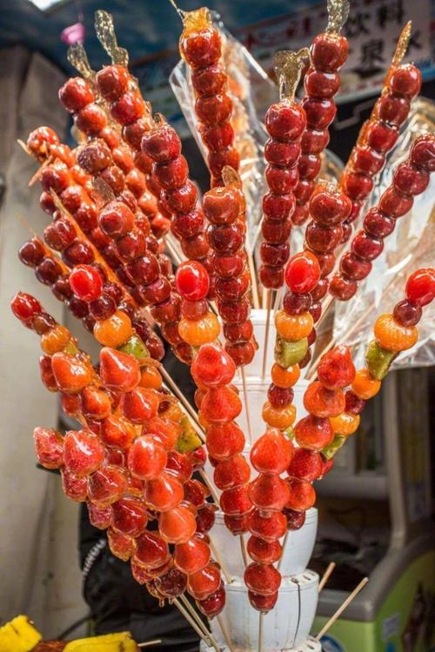
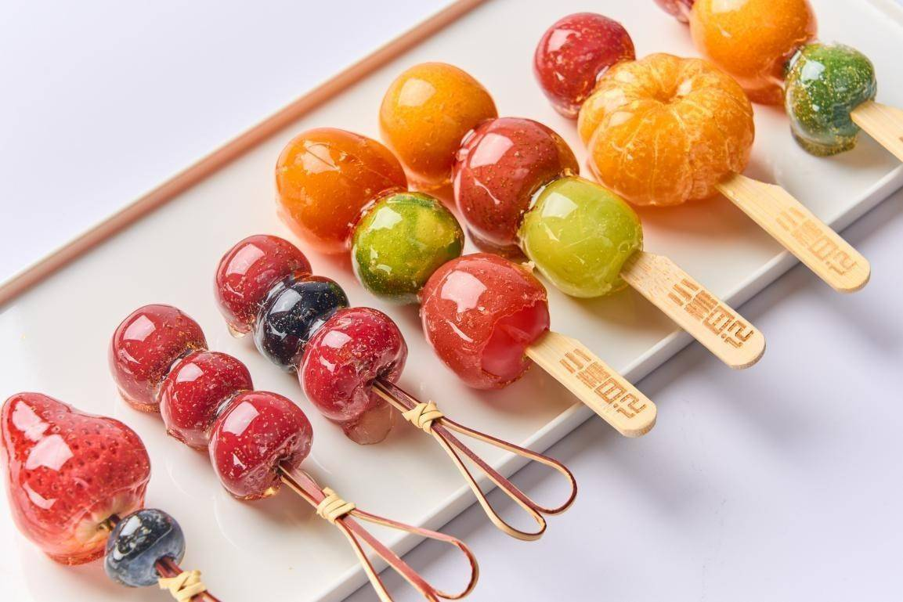
Commercialization & Innovation
Tanghulu.
Tanghuluhuluhulu...

Slide 16
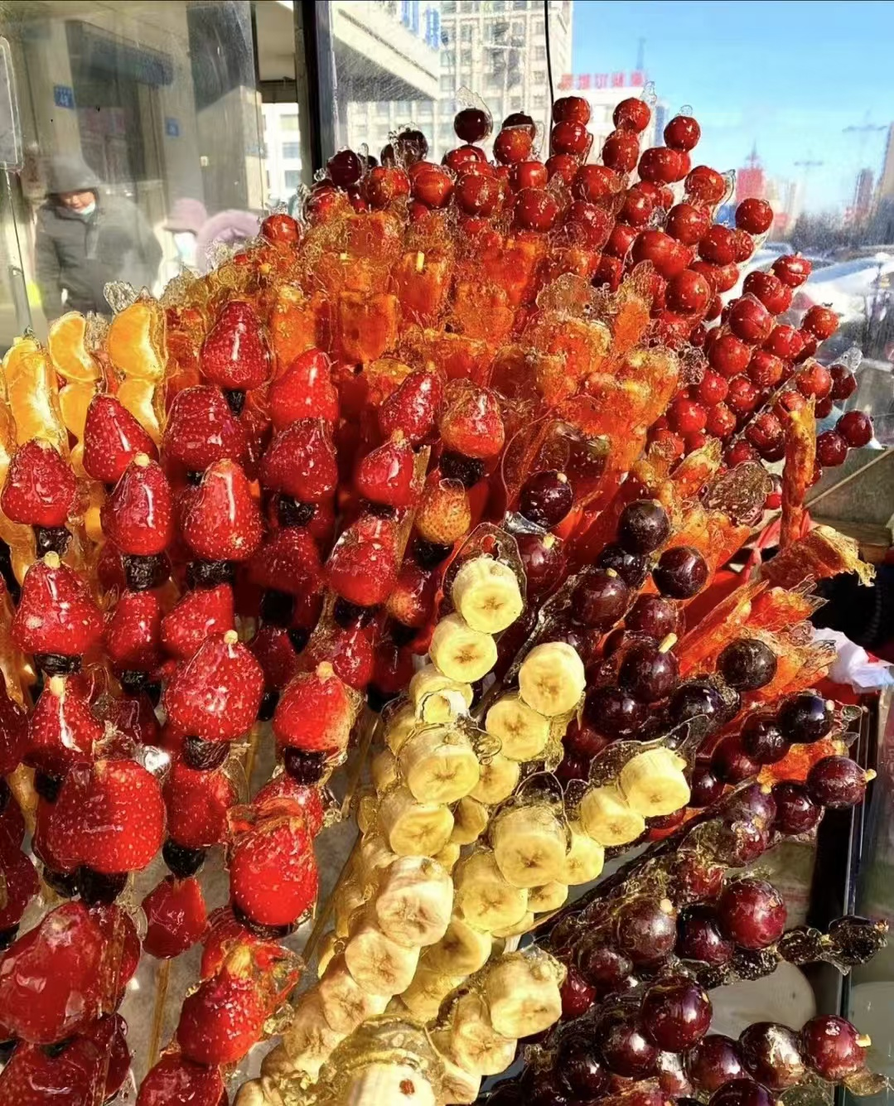
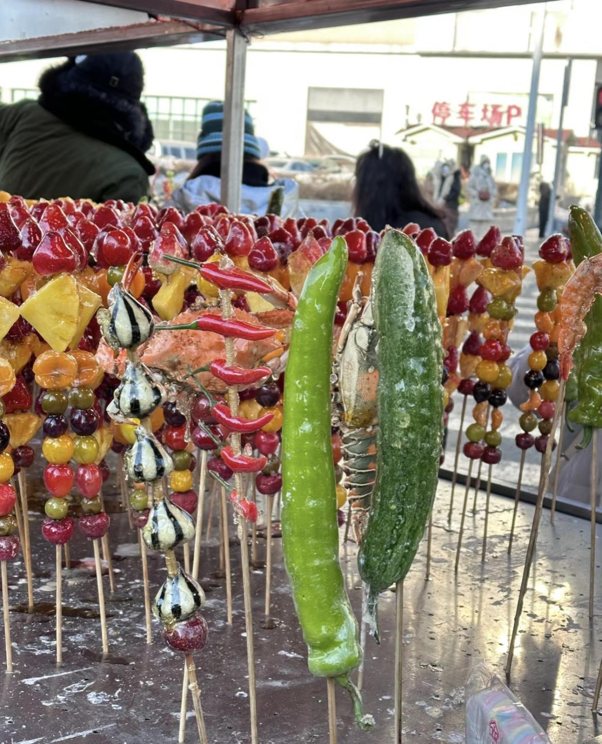
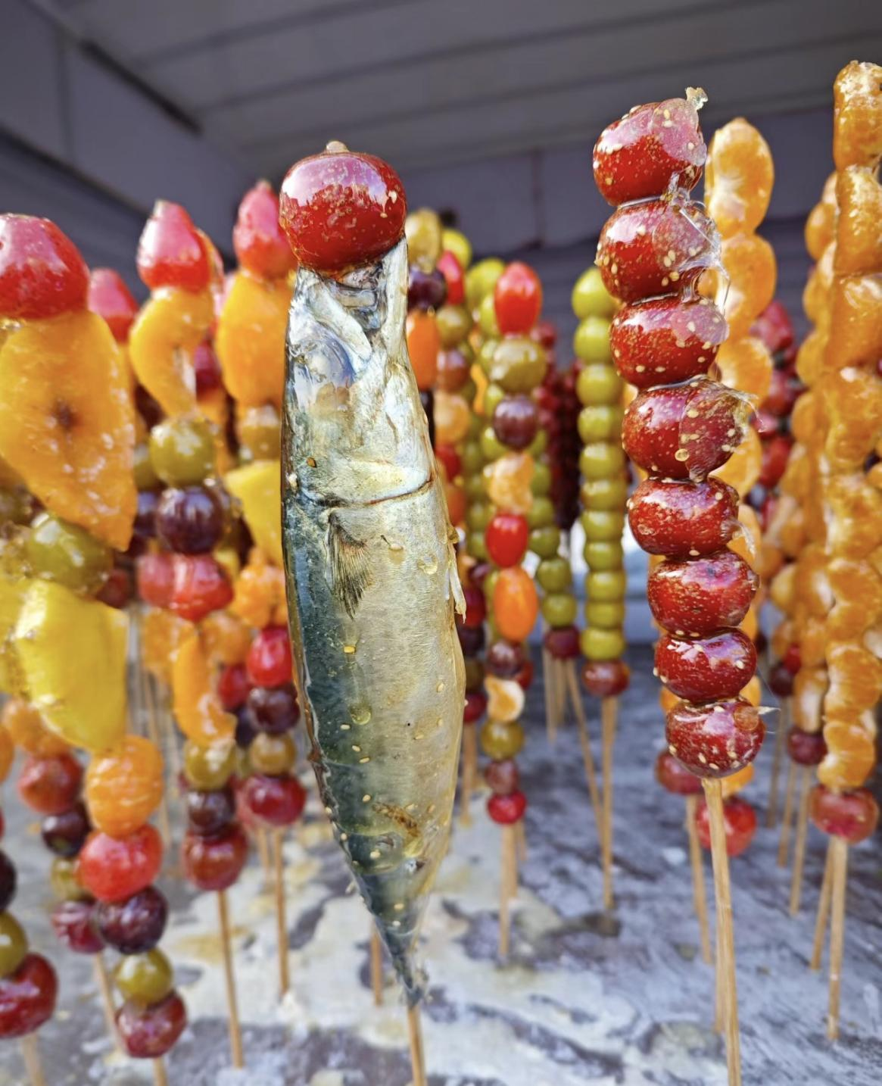
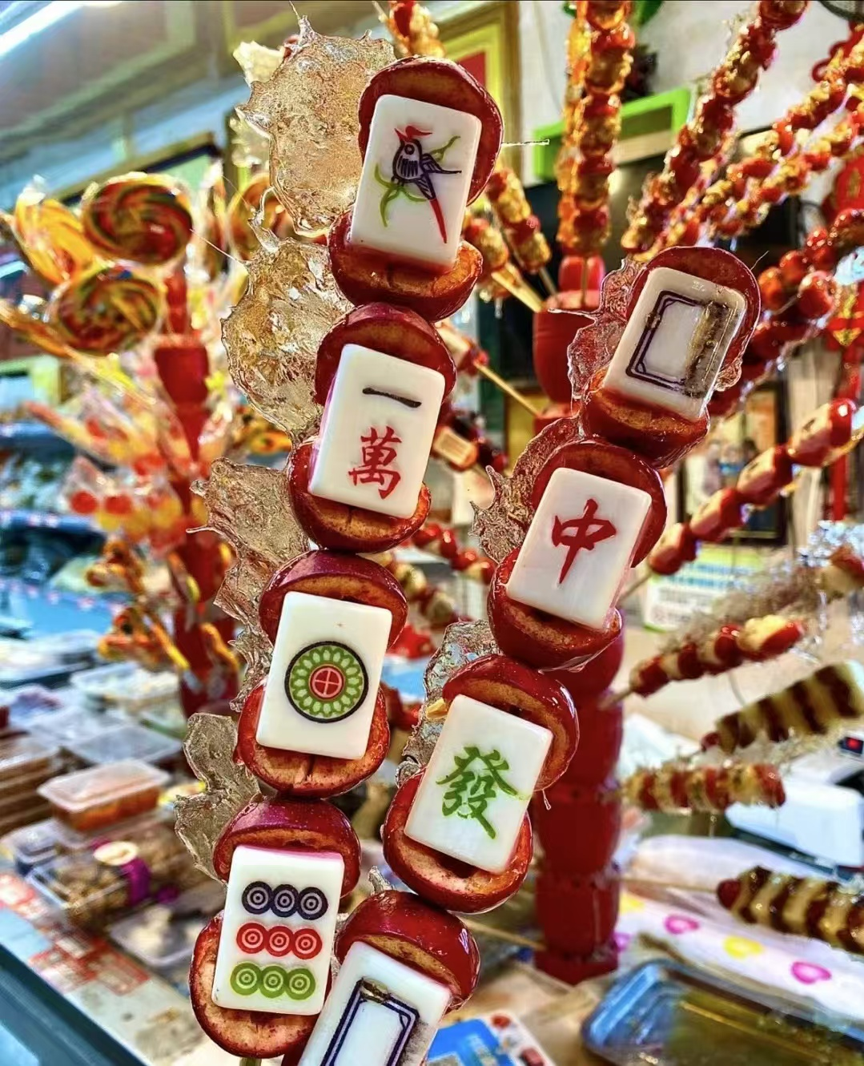
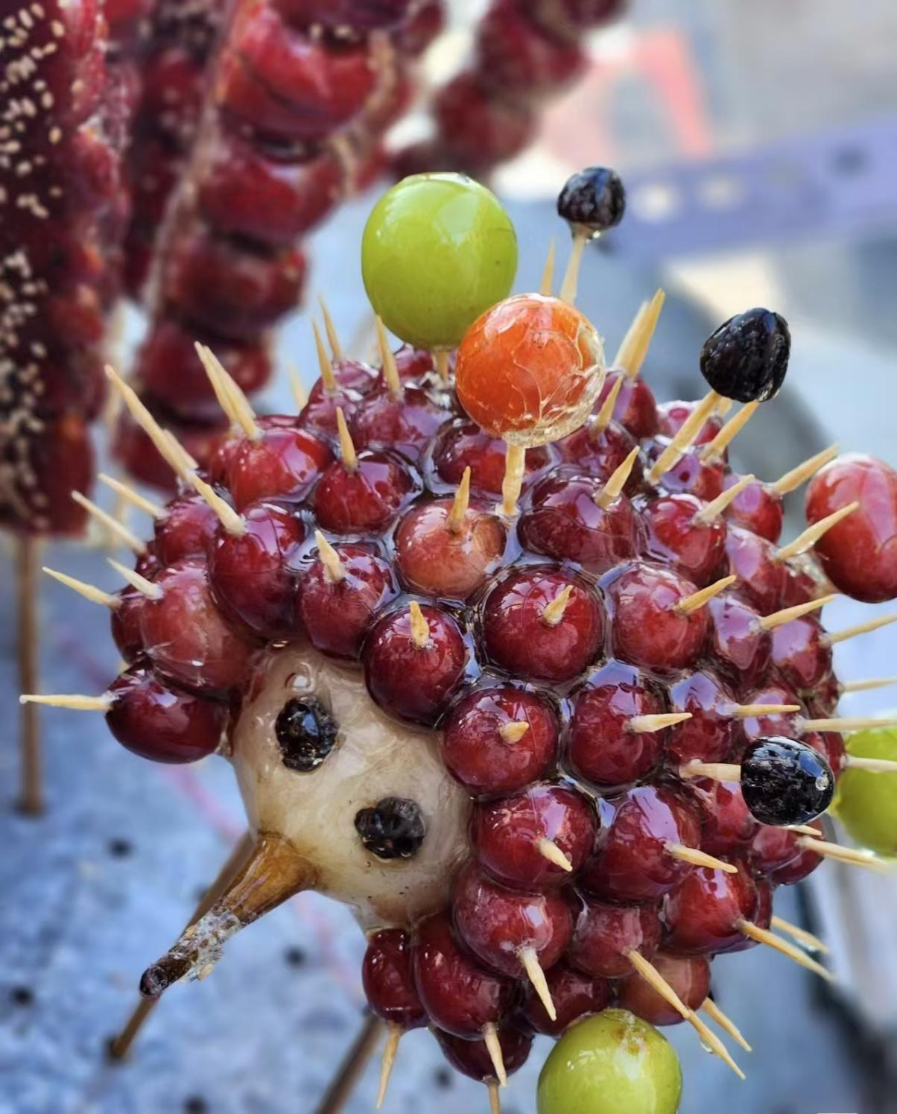
Commercialization & Innovation
Everything can be made into Tanghulu.
(万物皆可糖葫芦。）

Slide 17
Cultural Significance
Family Reunion and Harmony (团圆美满)
Prosperity and Vitality (红红火火)
Sweetness and Happiness (甜甜蜜蜜)
Good Fortune and Wealth (吉祥富贵)

Slide 18
THANKS

