Slide 1


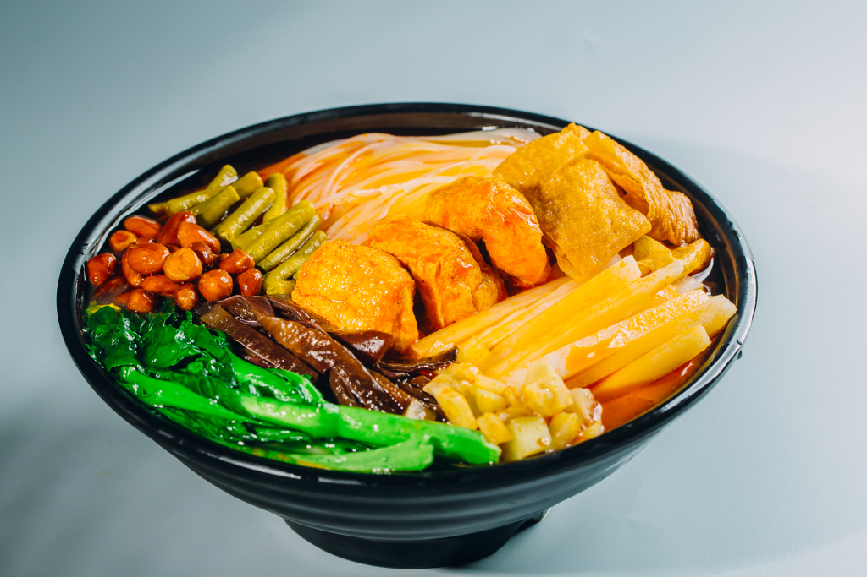

Cuisine:
Luosifen

Slide 2

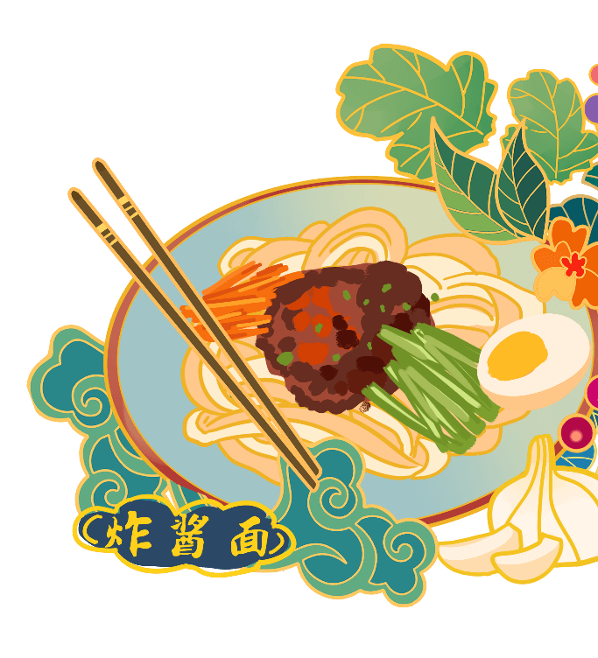

History of Luosifen
Content
Making Process
Influence

Slide 3

First Impression
https://wall.sli.do/event/8n4Nn7BtzgiCTa92nLLxni?section=259b9d76-7343-47cd-a2a8-027f55aa38f9

Slide 4
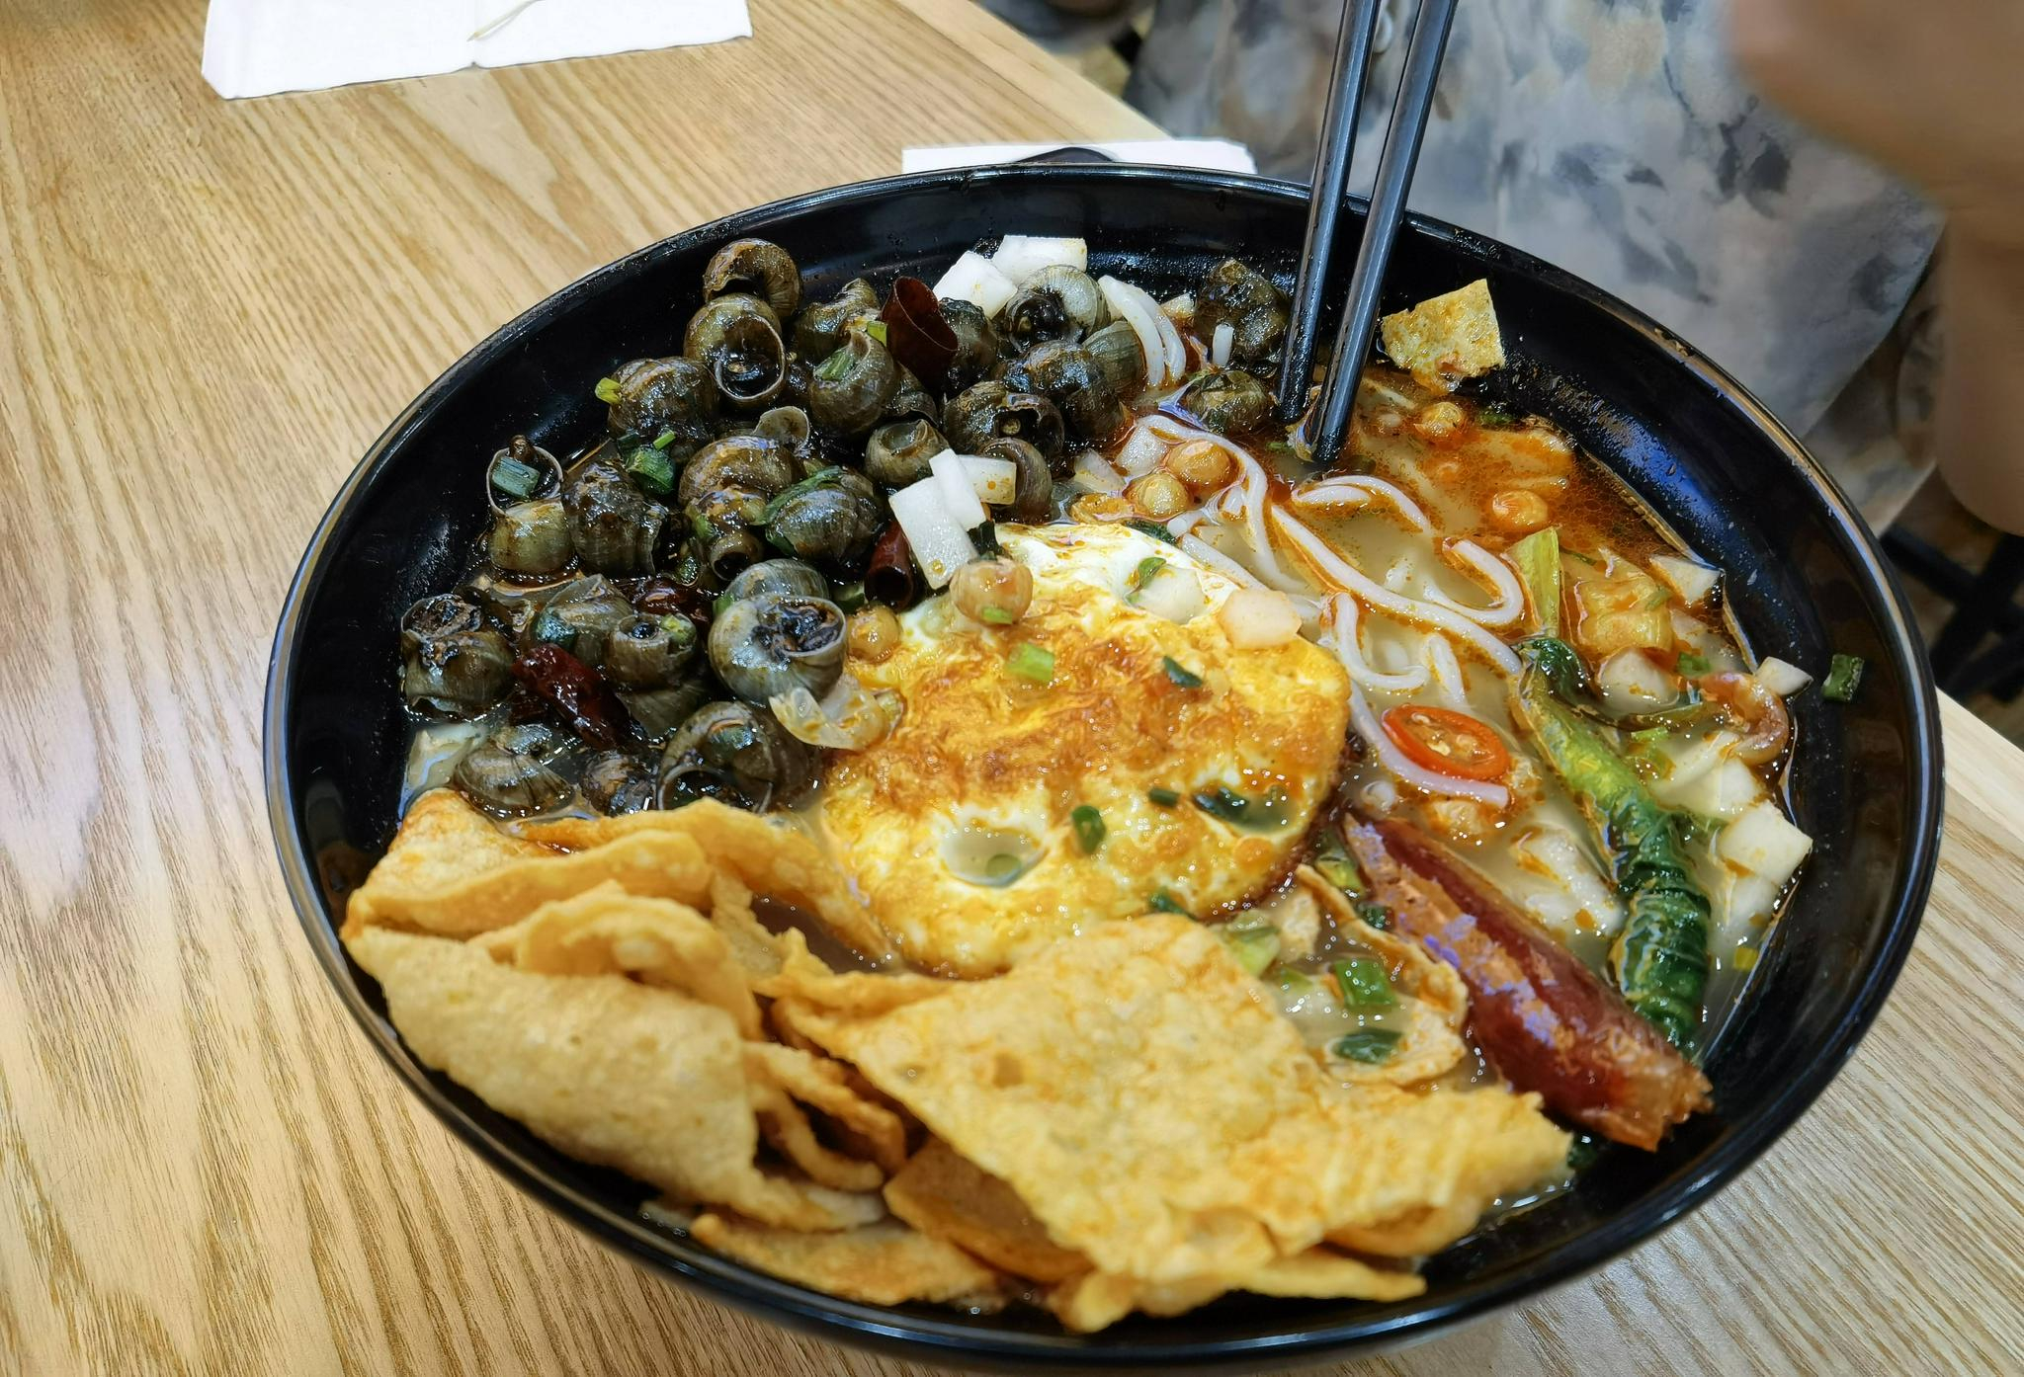
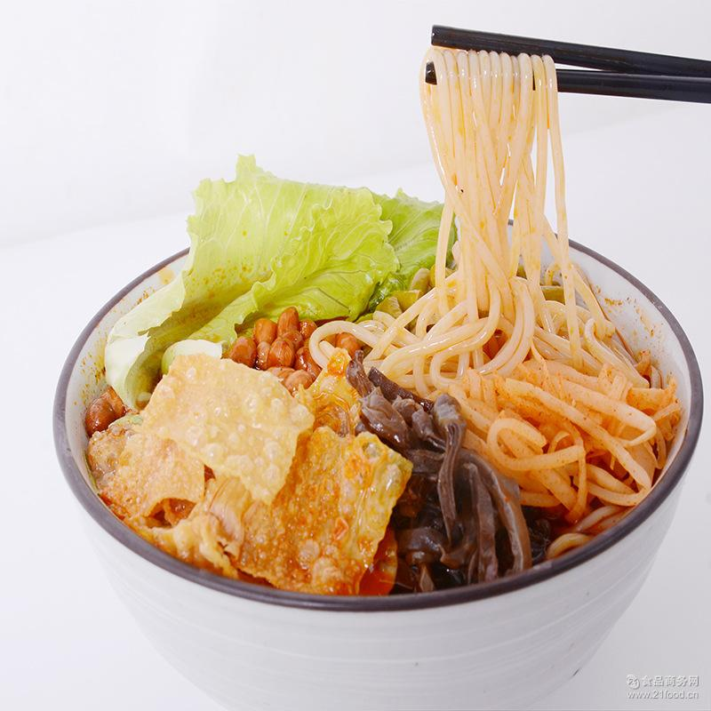
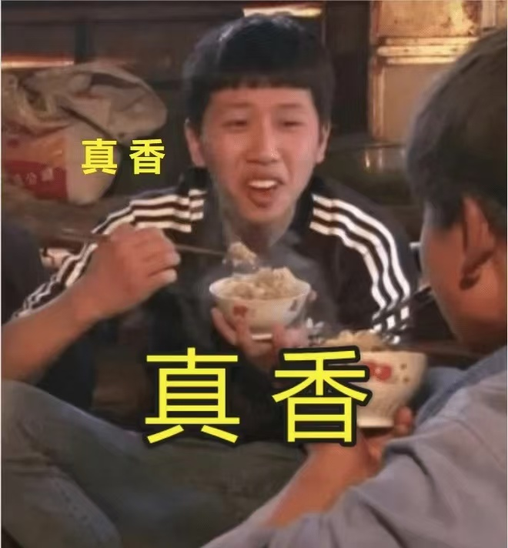
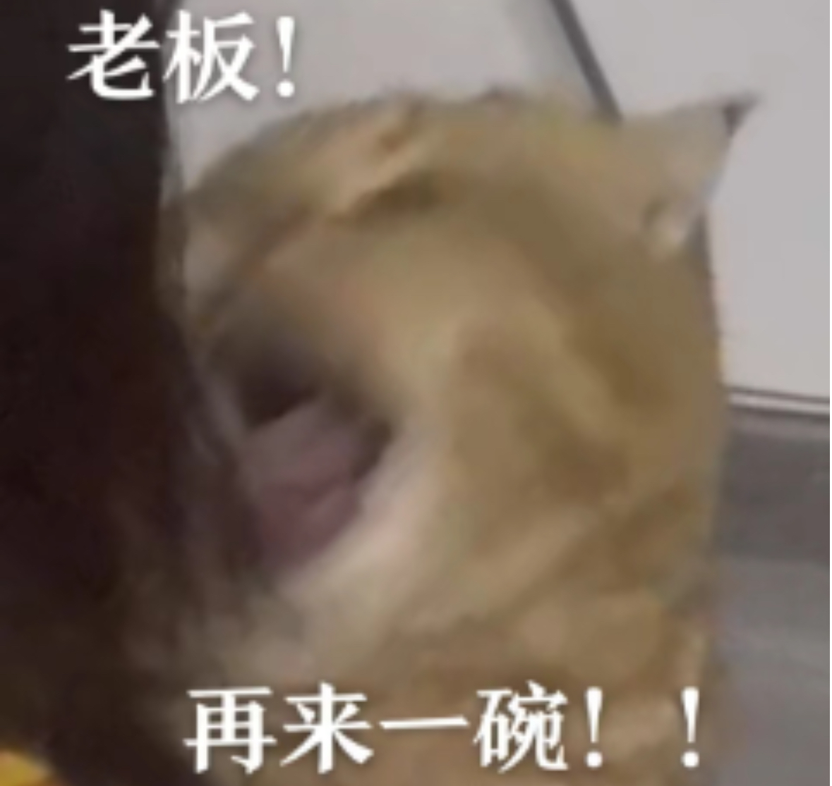
First Impression
02
03
04

Slide 5
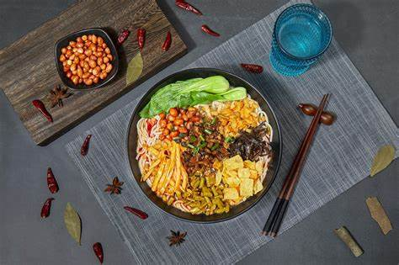
01
History of
Luosifen

Slide 6
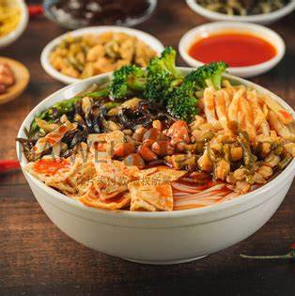
History of Luoshifen
In the last Paleolithic age forerunners have eaten the river snails in the White Lotus Cave and Big Dragon Pool which is in the Guang Xi province.
Since the Era before Qin Dynasty, rice noodle has become the staple food to people who grow up in southern China including Guang Xi Province.
The combination, Luosifen has appeared around 1970s-1980s.

Slide 7
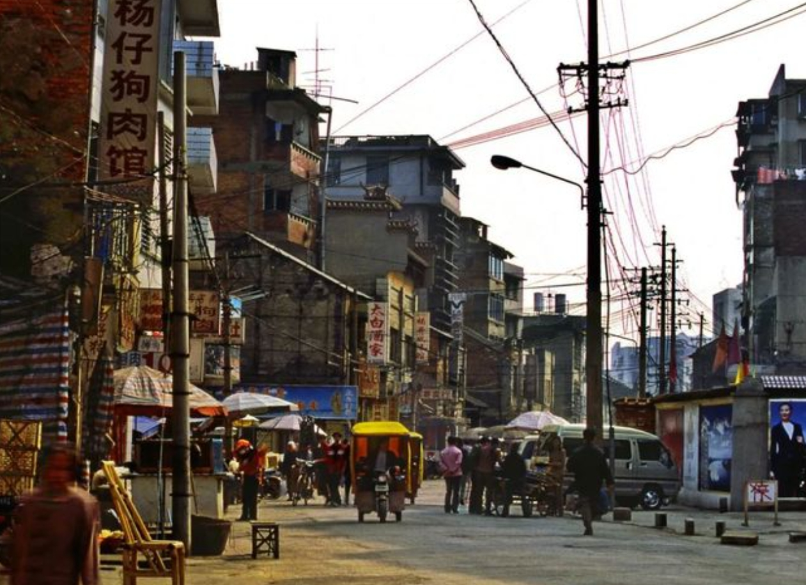
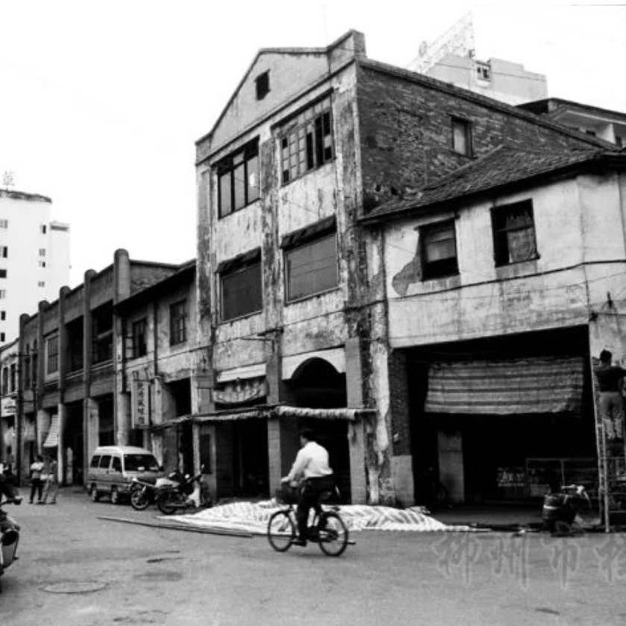
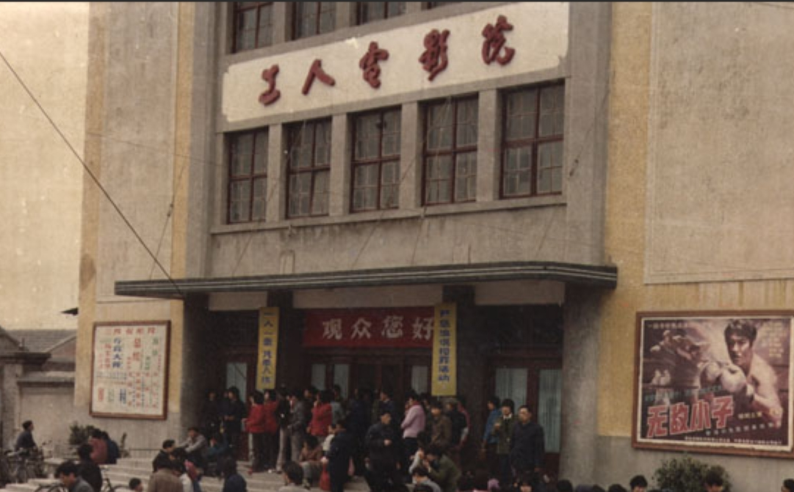
History of Luoshifen
Gu Bu Street
Jie Fang South Road

Slide 8
02
Making Process

Slide 9
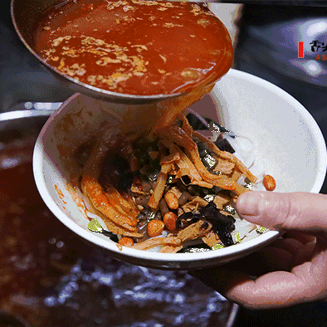




Making Process
Prepare the rice noodles
Prepare Ingredients
油炸腐竹、酸豆角、炒木耳、酸笋、油炸花生米、萝卜干丁、酸菜
干切粉，用水泡开(一小时以上)。
Prepare river snails and make the soup
Make Luosifen
真正的螺丝粉是没有螺丝的。买来活的螺丝，用清水泡2天,在水中投入一块铁，促进螺丝吐泥，这样螺丝肉才清甜。田螺吸干净后，取出，用铁嵌剪掉掉螺丝尾部
在烧开水中下蔬菜，空心菜、生菜、油菜花都可以菜8分熟后捞出，淋少许油。再下泡好的米粉煮熟捞出压在菜上，然后加上配菜，最后淋入螺丝汤即可。

Slide 10
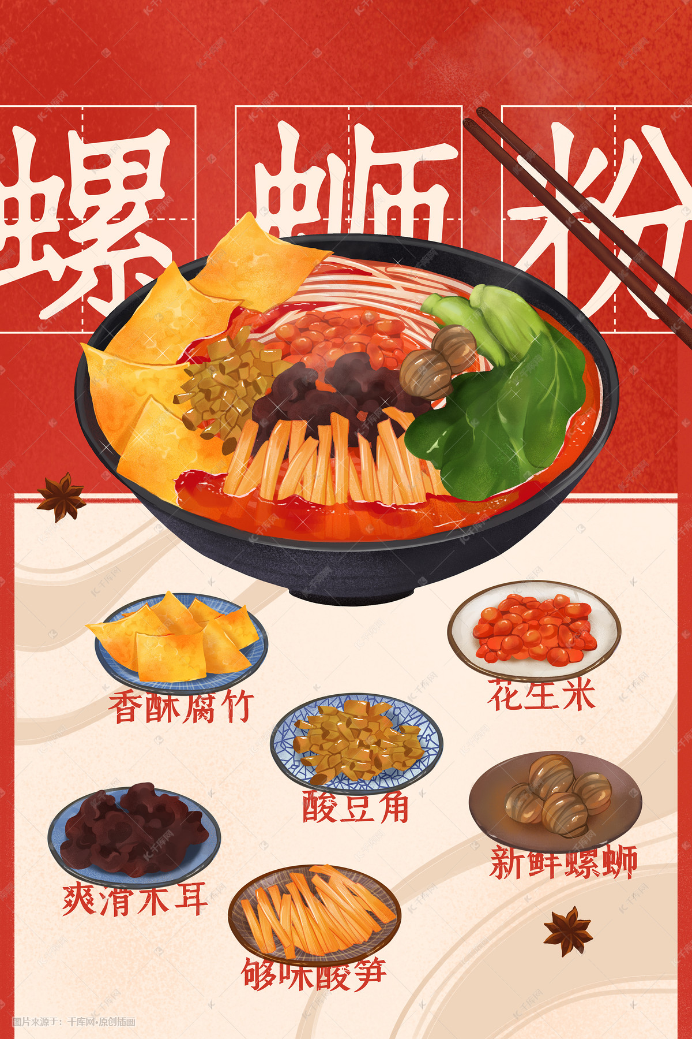
Making Process
视频链接：https://www.bilibili.com/video/BV1XV411K7eB/?spm_id_from=333.337.search-card.all.click&vd_source=6562dc266dda4948529f4844ab67a66a

Slide 11
03
Influence

Slide 12
Influence
壹
贰
Economy
Obviously, it supplies thousands of jobs for people, promotes the economic growth of Liu Zhou and cultivates Liu Zhou’s industrialization.
Culture
Nostalgia lies behind every special dish. So does Luosifen. It is good memory to people born and growing in Liu Zhou. It is a typical example to show the profound influence of traditional culture.

Slide 13
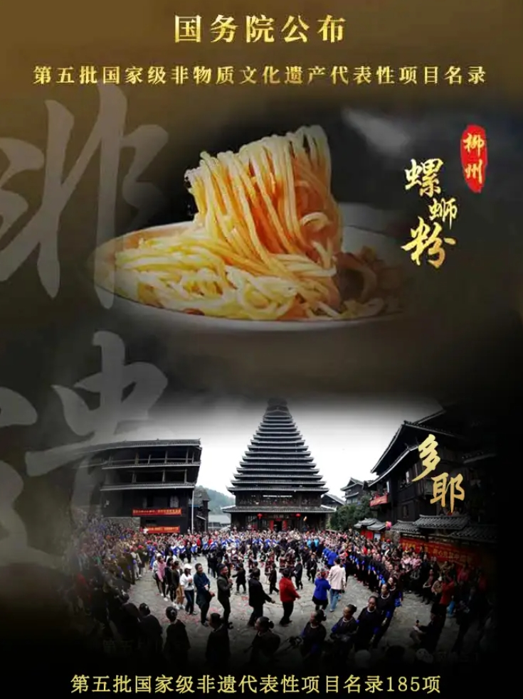
Influence
In 2018, the skill to make the rice noodle of Luosifen has been selected in the list of intangible cultural heritage of Guang Xi Zhuang Autonomous Region.
In 2021, it has selected in the list of national intangible cultural heritage.

Slide 14
Question
Question 1:
Where does Luosifen come from?
And When was Luosifen selected
in the list of national intangible cultural heritage?
Question 2:
What are the ingredients of Luosifen? (at least three)

