Slide 1
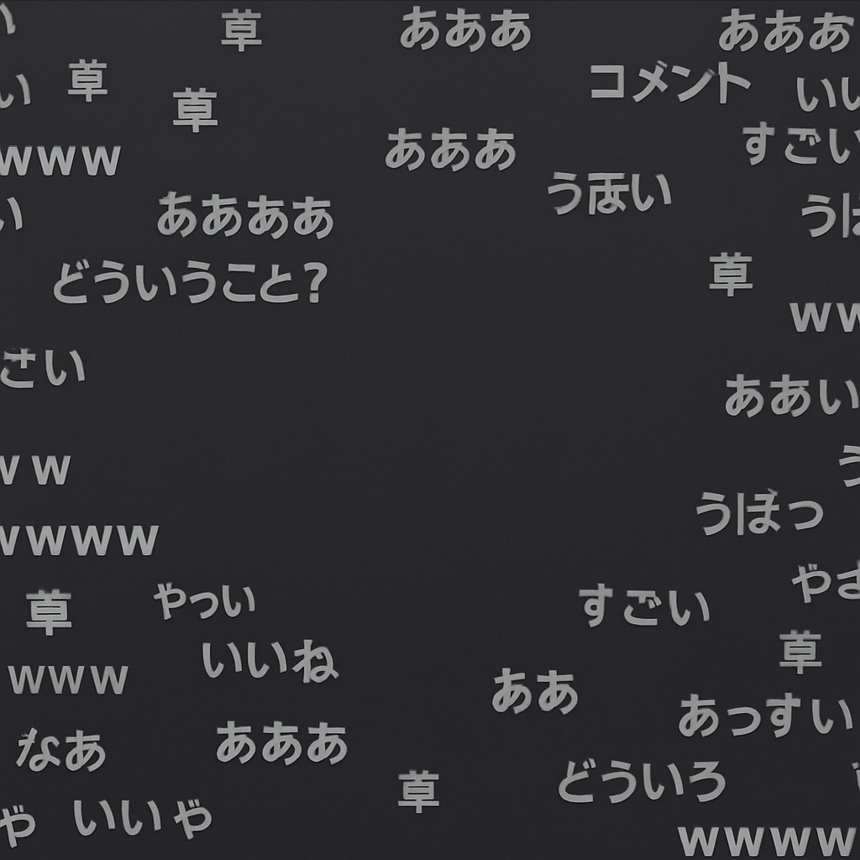
Danmu

Slide 2
From Japanese Bullet Hell to Chinese Video Platforms
In China, AcFun and Bilibili were the pioneers in adopting this format, calling it “danmu” or “弹幕.”
These platforms became hubs for subcultural communities where danmu flourished, especially in the context of animation and other niche content.
Adoption by AcFun and Bilibili
1
2
3
Origin in Japan’s Niconico
Mainstream Emergence Around 2014
Around 2014, danmu began to move from niche sites to mainstream platforms.
This shift marked the beginning of “danmu culture” in China, with a rapid expansion of its use and influence.
The concept of on- screen commentary, known as “comments,” first appeared on Japan’s Niconico video site.
This format allowed users to leave scrolling text comments that overlaid on videos, creating an interactive viewing experience.

Slide 3
the Special Effect Danmu and Advanced Danmu
Accumulation of Comments Before 2014
Challenges of Server Load and Purging
Modern Limitations in Recreating Density
Prior to 2014, some videos accumulated vast numbers of comments that filled the screen, creating a dense danmu experience.
This dense overlay of comments added a unique visual layer to the viewing experience, making it more engaging.
Due to server load and other technical issues, old danmu would be periodically purged.
After 2017, most advanced and special effect danmu gradually disappeared, making it difficult to recreate the same experience.
Nowadays, recreating that dense, effects- rich danmu experience on online platforms is all but impossible.
The technical and infrastructural limitations have led to a shift in focus from visual density to other aspects of danmu.

Slide 4
Danmu Games
Flash-Based Limitations
Since most of these games were built in Flash, they have largely vanished with the deprecation of Flash.
The decline of Flash technology marked the end of this unique form of interactive danmu gaming.
Emergence on Bilibili (2015–2016)
03
Around 2015–2016, many real- time danmaku dodge games appeared on Bilibili.
Viewers could control a plane (or other avatar) to dodge danmaku sent by other users, adding an interactive gaming element to the platform.
01
Legacy and Impact on User Engagement
These games were a significant part of early danmu culture, fostering a sense of community and competition among users.
They demonstrated the potential for danmu to be more than just comments, but also a medium for interactive entertainment.
02

Slide 5
the Danmu Mask Videos
01
02
03
Launch Around 2019
Use in Interactive Quizzes and Games
Enhancing Viewer Participation
Introduced around 2019, danmu masking allows users to apply a mask so that comments only appear over—or conversely, avoid—specific areas of the screen.
This feature has been used creatively to enhance the viewing experience.
Danmu masking is often used for interactive quizzes and guessing games embedded in videos.
By controlling where comments appear, creators can design more engaging and interactive content for viewers.
This feature encourages active participation from viewers, making the viewing experience more dynamic and engaging.
It has become a popular tool for content creators to enhance the interactivity of their videos.

Slide 6
the Live Stream Danmu Interaction
Influence of Live Streaming Technologies
Viewer Control Over Game Elements
Future Potential for Interactive Content
With the rise of live streaming and related technologies, new forms of danmu- based interactivity have emerged.
Live streaming platforms have enabled real- time interaction between viewers and streamers.
In some live- streamed games, viewers send danmu in real time to spawn enemy units or trigger events.
This direct influence on the streamer’s experience has created a new level of engagement and interaction.
The potential for further innovation in live stream danmu interaction remains high.
As technology advances, we can expect even more creative and immersive ways for viewers to participate in live content.

Slide 7
Danmu as a Standard Feature
Ubiquity in Chinese Online Culture
Shift in Focus to Textual Content
Potential for Reviving Classic Danmu Streams
Today, danmu is second nature for Chinese netizens and has become a standard feature on video and live streaming platforms.
It has become an integral part of the viewing experience, shaping how users interact with content.
The focus of “danmu culture” has shifted from the visual form of danmu itself to the textual content of comments.
While this has broadened its appeal, it has also led to a loss of some of the distinctive visual flair that danmu once had.
Although many classic danmu streams no longer exist online, tools like BiliLocal allow users to revive them offline.
By loading archived danmu packages, users can bring back the old danmu culture experience, preserving its unique heritage.

Slide 8
Thank you

