Slide 1

Chinese Writing: Chinese Characters
Hunan Normal University
Made by:夏临川（Xia Linchuan）、王纪龙（Wang Jilong）
Major：English Translation

Slide 2

Content
Origin of Chinese Characters
1.
Evolution of Chinese Characters
2.
Formation of Chinese Characters
3.

Slide 3
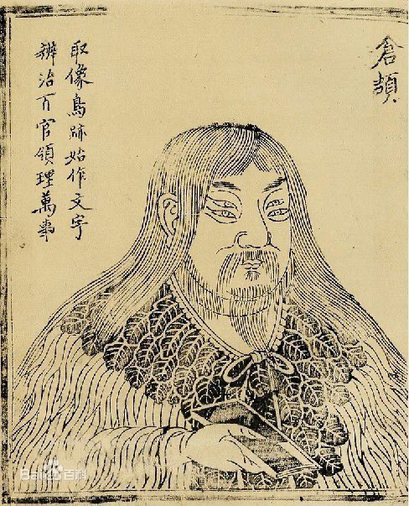
1. Origin of Chinese Characters
What is the source of Chinese Character?
1.1 Myth-Cang Jie created characters(神话——仓颉造字)
Cangjie, during the Yellow Emperor period, was a historical official （史官）who observed the footprints of birds and beasts and was inspired by it to create Chinese Character（汉字）.

Slide 4
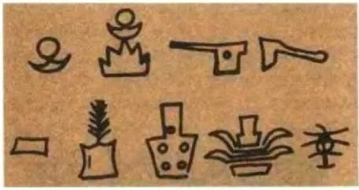
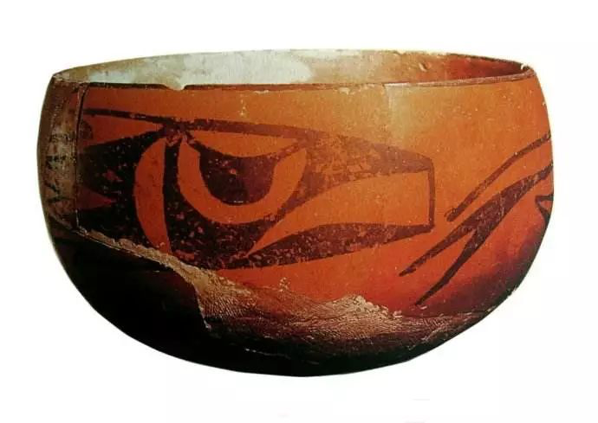
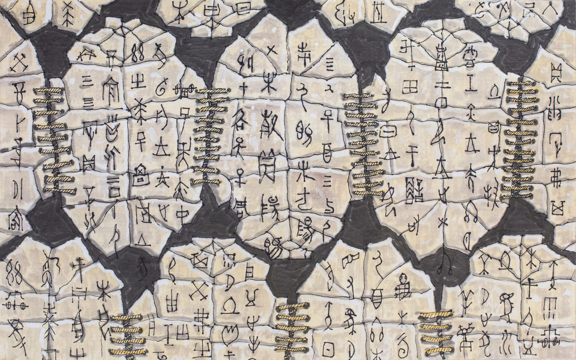
1.2 Archaeological materials-Chinese Character orginated from drawings
(考古史料——图画说)
According to archaeology, Chinese characters are drawings that originated in the early period.
From the early archaeological materials, it can be seen that whether it is the picture-type pottery symbols of the Dawenkou culture or the colorful pictures of the Banpo culture, these early graphics are very similar to our early Chinese characters.

Slide 5
2. Evolution of Chinese Characters
Chinese characters from the earliest Chinese hieroglyphs to today’s simple characters have undergone through a very long process of development.
Associated with these periods, Chinese characters had experienced several times of evolution into many different script forms.

Slide 6
Question
How many different script forms Chinese characters have?

Slide 7
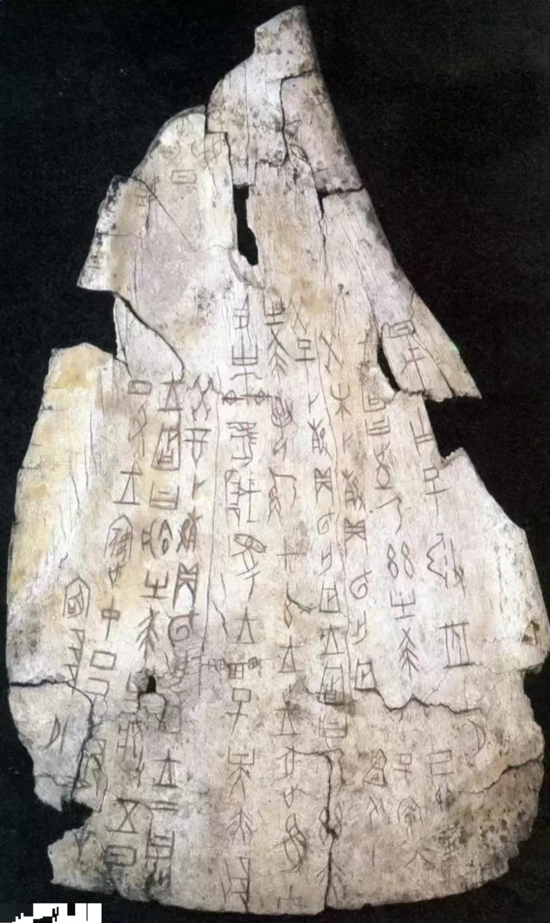
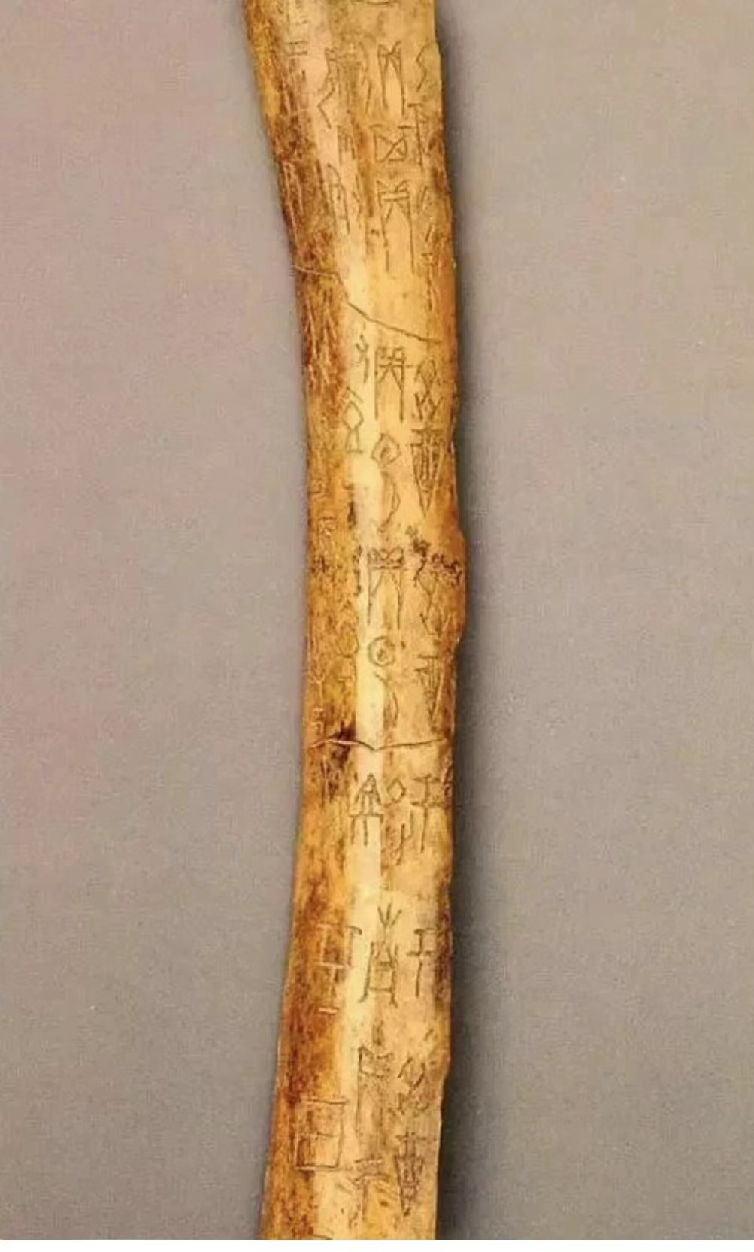
Oracle Bone Script
(Chinese: 甲 骨 文 , Pinyin: jia gu wen)
Oracle bone script is the
inscription on animal bones and tortoise shells of the Shang Dynasty (1711–1066 BC).
It was first excavated by the local farmers in Xiaotun Village, Anyang, Henan Province and was sold as a kind of traditional Chinese medicine called “Long Gu” (dragon bones).

Slide 8
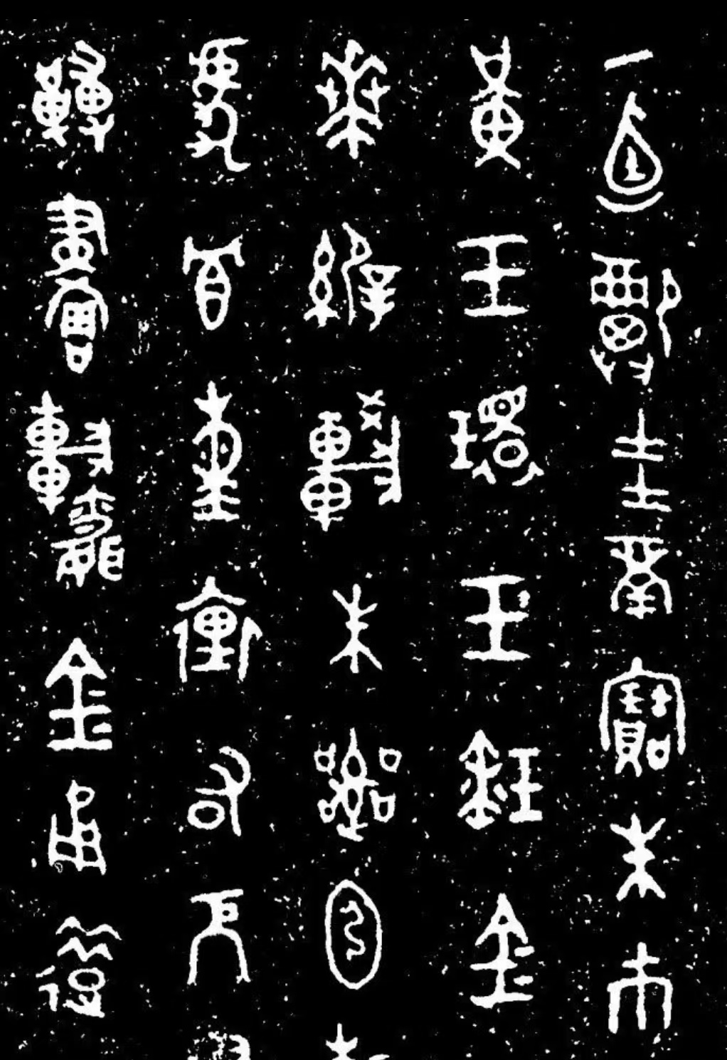
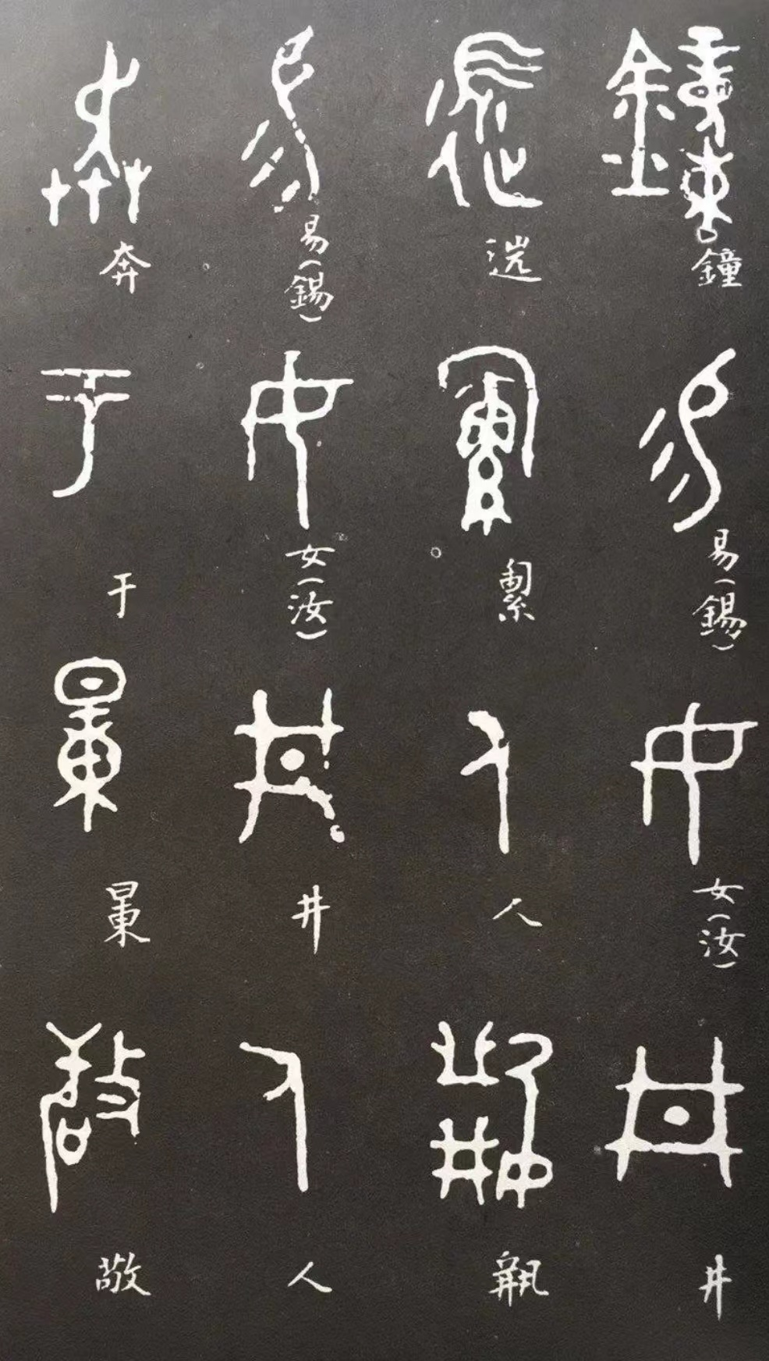
Bronze Script
(Chinese: 金 文 , Pinyin: jin wen)
In the “Age of Bronze Ware” of China during the period of Shang and Zhou Dynasties, bronze ware was cast as a container, and most often as the sacrificial vessels to inscribe great events
The bronze inscriptions looked like
drawings but had made significant progress from pictographic forms to
block-shaped linear words we use today. ( Yu Xinjia and Xue Ruijia,
2005）
西周金文《毛公鼎铭》

Slide 9
Seal Script
(Chinese: 篆 书 , Pinyin: zhuan shu)
1. The Large Seal Script (Chinese: 大篆）
The large seal script is a traditional reference to all types of Chinese writing systems used before the Qin Dynasty. However, due to the lack
of research achievements and precision, scholars often avoid the large
seal script, instead of using more specified terms to the examples of
writing. The large seal script was widely used in many vassal states in
the Spring and Autumn Period (770–476 BC).

Slide 10
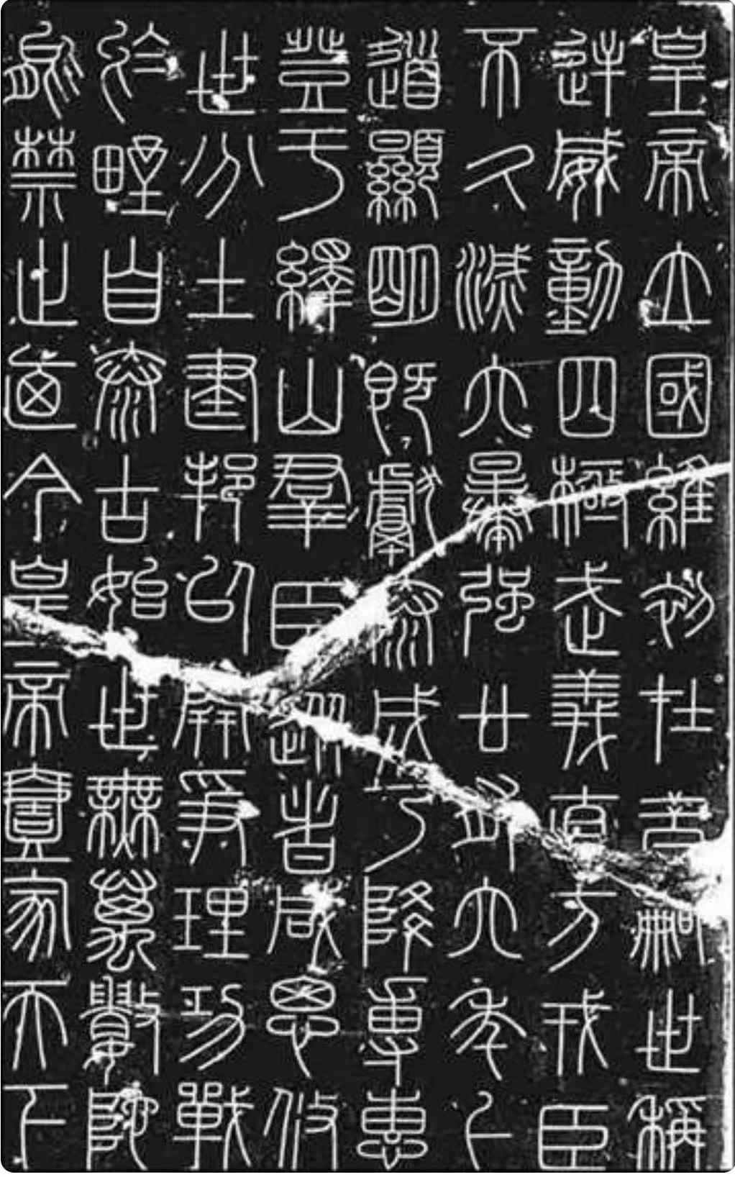
Seal Script
(Chinese: 篆 书 , Pinyin: zhuan shu)
2. The Small Seal Script (Chinese: 小篆）
After the Qin State conquered the other six states and established the Qin Dynasty (221–206 BC), Emperor Qinshihuang unified characters in order to strengthen his control.
The unified characters were called Small Seal Script which was the official style of characters in Qin Dynasty used for all the documents of the government.

Slide 11
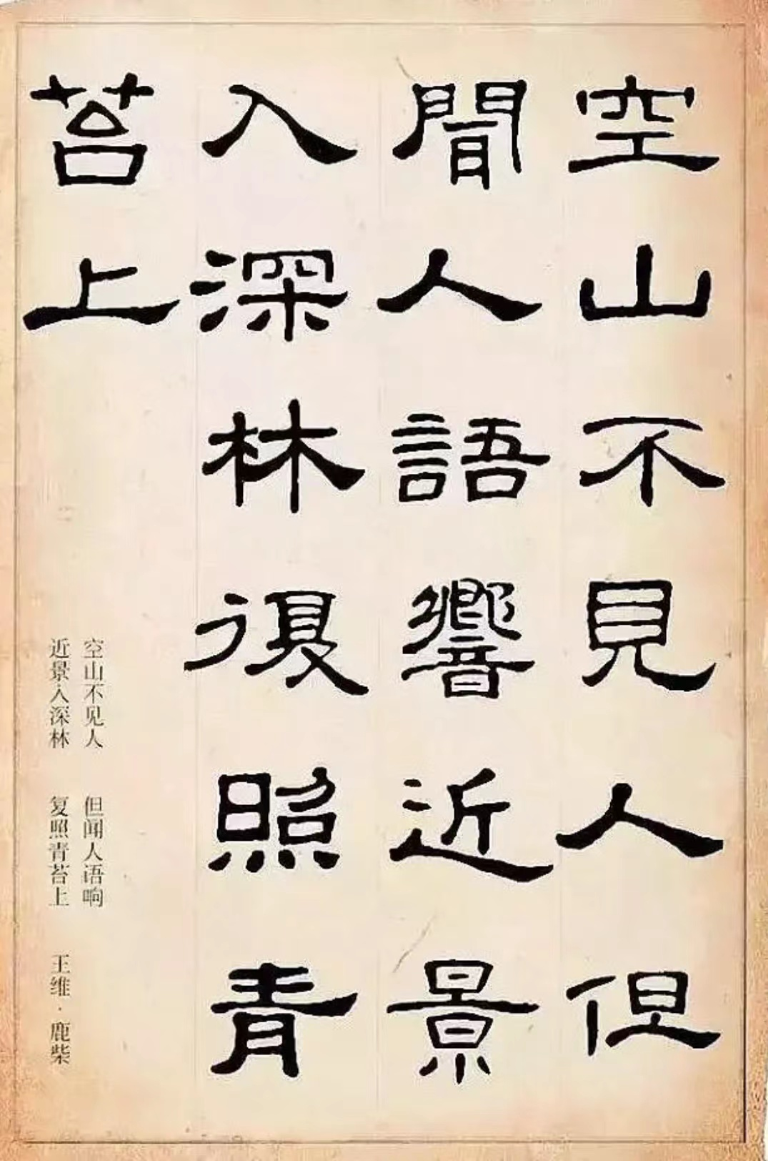
Clerical Script
(Chinese: 隶 书 , Pinyin: li shu)
Clerical script appeared during the late of the Qin Dynasty and the Han Dynasty (206 BC — 220 AD).
After the unification of China, the seal script was still popular, but could not satisfy the needs of people because of its lengthened and curved lines being written were quite time-consuming.
In order to save time, people changed the rounded lines into straight ones which became the officially approved formal way of writing.

Slide 12
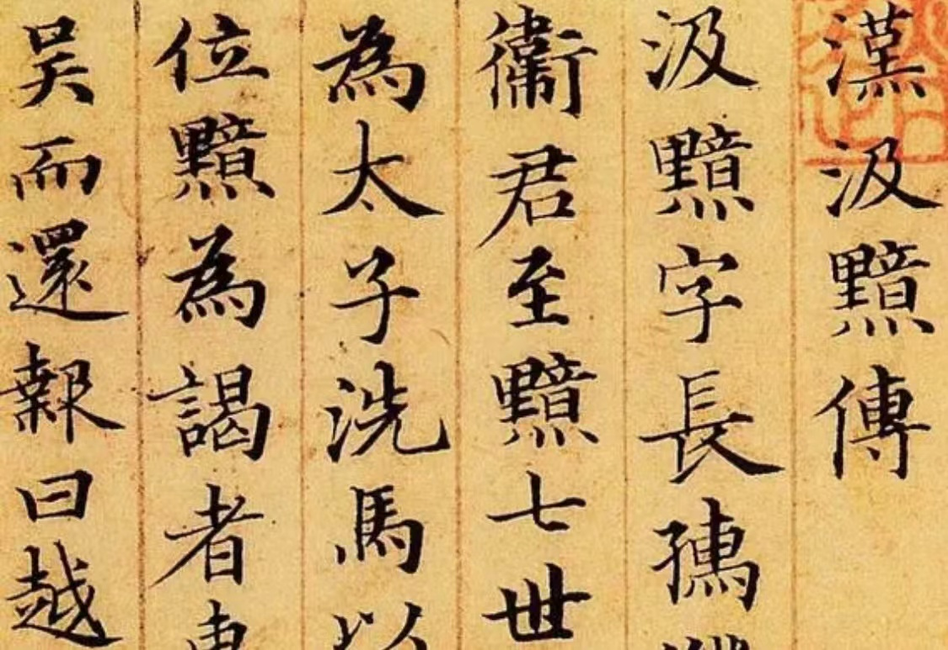
Regular Script
(Chinese: 楷 书 , Pinyin: kai shu)
Regular script appeared at the end of the Eastern Han Dynasty (25–220)and replaced the clerical script to be the major script form of daily writing.
Toward the end of the Han Dynasty, the strokes with the wavy endings and some thick curvy lines seen in the clerical script became smooth and
straight.
Regular script has been the standard and formal writing style for more than 1, 800 years with the widest and longest usage.

Slide 13
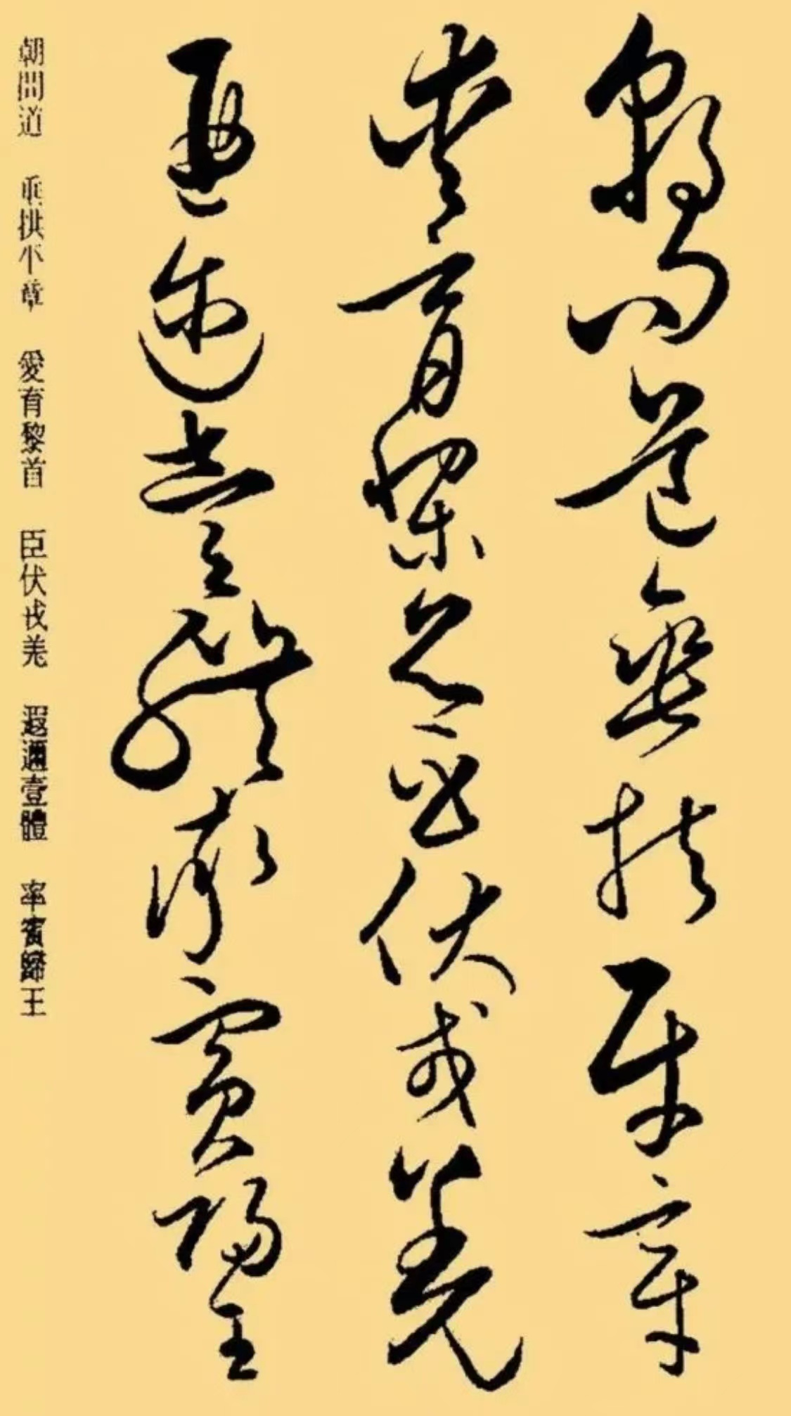
Cursive Script
(Chinese: 草 书 , Pinyin: cao shu)
The cursive script is a kind of a script form that is more scrawled than the standard script form.
When the clerical script and the regular script became popular, there are corresponding cursive scripts. Only after the Eastern Han Dynasty did the cursive script appear as a calligraphy art body. The cursive script can be divided into ‘Zhang Cao’, ‘Jin Cao’ and ‘Kuang Cao’.

Slide 14
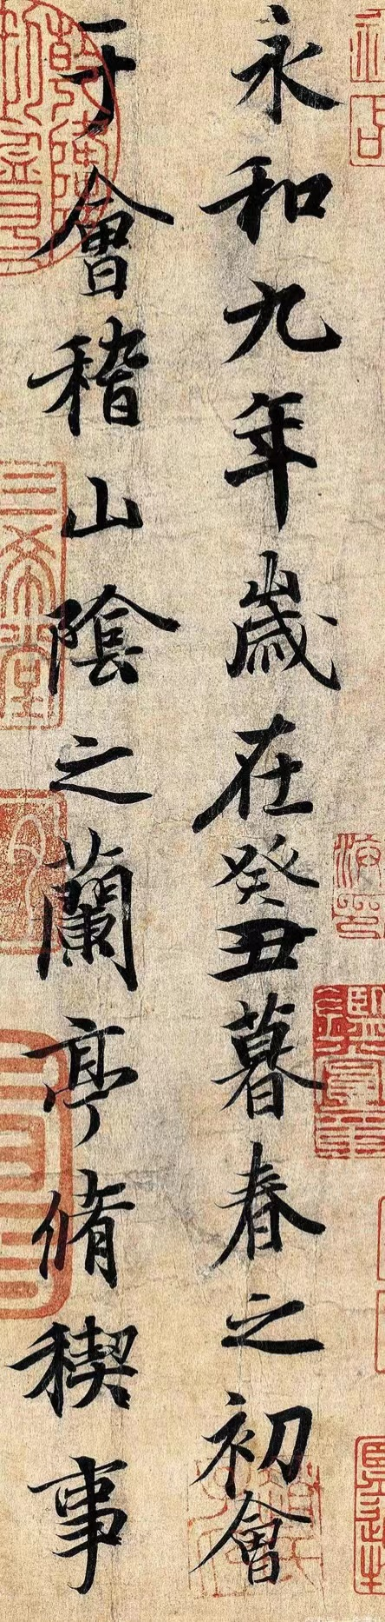
Semi-cursive Script
(Chinese: 行 书 , Pinyin: xing shu)
Semi-cursive script began after regular script and became popular in Jin Dynasty. This typeface simplify the strokes of regular script, and use cursive strokes
Semi-cursive script can be divided into ‘Xing Kai’ and ‘Xing Cao’.
Semi-cursive script is easier to write than regular script, and easier to recognize than cursive script. It is extremely practical and the most widely used script form.

Slide 15
Question
Do you have any ideas of the formation of Chinese characters?

Slide 16
3. Formation of Chinese characters
六书（the six categories of Chinese characters）
1. Pictograms （象形）
日 (rì) for "sun, " 月 (yuè) for "moon
象形、指事、会意
形声、假借、转注
2. Pictophonetic compounds （形声）
河 (hé) river, 湖 (hú) lake, 流 (liú) stream
3. Ideograph （指事）
刀 (dāo) is a pictogram for "knife, " placing an indicator in knife makes 刃 (rèn)
4. Logical aggregates （会意）
Combining 日 (rì) sun and 月(yuè) moon makes 明 (míng) bright
5. Associate transformation （转注）
考 (kǎo) to verify and 老 (lǎo) old meaning "elderly person
6. Borrowing (假借)

Slide 17
References
1. Liao Caigao 廖才高. 汉字的过去未来[M]. 湖南大学出版社, 2005.
2. Tang Lan 唐兰. 中国文字学[M]. 上海世纪出版集团, 2005.
3. Chinese Characters, Chinese Culture and Chinese Mind . Yu Xinjia and Xue Ruijia, https://web. uri. edu/iaics/files/12 Yuxin-Jia-Xuerui-Jia. pdf, 2005.

Slide 18
Thank you

