Slide 1

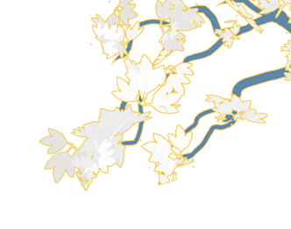
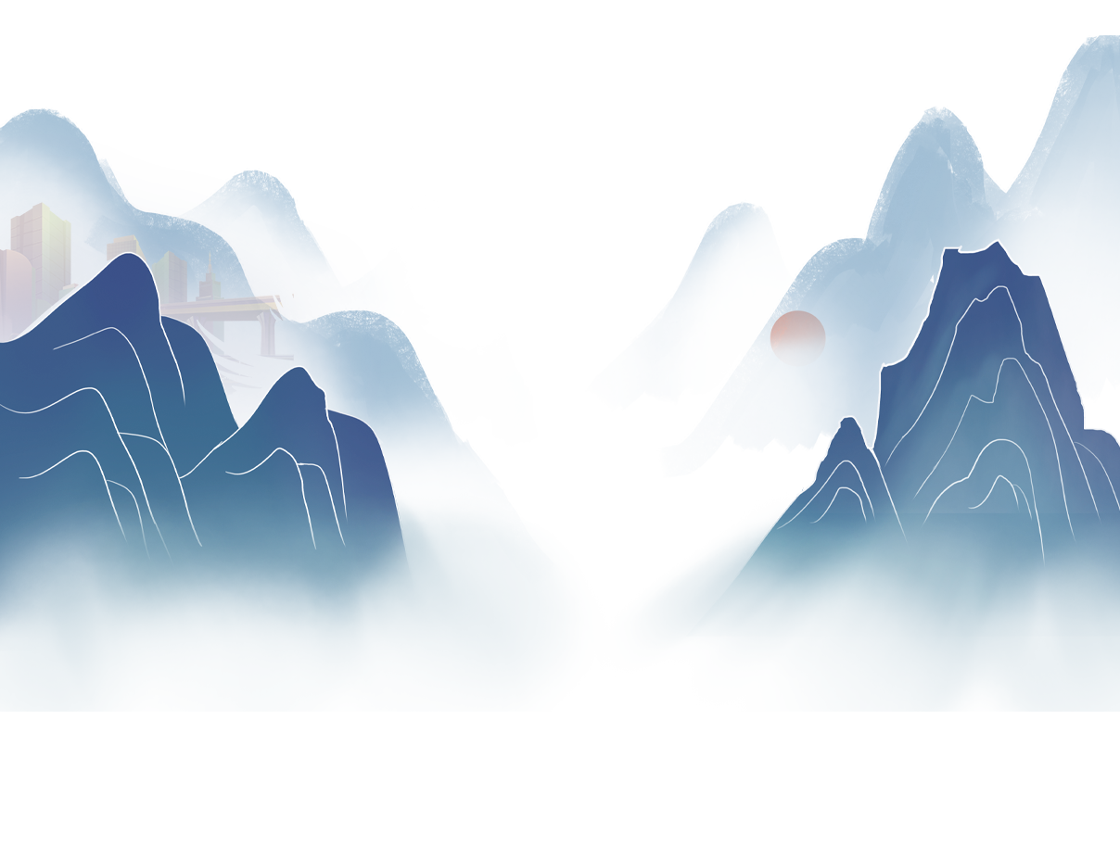
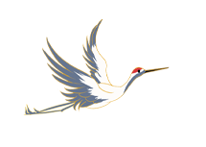


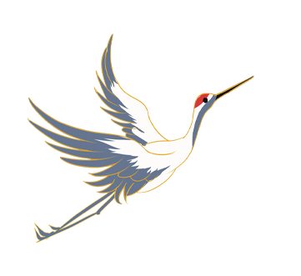
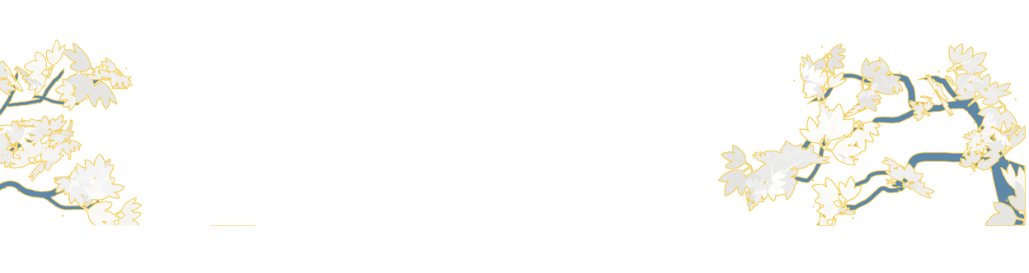
Tea-picking Opera
陈思思

Slide 2
<catalogue>
1
overview
2
origin
3
development
4
example

Slide 3
01
overview
Tea-picking opera is a kind of opera category popular in Jiangxi, Hubei, Anhui, Fujian, Guangdong and other provinces, and it is one of the regional cultures with strong local characteristics in China.

Slide 4
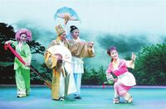
overview
It is produced in the Ming and Qing Dynasties, and has more than 400 years of history of a wide variety of distinctive features. On May 20, 2006, tea-picking opera was approved by the State Council and included in the first batch of the National Intangible Cultural Heritage Lists.
Tea-picking opera in the provinces take local names to distinguish according to the regions, such as Guangdong's "Guangdong North Tea-picking Drama", Hubei's "Yangxin Tea-picking Drama, " "Yellow Mei-Tea Opera, " "YuChun Tea-picking Opera" and so on.

Slide 5
02
origin
The production of tea-picking opera is related to the abundance of tea. According to historical records in the Ming Dynasty, in the tea area in the South of Fujian Province, east, south and north of Jiangxi Province, working women went up the mountain, picked tea while singing mountain songs to encourage labor enthusiasm.

Slide 6
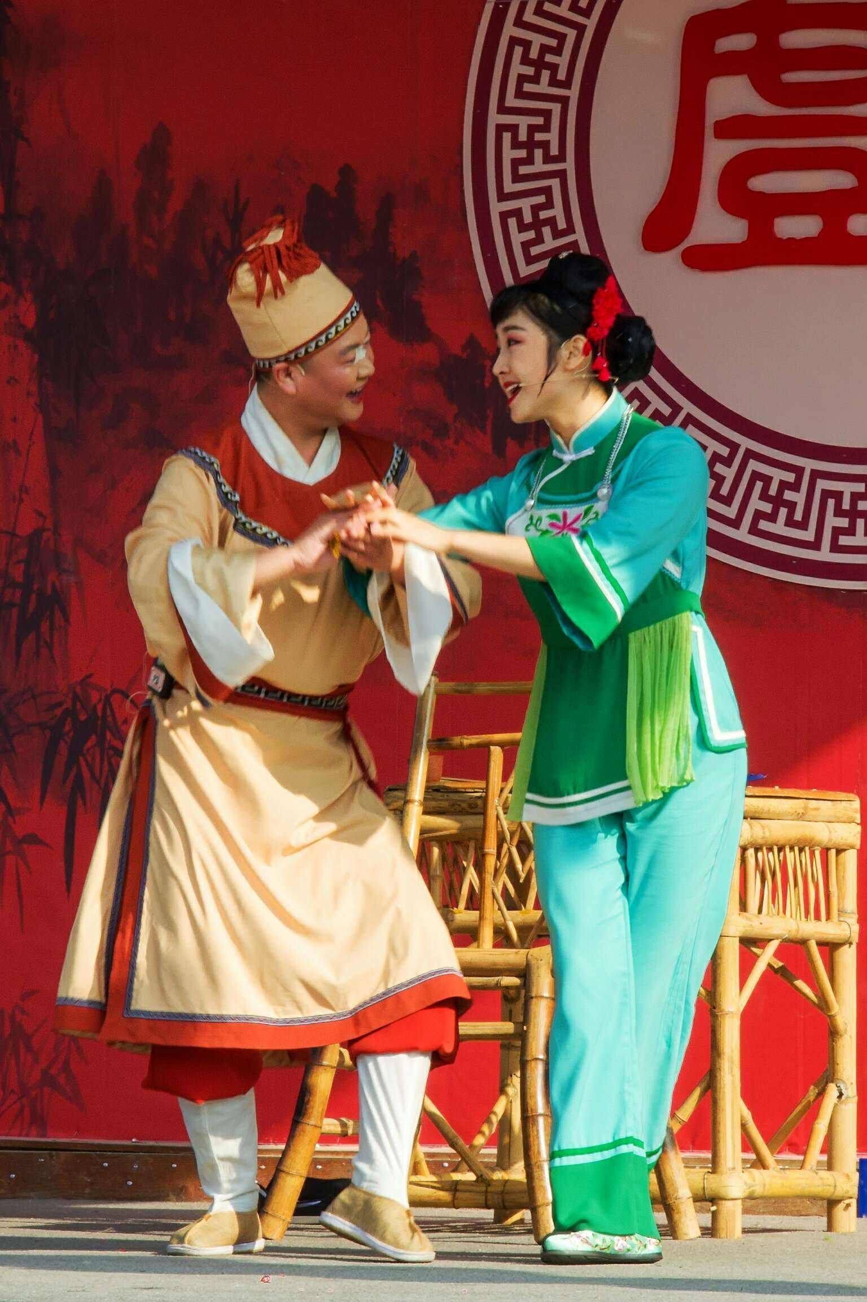
In special festival or time in rural areas such as at the time of widespread tea tress in March and harvesting, people sing in the tea forest with the joy of harvesting. Mountain songs and ditties sang by them are in vivid form and rich contents expressing the joy of labor and love between men and women. This kind of mountain songs circulating in the tea area are known as "tea-picking songs. " Tea-picking opera developed from the folk tea-picking songs and tea-picking lamp singing, and then become a kind of folk drama with characters and storyline. Because it is generally only two female roles and one clown, or a painted role, a female role, and a clown three persons’ performance, it is also known as “Three characters’ troupe. ” The drama has many sorts, such as Jiangxi tea-picking opera, that is, Gannan Tea-picking Opera, Fuzhou tea-picking opera, Nanchang tea-picking opera, Gaoan tea-picking opera, Wuning tea-picking opera, Gandong tea-picking opera, Ji'an tea-picking opera, Jingdezhen tea-picking opera and Ningdu tea-picking opera and so on.

Slide 7
There are several stages from tea-picking song to tea-picking opera. Tea-picking songs were first sung in minor tunes, with only four lyrics per line, which were lively and euphemistic.
After the development of the tea-picking song, it was composed of tea-picking ditty, which was called twelve-month tea-picking songs.
Later, the twelve-month tea-picking songs combined with folk dances became tea-picking lantern opera.

Slide 8
03
development
If there is no tea picking and other tea work, there will be no tea-picking songs and dances, and no tea-picking opera, which is widely popular in many provinces and regions in southern China. Therefore, tea picking is not only related to tea, but also a splendid culture derived from tea culture in the field of opera or absorbed by opera culture.

Slide 9
the performance of tea-picking opera was often interfered and banned by the rulers. The first reason was that there were few literati involved in tea picking, and tsome Qi opera artists and half-troupe performers could independently perform high-tone and disordered-tone repertoire. The original plays of Qi opera and half-troupe repertoire coexisted on the half-troupe stage, so they were called Half Mix Opera. Around 10 years in the Republic of China, Half Mix Opera disintegrated, caused the reproduction of “seven tight eight loose nine free ansome Qi opera artists and half-troupe performers could independently perform high-tone and disordered-tone repertoire. The original plays of Qi opera and half-troupe repertoire coexisted on the half-troupe stage, so they were called Half Mix Opera. Around 10 years in the Republic of China, Half Mix Opera disintegrated, caused the reproduction of “seven tight eight loose nine free and unrestrained” half-troupe. They performed in the mountains until the eve of liberation. d unrestrained” half-troupe. They performed in the mountains until the eve of liberation. he cultural level of the artists was not high, so the rulers thought these plays were very vulgar and difficult to be elegant. Secondly, in order to cater to the audience, the actors added some unhealthy contents during the performance. Some plays appear to be very vulgar and indecent, and even disturb social order.
development
In the middle Guangxu period of the Qing Dynasty
Ming Dynasty
Before the founding of the People's Republic of China
Tea farmers in the Jiulong Mountain Tea District of Anyuan County, Jiangxi Province, which is rich in famous tea, often performed impromptu programs related to tea picking in the form of tea-picking lantern opera in order to receive tea merchants from Guangdong. This kind of performance is already the prototype of tea-picking opera.
the performance of tea-picking opera was often interfered and banned by the rulers. The first reason was that there were few literati involved in tea picking, and the cultural level of the artists was not high, so the rulers thought these plays were very vulgar and difficult to be elegant. Secondly, in order to cater to the audience, the actors added some unhealthy contents during the performance. Some plays appear to be very vulgar and indecent, and even disturb social order.
some Qi opera artists and half-troupe performers could independently perform high-tone and disordered-tone repertoire. The original plays of Qi opera and half-troupe repertoire coexisted on the half-troupe stage, so they were called Half Mix Opera. Around 10 years in the Republic of China, Half Mix Opera disintegrated, caused the reproduction of “seven tight eight loose nine free and unrestrained” half-troupe. They performed in the mountains until the eve of liberation.

Slide 10
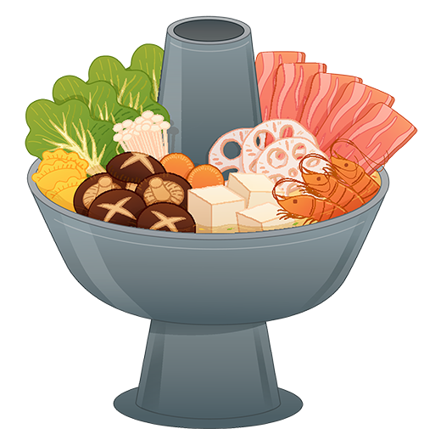
After the foundation of the People's Republic of China
professional opera troupes were established. They not only excavated, arranged and made excellent traditional repertoire, but also created a number of new repertoires, such as One Heart, Send Straw Shoes, New Neighbors and the adaptation of Legend of Luang Knife. Ningdu Hakka Tea Picking Opera not only has a complete range of skills, beautiful tunes, but also has a variety of performance procedures. It has become a regular drama class capable of singing and dancing, modern and ancient, large and small, and martial arts, and has become a unique style of drama in China.

Slide 11
04
example-Gannan Tea-picking Opera
Gannan Tea- Picking Opera is an important school of Tea picking Oper, mainly popular in southern Jiangxi, that is, Ganzhou. In the tea-picking opera groups, the characteristics of tea picking in southern Jiangxi are reflected in the following aspects.

Slide 12
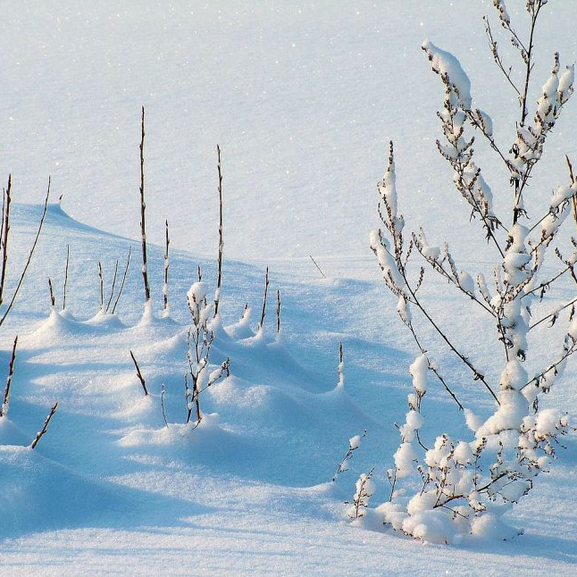
First, it belongs to the Hakka ethnic group. The dialect of the South Jiangxi is Hakka, so the traditional repertoire of Gannan Tea-peaking Opera is basically performed in Hakka.
Second, tea picking in southern Jiangxi originated early and had an impact on the early development of various tea picking operas.
Its origin can be traced back to the late Ming and early Qing dynasties. In the first year of Qianlong's reign, Yu Zhaoyue, governor of Jiangxi Province, mentioned in a note that “the custom of pretending to be a sex play is forbidden”. Drama experts believe that the “sex play” here is the tea-picking opera in southern Jiangxi Province, so it is speculated that its birth date should be earlier than this.
Thirdly, in terms of artistic form, the traditional repertory of tea-picking opera in southern Jiangxi still retains the form of “three small operas”. And many other types of tea-picking opera have a trend of development to the big drama. For example, tea-picking opera in northern Jiangxi (Jiujiang tea-picking opera, Nanchang tea-picking opera, etc. ), influenced by Huangmei Opera in Hubei, has developed into a “half-troupe”, which can be used to perform ancient costume drama. In addition, a symbolic difference between different types of operas is music. The music of the tea-picking opera in southern Jiangxi belongs to the combination of Qupai（曲牌）. There are as many as two or three hundred Qupai, with beautiful melodies, which are well known to the local people.

Slide 13
The main performance forms of Gannan Tea-peaking Opera include dwarf step, single sleeve and fan, which deeply depict the character image and perform the story plot incisively and vividly. The main Musical Instruments used in the accompaniment of Gannan Tea-peaking Opera are hooks, Suona horn, bamboo flute, gong, drum, cymbals and other folk instruments, which is full of local atmosphere.
As a native Gannan culture, tea picking is a portrayal of Hakka people's life in the mountains. It expresses the joys and sorrows of Gannan people's life through comedy and farce. It is also a folk activity created in the tea-picking work and the main leisure and entertainment activity of the people after dinner. Tea-picking opera is a local opera developed from folk songs and dances and lanterns, and its repertoire mostly reflects the life of working people. Its music and singing styles are also folk songs, so it is deeply loved by the people.

Slide 14
The general characteristics of Gannan tea-picking opera are: cheerful performance, humorous, singing and dancing, strong comedy, rich local flavor, quite popular with the masses. The representative works include Pairs of Flowers, Picking Tea in Jiulong Mountain, Digging Bamboo Shoots and so on.
Is it necessary to inherit opera culture and why

Slide 15
Thanks for listening

