Slide 1

Miao silver Ornaments culture
杨涵旭 202370081586

Slide 2


  Miao silver ornaments overview
  Miao silver ornaments production technology
  The cultural connotation of Miao silver ornaments
  Miao nationality silver ornaments aesthetics and appreciation
  Miao silver ornaments and tourism culture
目录

Slide 3

01
  Miao silver ornaments overview

Slide 4
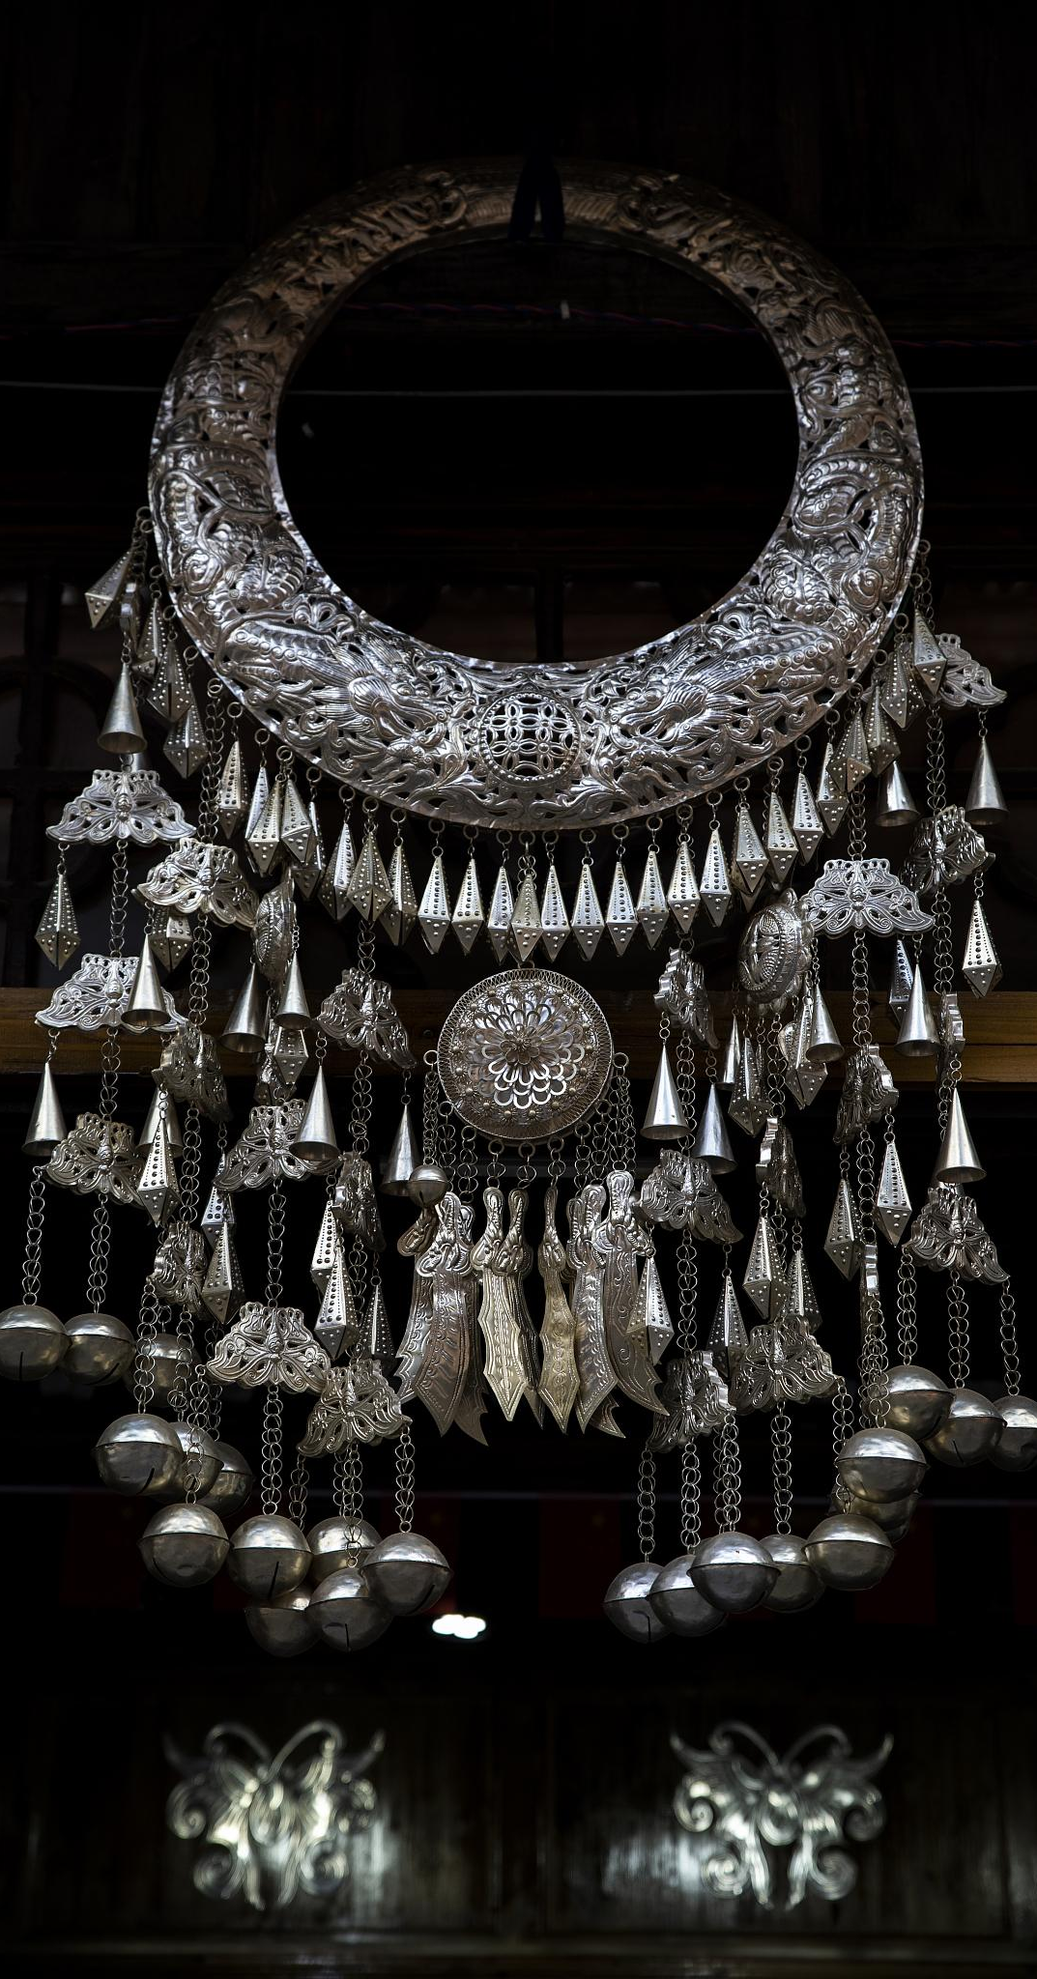
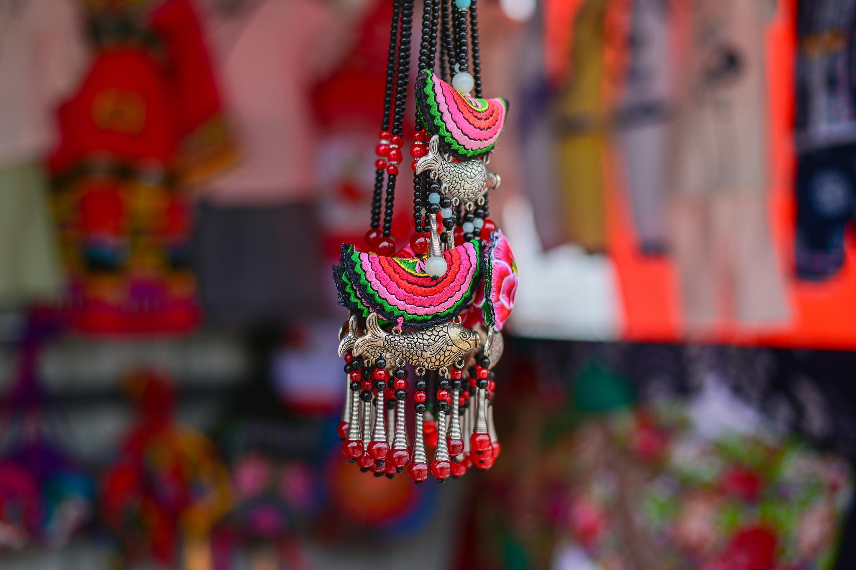
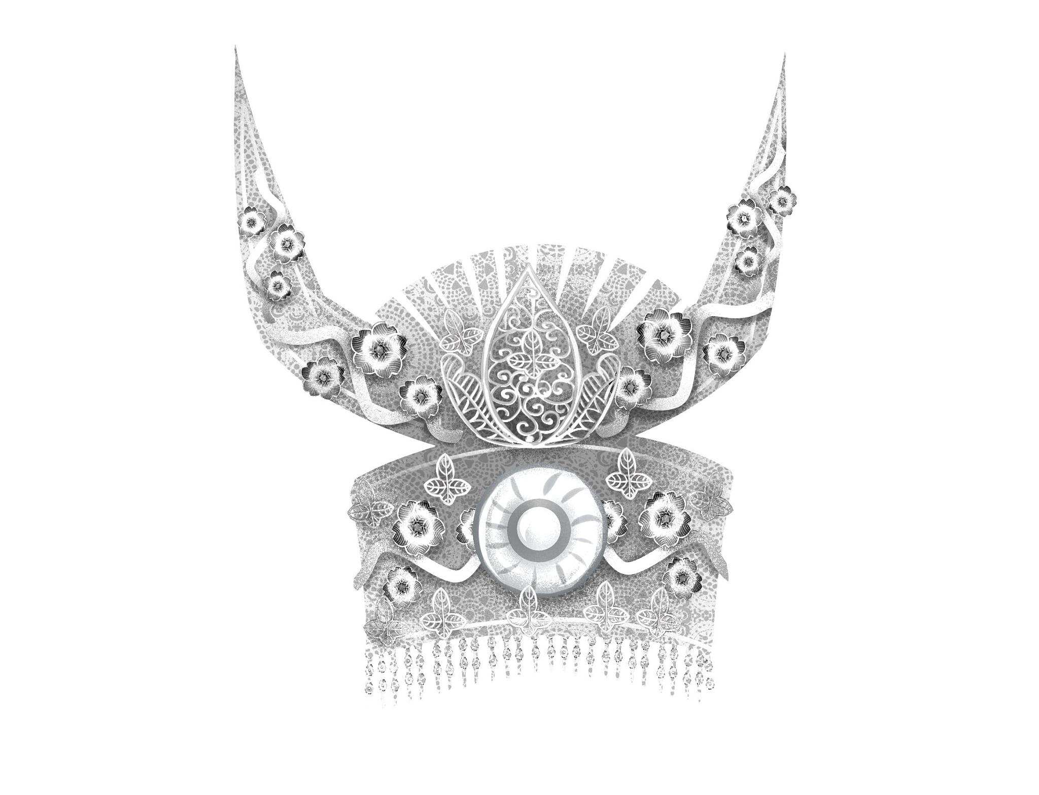
Miao silver ornaments definition and characteristics
definition
Miao silver ornaments is an important part of Miao culture, and it is a unique art form. All kinds of exquisite
ornaments are made from silver materials.
characteristics
Miao silver ornaments is famous for its exquisite craft, rich patterns and profound cultural connotation. Its diverse shapes, exquisite patterns, profound meaning, fully demonstrate the Miao's aesthetic pursuit and creativity.

Slide 5
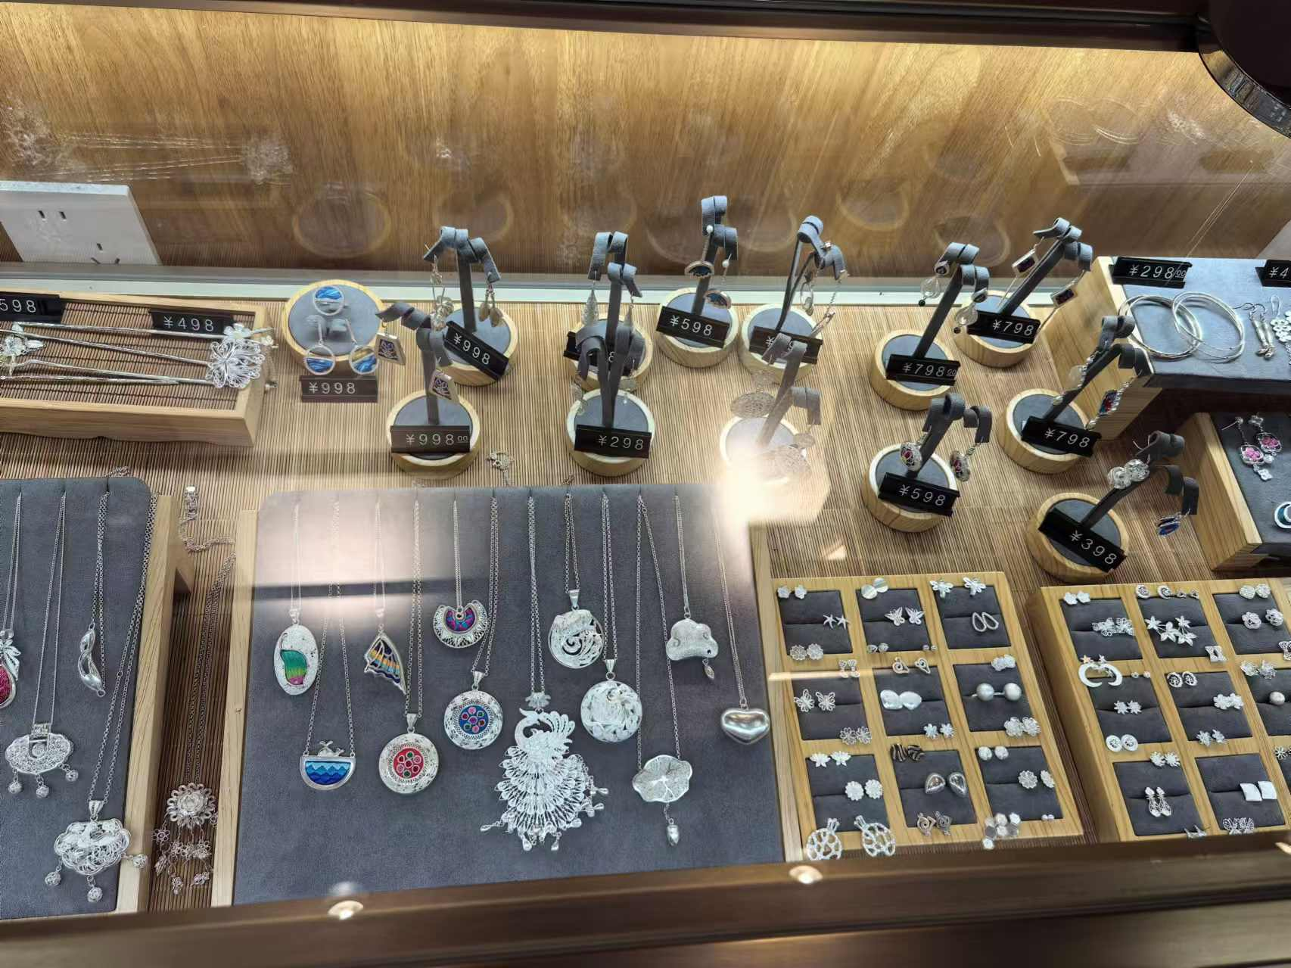
The species and distribution of Miao silver ornaments
Rich in variety
Widely distributed and concentrated

Slide 6
02
Miao silver ornaments production technology

Slide 7
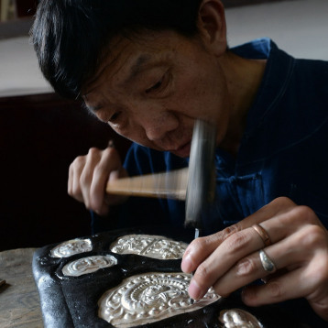
Traditional production process
Molten silver and casting mould
Forge and stretch
Carving and hollowing
Welding and assembly

Slide 8
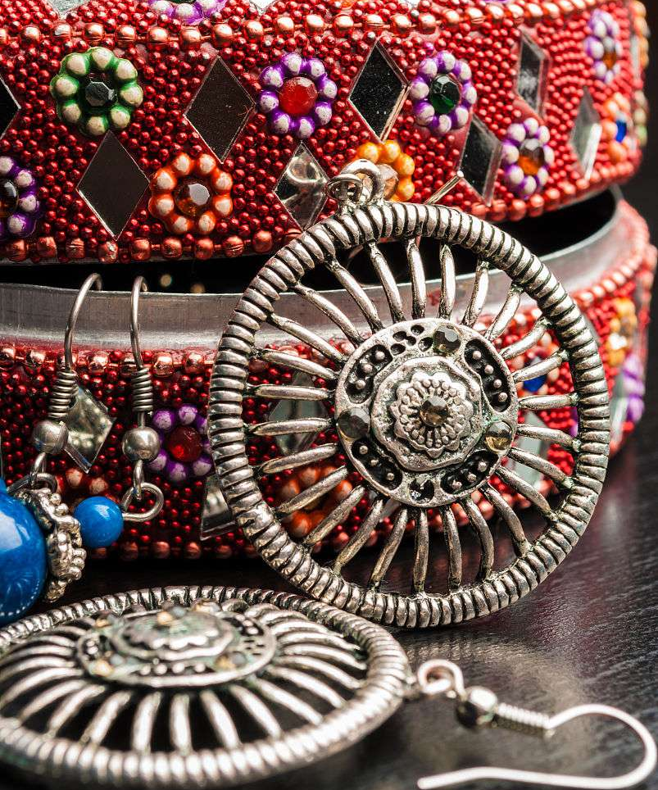
Modern production technology and innovation
Mechanized production technology
New material application
The introduction of modern machinery and equipment, improve production efficiency and accuracy, reduce labor costs。
Try to combine other metal materials with silver to create more novel and unique silver ornaments works.
Design concept innovation
Customized service
Drawing on modern design concepts and combining traditional Miao cultural elements, the silver ornaments products with more fashion sense and cultural connotation are created.
Customized according to customer needs to meet the aesthetic needs of different consumers.

Slide 9
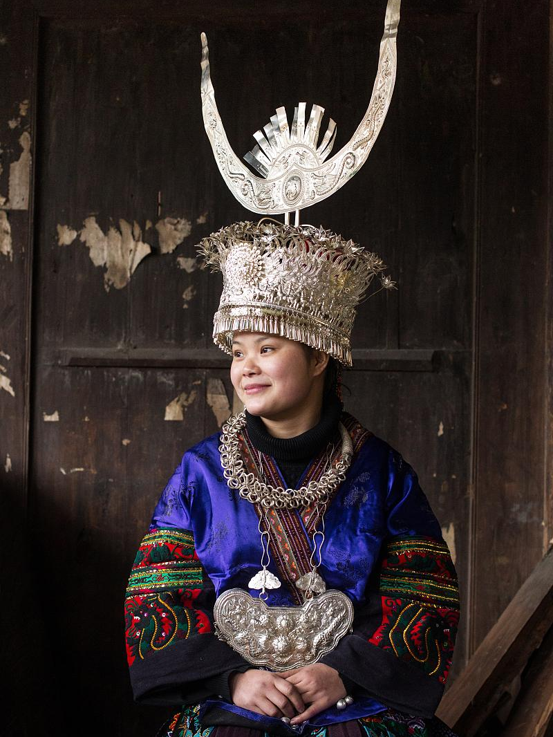
Material and selection of Miao silver ornaments
High quality silver material
Natural gemstone setting
selective
Environmental protection concept

Slide 10
03
The cultural connotation of Miao silver ornaments

Slide 11
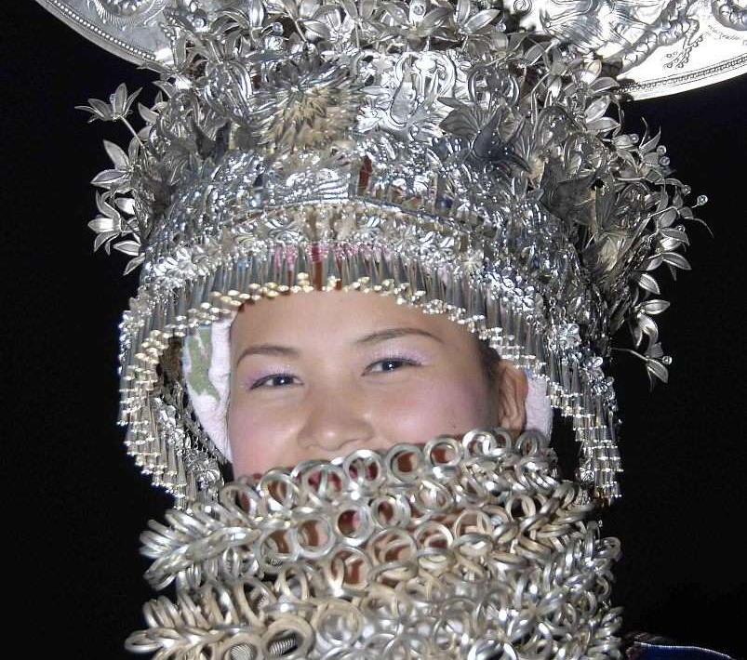
Miao silver ornaments and religious beliefs
Silver ornaments as a sacred symbol
01
In Miao culture, silver ornaments is often regarded as a symbol of holiness and purity, and is closely linked to religious beliefs.
Silver ornaments in sacrificial ceremonies
02
When Miao people hold sacrificial ceremonies, silver ornaments is an indispensable prop to pray for God's blessing and protection.
Religious motifs on silver ornaments
03
Miao silver ornaments is often engraved with religious patterns, such as gods, charms, etc., meaning the mysterious power and faith piety.

Slide 12
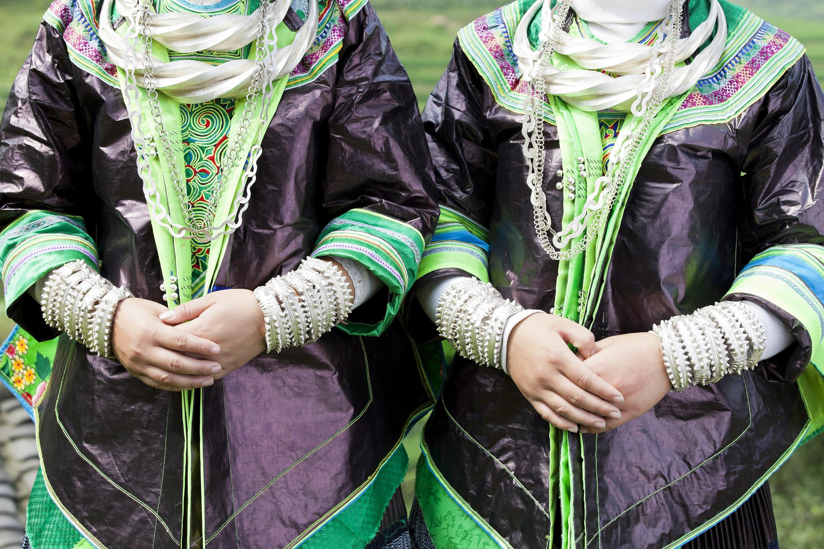
Miao silver ornaments and marriage family
Silver ornaments is necessary for marriage
In traditional Miao marriage customs, silver ornaments is a necessary dowry for brides, representing the wealth and dignity of the family.
Silver ornaments inherits family culture
Miao silver ornaments is often passed down from ancestors, and each piece of silver ornaments carries the history and cultural memory of the family.
Silver ornaments in a wedding ceremony
In Miao weddings, the wearing and exchange of silver ornaments has specific ceremonial significance, symbolizing the deep affection between the couple and their commitment to living together.

Slide 13
Miao silver ornaments and social status
Silver ornaments shows social status
Silver ornaments as a status symbol
The role of silver ornaments in social interaction
In Miao society, the quality, quantity and craftsmanship of silver ornaments often represent an individual's social status and wealth level.
The silver ornaments worn by Miao people of different social classes and roles also have their own characteristics, which has become an important symbol of identity.
Miao silver ornaments plays an important role in social communication and is an important medium to display personal charm and family strength.

Slide 14
04
Miao nationality silver ornaments aesthetics and appreciation

Slide 15
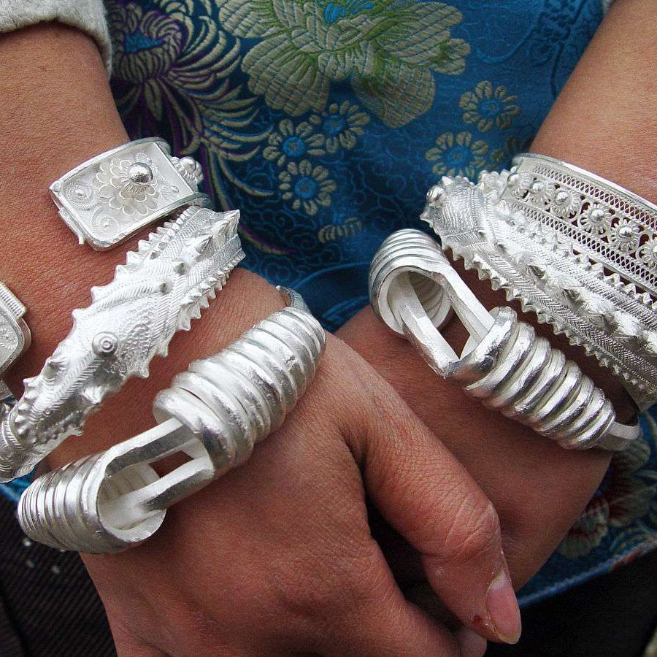
The aesthetic characteristics of Miao silver ornaments
Exquisite and delicate craftsmanship
Miao silver ornaments is famous for its exquisite craftsmanship and delicate ornamentation, showing a unique national art style.
Colorful pattern
Miao silver ornaments on a wide range of themes, including natural scenery, animals, character stories, meaning auspicious, happiness and longevity.
Unique charm of silver material
Miao silver ornaments is made of high quality silver materials. The silver is warm and glossy. It is comfortable to wear and looks noble and elegant.

Slide 16
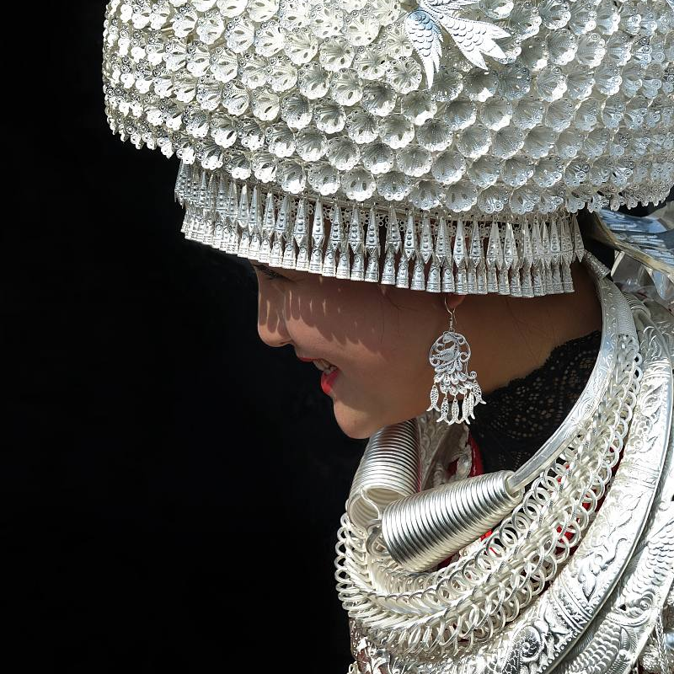
Miao silver ornaments appreciation methods and skills
Observe the craftsmanship and ornamentation
When appreciating Miao silver ornaments, we must first observe its production process and fine degree of decoration, so as to judge its artistic value and age.
Identify material and finish
The material and finish of Miao silver ornaments is also an important aspect of appreciation, high-quality silver materials and high finish can increase the value of silver ornaments.
Understand the cultural background and meaning
A thorough understanding of the cultural background and pattern implication of Miao silver ornaments is helpful to appreciate and evaluate its artistic value more accurately.

Slide 17
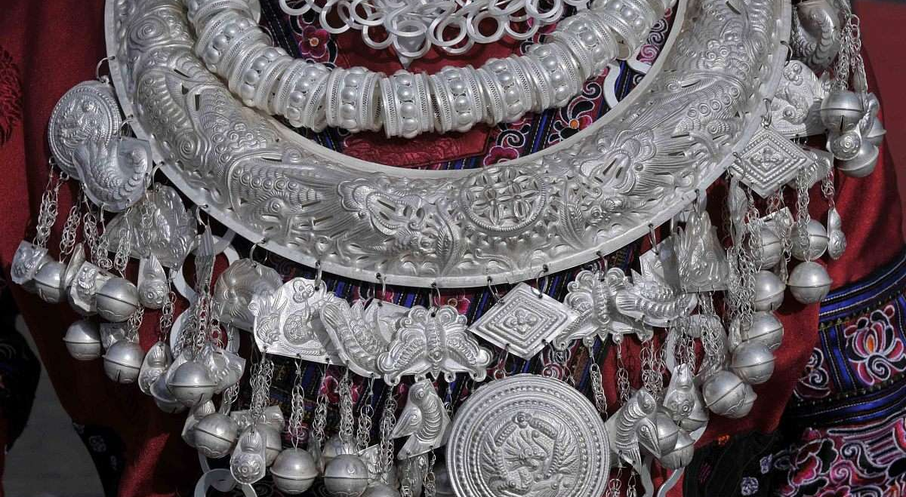
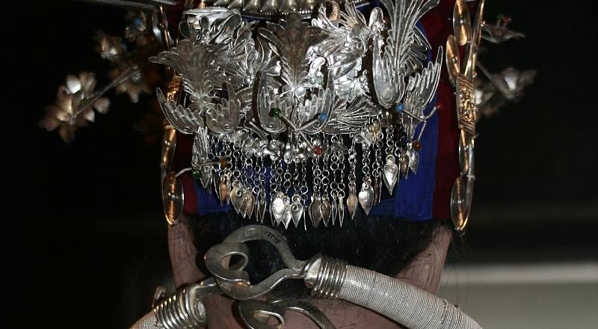
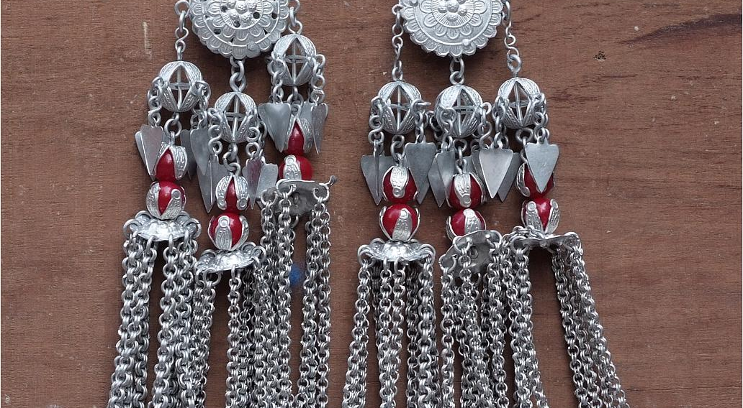
Miao silver ornaments collection and investment value
Rarity and uniqueness
Investment appreciation potential
Historical and cultural values
Miao silver ornaments, as a national traditional handicraft, is rare and unique, and is one of the hot collections pursued by collectors.
With the increasing attention of the market to the ethnic traditional handicrafts, the investment appreciation potential of Miao silver ornaments has become increasingly apparent, and has become one of the hot spots of investors.
Miao silver ornaments, bearing rich historical and cultural information, is an important material for the study of Miao culture, history and art, and has high historical and cultural value.

Slide 18
05
Miao silver ornaments development and cultural integration

Slide 19
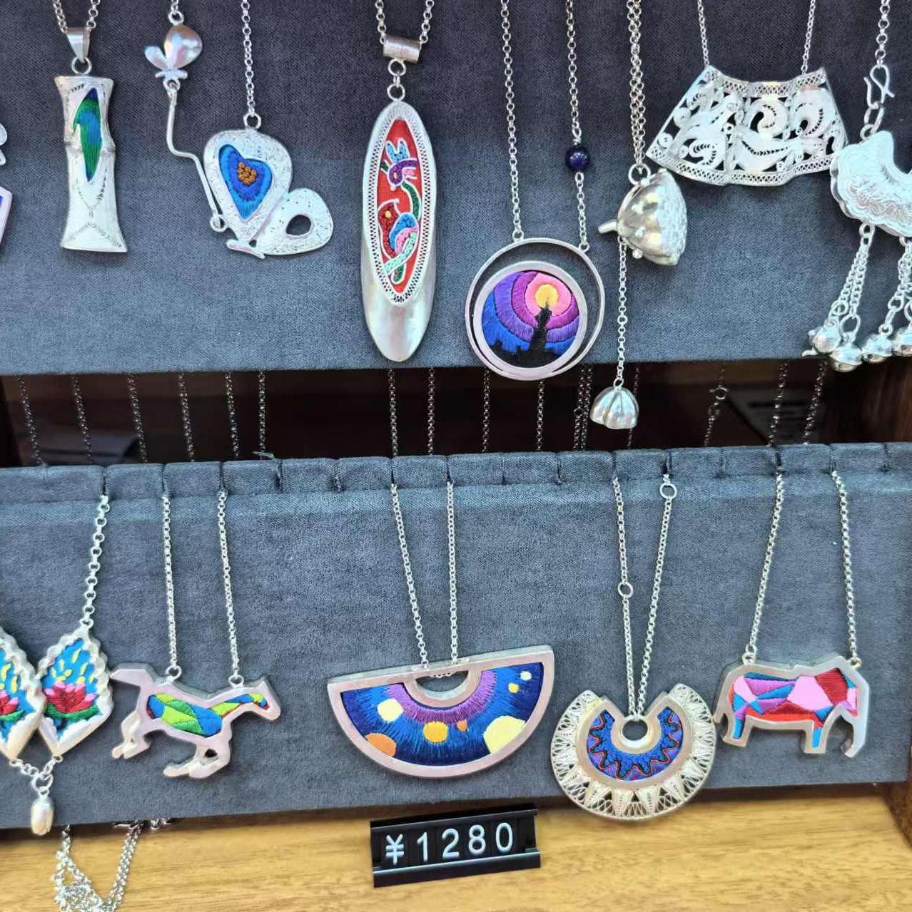
Miao silver ornaments in modern development value
Tourist attraction
Miao silver ornaments, with its exquisite craft, unique shape and rich cultural connotation, attracts a large number of tourists to watch and buy, and becomes a hot commodity in the tourism market.
Cultural symbol
Miao silver ornaments, as an important part of Miao culture, is the crystallization of the wisdom and creativity of the Miao people, representing the unique culture and historical inheritance of the Miao people.
Media of cultural exchange
Miao silver ornaments, as a representative of Miao culture, promotes the exchange and integration of Miao culture and other ethnic cultures through tourism activities, and enhances the understanding and friendship between different ethnic groups.

Slide 20

THANKS
感谢观看

