Slide 1
Representatives in china
The famous translators in Chinese History
Liu Zhiwei, 2020 Literature

Slide 2
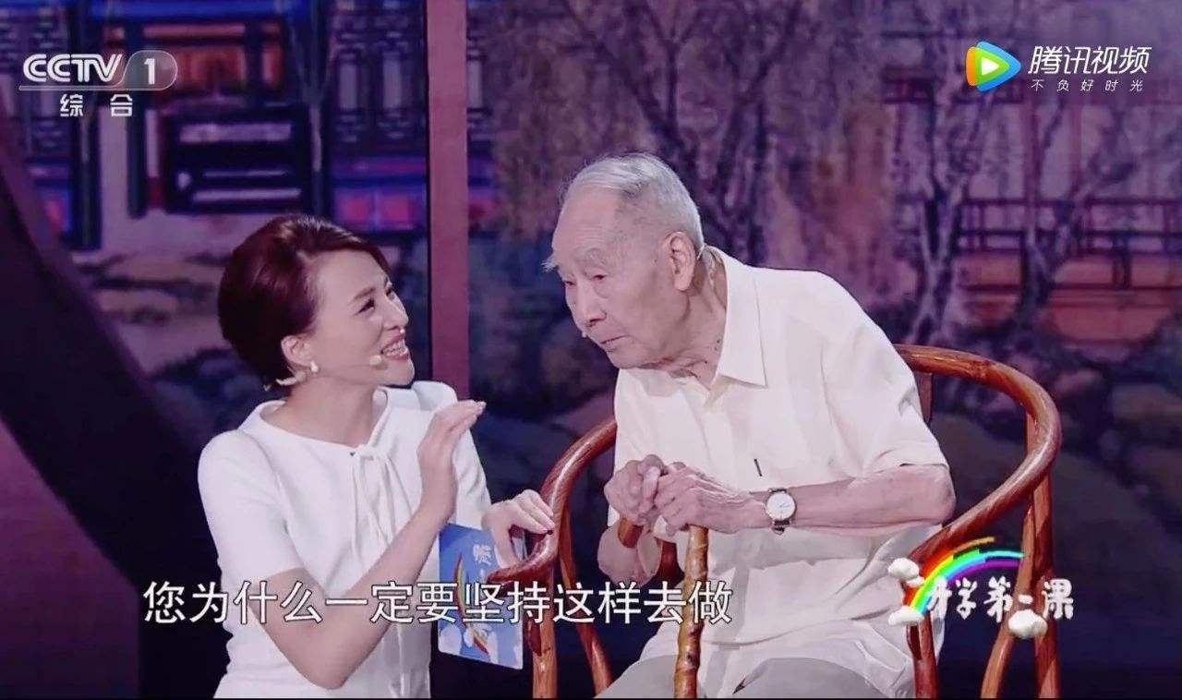
Xu Yuanchong
“贝多芬说得好，为了更美，没有什么清规戒律是不能打破的。”

Slide 3
Xu Yuanchong’s Translation Theories
三似论
Similar in form 形似
Similar in meaning 意似
Similar in spirit 神似
三化论
Simplifying 浅化
Being equivalent 等化
Deepening 深化

Slide 4
Xu Yuanchong’s Translation Theories
Best words in Best Order 三美合一
Beauty in sense 意美
Beauty in sound音美
Beauty in form形美
Appreciation:
In the steep sky cold waves are swiftly sweeping by，
On the vast earth warm winds gradually grow high.
高天滚滚寒流急，大地微微暖气吹

Slide 5
Back to Chinese History in Translation

Slide 6
Three Translation Climaxes
There have been three translation climaxes in the history of Chinese Translation: Buddhist Scripture Translation from Eastern Han Dynasty to Song Dynasty, Western learning translation from late Ming Dynasty to early Qing Dynasty, and western translation from Sino-British Opium War to May Fourth Movement

Slide 7
The Representatives in Every Climax
From Eastern Han Dynasty to Song Dynasty Xuan Zang
From late Ming Dynasty to early Qing Xu Guangqi
From Sino-British Opium War to May Fourth Movement Yan Fu

Slide 8
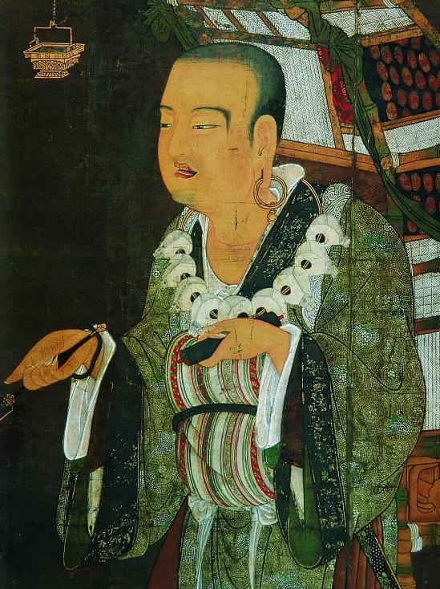
1
From Eastern Han Dynasty to Song Dynasty
Xuan zang(602-664) Sanzang Rabbi
From the Han Dynasty to the Tang and Song Dynasties, Buddhism was introduced into China and became associated with the traditional Confucianism and Taoism.With the translation of Buddhist sutras into Indian philosophy, literature and art,medicine and astronomy, arithmetic and even langusge all had a certain influence in China, but the translation activities in this period were mainly about the transmission of religion.

Slide 9
His Translation Theory
Core: It is necessary to seek truth and be straightforward.
（既须求真又须喻俗。）
1.The principle of ‘Five do not flip’ 五不翻译原则
2.Six methods of translation

Slide 10

The Influence of His Translation Ideas
1.Translation of foreign names
2.Translation of Chinese traditional culture words
3.Term translation
4.Translation of technical literature

Slide 11
2
From late Ming Dynasty to early Qing
At that time, due to the needs of foreign transportation, Siyi museum(四夷馆) was established to train translators. In the late Ming Dynasty, Western learning spread eastward, and translation became more active. But at this time, the direction of translation has completely changed. It was no longer the Buddhist scriptures of India, but the European classics of astronomy, geometry, medicine and so on. The history of Chinese translation has reached a new stage.

Slide 12
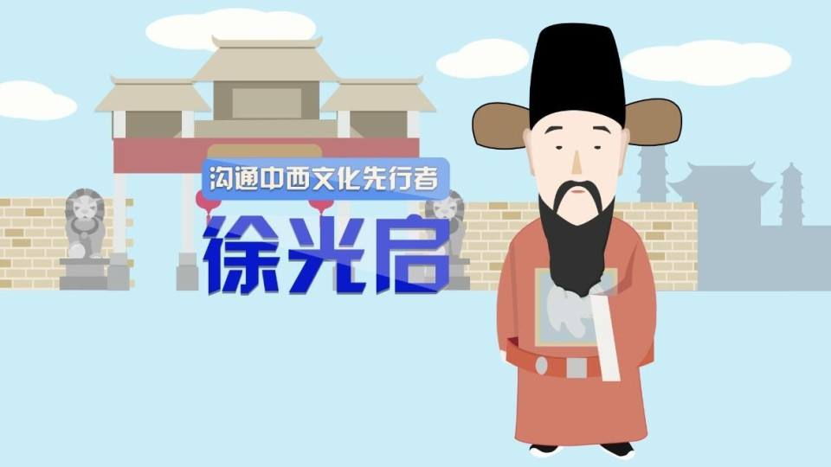

From late Ming Dynasty to early Qing
Why?

Slide 13
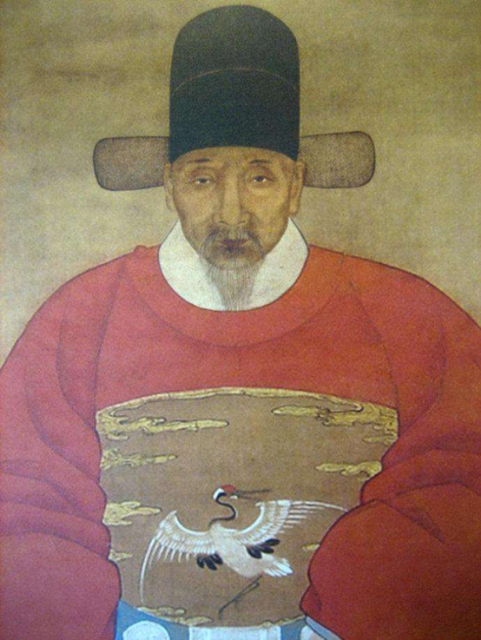
Xu Guangqi
He was the first one who introduced European natural science to China and translated Geometry into Chinese (six volumes of Geometry Original).

Slide 14
Xu Guangqi’s Translation Theory
他主张"翻译-会通-超胜"的思想。他在《历书总目表》中说到,臣等愚心以为: “欲求超胜,必须会通;会通之前,先须翻译。”意思是,只有通过翻译才能“会通”(学习与掌握)只有“会通”才能“超胜”(超越与争胜) 。
Only through translation can we learn and master, and only through knowing others well can we surpass and win.
He is the first one who has highlighted the social function of translation.

Slide 15
From Sino-British Opium War to May Fourth Movement
3
After the Opium War, some scholars in China felt the need to learn from the west, and thus translation activities gradually rose, forming another new stage in the history of Chinese translation. After the May 4th movement, Chinese history has turned into the modern era, the rise of Chinese new literature relied on translation in some ways.

Slide 16
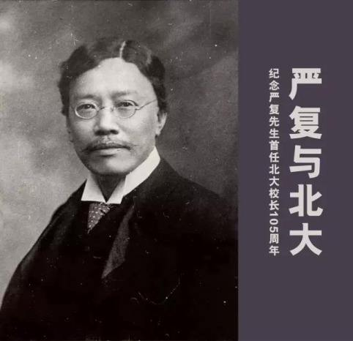
Yan Fu
He translated large numbers of Western academic masterpieces such as introducing the modern Western society, politics, culture and ideology, especially Darwinism, establishing his status of "top translator of modern China".
He translated the British political economist Adam Smith's An Inquiry into the Nature and Causes of the Wealth of Nations(今译《国民财富的性质及原因研究》), which was the most important of his translations and largest in scale.

Slide 17
Yan Fu’s Translation Theory
Faithfulness :To be loyal to the original text
Expressiveness: The target text should be read smoothly.
Elegance: The target text should be similar to the source text in style
信达雅

Slide 18
There are even more that we can learn from them.
I wish the world could be so small that I can meet you when I turn back.
---Xu Yuanchong

Slide 19
Thank You!

