Slide 1
Four major Chinese cuisines
Presenter——Peng Jiayi
——Sichuan cuisine, Cantonese cuisine, Shandong cuisine and Jiangsu-Zhejiang cuisine

Slide 2
Contents
Sichuan cuisine
Shandong cuisine
one
two
three
four
Cantonese cuisine
Jiangsu-Zhejiang cuisine

Slide 3
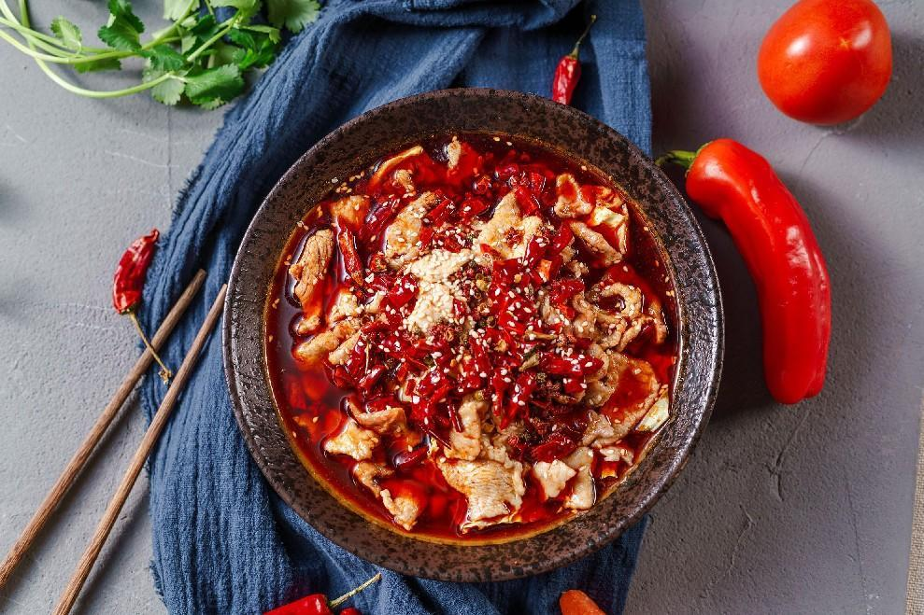
introduction to Sichuan cuisine
Spicy and delicious — Sichuan cuisine.
Sichuan cuisine is one of the eight major cuisines in China. It is renowned for its extensive selection of ingredients, diverse seasonings, various dishes, and adept use of spicy and numbing flavors.
Historical origin: Sichuan cuisine originates in the ancient states of Ba and Shu,and has evolved and developed for thousands of years.
poached spicy slices of pork

Slide 4
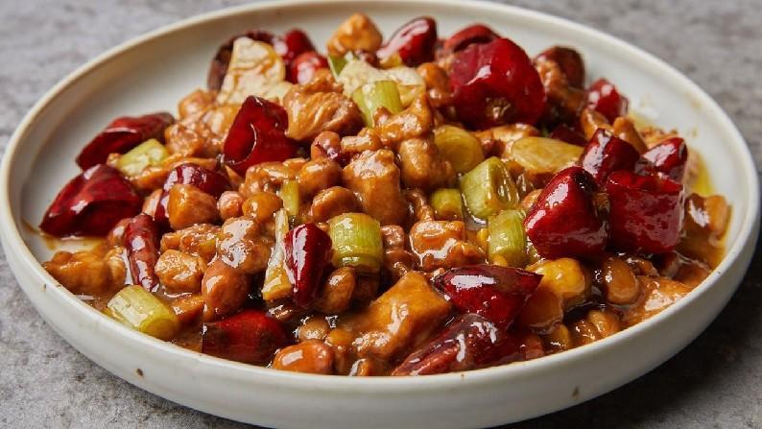
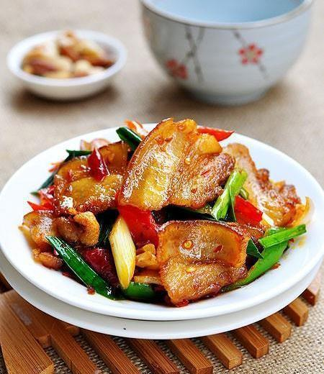
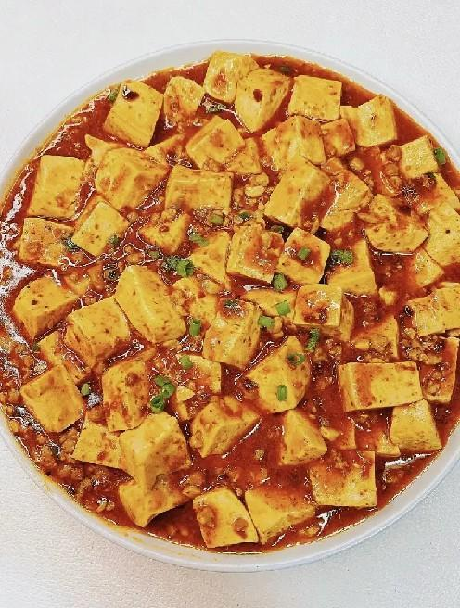
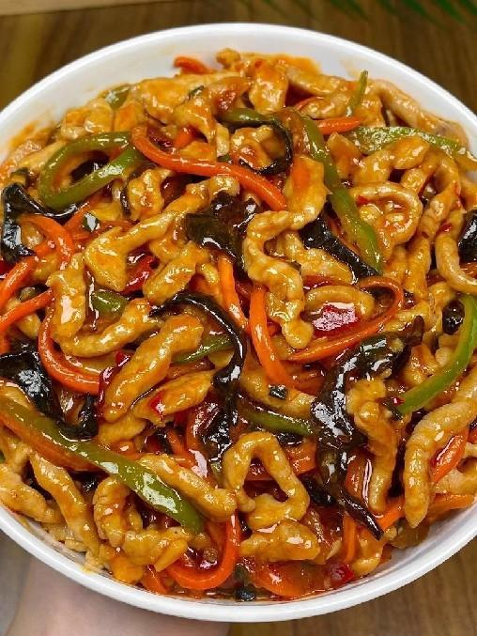
introduction to Sichuan cuisine
Spicy and delicious — Sichuan cuisine.
Representative dishes: Kung Pao Chicken, Mapo Tofu, Twice-cooked Pork, Yu-Shiang Shredded Pork, etc.

Slide 5
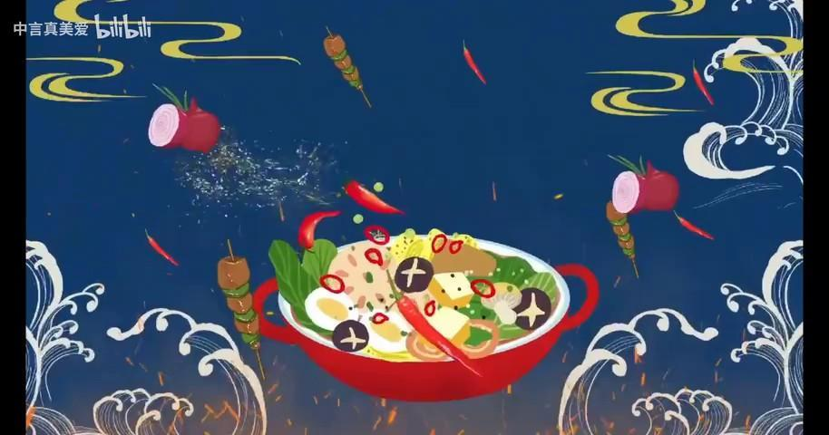
the Culture of Sichuan cuisine

Slide 6
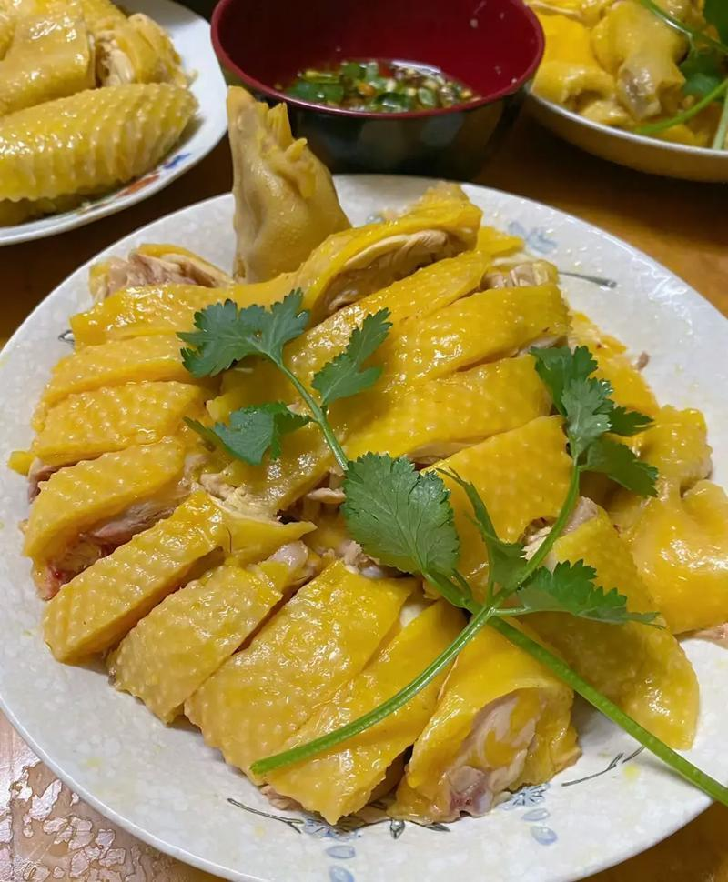
introduction to Cantonese cuisine--Fresh and original flavor.
Cantonese cuisine, also known as Guangdong cuisine, originated in Lingnan.
It has a long history and has integrated the food culture of Chinese Central Plains and overseas. Taste characteristics: clear, fresh, tender, smooth, refreshing, fragrant, and crisp.
Representative dishes: Plain Boiled Chicken, Roast Goose, Roast Suckling Pig, Honey Barbecued Pork.

Slide 7
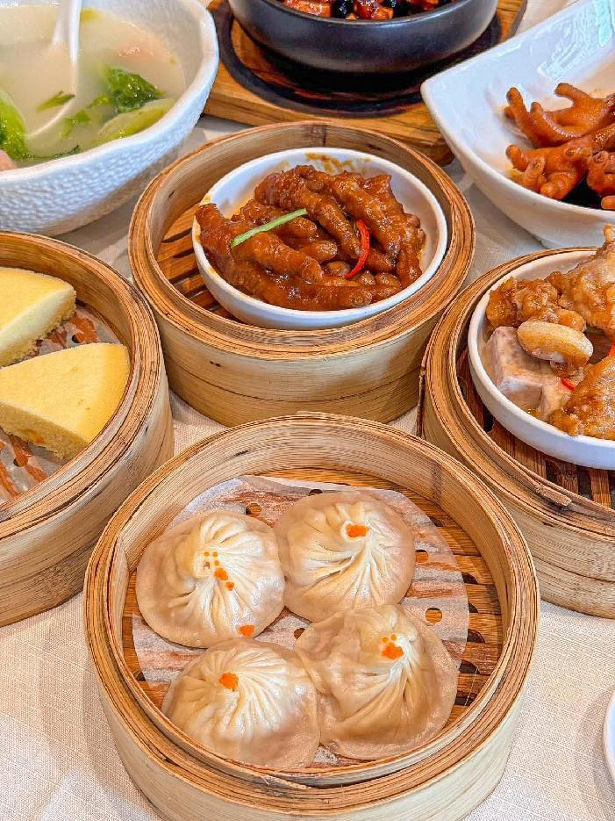
Characteristics of Cantonese cuisine
meticulous selection of ingredients and attention is paid to the original flavor of food materials.
It emphasizes being clear without being bland, fresh without being vulgar, tender without being raw, and oily without being greasy.

Slide 8
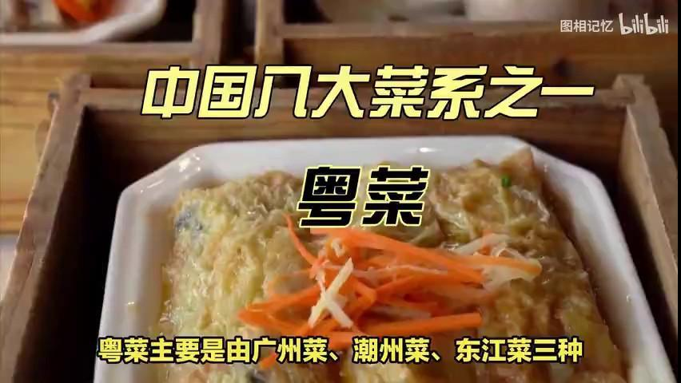
a video of Cantonese cuisine

