Slide 1
The Four Talented Women of Ancient China

Slide 2

Please answer a question

Slide 3
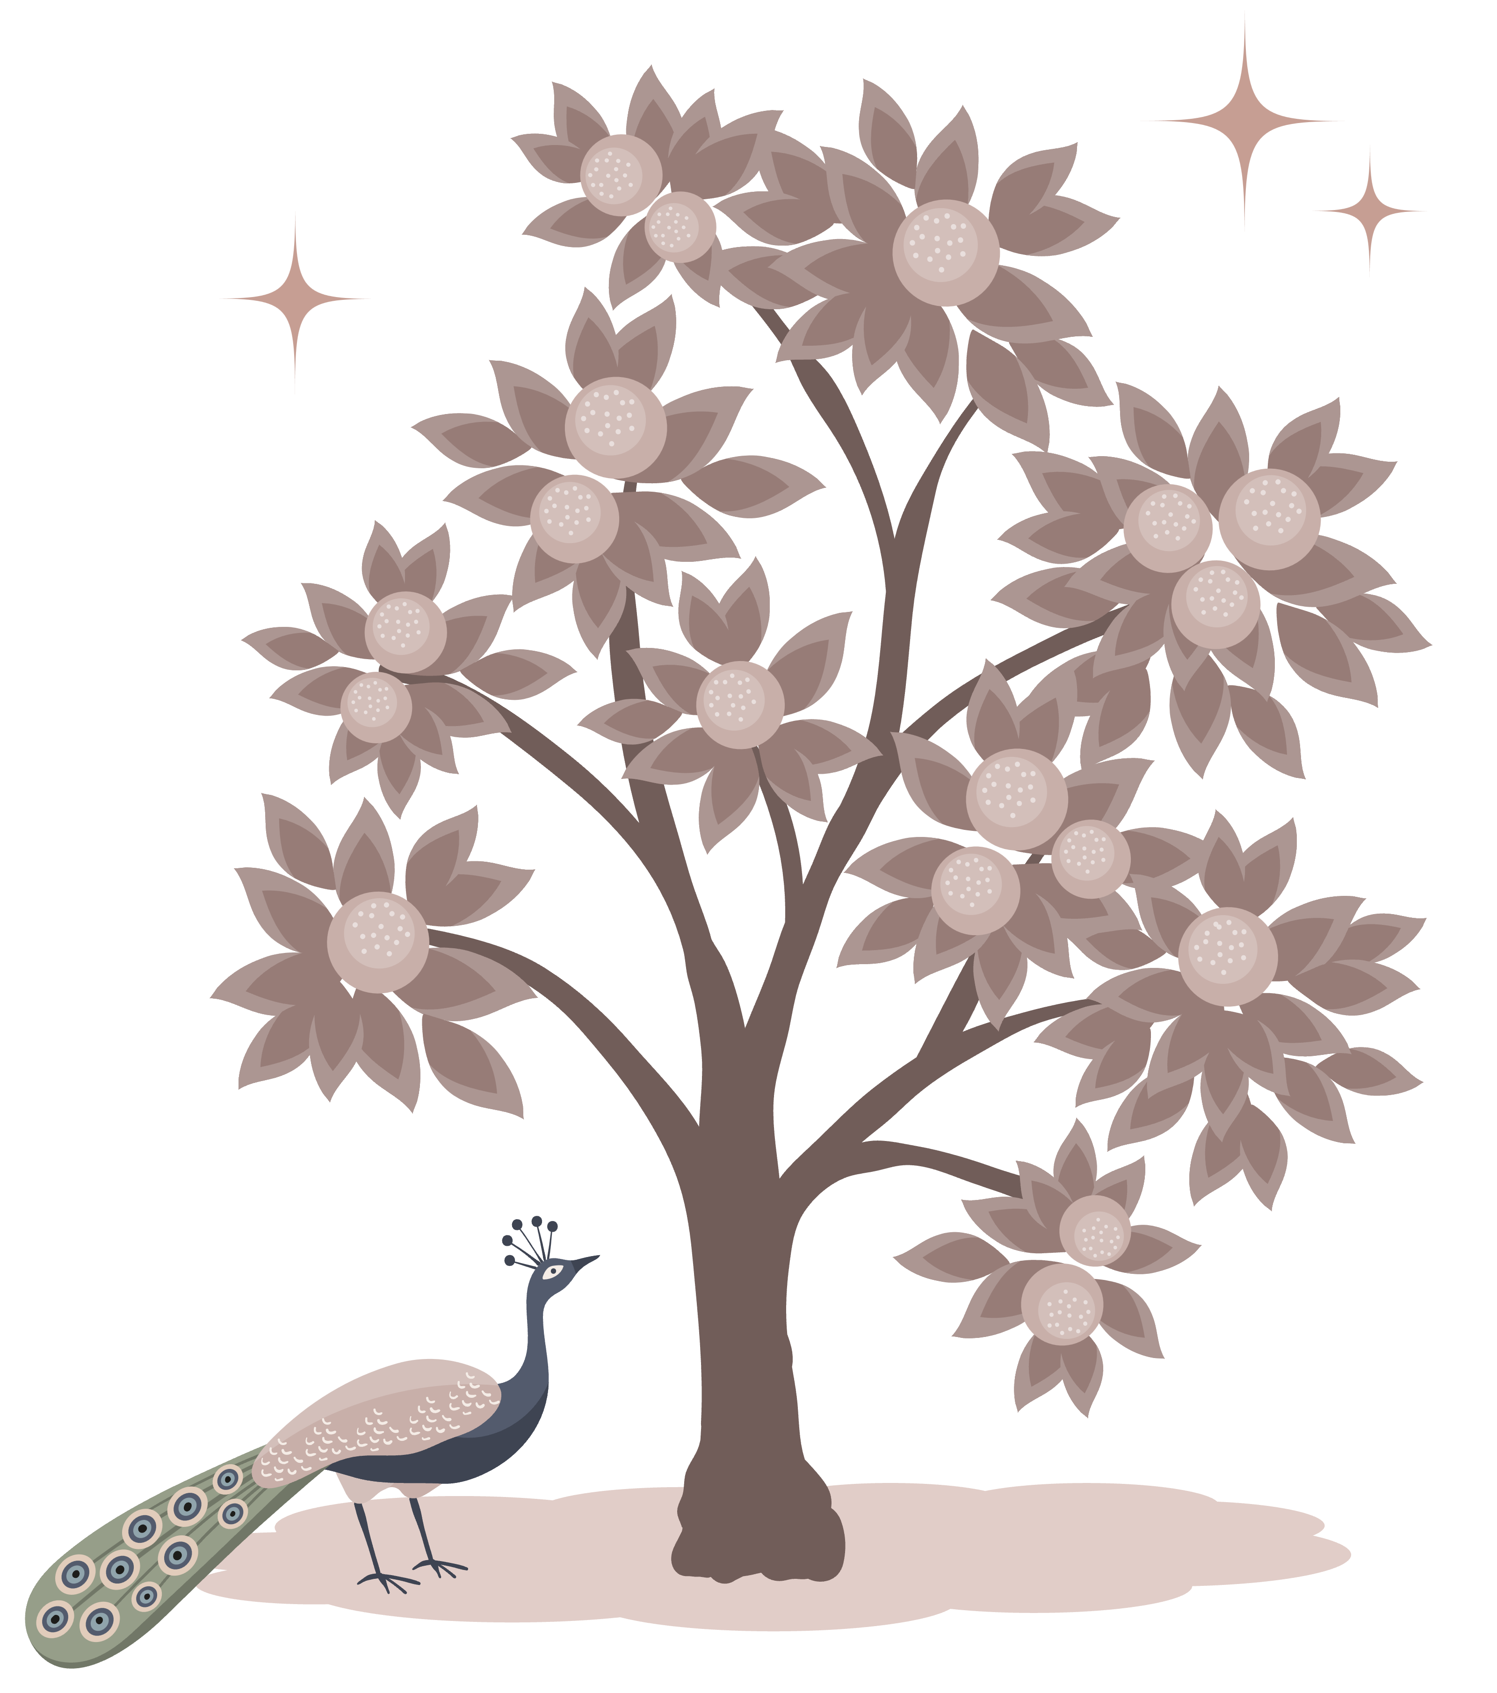
Contents
1
2
Cai Wenji
Ban Zhao
3
4
Zhuo Wenjun
Li Qingzhao

Slide 4
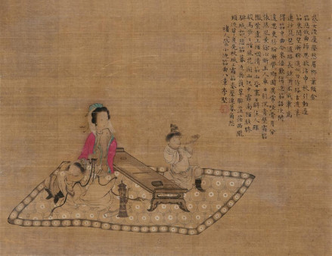
Cai Wenji ,a female literary figure of the late Eastern Han Dynasty, daughter of literary figure Cai Yong.
Literature:Two Indignant Poem
《悲愤诗》
Music:Eighteen Songs of a Nomad Flute Song
《胡笳十八拍》
Calligraphy

Slide 5
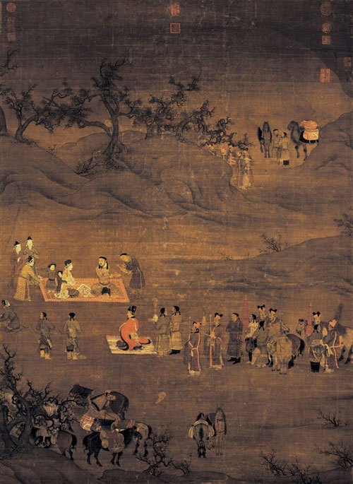
Return to Han Dynasty
文姬归汉

Slide 6
Eighteen Songs of a Nomad Flute Song
She combined the Sao style and seven words style and created a new form of poetry, greatly and vividly expressing the humiliation and anger of her captivity, her homesickness in a foreign country, and the pain of separation from her children.
Indignant Poem
She narrated the same story as Eighteen Songs of a Nomad Flute Song in five characters and created the first autobiographical five character poem in Chinese history.

Slide 7
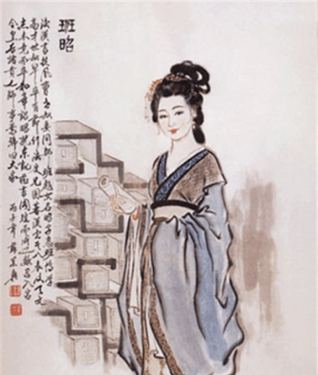
Ban Zhao (about 49-120 years), a famous talented woman in the Eastern Han Dynasty. Among the four talented women in ancient China, she was known as "the most talented woman in the world"
The first female historian in China
The world's first female educator
Writer
Politician

Slide 8
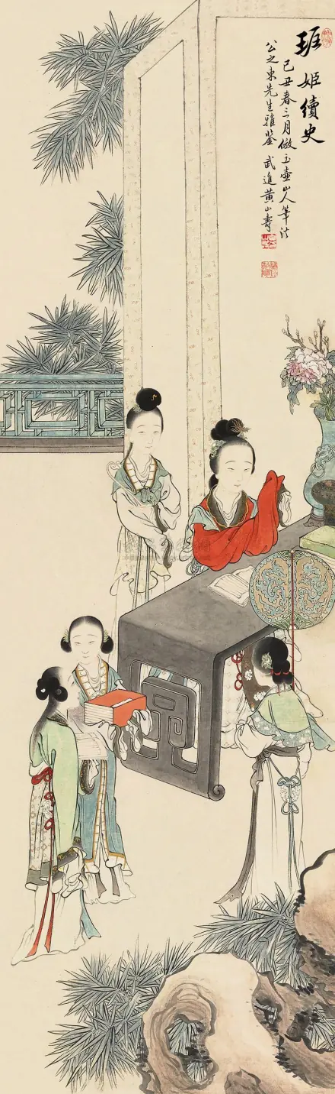
The first female historian in China
Ban Zhao continued to write the book of Han
班姬续史

Slide 9
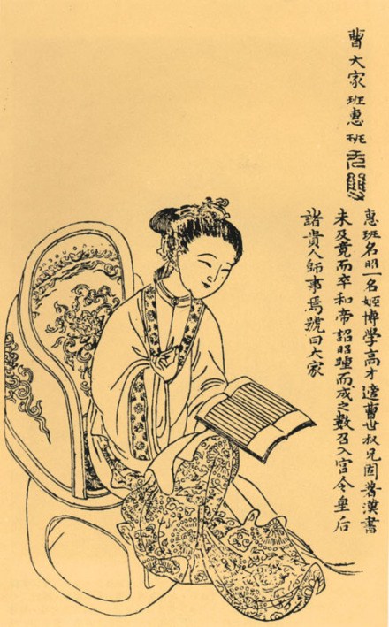
The world's first female educator
“Women cannot go out of the family”

Slide 10
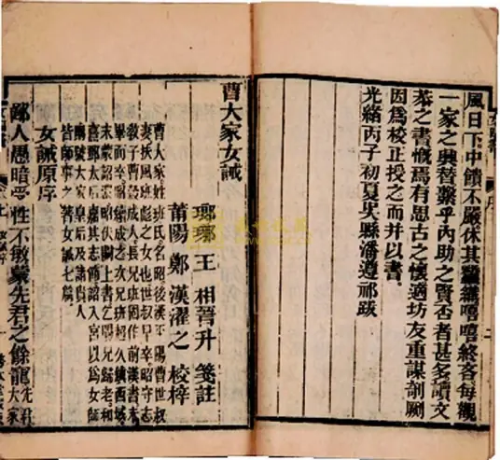
Writer
The Commandments for Women
《女诫》

Slide 11
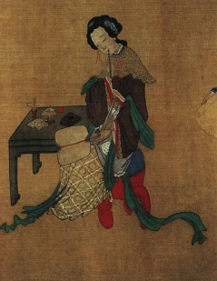
Politician
Confidants interfere in politics
”闺蜜干政“

Slide 12
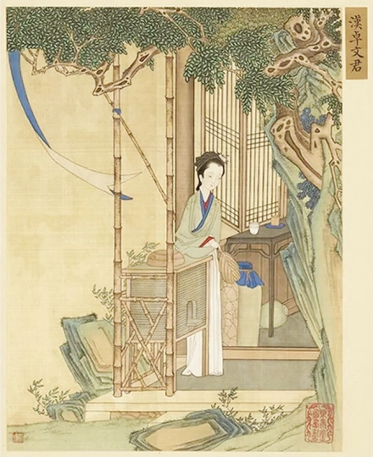
Zhuo Wenjun (175-121 BC), the daughter of the Zhuo Wangsun , was one of the four talented women in ancient China and one of the four talented women in central Sichuan
Bai Tou Yin
《白头吟》
Poem of Discontent
《怨郎诗》
Letter of Farewell
《诀别诗》

Slide 13
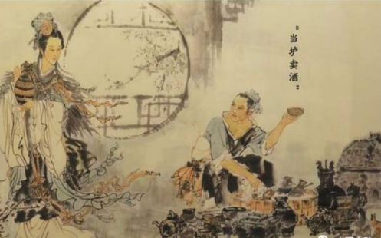
Zhuo Wenjun sells alcohol
当垆卖酒

Slide 14
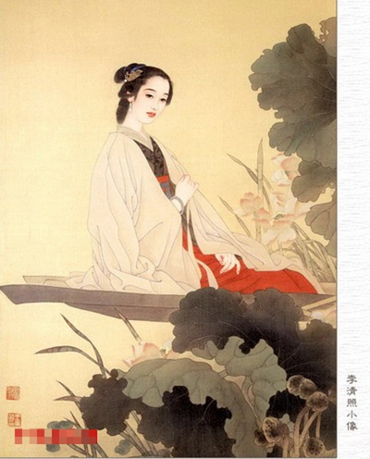
Li Qingzhao (March 13, 1084 – 1155) was a representative poet of the Wanyue School in the Song Dynasty.
Yi an Jushi Anthology
《易安居士文集》
Yi an Lyrics
《易安词》
Shuyu Lyrics
《漱玉词》

Slide 15
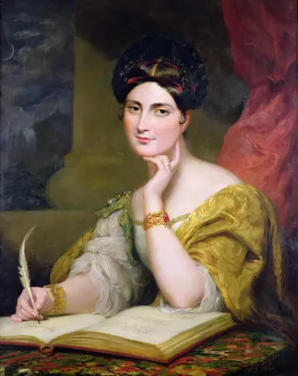
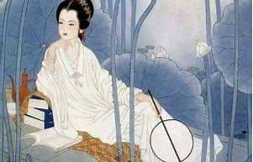
Divorce
Li Qingzhao
Caroline Norton

Slide 16
Summary

Slide 17
Thank you

