Slide 1



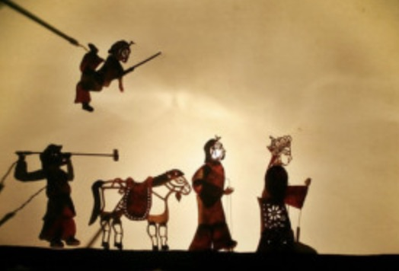
Shadow Play
19级翻译班 刘廷阳

Slide 2


Contents
01
The Origin of Shadow Play
02
The Introduction
03
The Situation of Contemporary Shadow Play

Slide 3
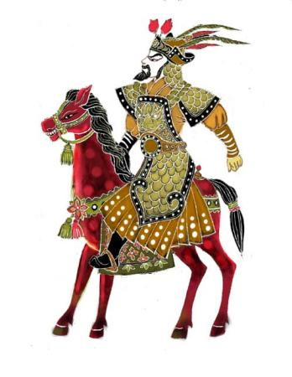

01
The Origin of Shadow Play

Slide 4

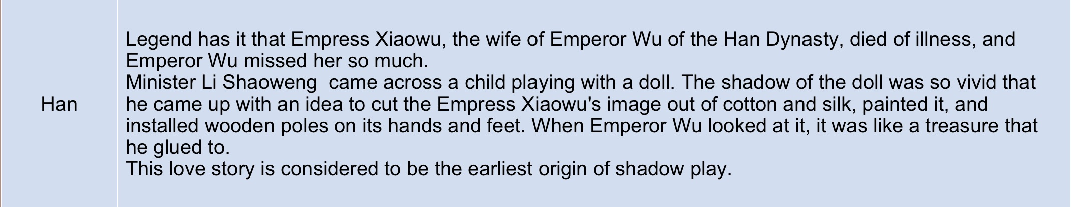



Slide 5
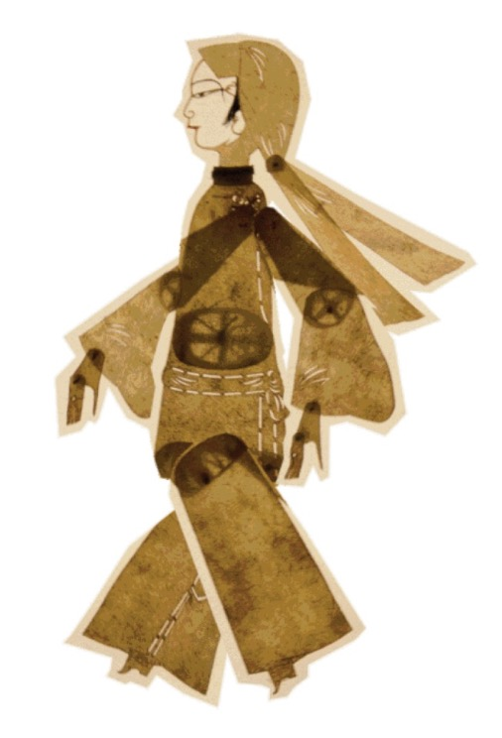
02
Introduction

Slide 6
Translation Version
Shadow Play
literal translation
Shadow Puppets
A combination of literal translation and liberal translation
Lamp and Shadow Play
Lamp and Shadow Puppets

Slide 7
Definition and Status
Definition:
Shadow Play is an ancient form of storytelling and entertainment which uses flat articulated cut-out figures which are held between a source of light and a translucent screen or scrim.
Status:
It is considered as “precursor of movie” because it was the earliest moving part of form dubbed with human voice in the world.

Slide 8
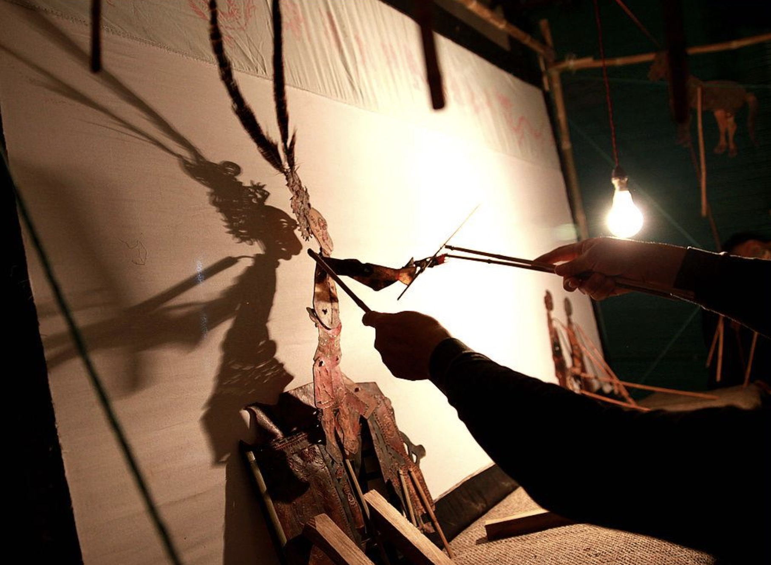
Performing form
During a play, puppeteers hide behind the white screen and move puppets, while narrating the story, usually through singing.Performances are accompanied by musicians playing percussion and stringed instruments.

Slide 9
The foundation and development
It combines traditional Chinese plastic art and performing art as well as the arts of painting, paper cutting, local opera, and so on.
It also has absorbed the best parts of local operas, folk songs and emerged into many schools. The well-known ones include Tangshan Shadow Play, Beijing Shadow Play as well as Shaanxi, Shanxi and Hunan Shadow Play.

Slide 10
The Manufacture Approach of puppets
1. Draw pictures of the various parts of the shadow puppets.
2. Finish carving with a knife and a hard board underneath the design.
3. Color the puppet with watercolor pens.
4. Paint the body parts with a brush dipped in oil. This can make the puppet transparent and better reflect colors under the light.
5. Connect joint sections with the cotton thread.
6. Make the manipulating rods.
7. Attach the manipulating rods to the shadow puppet with cotton thread.
Thanks to different manipulating rods moves, the shadow puppet can show its happiness, anger, sorrow and gladness.

Slide 11
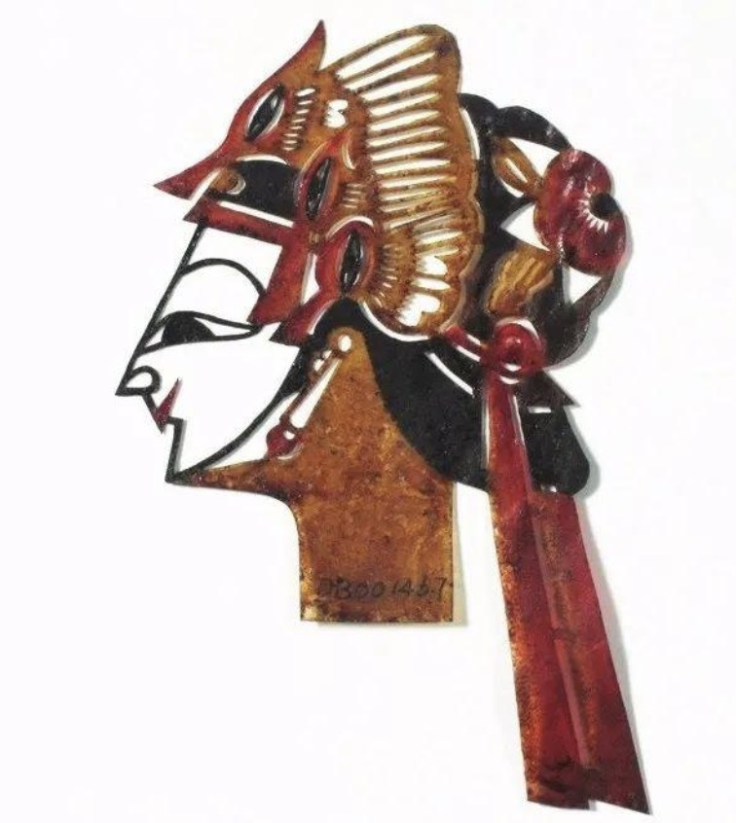
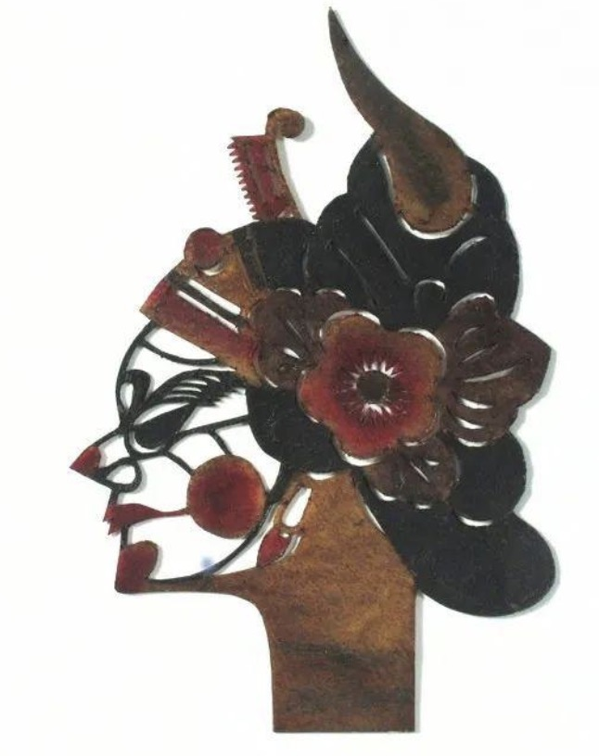
The Characters' Features
The eyes and the eyebrows of a shadow puppet’s facial features represent different personalities.
The good and positive people are typical of a benevolent and kind countenance, with nice-looking eyebrows and eyes.
The villains are ferocious looking, with sharp eyebrows and almond-shaped eyes.

Slide 12
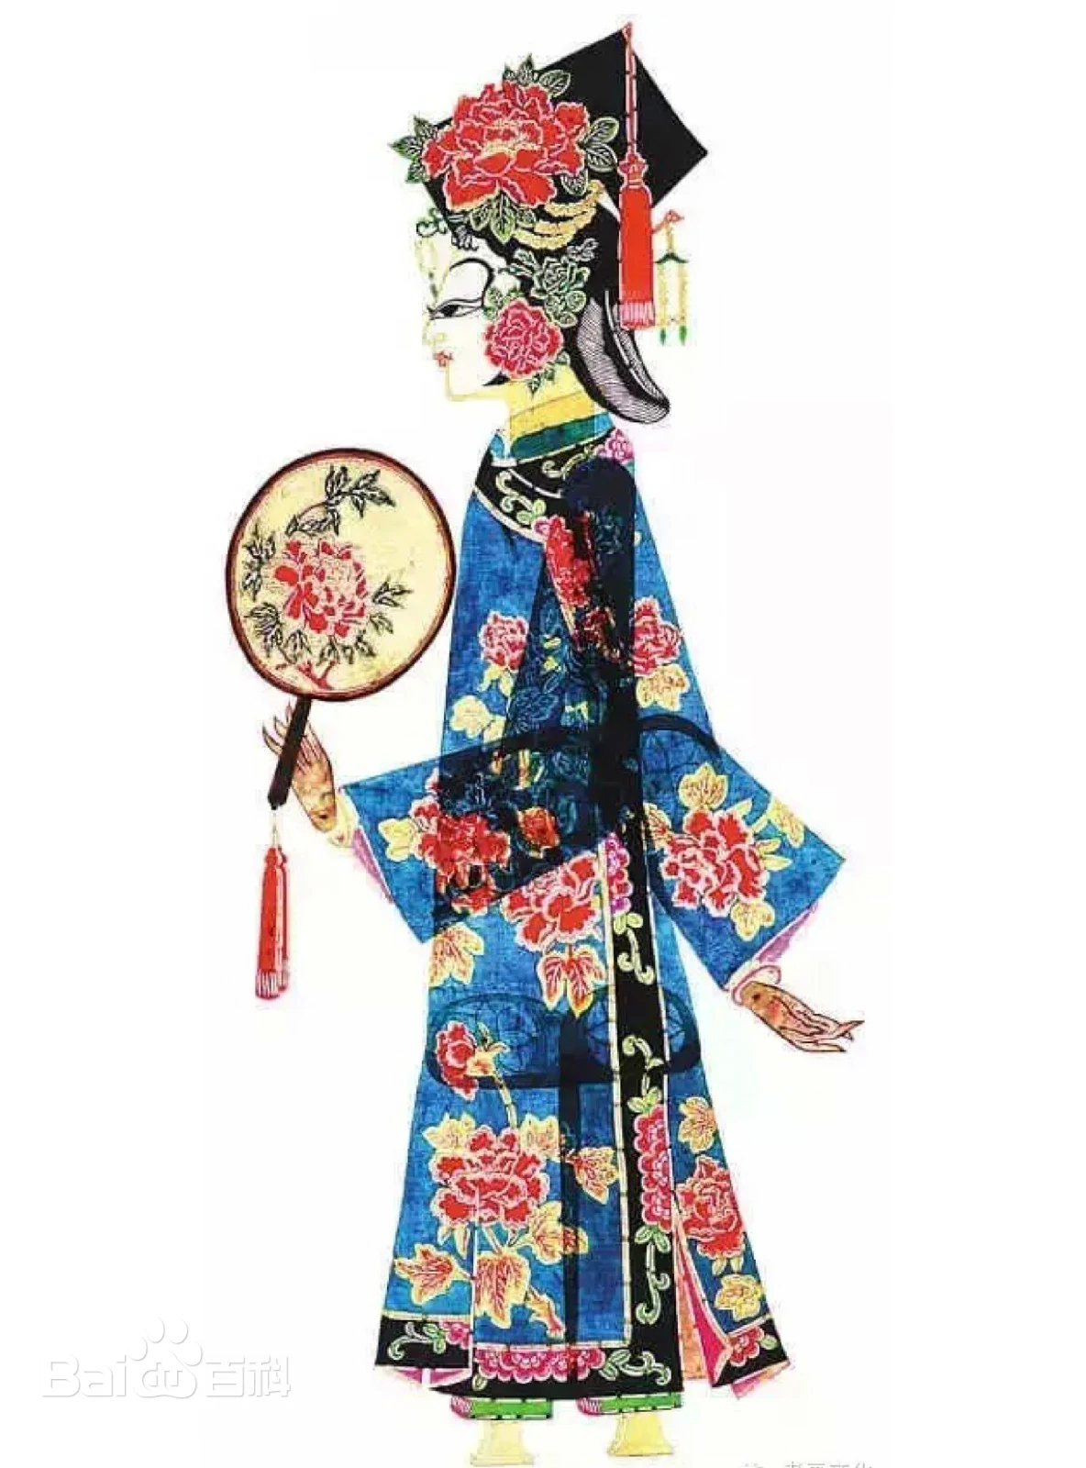
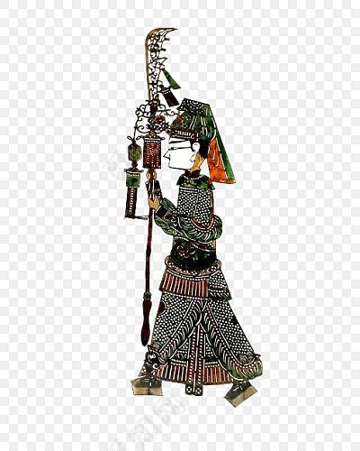
The Characters' Features
The decorative designs on the shadow puppets are so important that they must match the character’s social status.
Female characters are usually decorated with patterns such as flowers, grass, clouds and phoenix.
Male characters are often decorated with dragons, tigers, water and clouds.

Slide 13
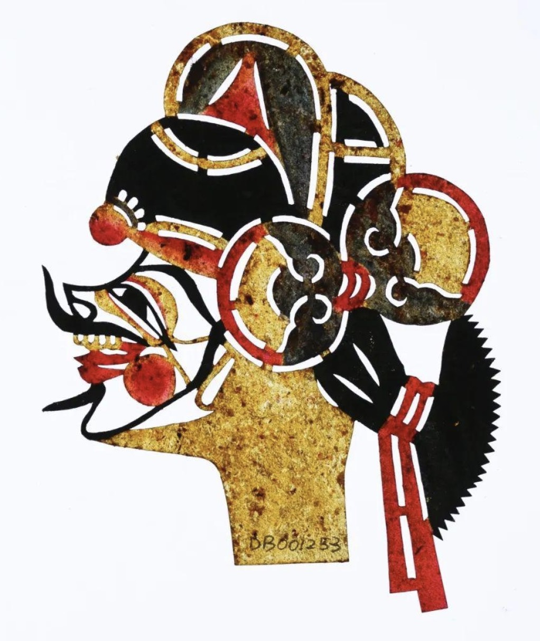
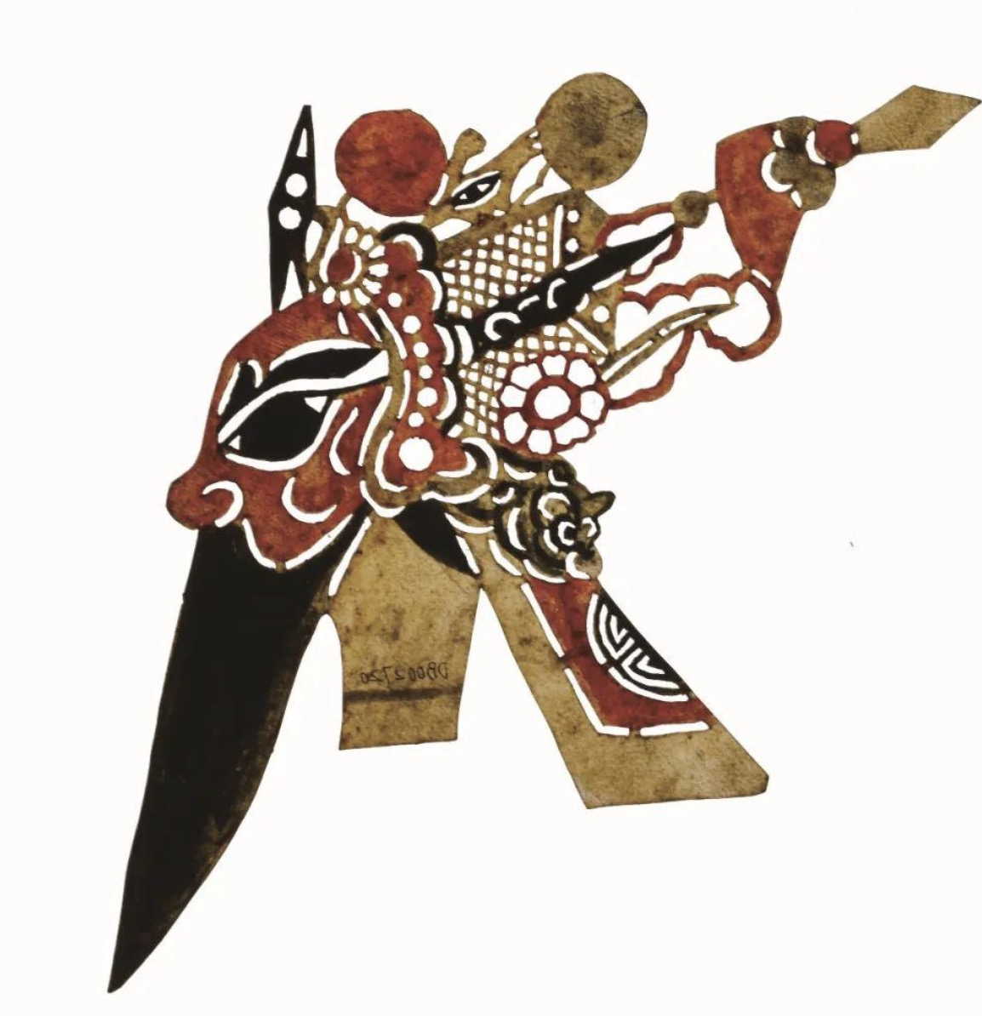
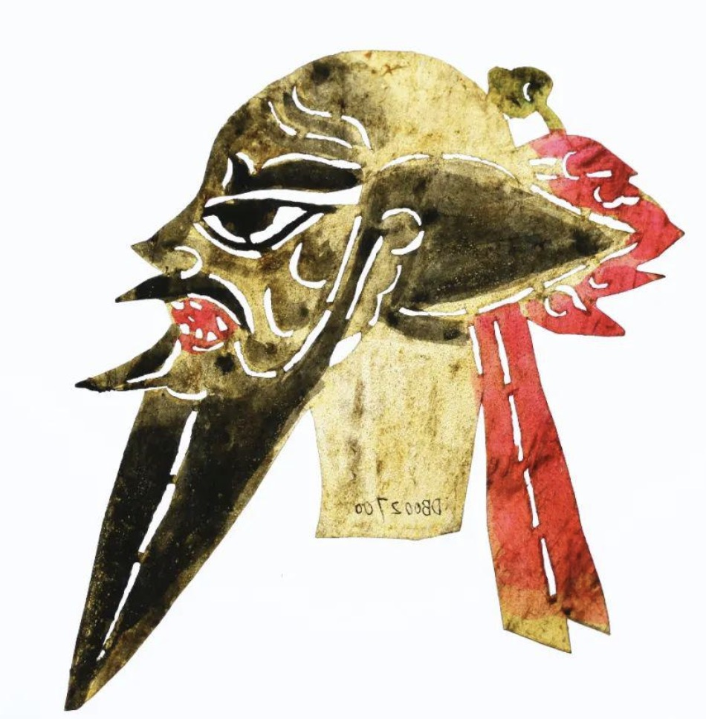
The Characters' Features
The different colors of heads can also represent different characters’ personalities.
The black is a sign of a just, honest and selfless personality and the representative is Zhang Fei.
The red is a symbol of a heroic and upstanding character and the representative is Guan Yu.
The yellow shows a brave and ill-natured character and is often used in fantasy plays to represent people with magic power.

Slide 14
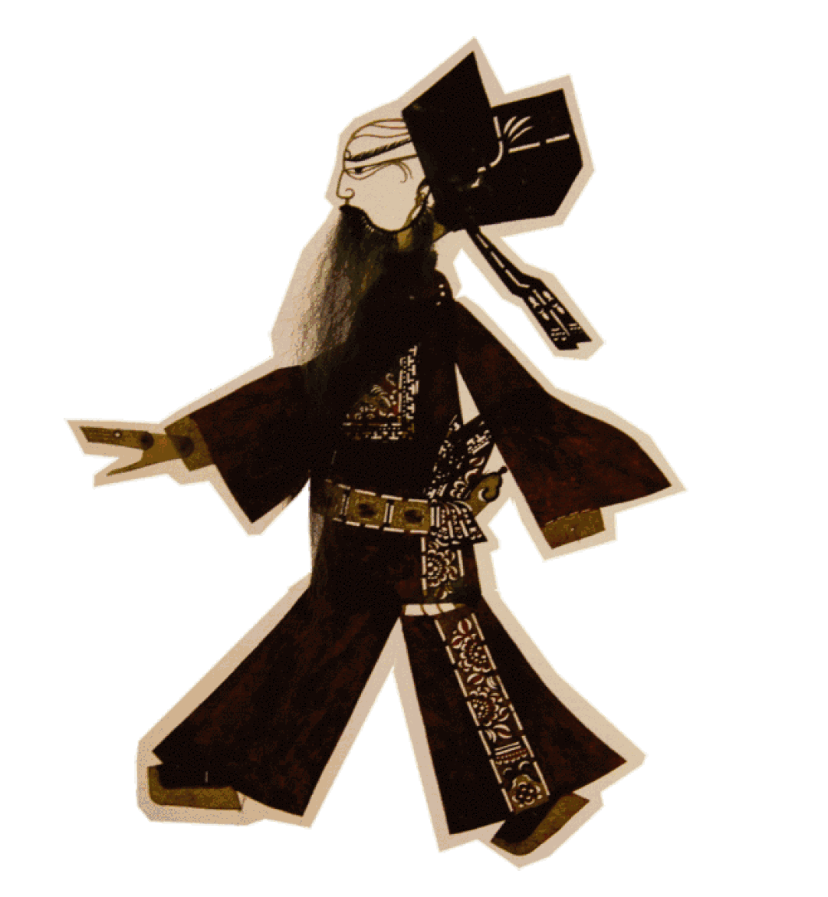
03
The Situation of Contemporary Shadow Play

Slide 15
20th Century
I.Since 1949：
Shadow play has undergone a series of reforms, including the organization of theatrical troupes, the compilation and creation of plays, the drawing and performing forms of shadow play.
II.During the 1960s and 70s:
The troupe was disbanded, and the artists were transferred to other fields. A large number of precious shadow puppet props and documents were damaged. This situation lasted until 1976.

Slide 16
21st Century
In order to inherit Chinese excellent element and protect the ancient art forms：
On May 20, 2006, it was approved by the State Council to be included in the first batch of national intangible cultural heritage list.
On November 27, 2011, UNESCO included Chinese shadow play in the "Representative List of Intangible Cultural Heritage of Humanity".

Slide 17
Thanks

