Slide 1
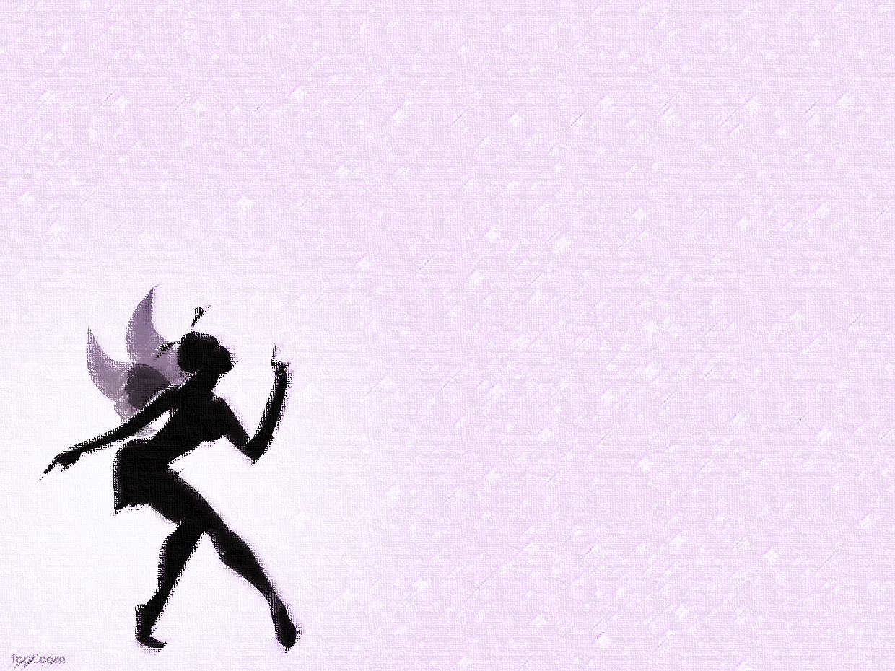
Chinese
Fairy Tales
By:
Liu Yao
and
Mahzad Sadat Heydarian

Slide 2
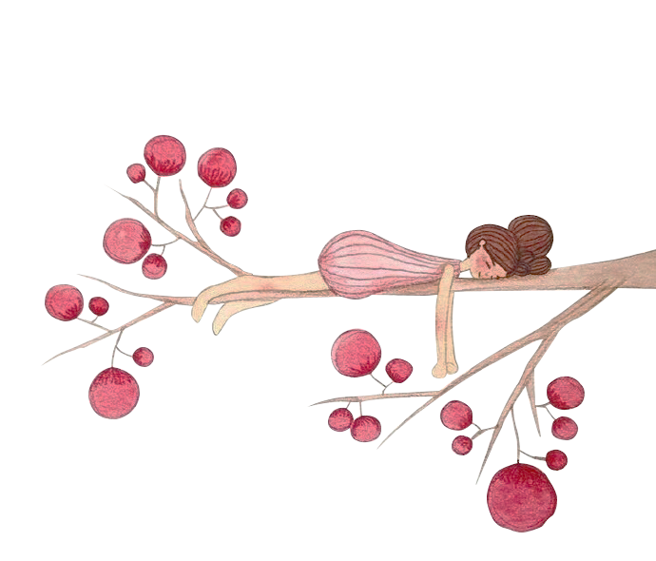


What is a fairytale?
A fairy tale is a type of short story that typically features folkloric fantasy characters, such as dwarves, elves, fairies, giants, talking animals, goblins, mermaids, trolls, or witches, and usually magic or enchantments.
In less technical contexts, the term is also used to describe something blessed with unusual happiness, as in “fairy tale ending” (a happy ending) or “fairy tale romance” (though not all fairy tales end happily).

Slide 3
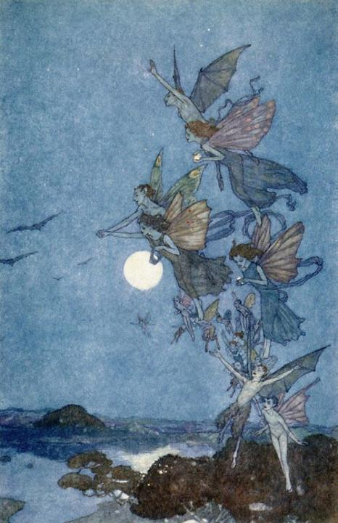
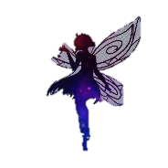
Difference with legends and epics
Unlike legends and epics, fairytales usually do not contain more than superficial references to religion and actual places, people, and events; they take place once upon a time rather than in actual times. For example, they often start the story with “long long ago...”.

Slide 4


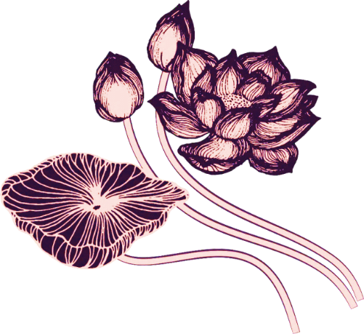
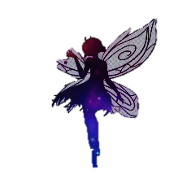
Types of Fairytale in Every Culture
Oral
The oral tradition of the fairy tale came long before the written page. Tales were told or enacted dramatically, rather than written down, and handed down from generation to generation. Because of this, the history of their development is necessarily obscure and blurred.
Literal
Fairy tales appear, now and again, in written literature throughout literate cultures, but it is unknown to what extent these reflect the actual folk tales even of their own time. What they do show is that the fairy tale has ancient roots, older than the Arabian Nights collection of magical tales (compiled circa 1500 AD), such as Vikram and the Vampire, and Bel and the Dragon. Besides such collections and individual tales, in China, Taoist philosophers such as Liezi and Zhuangzi recounted fairy tales in their philosophical works.

Slide 5
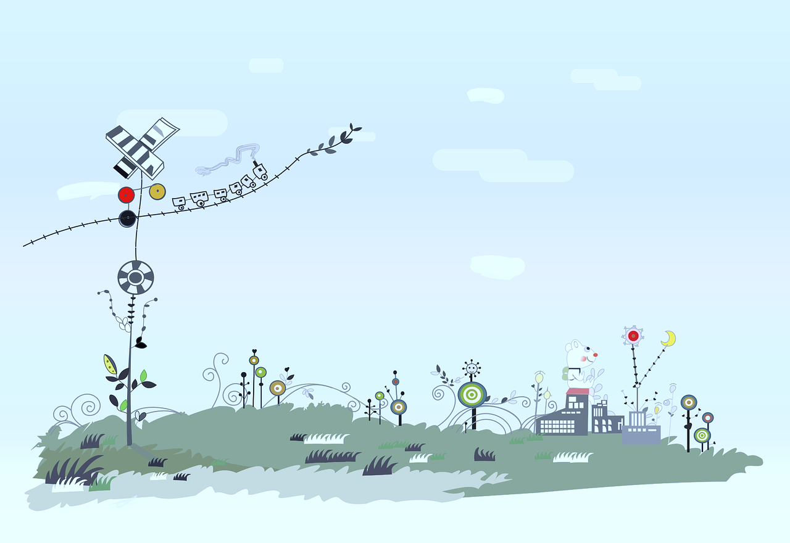
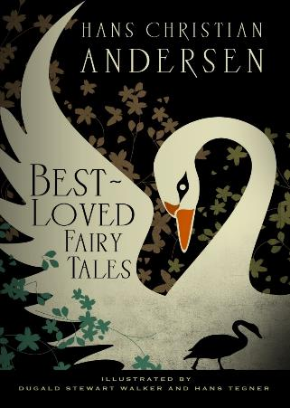
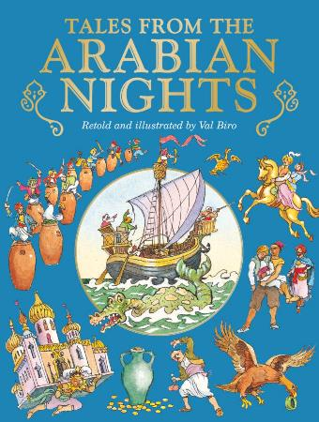
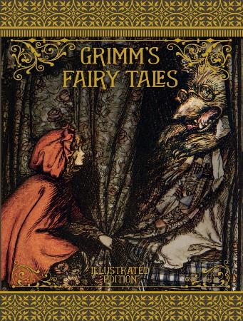

Slide 6
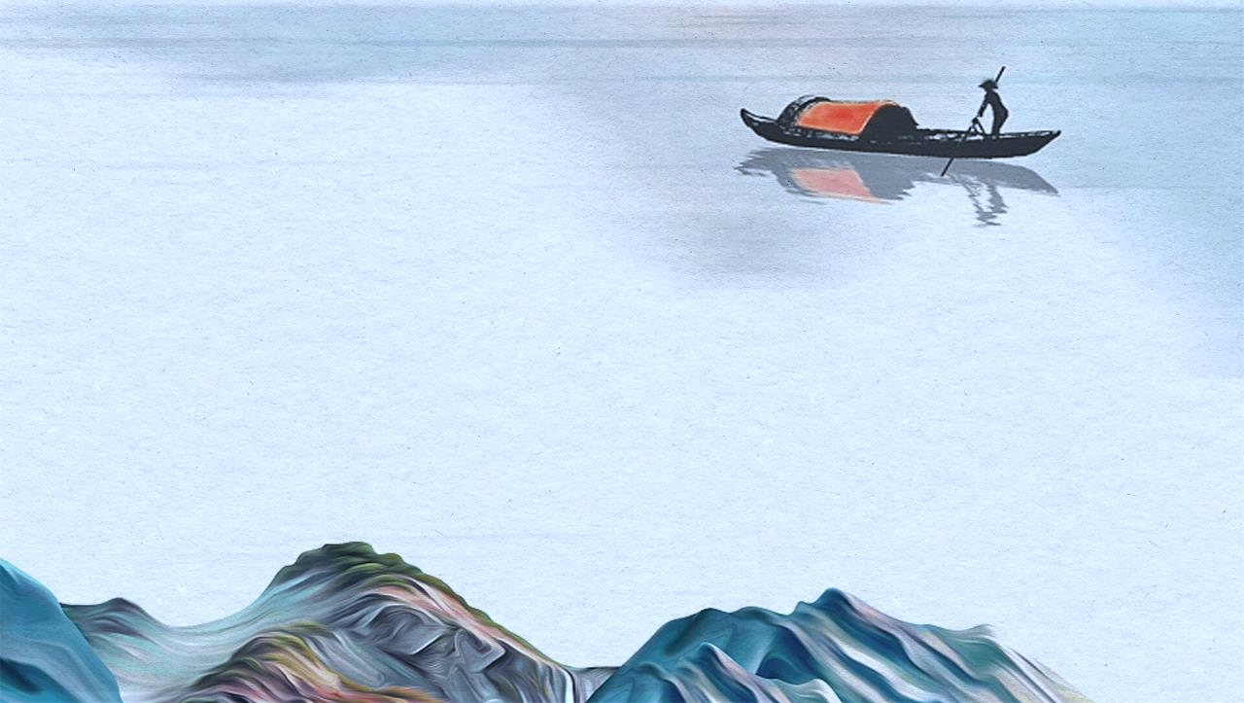
Chinese Fairy Tales
China’s folklore is part of the country’s tradition, with hundreds of stories beloved by young and old. Many of the folk tales and fairy tales are used to teach certain admirable characteristics in individuals. These values include moderation, the value of promises, respect for one’s elders, why you should follow the ways of the culture, justice and injustice, and the power of wisdom. The tales shine light on the traditions and culture of China throughout all of its years. Some of the folk tales seek to answer questions about the world and are shaped by China’s philosophies.
May Fourth Revolution
Intellectuals in China recognized the importance of folk culture and advocated the collection and study of folk songs and folk literature. Mr. Cai Yuanpei, who was the president of Peking University at that time, issued a notice and set up a “Song Collection Office” to collect folk songs from all over the country.

Slide 7

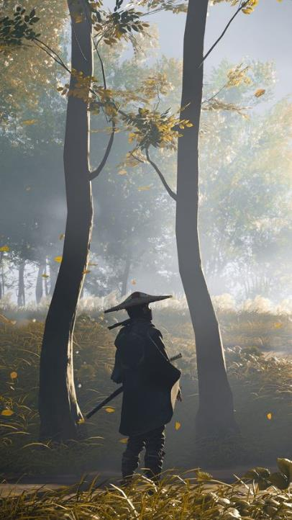
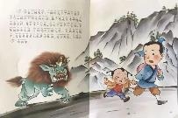
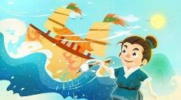
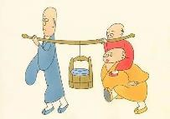
Among them is Chinese Folk Tales Collection, which includes Chinese Folk Fairy Tales Series. It sorts out the folk tales of China’ s various ethnic groups, shows the original appearance of traditional folk tales in a smooth and vivid text, and expresses the excellent qualities of Chinese people of all ethnic groups, such as hard work, bravery and optimism.

Slide 8

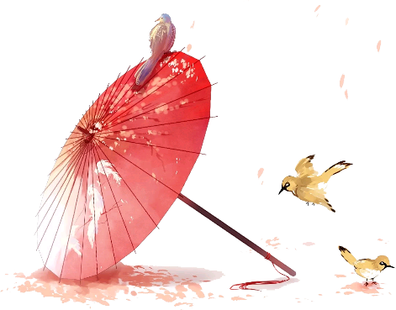

Chinese Ancient Fairy Tales
1
Jingwei Tries to Fill the Sea
2
The Great Flood of Gun-Yu
Examples
3
The Legendary of Nian
4
The River Snail girl
5
The Magic Brush
6
Three Monks

Slide 9
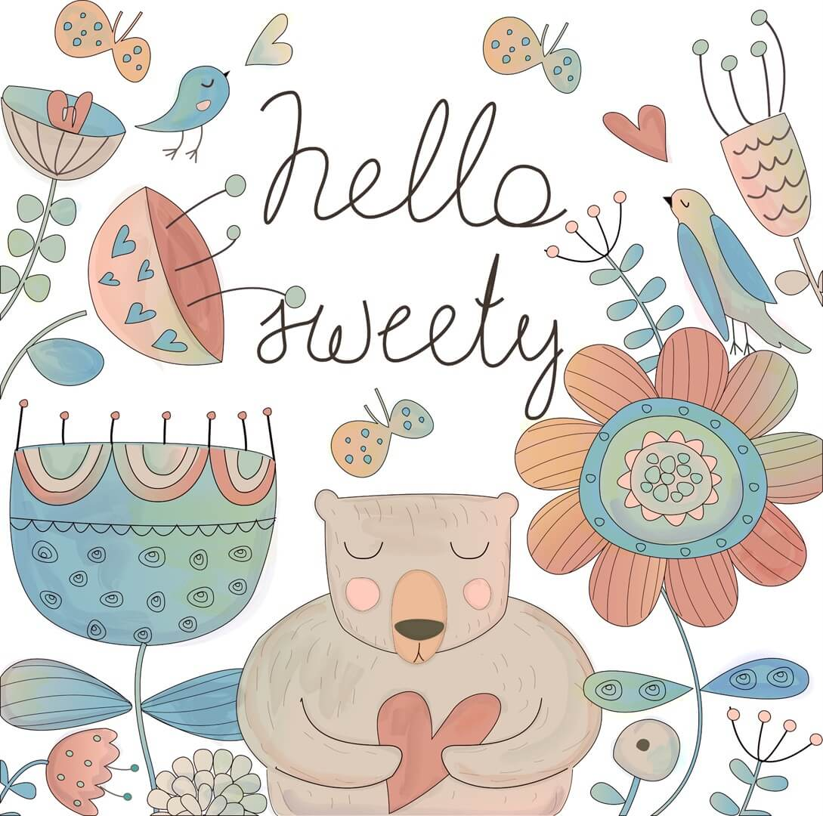
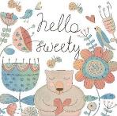
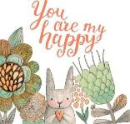

Features
2. The personality of the main character is distinctive and exaggerated, with strong contrast.
3. The language of the story is clear and straightforward, and the storyline is exciting with many ups and downs.
1. The theme of the stories is outstanding, they promote the truth, goodness and beauty.

Slide 10
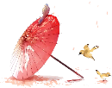
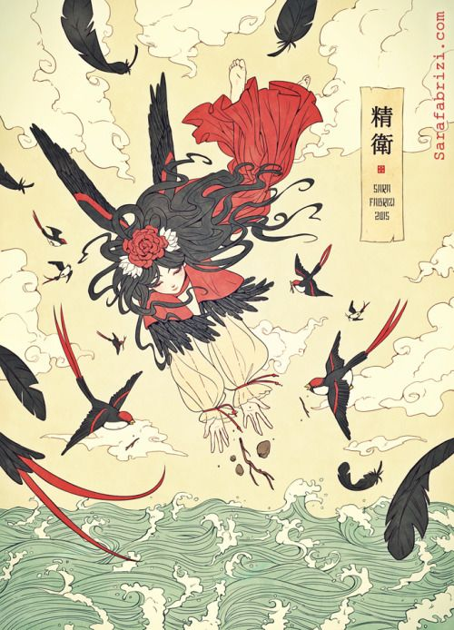
Jingwei Tries to Fill the Sea
Once you have made up your mind to do something, focus on your own persistent efforts instead of the results.

Slide 11
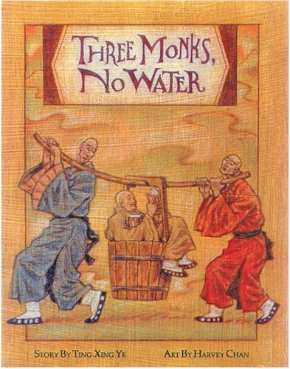
The Three Monks
As long as people cooperate with each other, the efficiency of the teamwork will be greatly improved. If each of them shirk their responsibilities, they can do nothing.

Slide 12
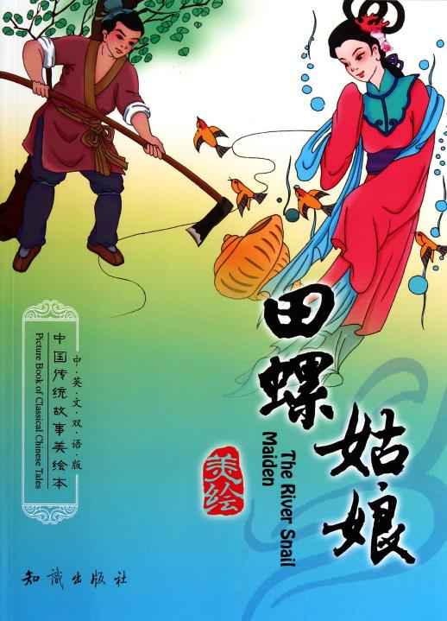
The River Snail girl
A person who is hardworking and kind will surely get happiness in the end;
A person should be grateful and know how to repay the kindness.

Slide 13
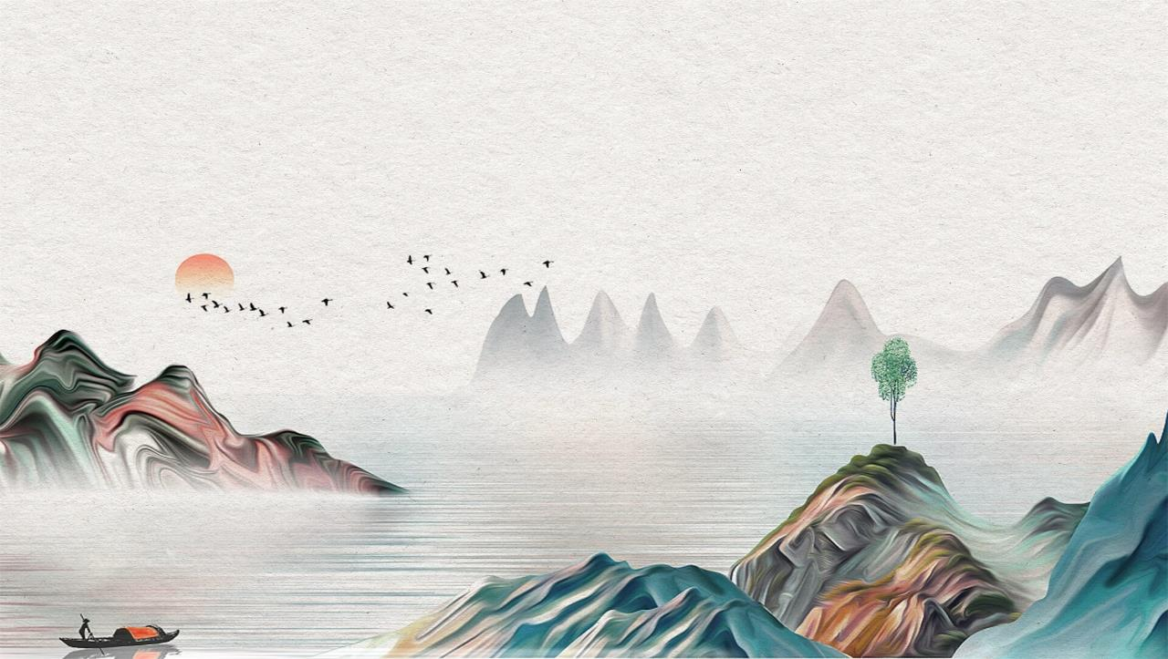
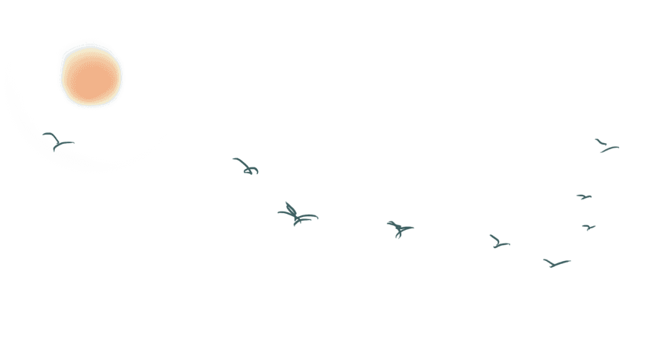

Thank you

