Slide 1


Slide 2
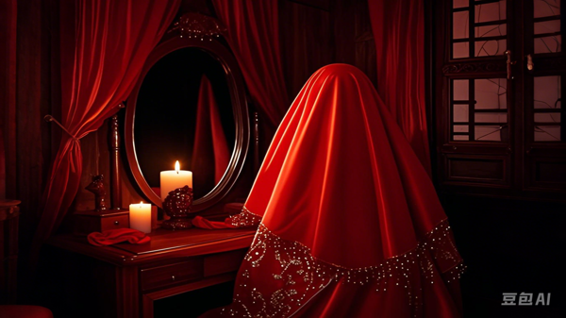

Slide 3
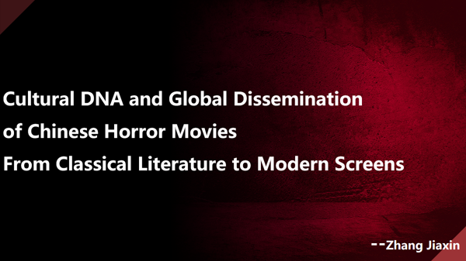

Slide 4


CONTENTS
Historical Development
Cultural Differences
Translation Strategies
Cultural Roots

Slide 5
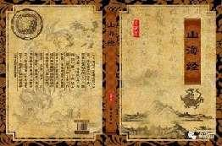
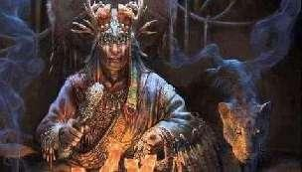
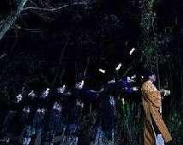
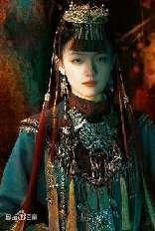
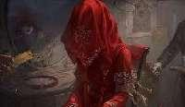

Cultural Roots:
Ghostly Traditions
and Literary Motifs
Ghosts and Spirits Beliefs
Folk Customs and Taboos
Classical Literary Influence

Slide 6
Historical Development:
From Emergence to Genre Formation
2020s to Present
2000s–2010s
1980s–2000s
1980s–1990s
1930s–1940s
1913

Slide 7
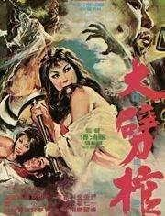
1913: The Embryonic Stage
Test of the Wife by Zhuangzi （庄子试妻）

Slide 8
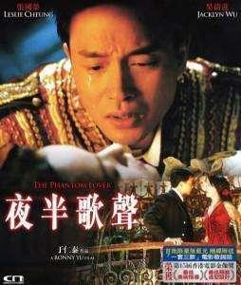
1930s–1940s：Early Exploratory Stage
The Phantom Lover （夜半歌声）

Slide 9
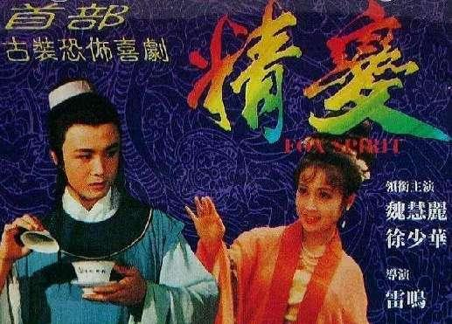
1980s–1990s：
Revival and Restrictions After Reform and Opening-Up
The Spirit (精变)

Slide 10
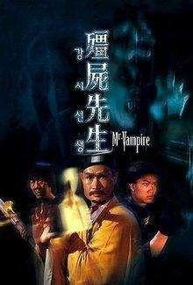
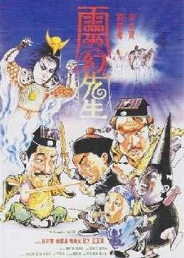
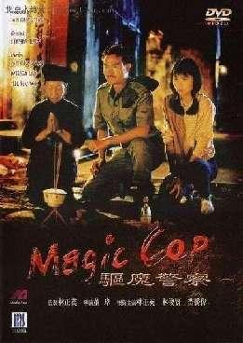
1980s–2000s：
Golden Age of Hong Kong and Taiwan Horror Films
Zombie series starring Lam Ching-ying

Slide 11
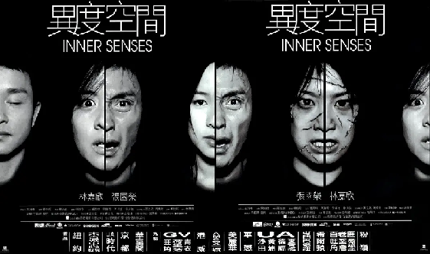
2000s–2010s：Modern Transformation Stage
Inner Senses （异度空间）

Slide 12
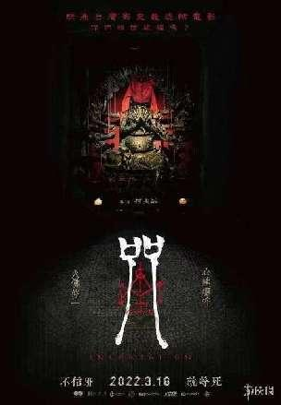

2020s to Present：Recent Rise and Diversification
Incantation (咒)
The Bridge of Ghosts（女鬼桥）

Slide 13
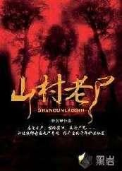

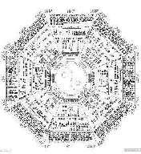
Cultural Differences:
Chinese vs. Western Horror Films——Thematic Contrasts
Collective Ethics
Chinese Core
Interplay of Nature
and Supernatural

Slide 14


Cultural Differences:
Chinese vs. Western Horror Films——Thematic Contrasts
Individual Fear
Western Core
Tangible Monsters

Slide 15


Translation Strategies: Bridging Cultural Gaps
Culture-Specific Terms
巫蛊——Witchcraft?
——Gu poison?
1
Title Translation
Literary quality
Atmospheric adaptation
2

Slide 16
"Some fears belong to all humanity;
but some secrets
can only be illuminated by the moonlight of the East."
第一部分
第三部分
第四部分
营销方案概述
营销支出预算
预计收益效果

Slide 17

THANKS

