Slide 1



Chinese Bossy Fictions and Micro-drama
姚可欣

Slide 2
  1
Origins
  2
Rise of Microdramas
  3
Reasons for Popularity
  4
Future Trends and Impact

Slide 3
01 Origins

Slide 4

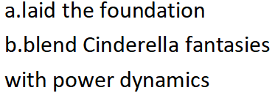

Slide 5
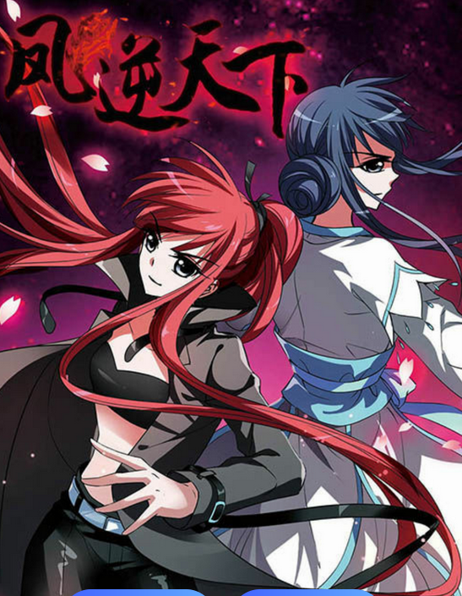
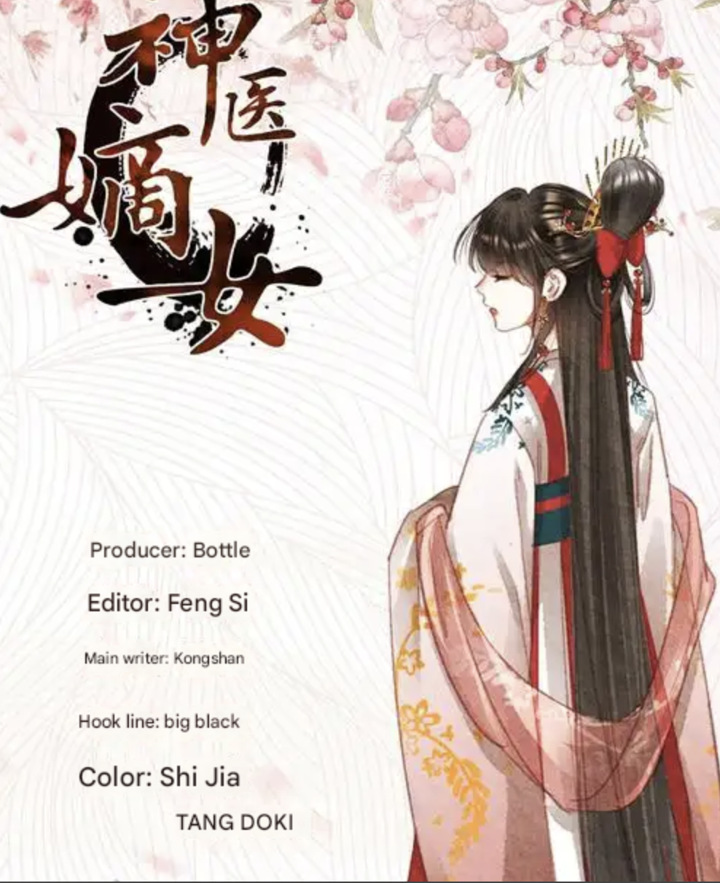
Powerful divine bird
noble female

Slide 6
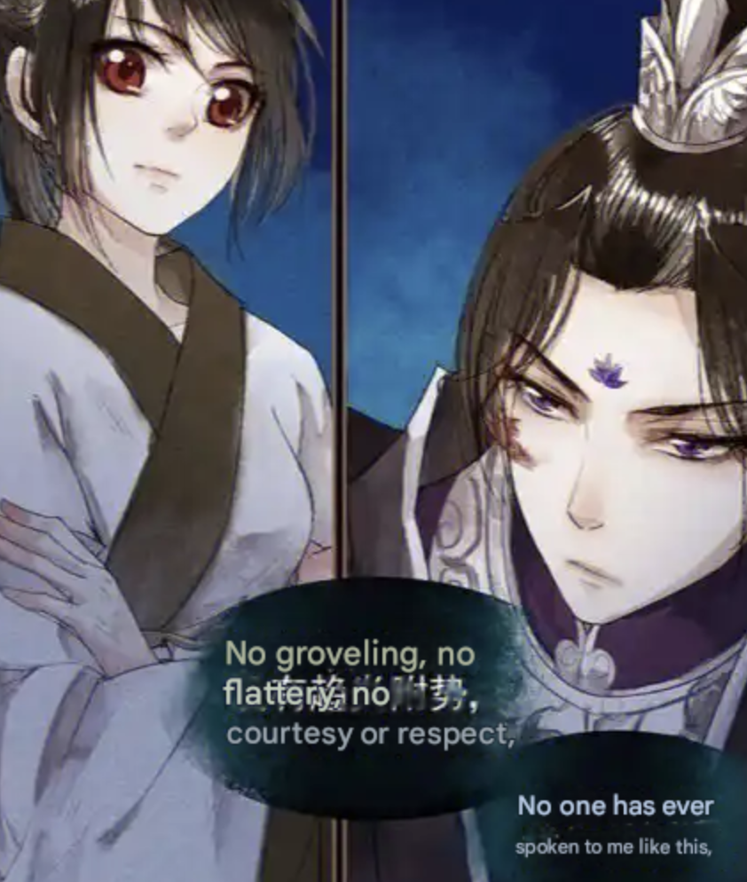
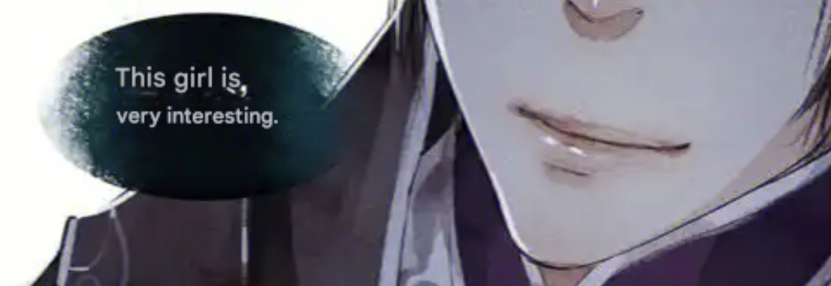

Slide 7

02 Rise of Microdramas

Slide 8
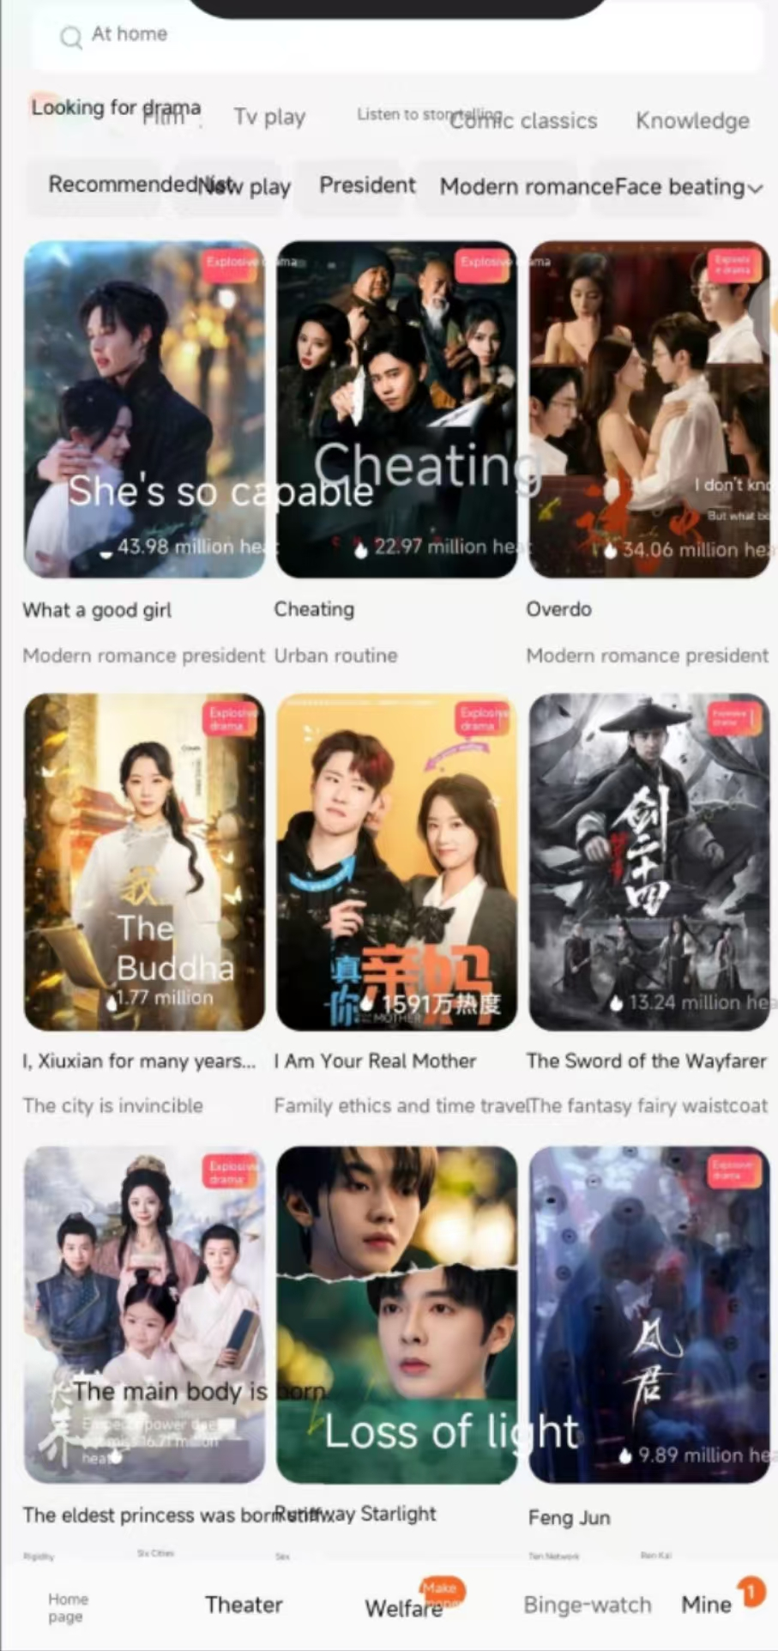
点击此处输入您的标题
请输入标题
在这里输入内本在这里输入内容文本在这里输入内容

Slide 9

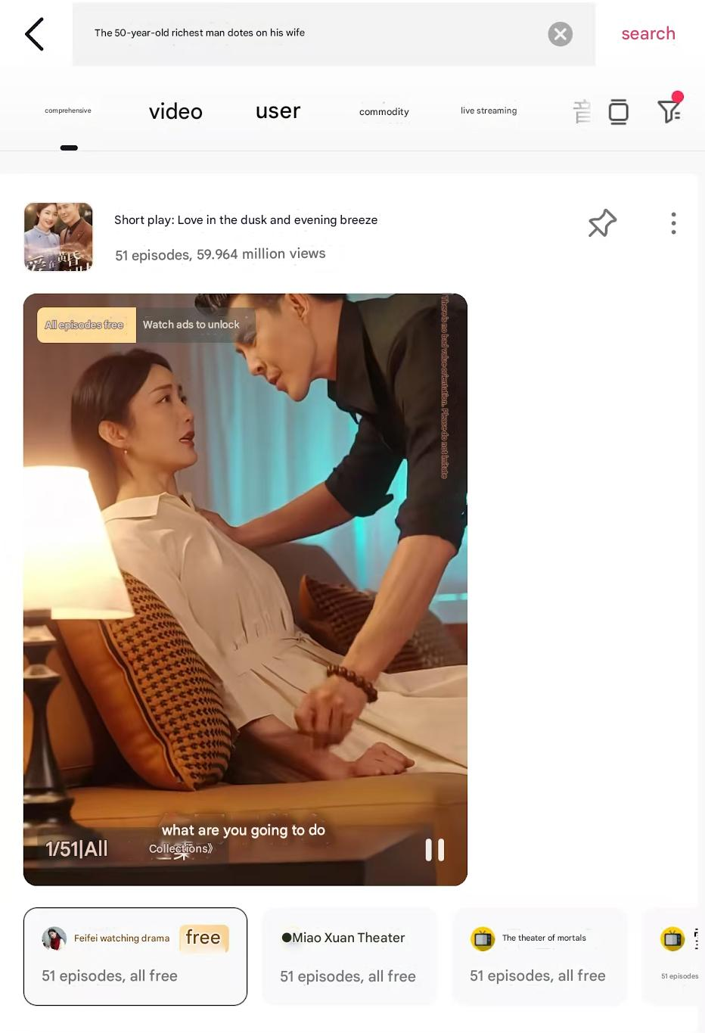
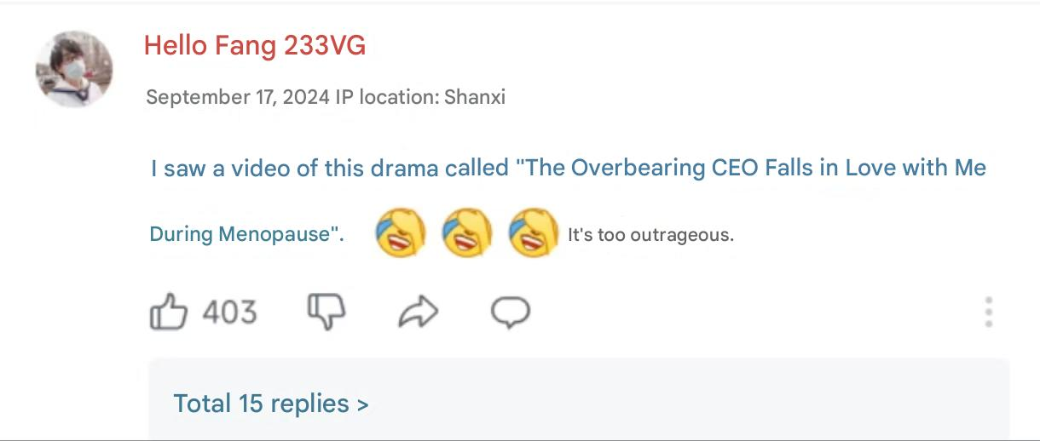
请输入标题
在这里输入内本在这里输入内容文本在这里输入内容

Slide 10
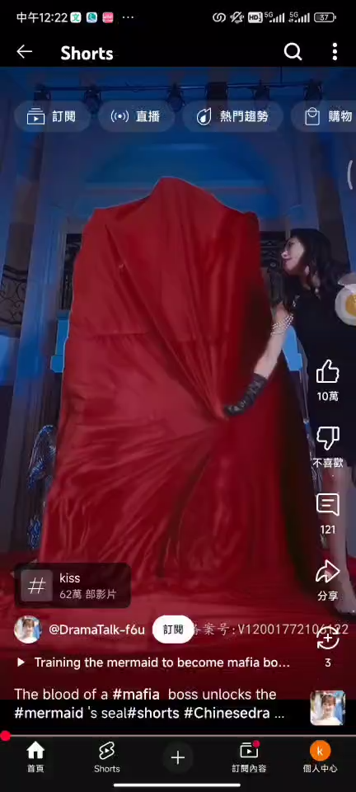
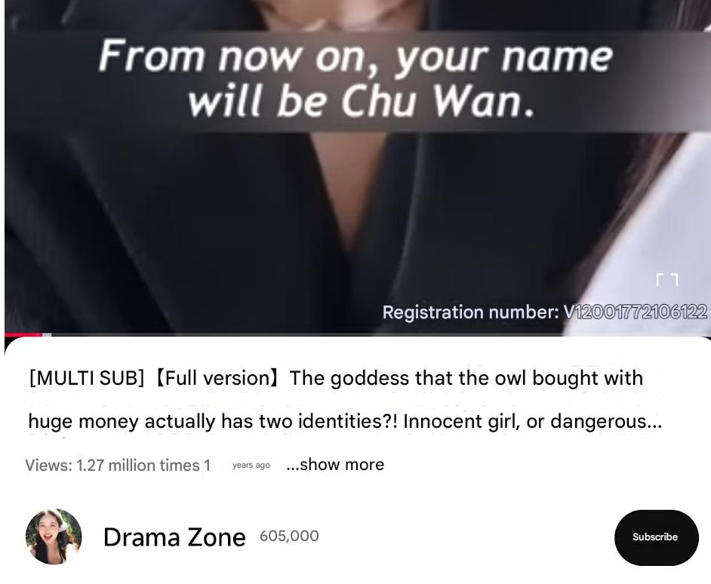
请输入标题
在这里输入内本在这里输入内容文本在这里输入内容

Slide 11
Defects of Mini - Dramas
Narrow Thematic Focus
  love stories of “a male leader or a boss”
Accusation of Materialism Promotion
One - dimensional Characters
  with female characters being weakened and overly feminized

Slide 12
03 Reasons for Popularity

Slide 13
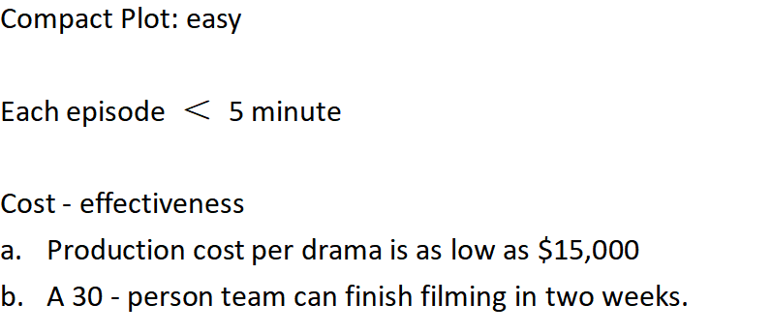


在这里加文本内容在这里添加文本内容

Slide 14
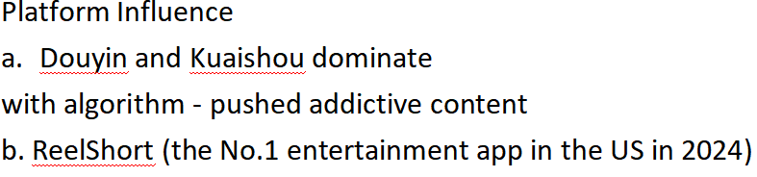
在这里加文本内容在这里添加文本内容

Slide 15
04 Future Trends and Impact

Slide 16

​Solutions to Address the Defects
​Diversify Themes
​Promote Authenticity
​Develop Multi-dimensional Characters
​Encourage Cultural Hybridization
​Strengthen Regulatory Oversight
0.5 秒延迟符，无
意义，可删除.

Slide 17

meaning
Cultural Soft Power
​Economic Impact
​Social Connection
​Empowerment Through Representation
​Innovation in Storytelling
0.5 秒延迟符，无
意义，可删除.

Slide 18
THANK YOU

