Slide 1
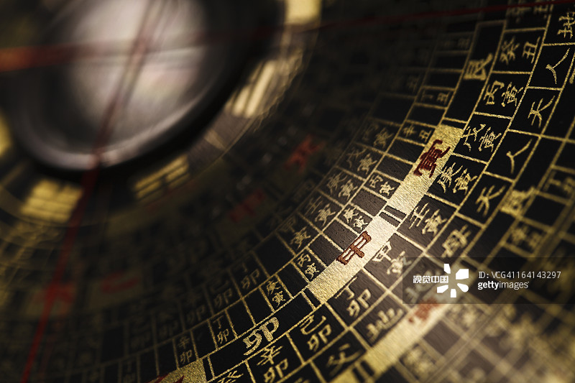
Fengshui in
Chinese
Architecture

Slide 2


1·Definition
Contents
2·History
3·Different schools
4·Major principles

Slide 3

1
Definition

Slide 4
Fengshui is a system of landscape assessment for finding propitious places for architectures. It's an art about location selection and layout of ancient Chinese architectures. This unique Chinese system of site selection covers both science and superstition. Nevertheless, Fengshui is still very important to traditional Chinese architecture. Fengshui is concerned as one of three old architecture theories together with gardening theory and construction theory in China. Its core concept is the harmonious coexistence between human beings and nature. Fengshui is concerned as one of the three old architecture theories together with gardening theory and construction theory in China.

Slide 5
2
History

Slide 6
Fengshui has a very long history in China. It originated in early human settlement. In the Zhou Dynasty (1046 – 256 BC), people used methods of observing soil, tasting water, and investigating terrain to choose the ideal base. In the Warring States Period (475 – 221 BC), the famous militarist and politician of the Qin State, Chu Liji predicted the future by observing the geographical features. The basic theories of Fengshui formed in the Han Dynasty (202 BC – 220 AD), based on observing surrounding geographical characteristics. These theories matured in the Tang, Song, and Yuan Dynasties (618 – 1368 AD) and perfected in the Ming and Qing Dynasties (1368 – 1911 AD).

Slide 7
3
Different schools

Slide 8
Fengshui can be divided into two main schools: Xingshi School (形势派)focuses on the study of mountains and rivers as well as the site selection for architecture. By using its main method (examining soil and tasting water), followers advocate that houses should be built at the mountain foot, encircled by mountains, exposed to the sun, and facing water. Liqi School(理气派) pays more attention to the position, orientation and layout of architecture by using eight diagrams and twelve earthly branches, which mainly derive from The Book of Changes and astronomy. The famous tool of Liqi School is the Fengshui compass. In history, famous Fengshui experts are well versed in both Xingshi and Liqi theories.

Slide 9
4
Major principles

Slide 10
In accordance with local conditions 因地制宜
Leaning against mountains and facing rivers 依山傍水
Facing south 坐北朝南
Moderate size and middle situation 中庸之道
Taking advantage of qi 本原
As Fengshui is a complicated theory, here we only list some major principles which we need to pay attention to when we select a site or build an architecture.

Slide 11
A. In accordance with local conditions
‘In accordance with local conditions’is to adopt a lifestyle suitable to nature, based on the objectivity of the environment. China is a vast country with a wide range of climates, different soils and various forms of architectures. In Northwest China where is dry, people live in cave-dwellings. The southwest is wet and rainy where has many insects and beasts, people take the bamboo-cottages to live. In addition, the Mongolian nomads use the yurt as a house as it is easily moved. The people in the mountainous areas of Guizhou construct their houses with mountains and stones. These forms of architectures were all created according to the specific conditions of local conditions.

Slide 12
B. Leaning against mountains and facing river
Mountains are the skeletons of the earth and water is the source of all living things. People could not survive without mountains and water. That why some Fengshui masters think a house leaning against mountains and facing rivers is auspicious and can bring good luck to people who live in it. There are two types of ‘leaning against mountains(依山)’. One is ‘houses covering the mountain’. That is, the house is surrounded by mountains on the northern, western and eastern sides while its southern side is open and flat with water flowing by. The other is ‘houses covering the mountain’(屋抱山). That is, vast stretches of houses cover the mountain slope, from mountain foot all the way up the mountainside. Many villages along the middle and lower reach of the Yangtze River are built in the way of “houses covering the mountain”.

Slide 13
C. Facing south
China is located in the northern hemisphere, east of Eurasia. Most of China’s territory is located to the north of the Tropic of Cancer(北回归线), so the sun shines from the south all year around. The houses facing south can easily absorb sunshine. Human beings can get many benefits from sunshine. Facing south is not only for the light, but also for avoiding the north wind. The northwest wind is always bleak and cold because of the topography(地形) in China.

Slide 14
D. Moderate size and middle situation
This principle was produced in the Qin Dynasty. First, the size of a house must be moderate, neither too big or too small. A big house with few people is not auspicious(吉利的), neither a small house with many people. Then, the situation of the house must be middle, neither too high or too low. And this principle also calls for stressing the center(中宫). The layout must be neat and other facilities should surround the central house.

Slide 15
E. Taking advantage of qi
In Fengshui, Qi is the origin of all things. And Fengshui requires people build architecture in which is full of qi. In this way, people can live longer and heathier. So how to take advantage of qi? If there is a road or a river loop in front of the house, the house has the qi. People who live in it will gain more energy. It is also convenient for them to communicate. If there is no road or river, there is no qi, which represents the ominous(不详的).

Slide 16
E. Taking advantage of qi
The Imperial Palace, also known as the Forbidden City, is the royal palace of China in the Ming and Qing Dynasties. It is located in the center of the Peking axis(北京中轴线) and takes the three main halls as the core, occupying 72hm². There are more than 70 palaces which contain nearly 10000 houses. The Imperial Palace is the representative of Fengshui-architecture in ancient China. The core of the Imperial Palace was an axis line, which traveled through the palace in a south-north direction. It is used to divide the Imperial Palace into two parts: the East and the West. The East belongs to Yang while the west belongs to Yin. The main halls on the central axis all face south. The left is Yang, from which the sun rises; the right is Yin, where the sun falls down. The Imperial Palace is backed by Jingshan Mountain(景山) and Longevity Hill(长寿山) and surrounded by the moat, the Golden Stream(金水河).

Slide 17

E. Taking advantage of qi
Here just some of the principles of Fengshui the Imperial Palace embodies: leaning against mountains and facing rivers, facing south, taking advantage of qi. And there are still lots of mysteries of Fengshui waiting to be explored.

Slide 18
Thank you!

