Slide 1
Secrets of Chinese Training Schools
Presenter Name:Huang Yixuan

Slide 2

Agenda
02
03
Pros and Cons
Impact of Policies
01
04
Introduction to Tutoring Classes
Global Education Trends

Slide 3
Introduction to Tutoring Classes

Slide 4

What are Tutoring Classes?
Various Options
Targets
Uses
Provide additional academic support and enrichment activities.
access to academic tutoring, interest-based classes and even online courses.
Improve competitiveness among peers, whether in academics or interests.

Slide 5

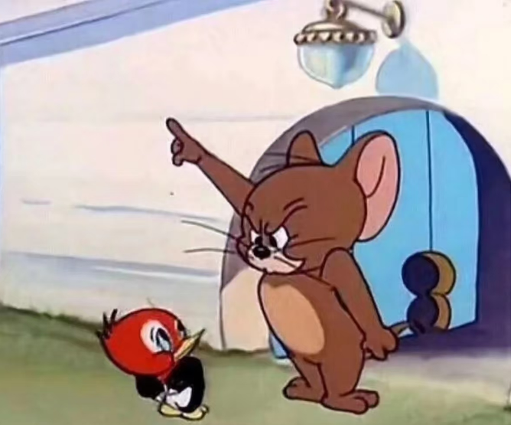
Why are They Popular?
Intense academic competition
02
Students face fierce rivalry to enter top schools.
03
"Don't Let Your Child Lose at the Starting Line"
Parents' aspirations
A common belief emphasizing early education.
Many parents want their children will have a bright future.
01

Slide 6
Pros and Cons

Slide 7

Benefits
The positive impacts
Improved academic performance
personalized attention
self-discipline and time management skills

Slide 8


Drawbacks
The challenges involved
Increased stress
Financial burden
Limited leisure time
01
02
03

Slide 9
Quick Question:
What is China’s approach to this situation?

Slide 10

The Double Reduction Policy
01
02
Reducing homework burden
Limiting extracurricular tutoring

Slide 11
Tutoring Classes After the Policy
01
02
Growing focus on 素质教育 (quality education)
Enhanced oversight on online courses

Slide 12
Grobal Education Trends

Slide 13

International Comparisons
Match
Rare use of tutoring, focus on equal opportunities.
Finland
High academic standards, widespread use of Juku (tutoring schools).
India
Growth in educational tech startups. (e.g. BYJU’s)
Japan

Slide 14
Thanks

