Slide 1
Translations by Mao Dun
by Yao Jia & Yuan shiqi

Slide 2
Contents
1. Personal Experience
2. Translation Theory
3. Translation Practice

Slide 3
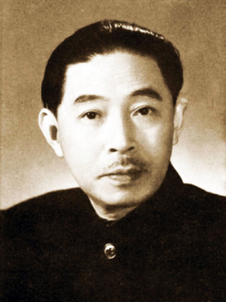
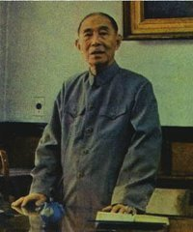
Mao Dun's personal experience

Slide 4
1. A Brief Introduction to Mao Dun's Lifetime
Mao Dun (1896-1981) was the pen name of Shen Dehong (Shen Yanbing), a 20th century Chinese novelist, cultural critic, and journalist.
He was also the Minister of Culture of China from 1949 to 1965.
He is currently renowned as one of the best realist novelists in the history of modern China.
He died on March 27, 1981 (aged 84) in Beijing.

Slide 5
2.Translation Achievements
Mao Dun is also an outstanding translator in modern China.
His literary career started from the initial translation activities, and his literary translation practice has run through his literary creation practice for more than 60 years.

Slide 6
2.Translation Achievements
He made outstanding contributions to literary translation in China. A large number of his translations, especially his works on the introduction of foreign literature, have become a valuable treasure in Chinese literary works.

Slide 7
Translation Theory
1.The Purpose of Literary Translation
Mao Dun believes that the main purpose of translating and introducing foreign literature is to facilitate the development of new literature and the spread of new thoughts in China.
Mao Dun's discussion on the purpose of translation plays an important role in guiding the development of translation in China.

Slide 8
2.Requirements of Literary Translation
Firstly, Mao Dun emphasized the "Romantic Charm" of literary translation. He requires that the translation and the original work should be similar in spirit, that is, "spirit similarity".
He is the earliest one in the history of Chinese translation who explicitly put forward that translation should not lose its “Romantic Charm”. It is Mao Dun who formally introduced "Romantic Charm", an important concept in traditional aesthetics, into translation theory.

Slide 9
Secondly, Mao Dun emphasizes the "style" of literary translation.
Mao Dun agreed with Yan Fu's translation criteria"faithfulness, expressiveness and elegance" , but due to the characteristics of literary translation, he paid special attention to "elegance".
He attached great importance to the literary grace and style of the translation.

Slide 10
Mao Dun also emphasized the artistic creativity of literary translation.
He believes that the translation language has to not only be the standard literary language of the country, but also conform to the style of the original work.
If there is no ready-made language for translators , they should explore suitable vocabulary from life or refine new vocabulary like writers.

Slide 11
3. Methods and Principles of Literary Translation
Mao Dun advocated both literal translation and free translation. For proses, he advocate literal translation; for poetry,free translation.
Mao Dun agreed that free translation should be based on preserving the spirit of the original rather than arbitrarily deleting words from original works.
In a word, Mao Dun's general principle of literary translation is to be loyal to the original work and express the spirit of the original work.

Slide 12
Translation Practice
1. Early Stage (1916-1919)
The genres of his translation at this stage are popular books, science fiction and the like, mostly of which are from British and American magazines and children's or students' books.
Most of his translations are written in classical Chinese and free translation is adopted.

Slide 13
2. Middle Stage (1919-1936)
After the Outbreak of the May 4th Movement, Mao Dun began to focus on literary translation and introduced a large number of foreign literary works, formally embarking on the road of literary translation.
The first novel he translated was Chekhov's short story At Home. This is Mao Dun's first vernacular translated novel.

Slide 14
The translated objects at this stage are mainly works of weak nations and oriental nations.
The translated works of this period are more varied in genres, including novels, plays, poems and so on.

Slide 15
3. Late Stage (1936-1948)
In this stage, China's War of Resistance against Japanese Aggression broke out, and the world anti-Fascist movement gained momentum.
At this period, Mao Dun finished his last translation work Candle which is written by Simonov.

Slide 16
It was winter-time; the air was cold, the wind was sharp, but within the closed doors it was warm and comfortable, and within the closed door lay the flower; it lay in the bulb under the snow-covered earth.
茅盾的译文:是冬天哪;天气冷，风是尖溜溜的;可是屋子里关得紧紧儿的，是暖和的，那雪球花儿呢，这时也躺在尾子里;就是躺在雪泥土下面的那个球根儿里。

Slide 17
Thanks for listening！

