Slide 1

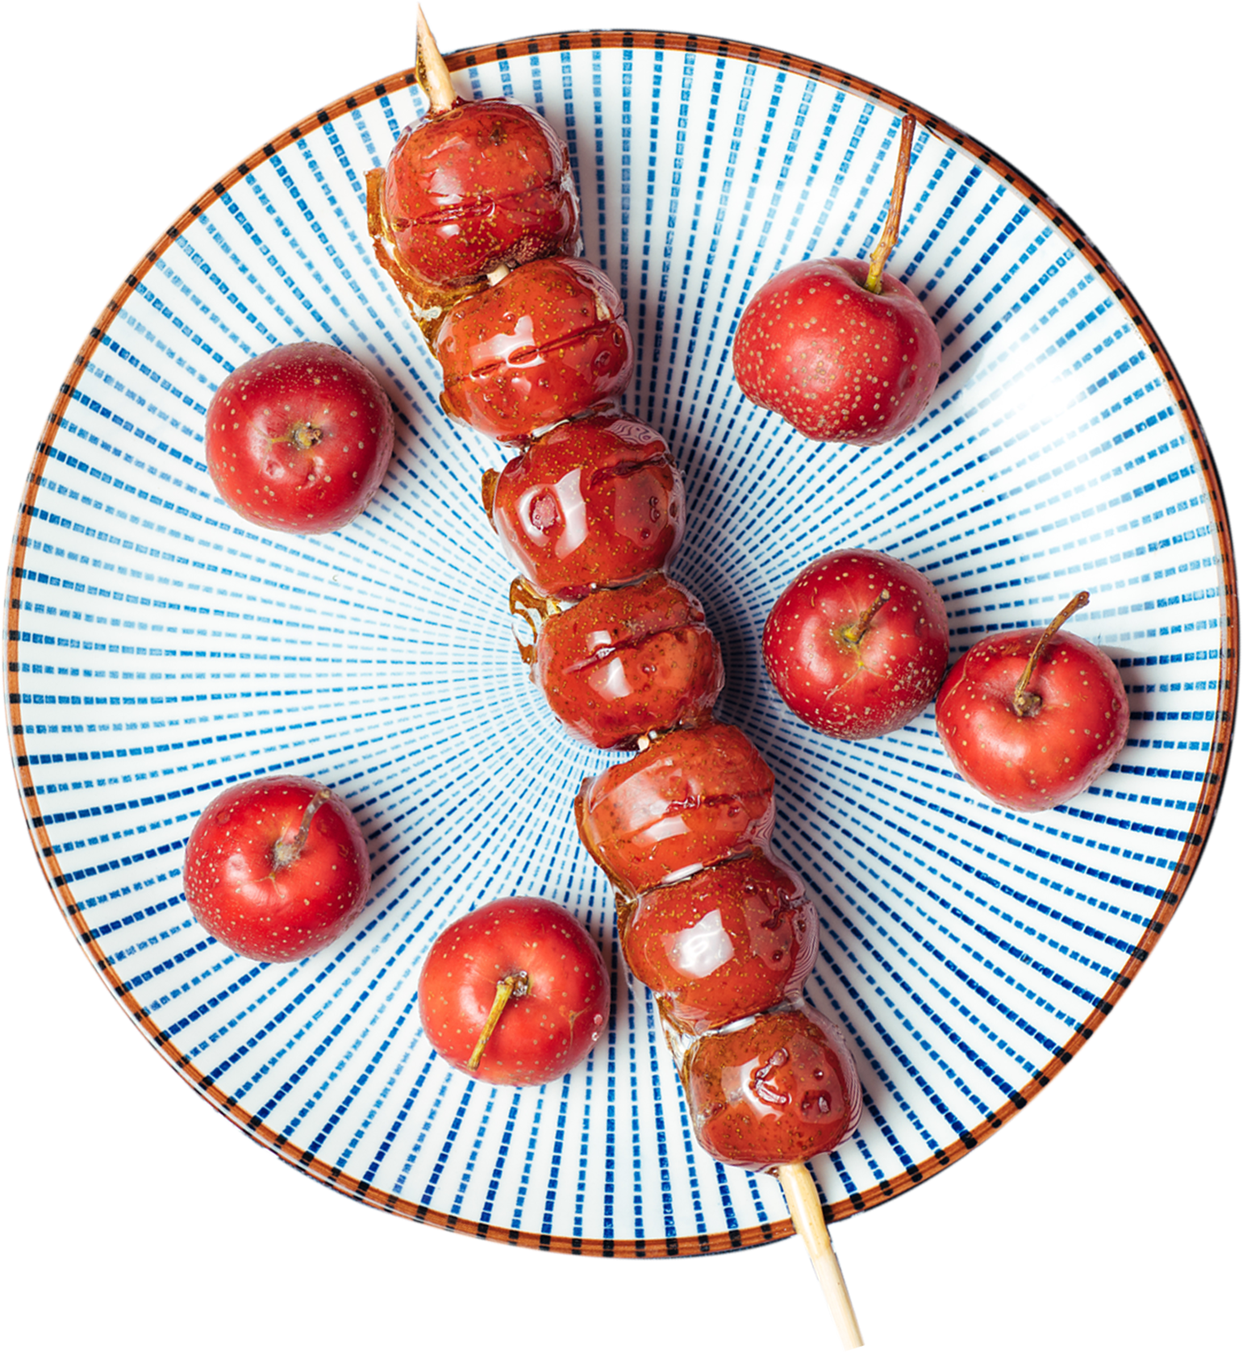
Tanghulu,
Sugar-coated Haws on a Stick
Chen Mengzhu (Chris)

Slide 2
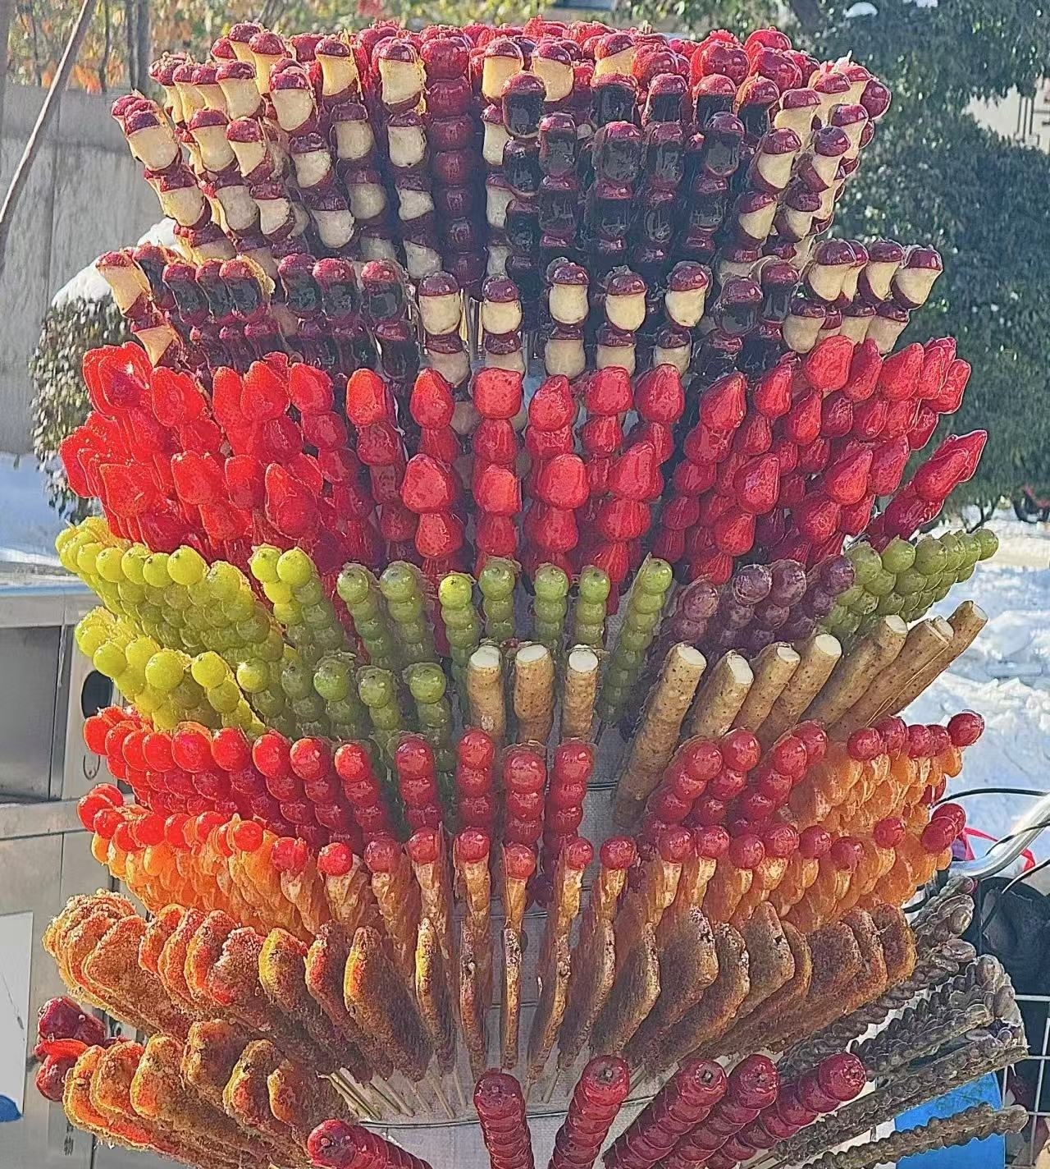
Which is your favorite one?

Slide 3
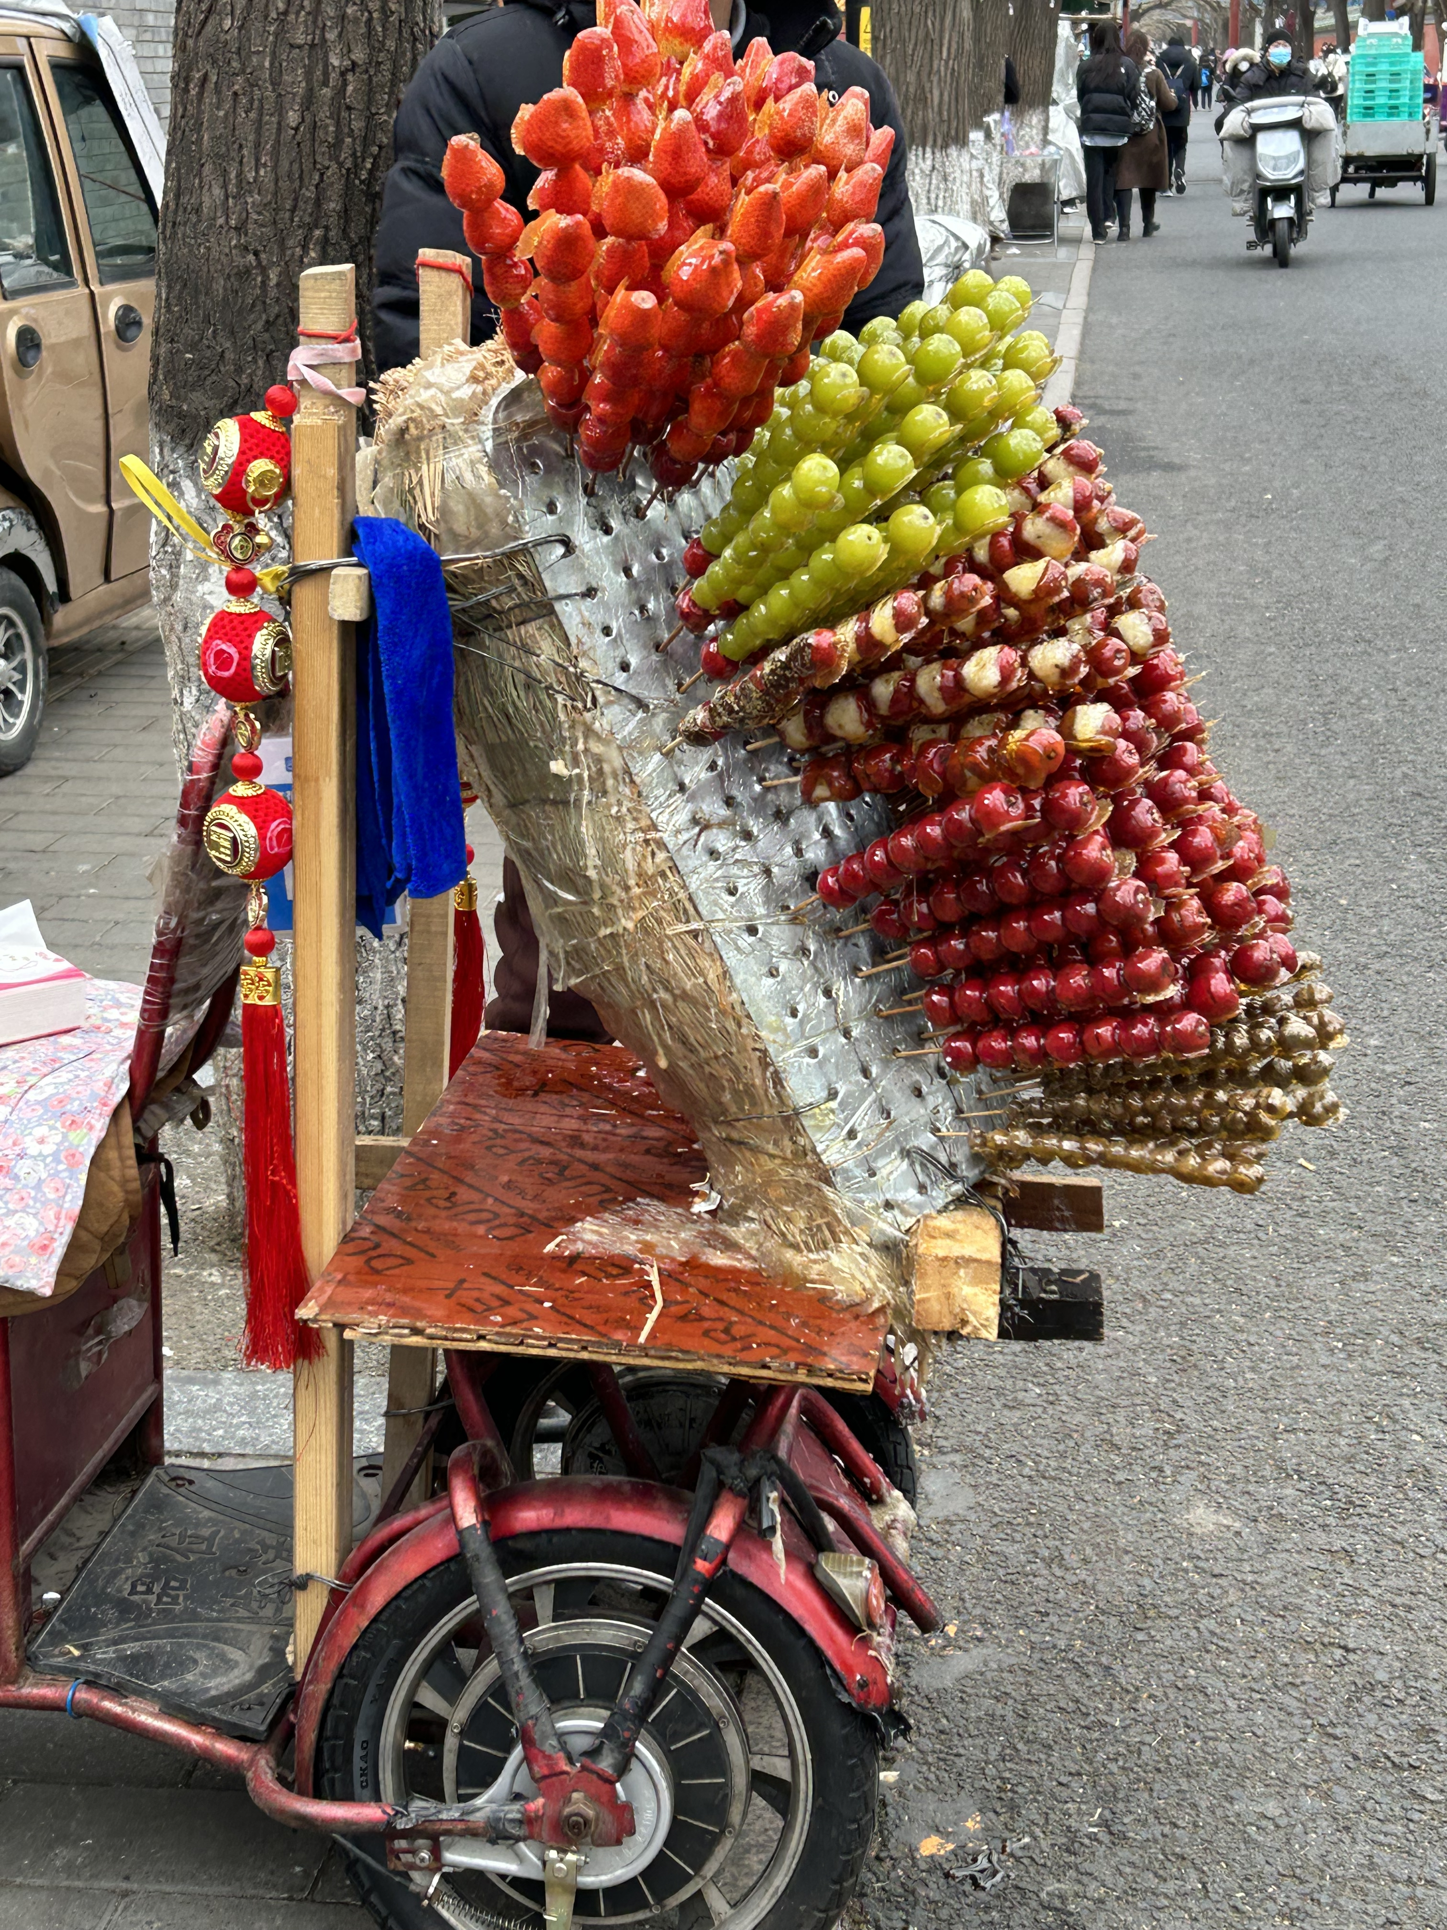
About Tanghulu
Origins of Tanghulu
Production Process
Nutritive Value
Commercialization & Innovation
Cultural Significance

