Slide 1
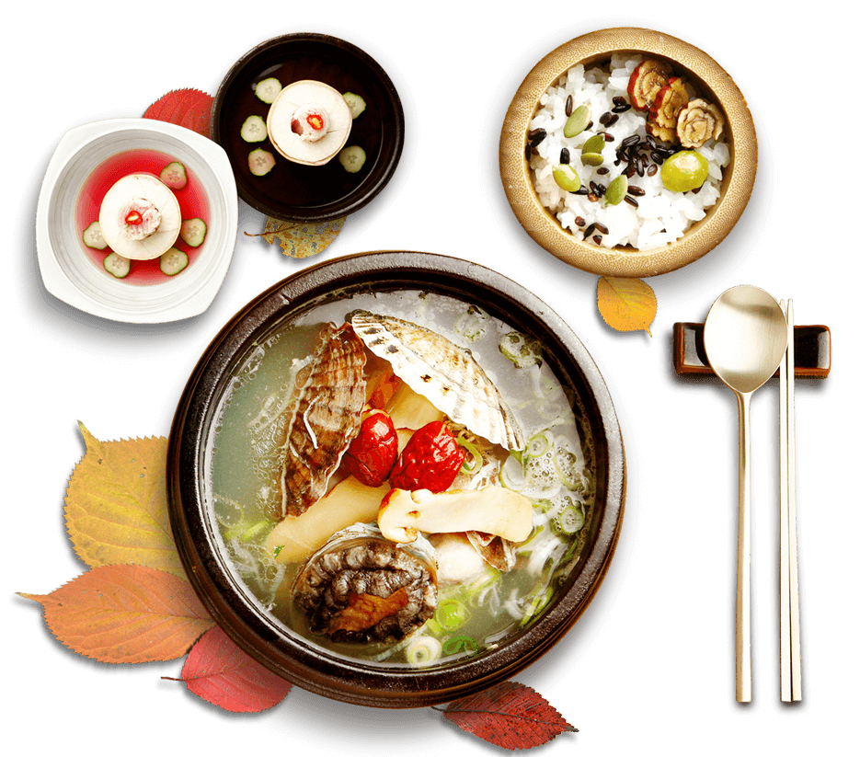

Exploring China's Eight Culinary Traditions
Speaker: Zheng Kaiwu
TIME: 2025
2025
DESIGN
DESIGN
DESIGN
DESIGN
DESIGN
DESIGN
DESIGN
DESIGN
DESIGN

Slide 2

目录
CONTENTS
01
Chinese Culinary Philosophy
02
Formation of 8 Traditions
03
Culinary Regions Breakdown
04
Cultural Connections

Slide 3
01
Part
Chinese Culinary Philosophy
2025
DESIGN
DESIGN
DESIGN
DESIGN
DESIGN
DESIGN
DESIGN
DESIGN
DESIGN

Slide 4
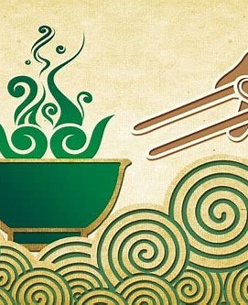
Chinese Culinary Philosophy
1、Five Elements Theory：Balance of flavors (Sweet/Sour/Bitter/Spicy/Salty)
2、Seasonal Eating："Eat with the seasons" principle
3、Food as Medicine：Herbal ingredients integration

Slide 5
02
Part
Formation of 8 Traditions
2025
DESIGN
DESIGN
DESIGN
DESIGN
DESIGN
DESIGN
DESIGN
DESIGN
DESIGN

Slide 6
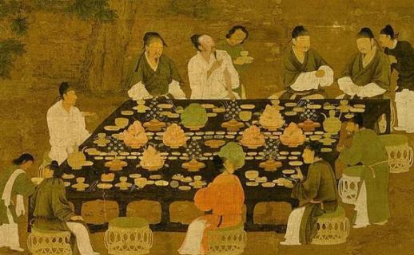
Formation of 8 Traditions
Key Influences
1、Geographical diversity (Mountains/Coasts/Rivers)
2、 Historical trade routes (Silk Road/Tea Horse Road)
3、Imperial court influences
4、Climate impact（e.g.，
Humid Sichuan → Chili-heavy dishes
Coastal Fujian → Seafood mastery）

Slide 7
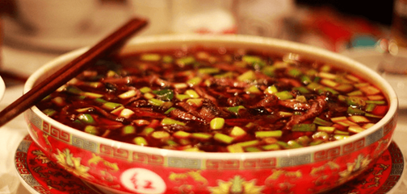
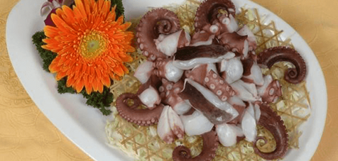
Climate Impact
Humid Sichuan
Sichuan's humid climate leads to a preference for chili peppers to remove dampness. Hot pot has become a must- have dish in winter.
Dishes like Mapo Tofu and Spicy Shredded Beef are popular for their rich spicy flavors.
Coastal Fujian
Fujian's coastal location provides abundant seafood. Steaming and poaching are used to preserve the original flavor of seafood.
The famous Buddha Jumps Over the Wall is a nutritious dish that combines various delicacies.

Slide 8
03
Part
Culinary Regions Breakdown
2025
DESIGN
DESIGN
DESIGN
DESIGN
DESIGN
DESIGN
DESIGN
DESIGN
DESIGN

Slide 9

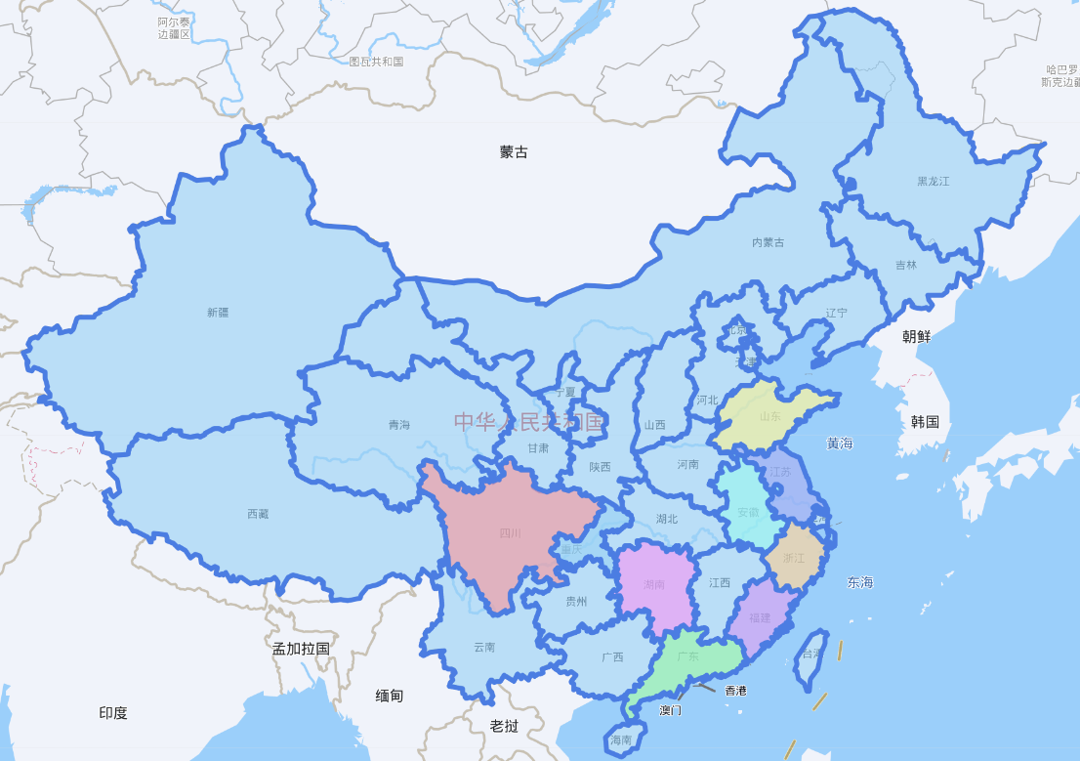
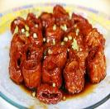
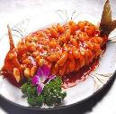
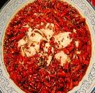
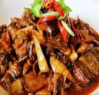
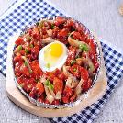
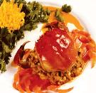
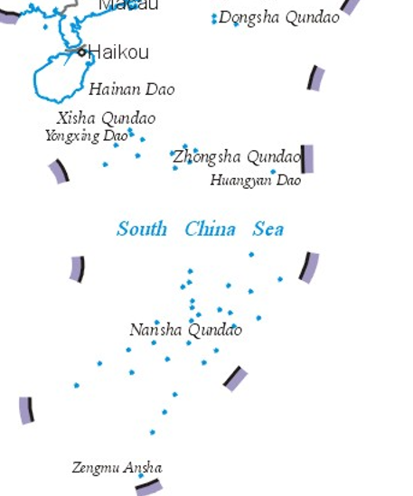
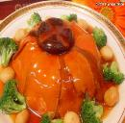
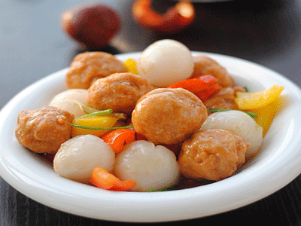
Culinary Regions Breakdown
Lu
Su
Hui
Chuan
Zhe
Xiang
Min
Yue

Slide 10
Quiz
Which cuisine is the most spicy？And how about the least one？
01
Spicy Degree
Zhe
Su
Yue
Min
Lu
Hui
Xiang
Chuan
Response from Doubao

Slide 11
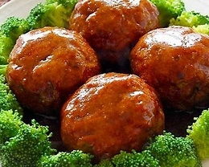
Shandong (Lu)
Signature
Shandong cuisine is known for its soup- making skills and seafood dishes. Clear and creamy soups are distinctive. Cooking methods like steaming and braising are common.
For example, Dezhou Braised Chicken is crispy on the outside and tender inside, with a rich aroma. Four- Joy Meatballs are plump and juicy, symbolizing happiness.
Must-try
Shandong cuisine emphasizes the use of high heat and precise seasoning, resulting in rich and nutritious dishes.
For example, Sweet and Sour Yellow River Carp is a classic dish with a perfect balance of sweet and sour flavors, and the fish is crispy on the outside and tender inside.
Four-Joy Meatballs

Slide 12
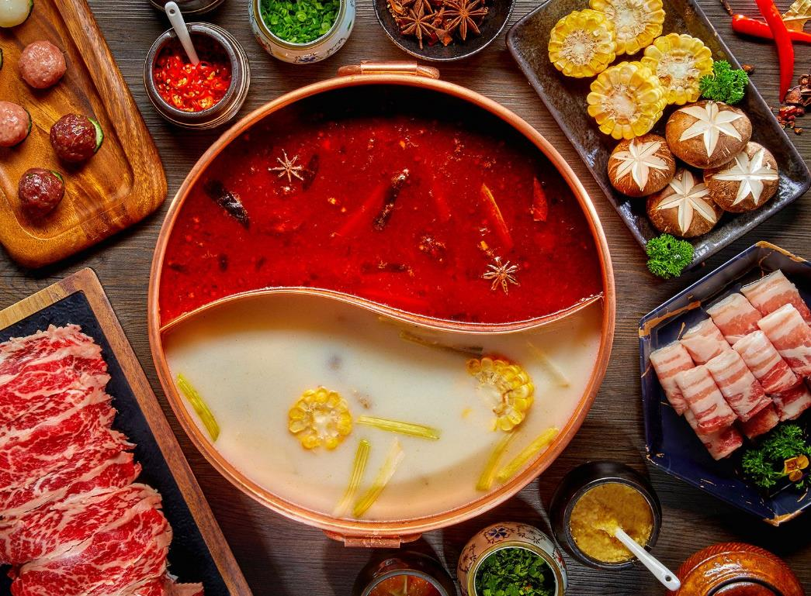
Sichuan (Chuan)
Magic
Sichuan peppercorns provide a unique numbing sensation that complements the spiciness of chili peppers. Dishes like Hot Pot and Shredded Beef in Chili Sauce are widely loved.
For example, Mapo Tofu is a signature dish with a rich spicy flavor and a soft, tender texture.
Fun Fact
Sichuan cuisine has 23 distinct flavor combinations, showcasing its complexity. Fish- fragrant shredded pork, despite its name, does not contain fish but has a unique flavor.
For example, Kung Pao Chicken is a popular dish with a sweet and spicy taste, tender chicken, and crunchy peanuts.

Slide 13
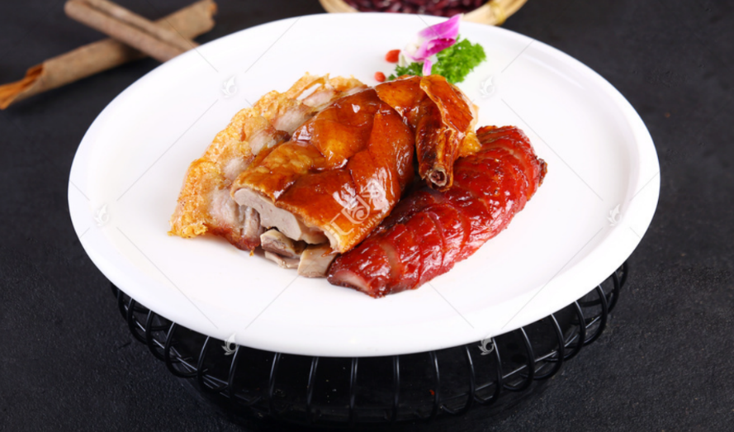
Guangdong (Yue)
01
Global Influence
Cantonese cuisine has the highest global presence, with 70% of Chinese restaurants worldwide. Dim sum culture is popular globally, with items like shrimp dumplings and pork buns.
For example, Cantonese cuisine focuses on precise cooking techniques to retain the freshness of ingredients. The "wok hei" or "breath of the wok" is key to the unique flavor of stir- fried dishes.
02
Technique
Cantonese cuisine emphasizes precise cooking techniques to retain the freshness of ingredients. The "wok hei" or "breath of the wok" is key to the unique flavor of stir- fried dishes.
For example, Cantonese roast goose has crispy skin and tender meat, with a golden color, making it a classic dish.
Roast Meat Platter

Slide 14
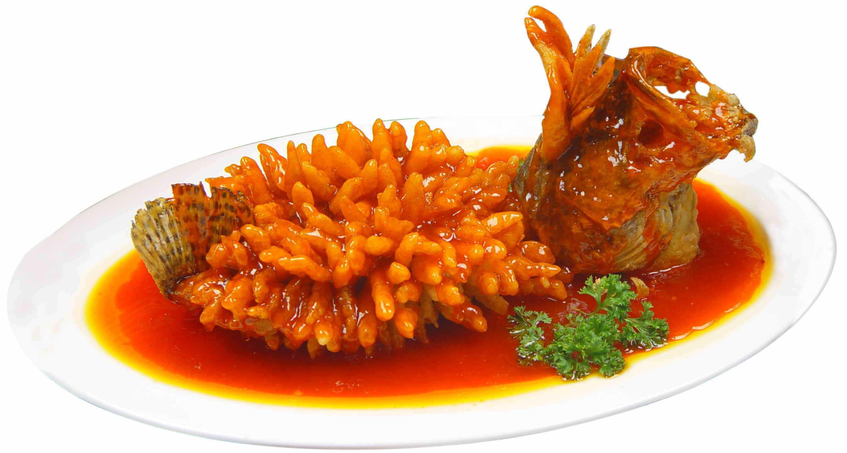
Jiangsu (Su)
Artistry
Specialty
Jiangsu cuisine is known for its exquisite presentation, like the lifelike appearance of squirrel fish. The dishes are visually appealing and delicious.
For example, the cooking of Jiangsu cuisine focuses on precise heat control and seasoning, resulting in dishes that are fresh and nutritious.
Lion's Head meatballs are tender and juicy, with a rich flavor. Yangzhou Fried Rice is a classic dish with a variety of ingredients and a harmonious taste.
For example, Jiangsu cuisine emphasizes the use of high heat and precise seasoning, resulting in dishes that are rich and nutritious.
Squirrel-Shaped Mandarin Fish

Slide 15
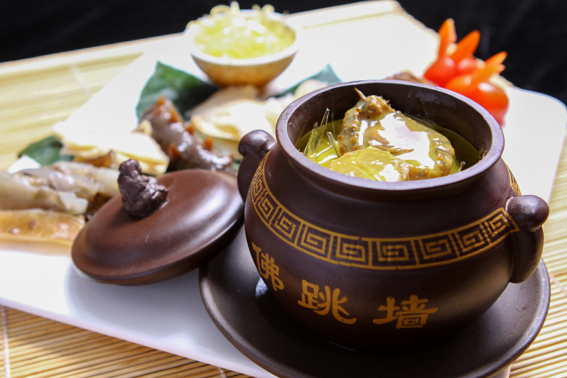
Fujian (Min)
Unique
Fujian cuisine often uses red yeast rice for fermentation, giving dishes a unique color and flavor. Buddha Jumps Over the Wall is a nutritious dish combining various delicacies.
For example, Fujian cuisine focuses on precise cooking techniques to retain the freshness of ingredients, resulting in dishes that are fresh and nutritious.
Legend
The aroma of Buddha Jumps Over the Wall is so enticing that it is said to make monks jump over walls. Fujian cuisine has a long history and rich cultural heritage.
For example, Fujian cuisine focuses on precise cooking techniques to retain the freshness of ingredients, resulting in dishes that are fresh and nutritious.
Steamed Abalone with Shark’s Fin and Fish Maw in Broth

Slide 16
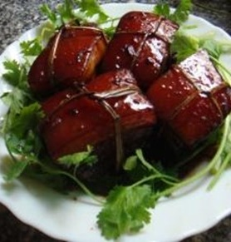
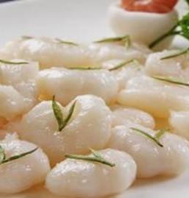
Zhejiang (Zhe)
Essence
Zhejiang cuisine is known for its freshwater delicacies, such as West Lake Fish in Vinegar Gravy, which is sour and refreshing with a delicate taste.
For example, Zhejiang cuisine focuses on precise cooking techniques to retain the freshness of ingredients, resulting in dishes that are fresh and nutritious.
”
History
Zhejiang cuisine originated from the royal recipes of the Southern Song Dynasty and has a long history. Dongpo Pork is a classic dish with a shiny red color and a rich flavor.
For example, Zhejiang cuisine focuses on precise cooking techniques to retain the freshness of ingredients, resulting in dishes that are fresh and nutritious.
”

Slide 17
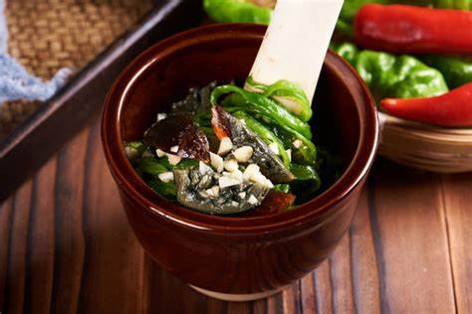
Hunan (Xiang)
Spicy Level
Character
Hunan cuisine is known for its high spice level, with a preference for dried chili peppers and a strong flavor. The dishes are spicy but not greasy.
For example, Hunan cuisine focuses on precise cooking techniques to retain the freshness of ingredients, resulting in dishes that are fresh and nutritious.
Hunan cuisine is known for its dry- spice character, which is different from Sichuan's oily- spice. Dishes like Steamed Fish Head with Chopped Chili are fresh and spicy.
For example, Hunan cuisine focuses on precise cooking techniques to retain the freshness of ingredients, resulting in dishes that are fresh and nutritious.

Slide 18

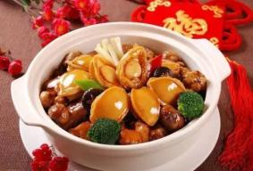
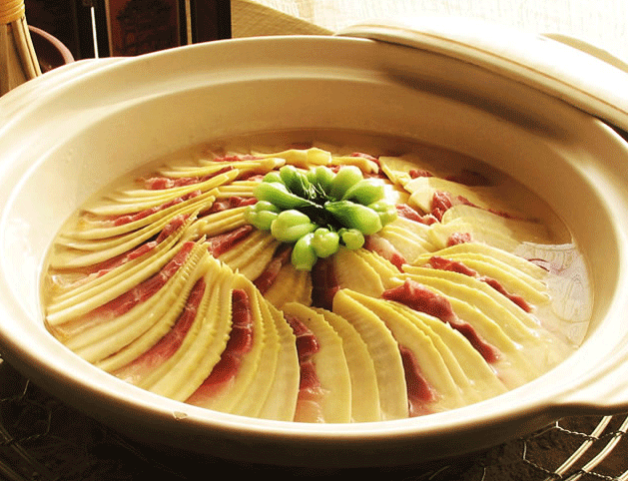
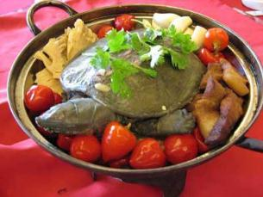
Anhui (Hui)
Mountain Cuisine
Secret
Hui cuisine often uses wild herbs and preserved ingredients. It is known for its rich oil, dark color, and strong flavor. Huangshan Braised Pigeon is a classic dish.
For example, Hui cuisine focuses on precise cooking techniques to retain the freshness of ingredients, resulting in dishes that are fresh and nutritious.
The banquet culture of Hui merchants has influenced Hui cuisine. The dishes emphasize the original flavor of ingredients and have unique cooking techniques.
For example, Hui cuisine focuses on precise cooking techniques to retain the freshness of ingredients, resulting in dishes that are fresh and nutritious.

Slide 19
04
Part
Cultural Connections
2025
DESIGN
DESIGN
DESIGN
DESIGN
DESIGN
DESIGN
DESIGN
DESIGN
DESIGN

Slide 20
Food Rituals
Lunar New Year fish
Mooncakes for Mid-Autumn
Eating fish during the Lunar New Year is a tradition symbolizing abundance. Various types of fish are prepared in different ways.
For example, braised fish and steamed fish are common dishes on New Year's Eve, symbolizing prosperity and good fortune.
Mooncakes are eaten during the Mid- Autumn Festival to symbolize unity. There are many types of mooncakes with different fillings.
For example, five- nut mooncakes and lotus seed paste mooncakes are popular, symbolizing reunion and happiness.

Slide 21
Modern Impact
UNESCO Intangible Heritage
World Food Travel Map
Chinese culinary culture has been included in UNESCO's Intangible Cultural Heritage, highlighting its unique value.
For example, local cuisines like Sichuan and Cantonese have gained global attention and become representatives of Chinese culture.
Three Chinese cities have been included in the World Food Travel Map, showcasing the global influence of Chinese cuisine.
For example, cities like Chengdu, Guangzhou, and Shanghai attract numerous tourists with their rich culinary cultures.

Slide 22
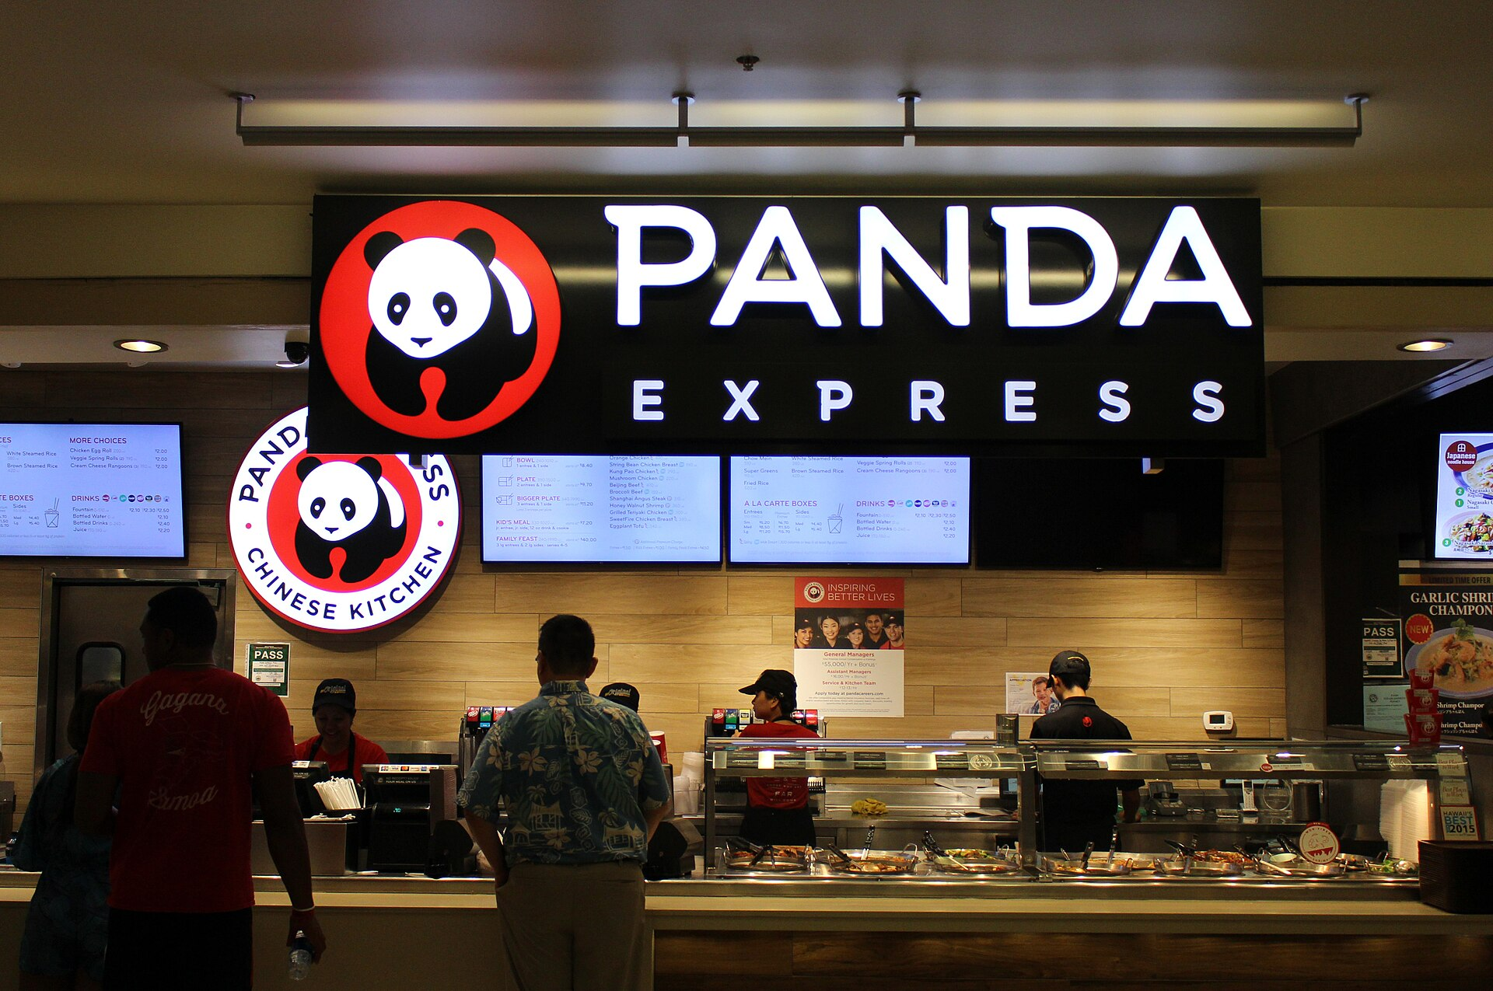
Global Impact
Panda Express is an American fast food restaurant chain that specializes in American Chinese cuisine. With over 2,400 locations, it is the largest Asian-segment restaurant chain in the United States.

Slide 23
Thank
Yyou
Speaker: Zheng Kaiwu
TIME: 2025
2025
DESIGN
DESIGN
DESIGN
DESIGN
DESIGN
DESIGN
DESIGN
DESIGN
DESIGN

