Slide 1

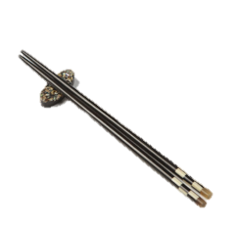
Shandong
中
国
美
食
文
化
Cuisine
—— Shandong Cuisine——
Prensenter: Lu Wei

Slide 2
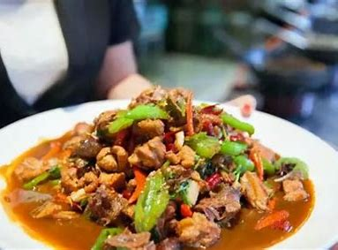


Shandong Cuisine
Contents
Historical Origins
Classification and Taste
Meaning

Slide 3
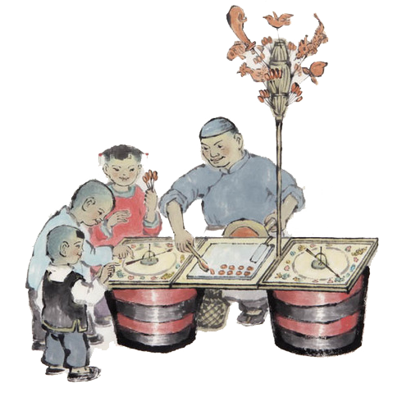
Historical Origins
1

Slide 4
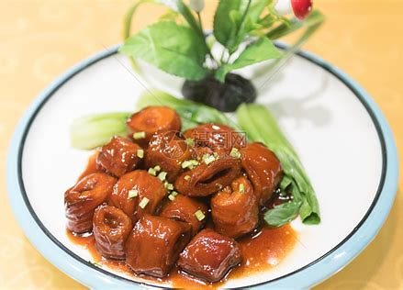
Historical Origins
One of the “Four Major Cuisines” in China
The origins: the Spring and Autumn Period and the Warring States Period

Slide 5






Historical Origins
Qi
Han
the Northern Wei
Song
the Ming and Qing Dynasties
After the founding of the People's Republic of China:
the policy of "adapting to local customs and simplifying rituals
Yi Ya
diversity
the agronomist Jia Sixie summarized 17 common cooking techniques in his book "Qi Min Yao Shu
"Northern Cuisine," spreading to Beijing, Tianjin, and the three northeastern provinces.
Many chefs and dishes from Shandong made their way into the imperial court
a staple at state banquets

Slide 6
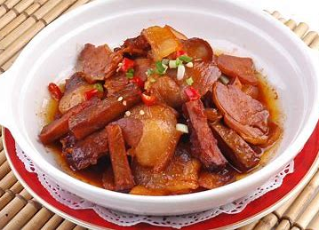
Classification and Taste
2

Slide 7
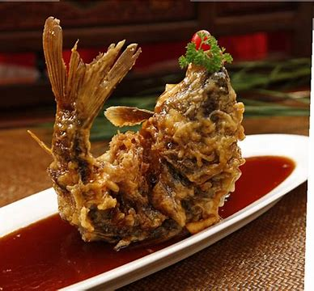
Part 1 Traditional Dishes
Sweet and sour carp（Jinan）
golden color
crispy exterior
tender interior
sweet and sour taste
fragrant freshness

Slide 8
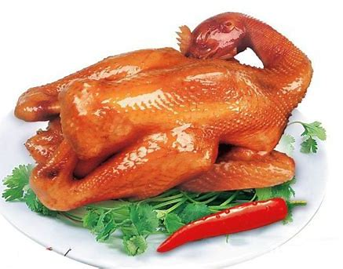
Part 1 Traditional Dishes
Dezhou Braised Chicken(Dezhou)
Dezhou Five-Spiced Deboned Braised Chicken
one of the famous "Three Treasures of Dezhou" (Braised Chicken, Watermelon, and Golden Thread Dates)
earning the reputation of being the "Best Chicken in the World"

Slide 9
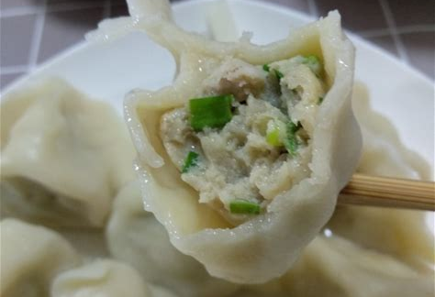
Part 2 Seafood--The Delicacy of Coastal Cities
Jiaozi Stuffed with Mackerel
The skin is thin, elastic and moist--perfectly wrap the generous fillings
Not only retains the fresh and fragrant flavor of the Spanish mackerel but also enhances the overall taste layers.
The dumplings have thin skins and thick fillings.

Slide 10
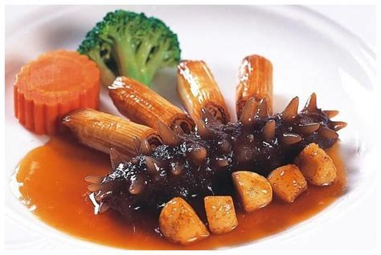
Part 2 Seafood--The Delicacy of Coastal Cities
Braised Sea Cucumber with Scallion(Jiao Dong)
One of the "Ancient and Modern Eight Delicacies"
Soaked sea cucumber and green onions
Resh and tender with a smooth, fragrant texture, while the green onion segments are richly flavored.

Slide 11
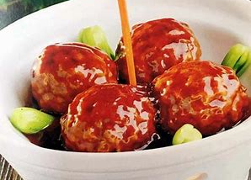
Meaning
3

Slide 12
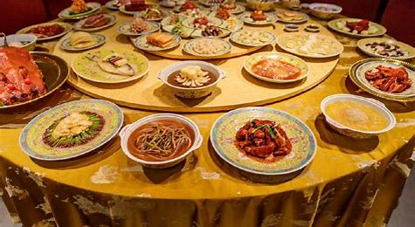
Meaning
The perfect integration of visual, olfactory, and taste sensations
Solemn sense of ritual
Table manners

Slide 13
Thanks for
中
国
美
食
文
化
your listening
—— Shandong Cuisine——
Prensenter: Lu Wei

