Slide 1
The Wedding Dress in the Song Dynasty
Exploring the Traditional Attire of Marriage in Ancient China
Liu Chao
2025/03/14

Slide 2
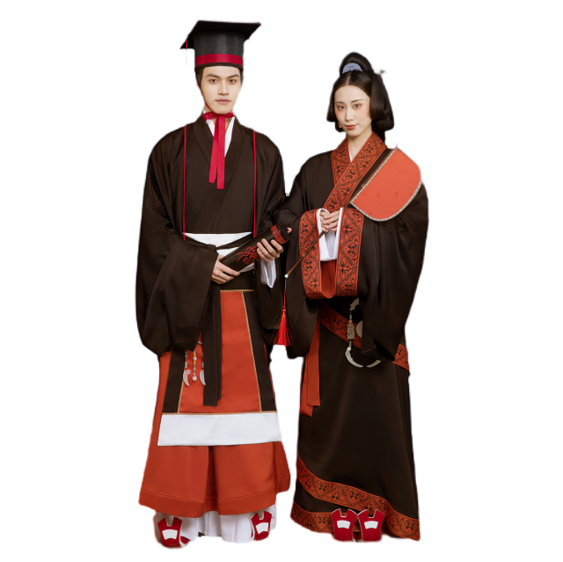
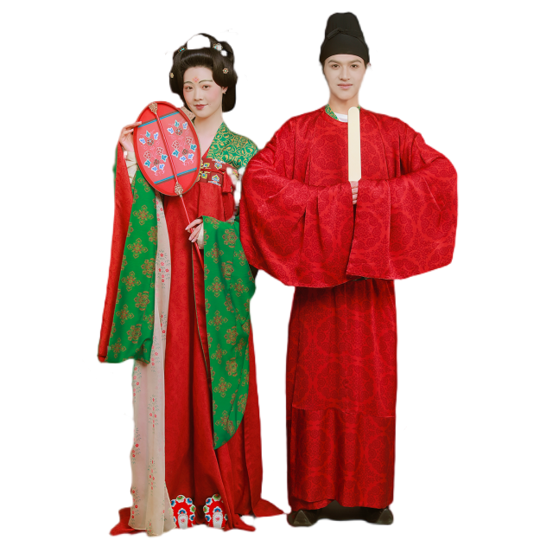
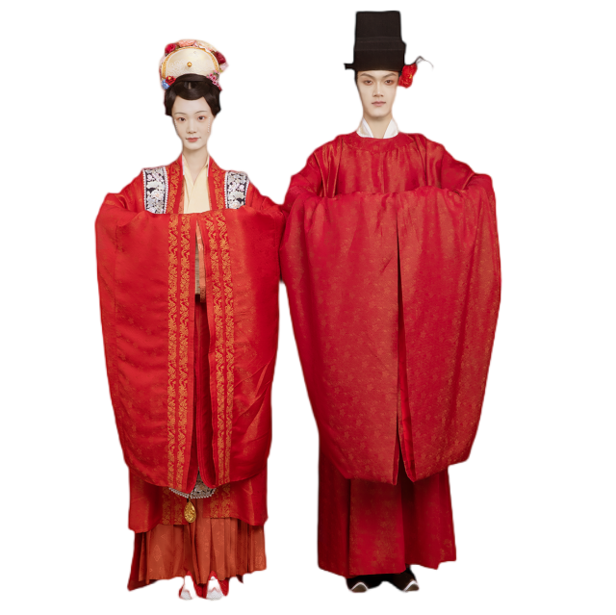
What comes to your mind when you think of ancient wedding dresses?

Slide 3
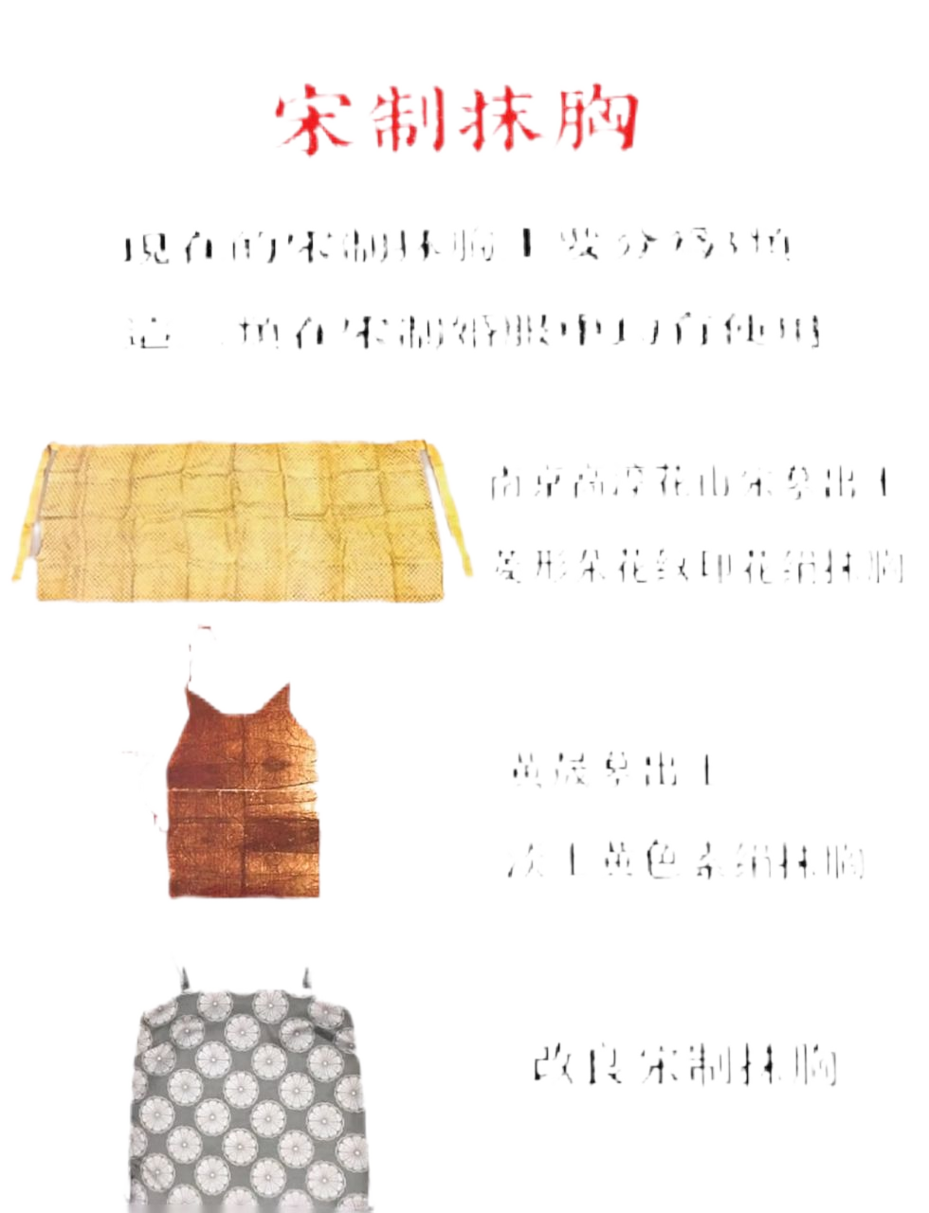
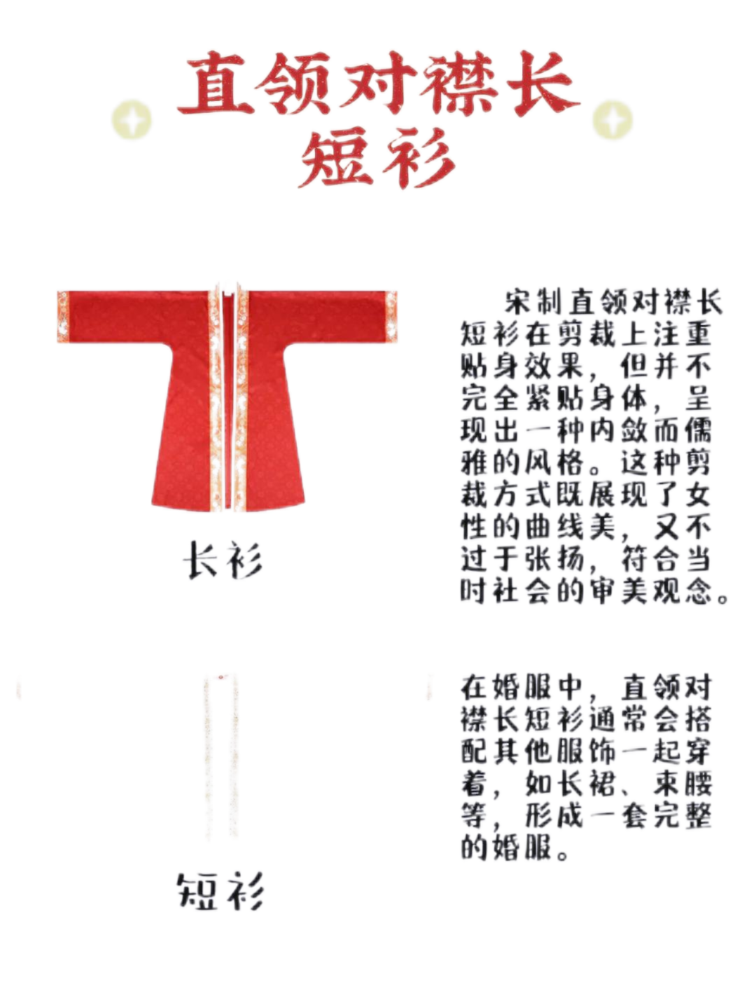
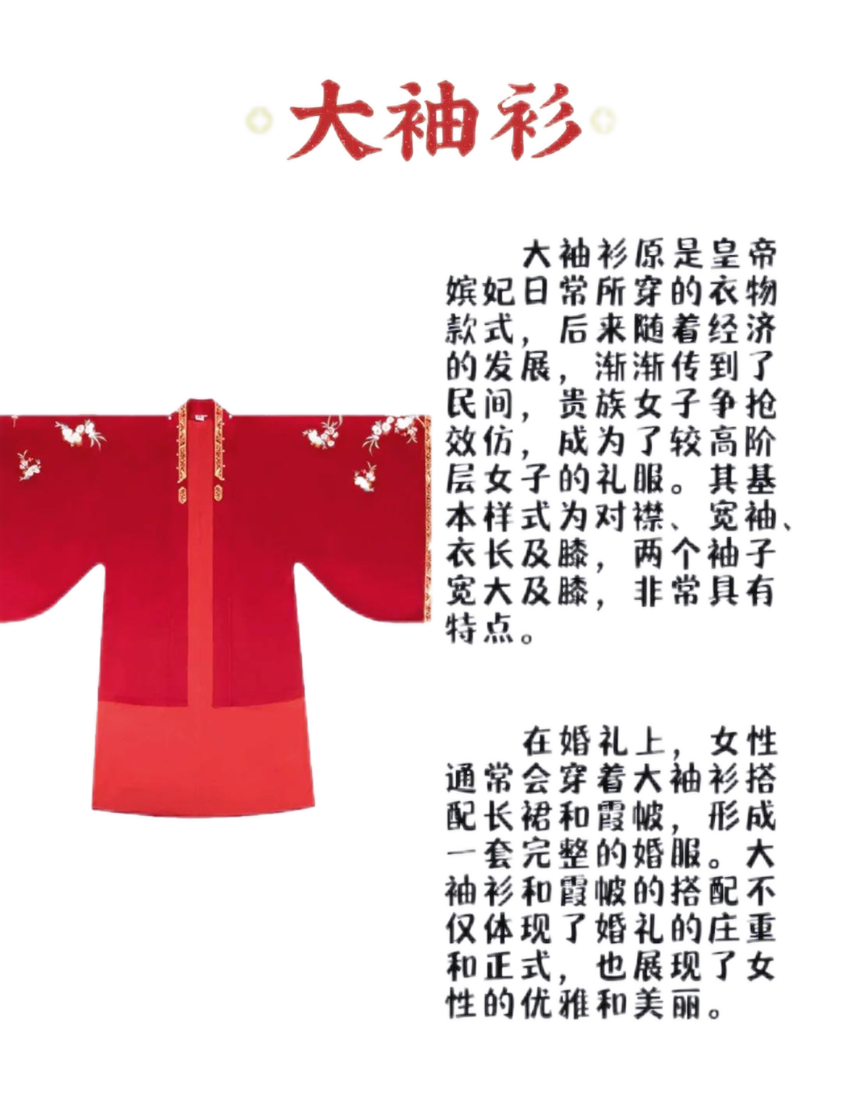
1.1 Key Garments
Bodice（抹胸）
Long Sleeve（大袖衫）
Jacket（直领对襟长短衫）

Slide 4
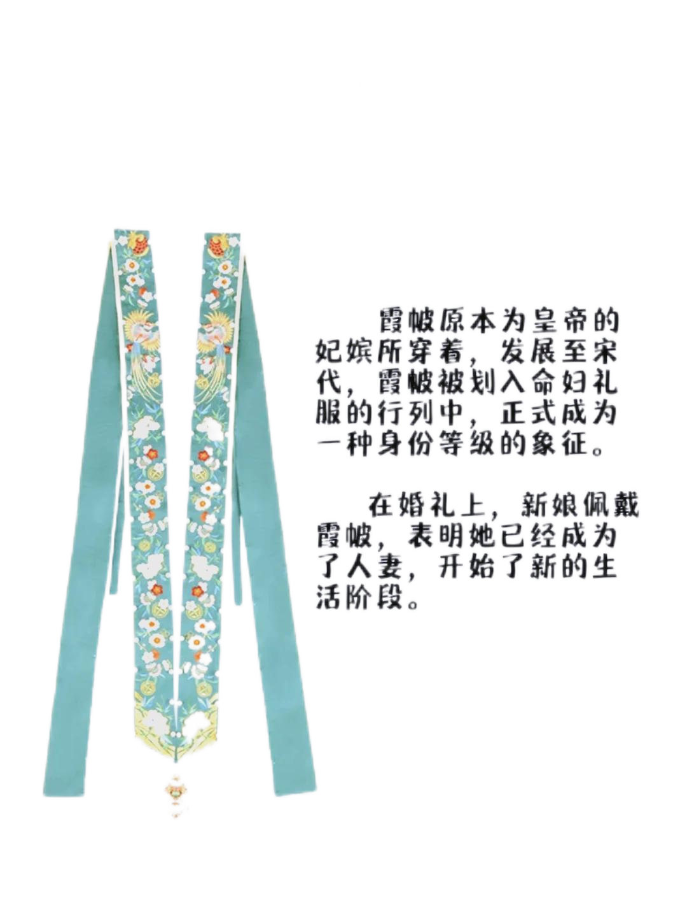
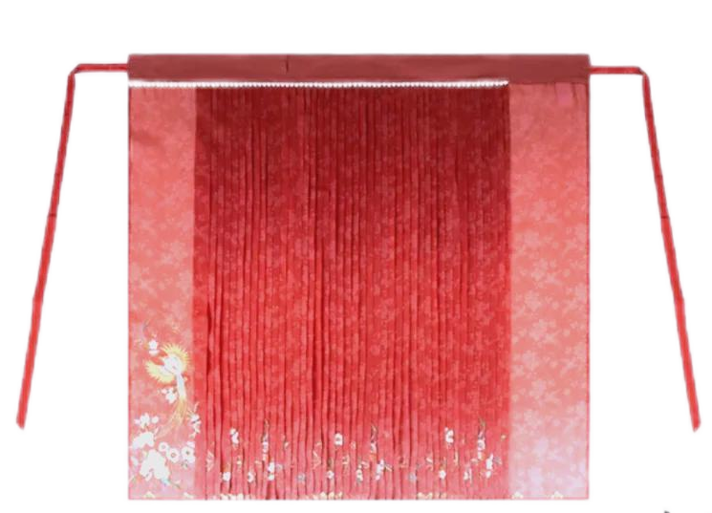
1.2 Skirt and Shawl
O1
Pleated Skirt（百迭裙）
O2
Xiapèi（霞帔）

Slide 5
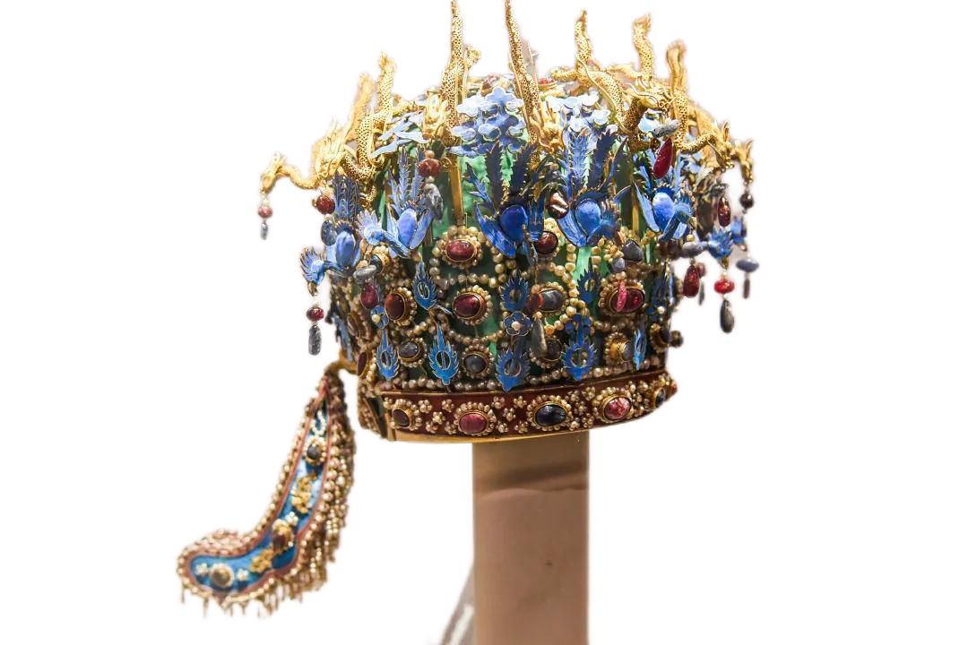
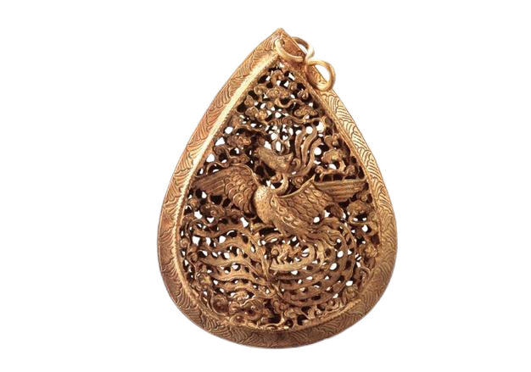
1.3 Headwear
Phoenix Crown（凤冠）
Pendant（帔坠）

Slide 6
Demonstration
Phoenix Crown
Bodice
Xiapei
Long Sleeve
Jacket
Pleated Skirt
Pedant

Slide 7
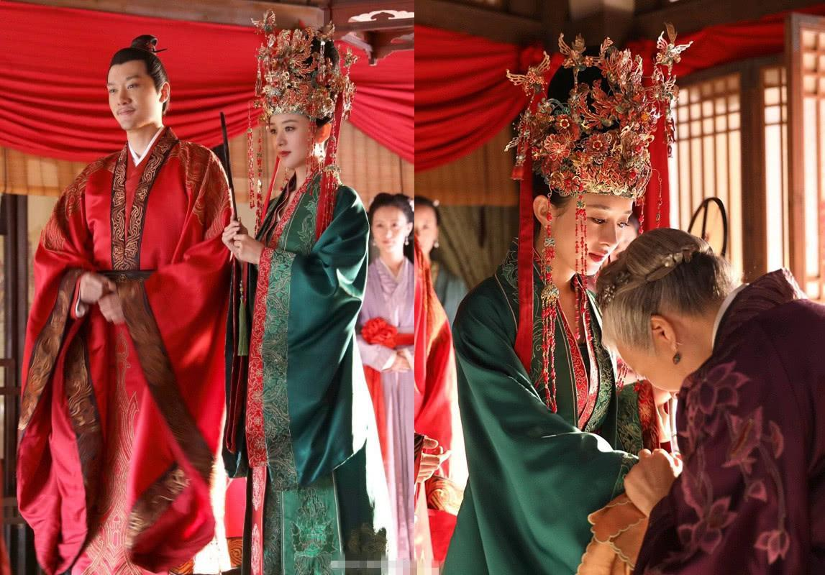
2 Color and Matching
Red and Green
Marriage Rules:
brides of lower social status wore red, while those of higher status wore green

Slide 8
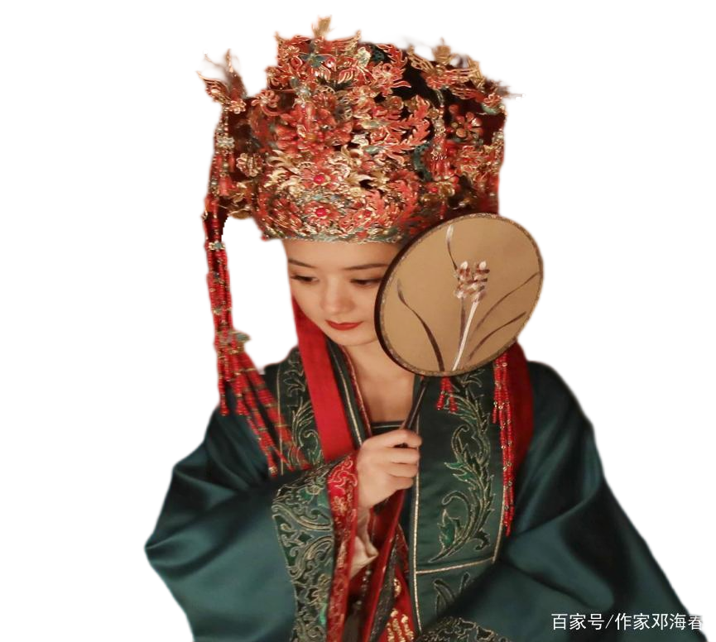
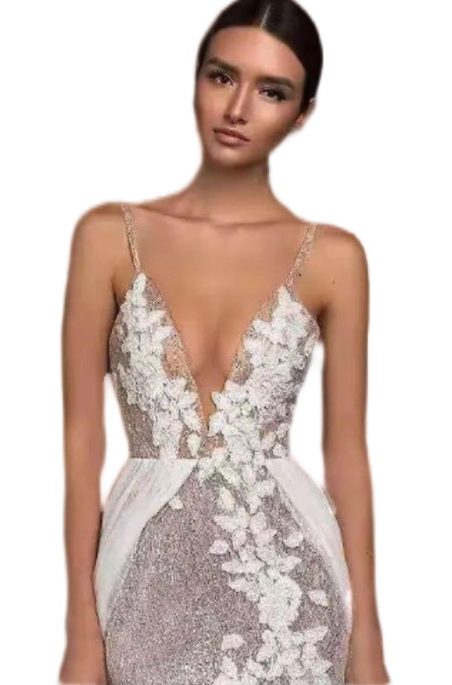
3. Comparison
Eastern Dress
Western Dress
In Song Dynasty, brides wore red silk dresses.
In Western cultures, white gowns.

Slide 9
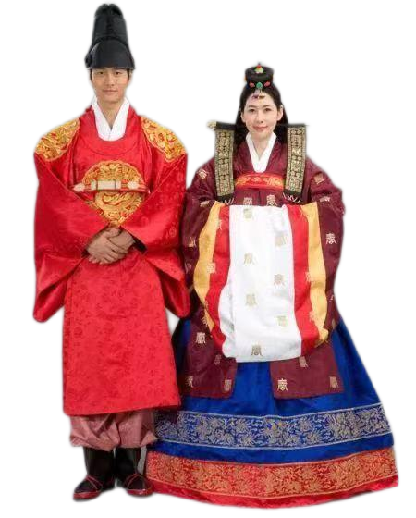
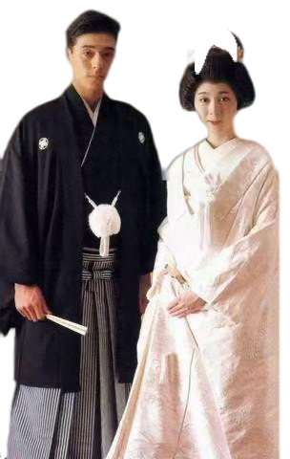
3. Comparison
South Korea
Japan
Similar to China’s wedding attire
Primarily in black and white

Slide 10
Thanks for your listening!
Liu Chao
2025/03/14

