Slide 1

The Chinese tradition of ancestor worship

Slide 2

veneration: no religion but loyalty
Neolithic period and Shang Dynasty
Beliefs: two souls: “魄”（po） “魂”（hun）
Origins

Slide 3
1. Washing Hands
4. Reading the Sacrificial Text
Customs
2. Burning Incense
5. Kowtow or Bowing
3. Setting out Offerings
6. Burning Paper Money

Slide 4

Q: What festivals are there in China to worship ancestors?

Slide 5
New Year's Eve
Qingming Festival
Zhongyuan Festival
The Double Ninth Festival
Festivals of worship

Slide 6
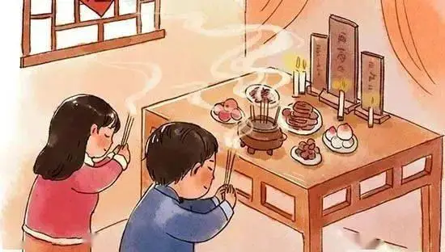
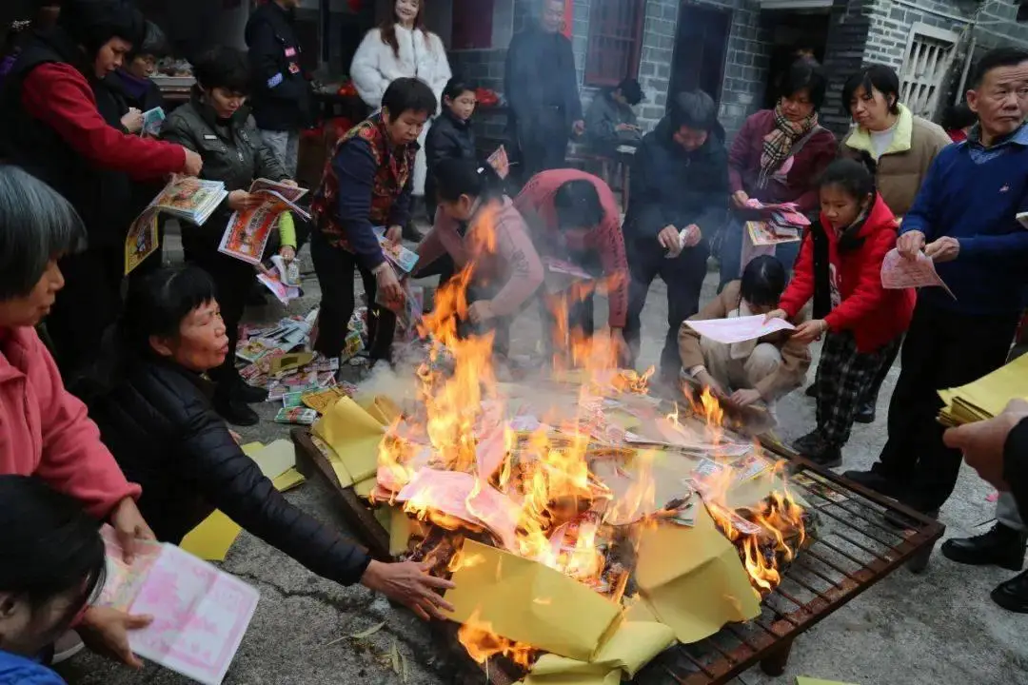
New Year's Eve
1. couplets
2. Paper cuttings
3. paper money
1

Slide 7
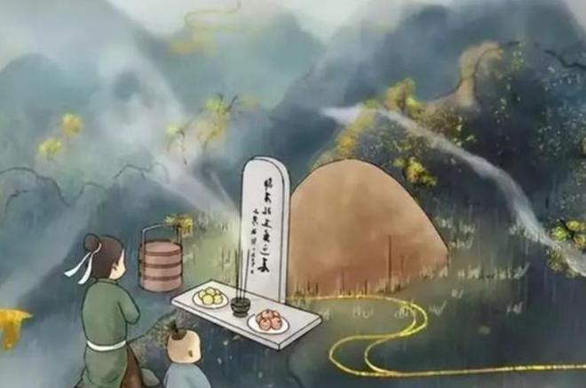
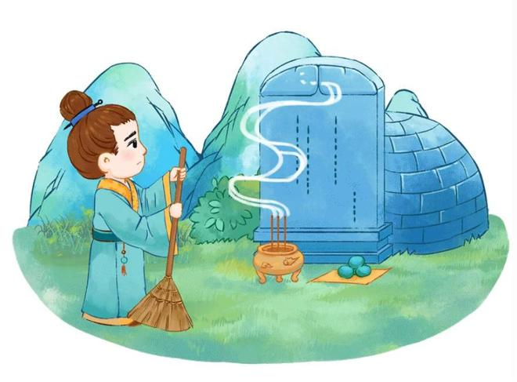
Qingming Festival
2
1. Grave Sweeping
2. Burning Paper

Slide 8

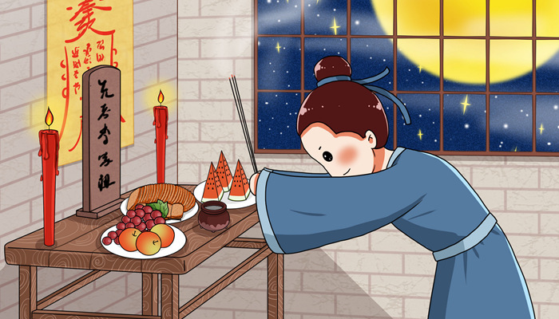
Zhongyuan Festival
1. Veneration
2. Praying for a Bountiful Harvest
3. Releasing River Lanterns
3

Slide 9
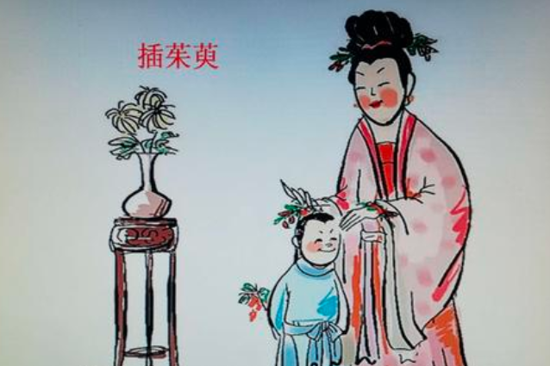
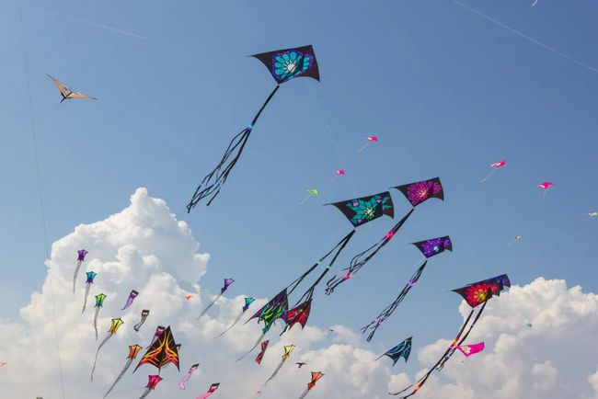
The Double Ninth Festival
4
1. Wearing cornel twigs
2. Respecting the Elderly
3. Flying Kites

Slide 10

Thanks

