Slide 1



PDD 拼多多Buytogether
Wang Yujiao
2024.11.14

Slide 2
CONTENTS
PART 1
A brief introduction to Pinduoduo.
PART 2
The development history of Pinduoduo.
PART 3
The advantages of Pinduoduo.
PART 4
The problems of Pinduoduo.

Slide 3

PART1
A brief introduction to Pinduoduo

Slide 4
PART1
A brief introduction to Pinduoduo
Pinduoduo was founded in April 2015, and it is a third-party social e-commerce platform focused on C2M (Consumer-to-Manufacturer) group buying. Pinduoduo opened up the market with low prices and has developed rapidly since its establishment. It has now become one of China's mainstream e-commerce platforms.
https://en.pinduoduo.com/

Slide 5
PART2
The development history of Pinduoduo

Slide 6

PART2
The development history of Pinduoduo.
The development history of Pinduoduo can be mainly divided into two stages.
Early Developing Period (2015-2018)
Growing Period (2019 to now)

Slide 7
PART2
The development history of Pinduoduo.
Early Developing Period (2015-2018)
In September 2015, Pinduoduo's official account was launched.
In September 2017, the number of users over 200 million.
2015.04
2016.07
2018.07
In April 2015, Pinduoduo was founded.
In July 2016, the number of users over 100 million.
In July 2018, Pinduoduo went public on the Nasdaq in the United States.
2015.09
2017.09

Slide 8


PART2
The development history of Pinduoduo.
Growing Period (From 2019 to now)
In August 2020, Pinduoduo launched the "Duoduo Maicai" community group-buying business.
In September 2022, Pinduoduo launched the cross-border e-commerce platform Temu.
2019
2020
2023
In 2019, Pinduoduo's operating revenue reached 30.142 billion yuan.
In 2020, Pinduoduo's operating revenue reached 955.992 billion yuan.
In 2023, the number of users over 869 million.
2020.08
2022.09

Slide 9
PART3
The advantages of Pinduoduo

Slide 10
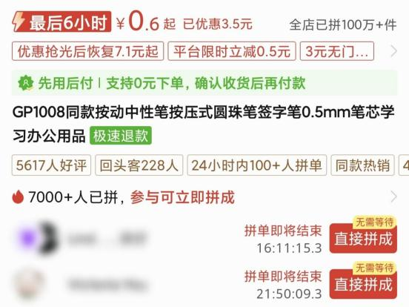
PART3
The advantages of Pinduoduo
1.The target customer is clear：targeting customers in the sinking market.
Pinduoduo offers products at lower prices compared to other traditional e-commerce platforms, and even items priced in the single digits can be shipped for free. These factors are highly attractive to consumers in the sinking market, and more and more consumers choose to buy items on Pinduoduo.
The increase in users has attracted more sellers to join Pinduoduo. And, the relatively low barriers to entry for sellers on Pinduoduo have brought opportunities to even more sellers.

Slide 11
PART3
The advantages of Pinduoduo
2.C2M (Consumer-to-Manufacturer)
The main transaction modes of traditional e-commerce platforms are C2C (Consumer to Consumer) and B2C (Business to Consumer), but this doesn't shorten the transaction distance between Manufacturers M and consumers C. However, Pinduoduo's transaction mode is positioned as C2M (Consumer to Manufacturer), attracting a large number of suppliers of different brands to join the platform to communicate directly with consumers. This shortens the transaction distance between consumers and suppliers.
Others：(M→)B/C→C
Pinduoduo：C→M

Slide 12
PART3
The advantages of Pinduoduo
3.Selling in the form of group.
Pinduoduo uses a group-buying model for sales, allowing consumers to purchase goods at a reduced price after reaching a certain quantity. This approach lowers the cost for individual consumers and increases sales volume.

Slide 13
PART3
The advantages of Pinduoduo
4.Unique ways of promotion
Pinduoduo sells through group-buying. Users on social media, after receiving group-buying links from friends, will browse product information. These products are usually affordable and practical, so they are likely to purchase them too. This makes more consumers start using PDD.
In addition, Pinduoduo has innovated promotional methods. Such as， invite friends to click the link to get free orders and money. It not only meets consumers' actual needs but also enhances their shopping experience through interaction.

Slide 14
PART4
The problems of Pinduoduo

Slide 15
PART4
The problems of Pinduoduo
1.The problem of low quality
Since its start, Pinduoduo has used a low-price strategy, cutting into sellers' profits. This pushed sellers to lower costs, causing quality problems. Furthermore, with low barriers, some sellers sold fake goods on Pinduoduo, harming consumers’ trust.
Now, "low quality" is often linked with Pinduoduo. Consumers even call it "Pinxixi".
拼多多→拼夕夕

Slide 16
PART4
The problems of Pinduoduo
Please state the reasons why consumers give negative reviews
互动环节：请说出消费者给差评的原因

Slide 17
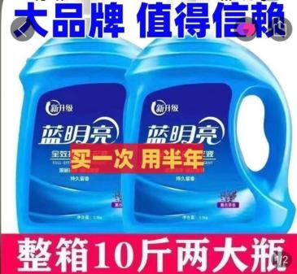
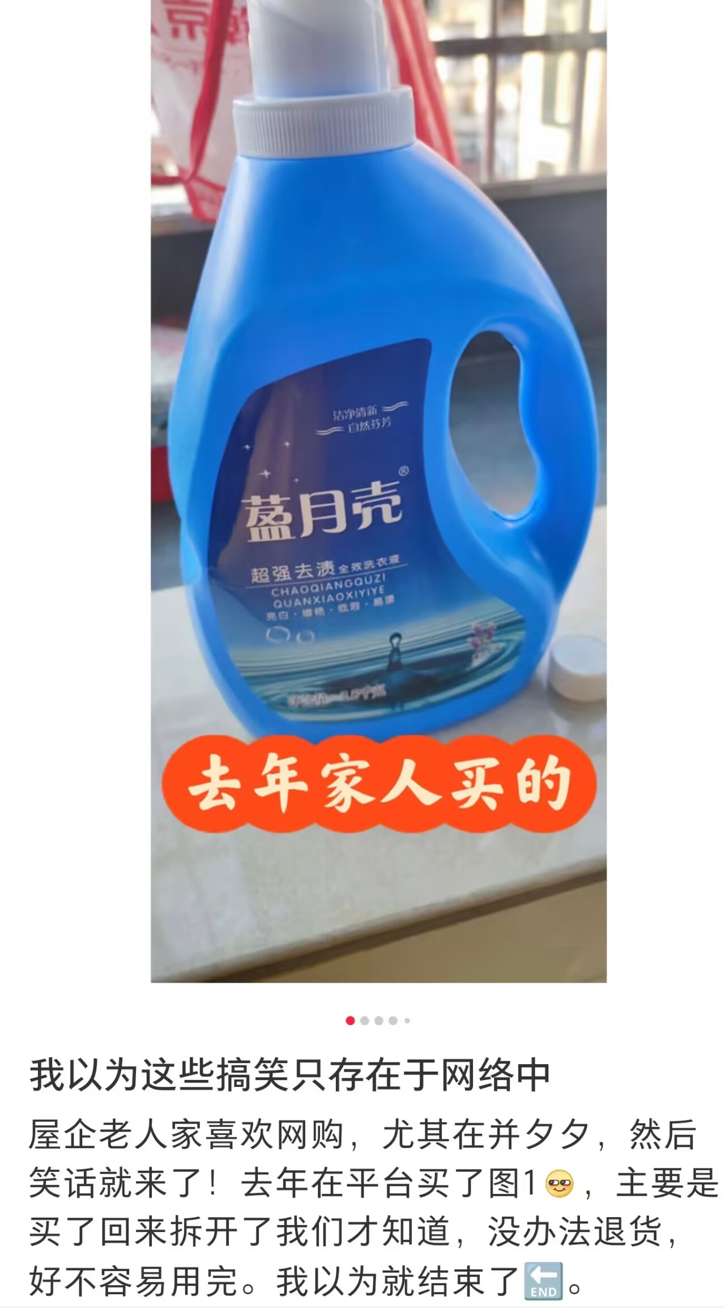
PART4
The problems of Pinduoduo
Please state the reasons why consumers give negative reviews
互动环节：请说出消费者给差评的原因

Slide 18
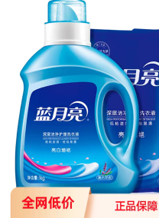
PART4
The problems of Pinduoduo
Please state the reasons why consumers give negative reviews
互动环节：请说出消费者给差评的原因
买家图
正品图
卖家图

Slide 19
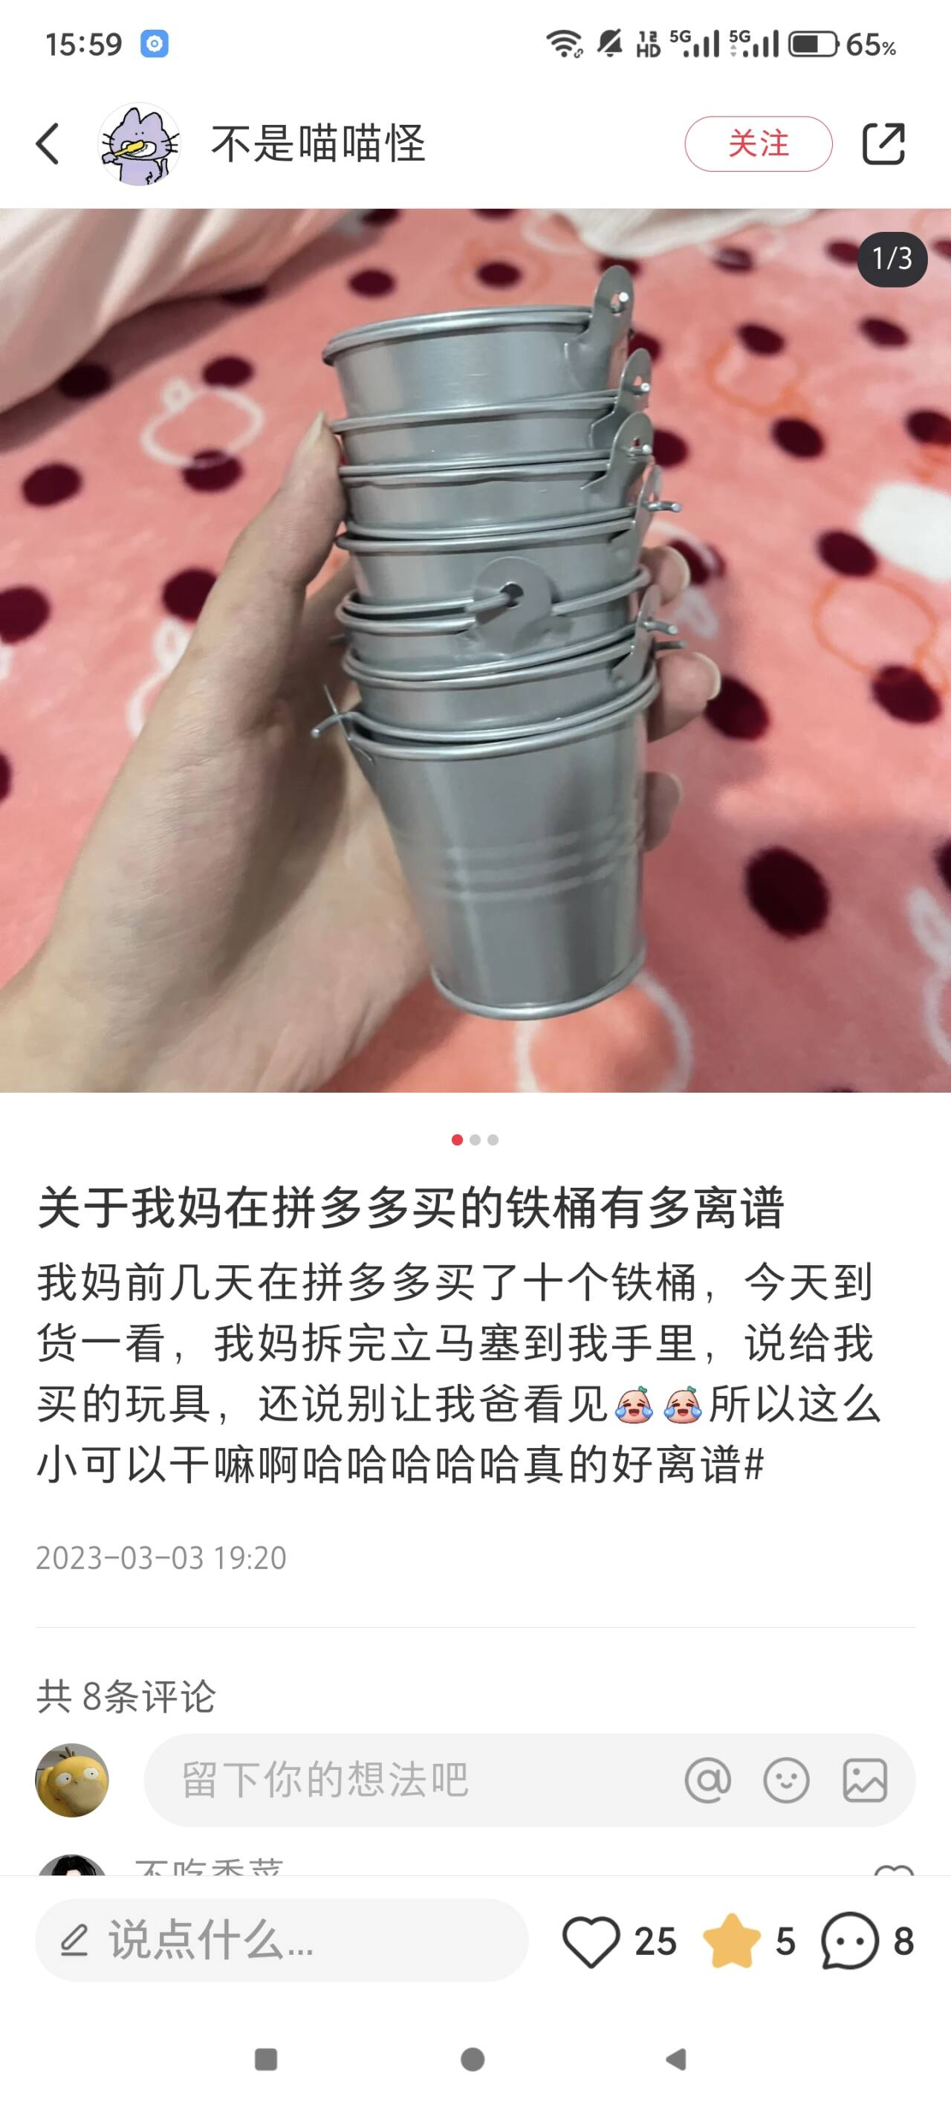
PART4
The problems of Pinduoduo
Please state the reasons why consumers give negative reviews
互动环节：请说出消费者给差评的原因

Slide 20
PART4
The problems of Pinduoduo
Please state the reasons why consumers give negative reviews
互动环节：请说出消费者给差评的原因

Slide 21
PART4
The problems of Pinduoduo
Please state the reasons why consumers give negative reviews
互动环节：请说出消费者给差评的原因

Slide 22
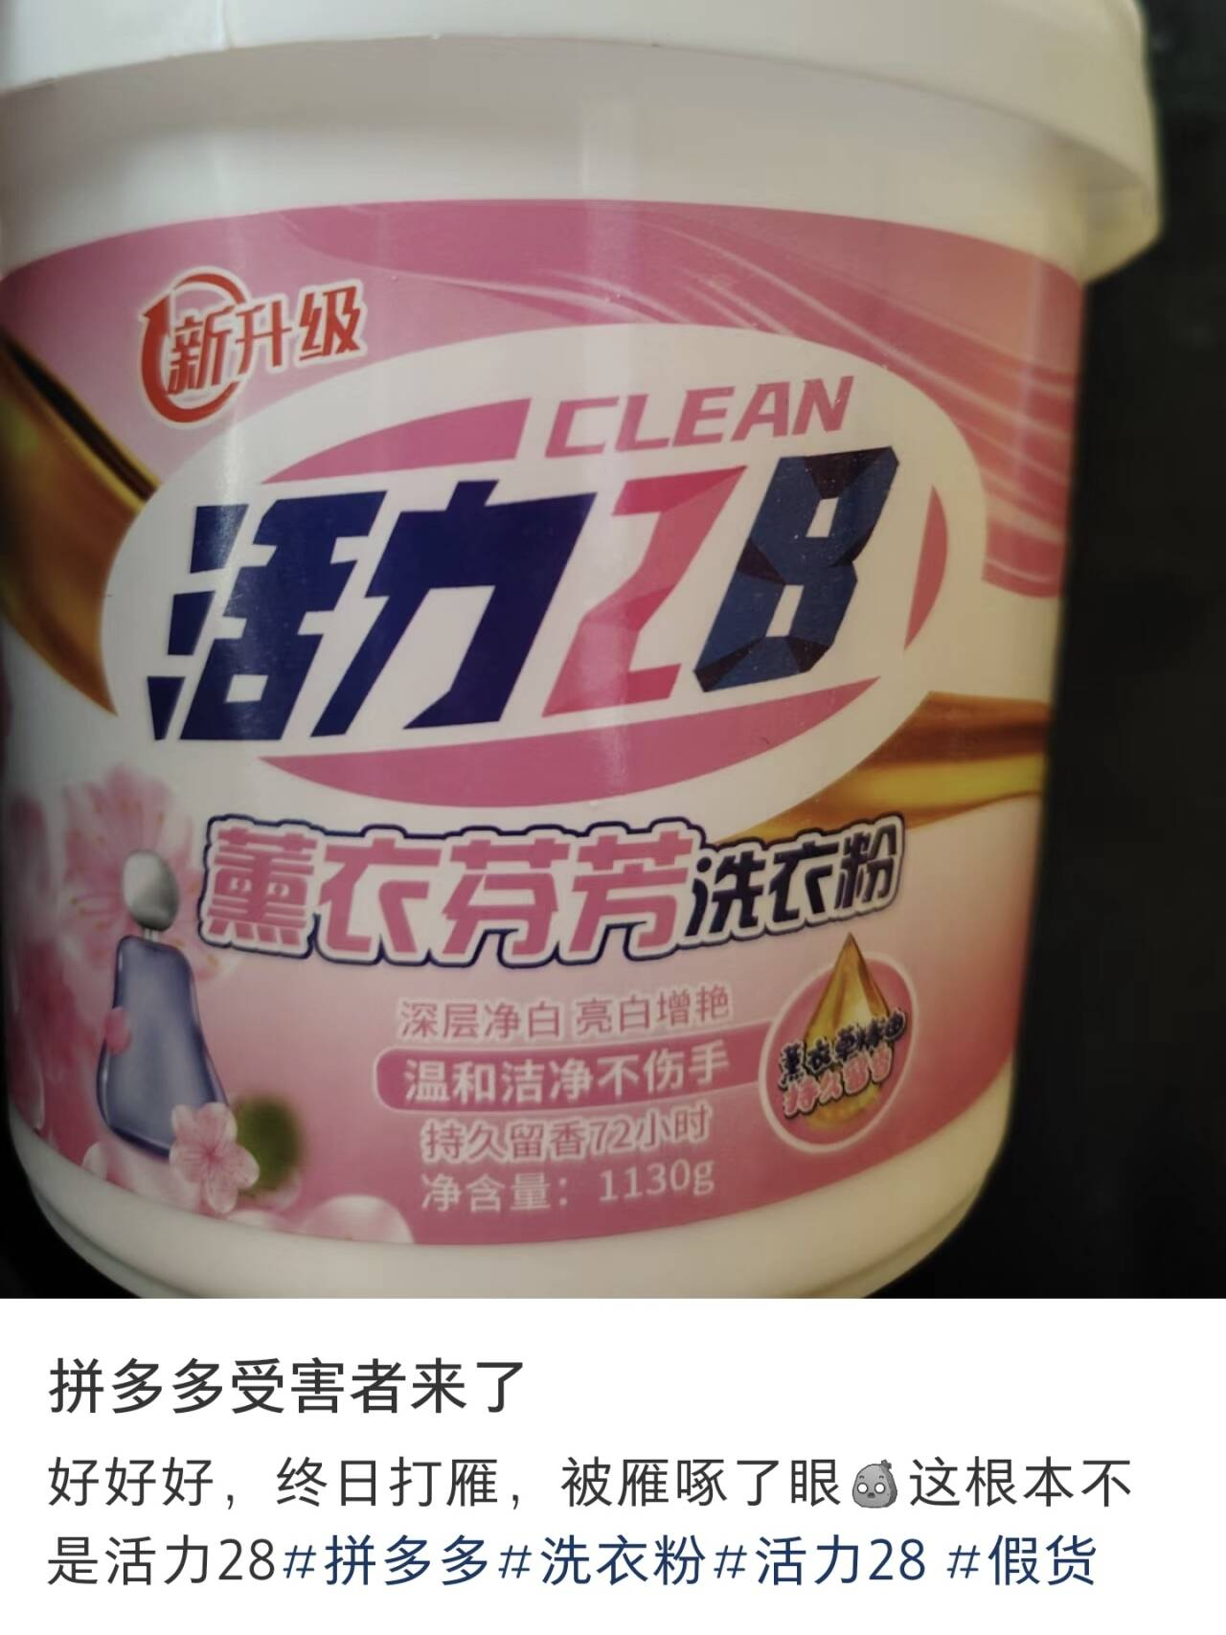
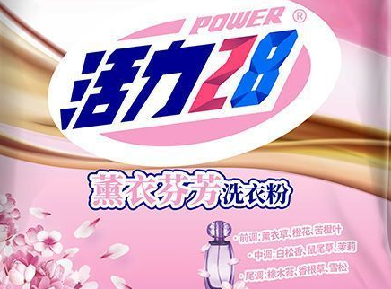
PART4
The problems of Pinduoduo
Please state the reasons why consumers give negative reviews
互动环节：请说出消费者给差评的原因
买家图
正品图

Slide 23
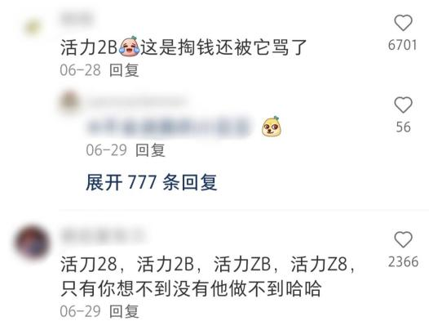
PART4
The problems of Pinduoduo
Please state the reasons why consumers give negative reviews
互动环节：请说出消费者给差评的原因

Slide 24
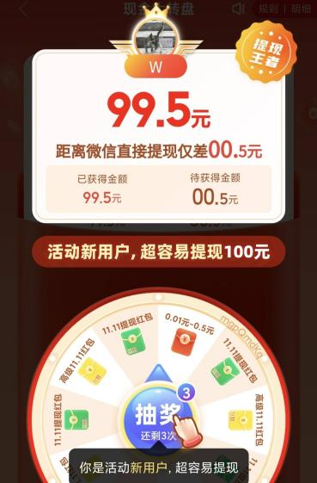
PART4
The problems of Pinduoduo
2.Crisis of trust
Pinduoduo has launched numerous activities that require users to invite friends to participate. However, it is often difficult for users to truly obtain the promised benefits. Therefore, during these activities, consumers may initially find them interesting, but they are likely to become disappointed and even abandon them midway. This affects users' trust in the platform.

Slide 25
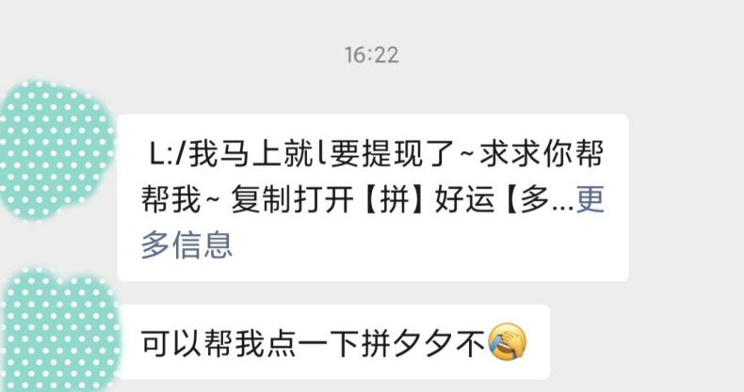
PART4
The problems of Pinduoduo
3.The damage of corporate image
The way of attracting new users by encouraging existing users to constantly share links can easily provoke people's resentment towards Pinduoduo. Although this marketing strategy yields significant results, it also greatly damages Pinduoduo's corporate image.

Slide 26
In summary, with its unique C2M (Consumer-to-Manufacturer) group-buying model, Pinduoduo has rapidly opened up the consumer market and become one of China's mainstream e-commerce platforms.
However, there are also issues such as poor product quality and a negative corporate image. If Pinduoduo wants to achieve long-term development, it cannot rest on its laurels. It should improve the current problems and continuously provide better products and services to consumers.

Slide 27
THANKS

