Slide 1
Love and Marriage in Chinese Culture
ZhouQingyi
2025.3.5

Slide 2
catalog
1.Introduction
2.The role of Translation
3.Ancient to Modern Views
4.Interaction

Slide 3
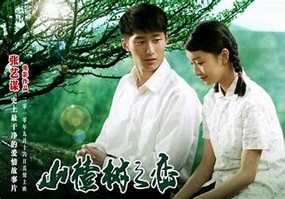
Introduction
Topic Overview
01
Love and marriage in Chinese culture have evolved significantly over time.
Importance of Translation
02
Accurate translation is crucial for understanding cultural nuances.
Audience Relevance
03
This topic is relevant to anyone interested in cross-cultural communication.

Slide 4

The Role of Translation
Bridging Cultures Through Translation
Why Translation Matters
Translation helps convey complex cultural concepts accurately.
Challenges in Translation
Translating cultural nuances requires deep cultural understanding.
Effective Translation Tips
Always consider the cultural context when translating.
How to convey the nuances of traditional Chinese values?
How do you explain the concept of 门当户对 to someone who is unfamiliar with it?

Slide 5
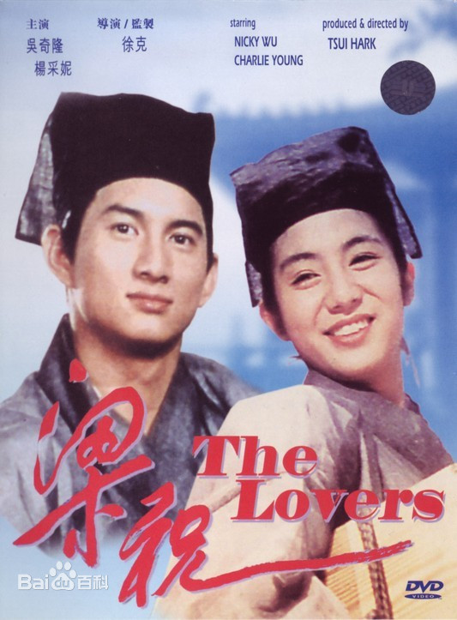
Ancient to Modern Views
Ancient Views:
Historical Context
Love as an Anomaly
Love was often seen as rare and unconventional.
Traditional Marriage
Marriages were primarily for family alliances.
Translation Challenge
Explain extreme views of love to modern audiences.
How do you explain this extreme view of love to those who see it as part of everyday life?
In ancient China, love was like a rare treasure, often appearing in the most unexpected places and sometimes ending in tragedy.
、

Slide 6


Ancient to Modern Views
Modern Views:
Personal Awakening
Love as a Foundation
Influence of Western Culture
The rise of feminism and the change in women's attitudes as a result of their studies have led to the phenomenon of late marriages.
Evolution of Love
The concepts of “free love” and “free marriage” emerged and divorce became more acceptable.
Love is now considered the cornerstone of marriage.
In translating modern Chinese love stories, the importance of personal feelings and autonomous choices is emphasized.
In modern China, love is not only a luxury but also a necessity in marriage.

Slide 7

Ancient to Modern Views
Transformation from ancient to modern values
the importance of the “right family” and “family responsibility” in traditional marriage.
she chose the path of self-realization.
No longer see marriage as the only destination in life, but prioritize career and personal development

Slide 8
Ancient to Modern Views
Transformation from ancient to modern values
1.mate selection views
"matching family status"
internal qualities
2. celibacy
male master outside and female master inside
more and more single women to compete in the workplace

Slide 9
Ancient to Modern Views
Transformation from ancient to modern values
3. marriage autonomy
marriage emphasized the order of parents, matchmakers, three wives and four concubines, etc.
proposed monogamy
4. the age of first marriage
men and women generally married at the age of 14 or 15
women's ideas changed after they studied, resulting in the phenomenon of delayed marriage

Slide 10

Interaction
Let's see how well you've understood the differences between ancient and modern views on marriage and love！

Slide 11
Thanks for listening!

