Slide 1

DOU YIN(TIK TOK)
SCIENCE AND TECHNOLOGY:
Ou Xinyu

Slide 2

CONTENTS
1
PART ONE Overview
2
PART TWO Comparison
3
PART THREE Popularity
4
PART FOUR Effects

Slide 3
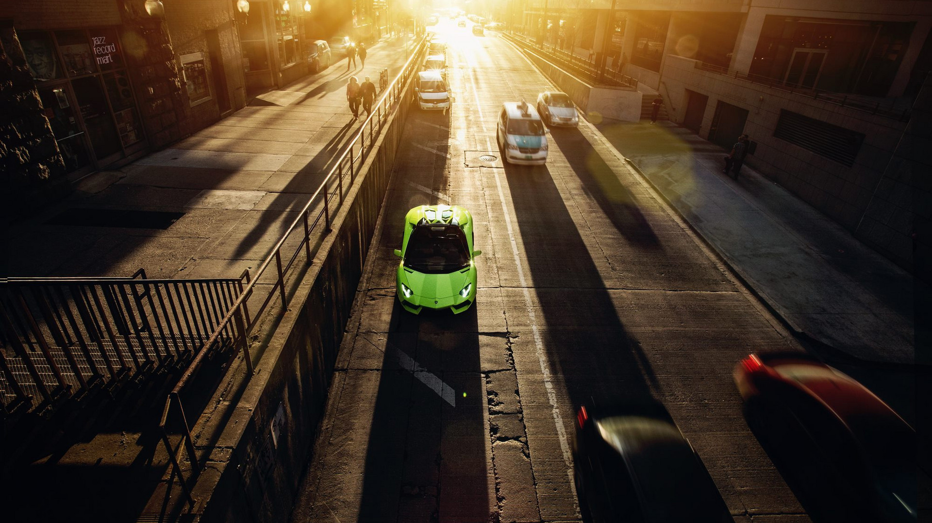
Part One
Overview

Slide 4
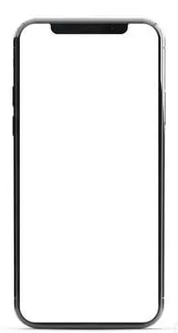

# It is a platform for creating and sharing 15-second videos.#
ABOUT Tik Tok
Douyin is a short video media app developed by China’s young tech giant Bytedance.
Users
Douyin allows users to create, edit, and share short videos as well as livestreams, often featuring music in the background. In their videos, users can interact with the camera and sing at the same time, with songs provided by Douyin's extensive music library.
Contents
Contents themed on dances, comedies, babies, food, pets pranks, and stunts are most welcomed on Douyin. Showing off dance skills and comedy routines are also popular pastimes on the app.

Slide 5
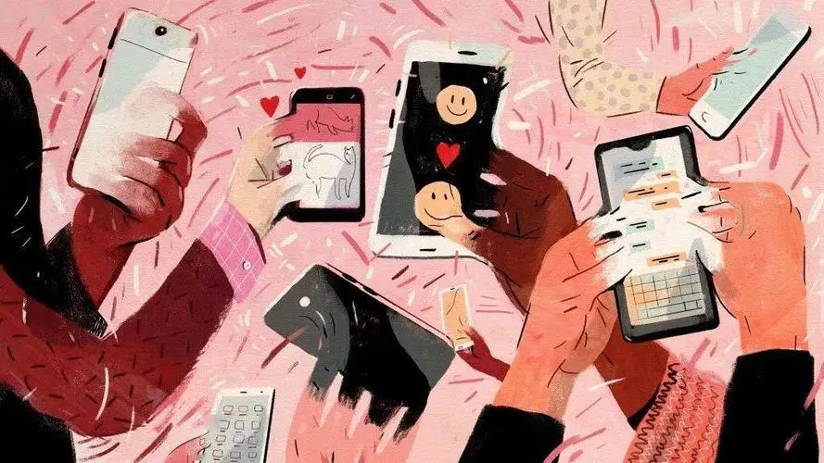
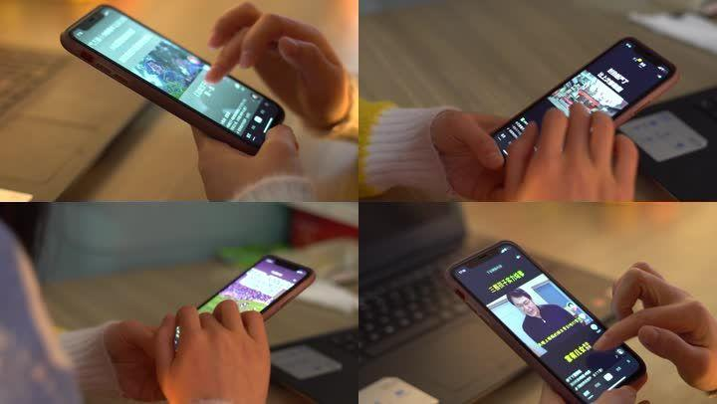
Characteristics
# No ”play” or “pause” button#
# Personalized Recommendation#
Once you open the app, a video starts immediately. You scroll through a 15-second stream of videos nonstop, as does how you look through photos on Instagram. Therefore, many people can't help spending most of their spare time on the For You Page.
Unlike other popular Chinese apps like Weibo, where you have to actively follow specific accounts to be pushed toward their content, Douyin identifies users’ interests through a powerful recommendation algorithm that tracks the users’ preferences through their browser history.
It also shows content it thinks could go viral, regardless of how many followers the creator has.

Slide 6
Part Two
Comparison

Slide 7
Comparison between Tik Tok and Bilibili
Position
Short video culture community
Time Limit
21 seconds on average, less than 60 seconds mostly
Volume
DAU: 600 million
Users
Across all age group, a platform of mass culture
Tik Tok
Position
ACG culture community
Time Limit
More than 2 minutes, 8 minutes on average
Volume
DAU: 65 million
Users
Mostly generation Z, a minority of generation Y
Bilibili

Slide 8
Part Three
Popularity

Slide 9
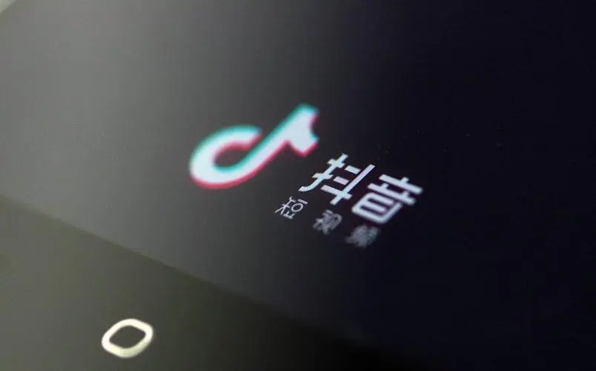
Several reasons why Tik Tok is so popular include：
Localized content
The app often runs local contests and challenges and captures local trends using localized hashtags. Douyin also sends personalized recommendations to each of its users. This ensures that Douyin users are always updated on the latest trending videos and are never out of ideas for video creation
Easy content creation, sharing and viewing
Due to the short format, neither the video-creation nor the watching process takes much time or effort. Also, the short-form video content plays as soon as a user opens the app.
Celebrity endorsements
Several celebrities, including Angelababy from China, Jimmy Fallon from American, have helped drive Tik Tok's popularity.

Slide 10
Part Four
Effects

Slide 11
Effects
Most people scroll through the For You Page looking at videos perfectly catered to their tastes through the TikTok algorithm. The app is designed to be addictive, with an unlimited stream of videos at around 30 seconds each, making users hard to get bored. It's incredibly easy to fall down the TikTok hole and suddenly reemerge hours later only to find have lost an entire day.
.
Addiction
While the application can be used to spread positivity, it can also be used as a platform for bullying. Some people criticize other people's videos, while others create videos for deriding someone. This leads to a negative impact on the mental health of everyone involved, thus resulting in life-threatening situations and decisions.
Bullying/Mental Health
On Tik Tok, there are no restrictions as to who can join the app, so strangers can easily message children and create harmful situations.
Unsafe

Slide 12
THANKS.

