Slide 1
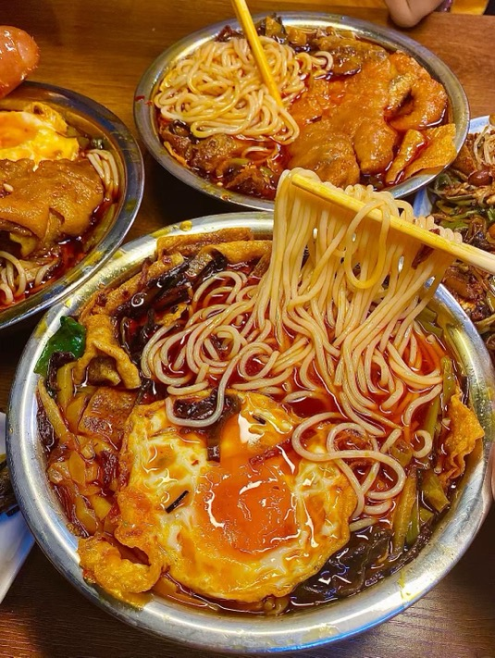
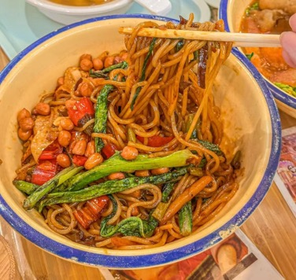
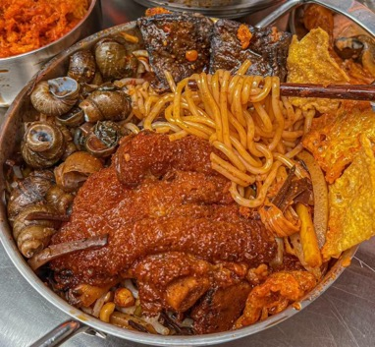
Luosifen
There is nothing that Luosifen can’t solve.
没有一碗螺狮粉解决不了的事。

Slide 2

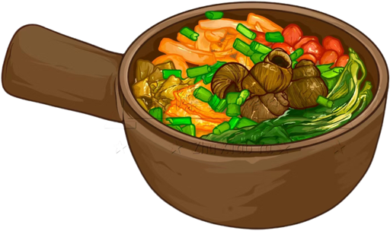
CONTENTS
01
Introduction
02
History
03
Production Methods
04
The Reason
02
05
Benefits of its popularity
04

Slide 3
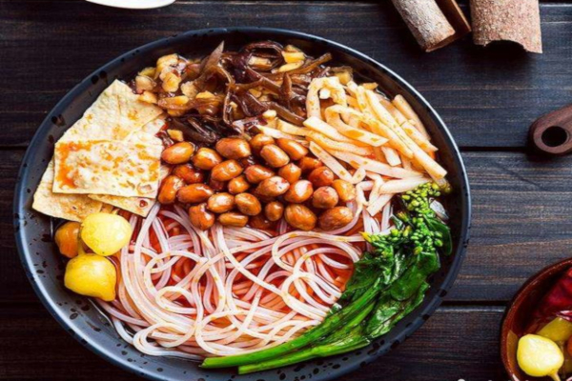
01
Introduction

Slide 4
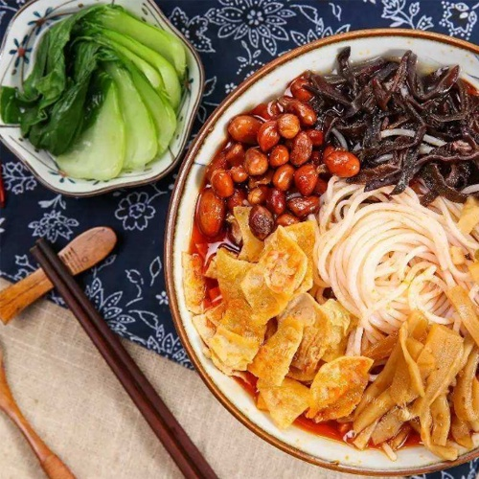
1. Introduction
A traditional snack originating from Liuzhou, Guangxi Zhuang Autonomous Region.
They are made primary from rice noodles and are served with ingredients such as green vegetables,bamboo shoots ,and black fungus.
It has the unique flavor of spicy, cool, fresh, sour and hot.
A chewy texture that adds a satisfying element to each bite.

Slide 5
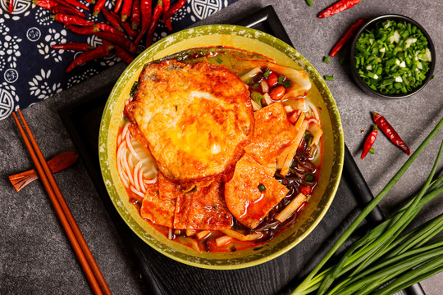
02
History

Slide 6
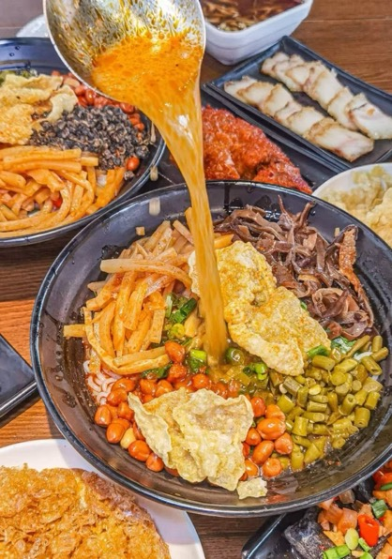
2.History
Legend of Luosifen
It is said that when Liu Zongyuan was serving as the Governor of Liuzhou, one day he strolled by the Liujiang River and was attracted by a strong aroma. He followed the aroma to a small stall and found that it came from a steaming bowl of snail soup. He took a sip and was deeply attracted by the taste of the soup. Therefore, Liu Zongyuan began to recommend this delicacy to his friends and colleagues, which opened the way for the promotion of Luosifen.

Slide 7
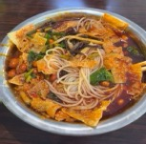
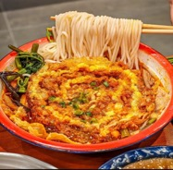
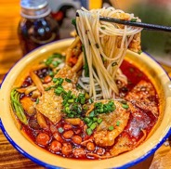
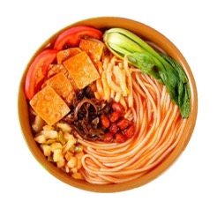
On May 24, 2021, the Liuzhou Luosifen production technique declared by Liuzhou City was approved by The State Council to be included in the fifth batch of national intangible cultural heritage representative projects.
2021年5月24日，柳州市申报的柳州螺狮粉制作技艺，经国务院批准列入第五批国家级非物质文化遗产代表性项目。
On August 20, 2018, “Liuzhou Luosifen” won the National Geographic Indication trademark.
2018年8月20日，“柳州螺狮粉”获得国家地理标志商标。
In 2008, Liuzhou Juosifen handicraft was selected into the Guangxi intangible Cultural Heritage list.
2008年，柳州螺狮粉手工制作技艺入选广西非物质文化遗产名录。
In 2020,it was included in the national intangible cultural heritage
list.
2020年被列入国家非物质文化遗产名单。

Slide 8
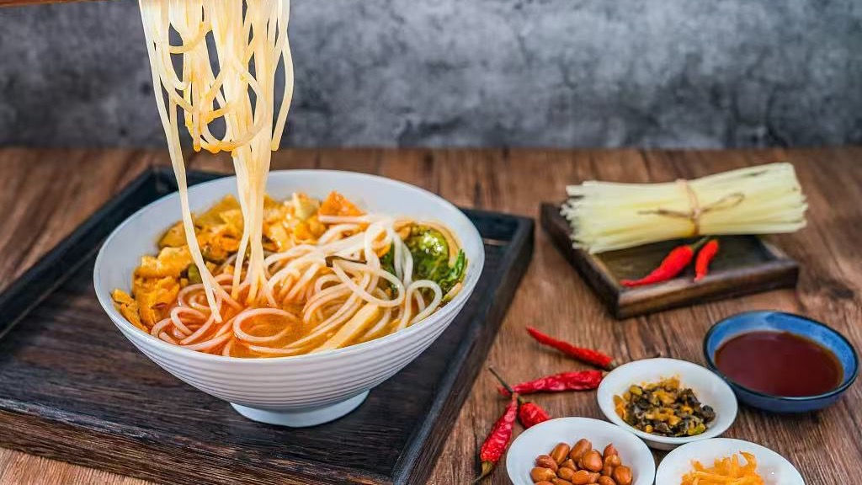
3.Production Methods

Slide 9
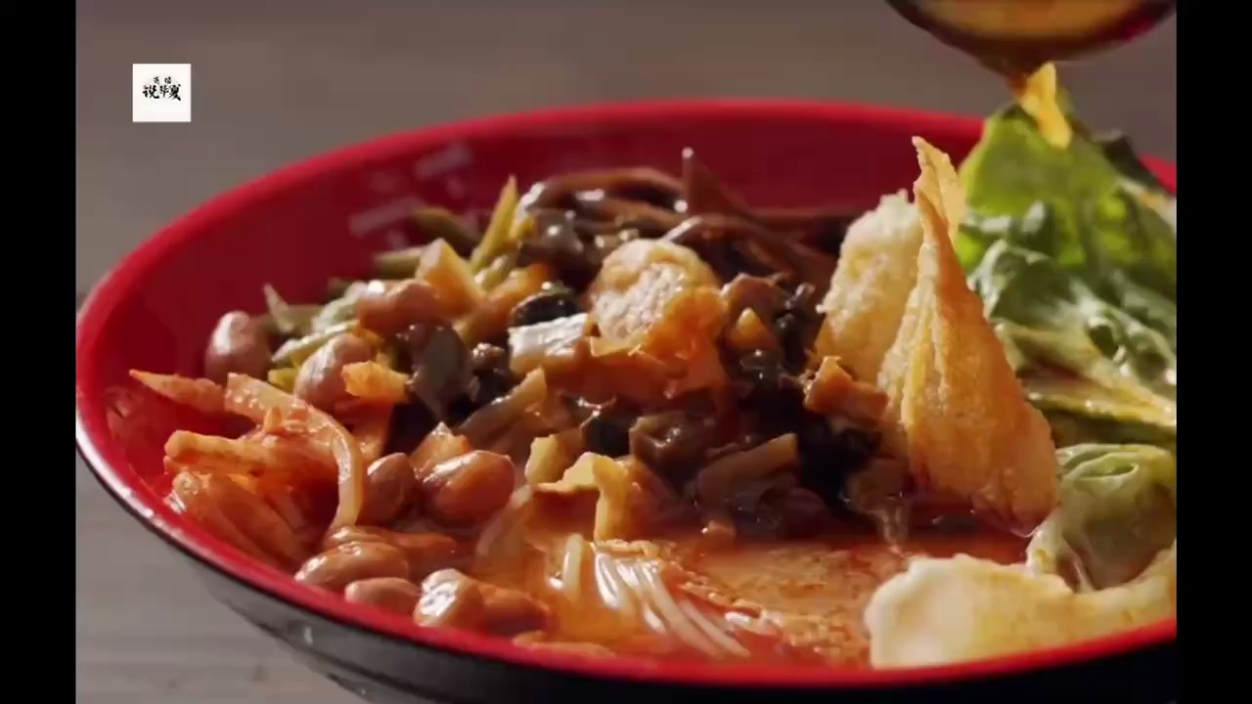

Slide 10
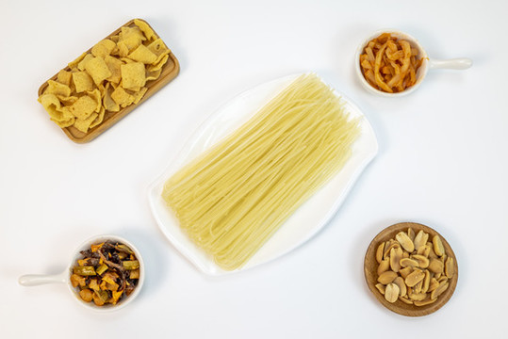

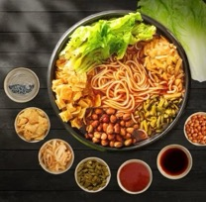
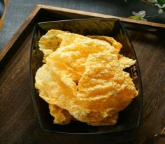
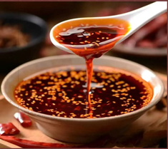
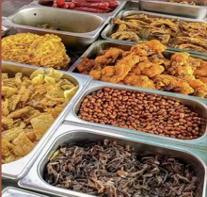
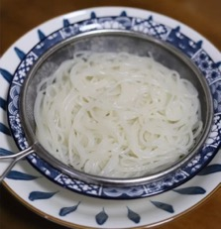
02
Production Methods
3
4
5
1
2
Make chili oil
Wash the garnishes
Fried beancurd skin
Make chili oil
Stir-fried vegetable side
Powder cooking
Wash and drain the green vegetables, wash and shred black fungus, wash sour bamboo shoots and shred, dry clean and chop sour beans and radish.
Work into the wide oil, oil temperature 60% hot into the tofu bamboo skin fried crisp, remove the oil, the tofu bamboo skin to cool down and break into small pieces
Put the chili powder into the bowl, while the oil is hot after frying the bean curd, pour the appropriate amount of hot oil into the bowl, and let it stand for a moment to become chili oil.
1. Fry peanuts in oil until crisp, then remove.
2. Stir-fry radish, sour beans, black fungus, stir-fry and serve.
3. Dry sour bamboo shoots, stir-fry with oil and salt, then serve.
Soak the noodles in cold water, cook with vegetables, then add peanuts, tofu, and pour the river snail soup over.

Slide 11
04
The Reason

Slide 12
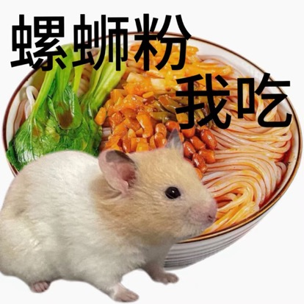
4.Reasons for its popularity
01
Luosifen 's greatest feature lies in its unique taste. The sour and spicy broth, combined with a variety of rich ingredients, makes it stand out among other rice noodle dishes.
Unusual foods often gain cult followings. But it‘s rare for an odorous dish to become a national favorite, which is exactly what’s happened with it.
02
This snail-based rice noodle soup dish has created a buzz on Chinese social media thanks to its infamous smell.
03

Slide 13
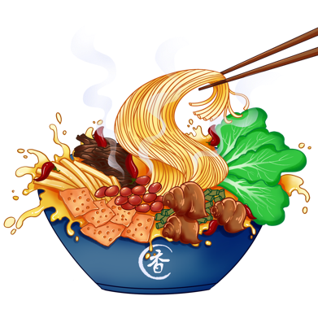

05
Benefits of its popularity

Slide 14
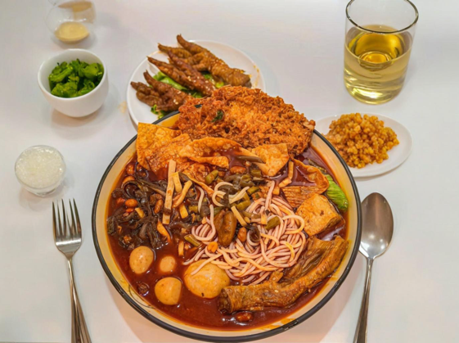
Economic benefits
Job Creation
Cultural Promotion
The popularity of Luosifen has not only spurred the growth of the local dining industry but has also promoted the formation of a related industrial chain.

Slide 15
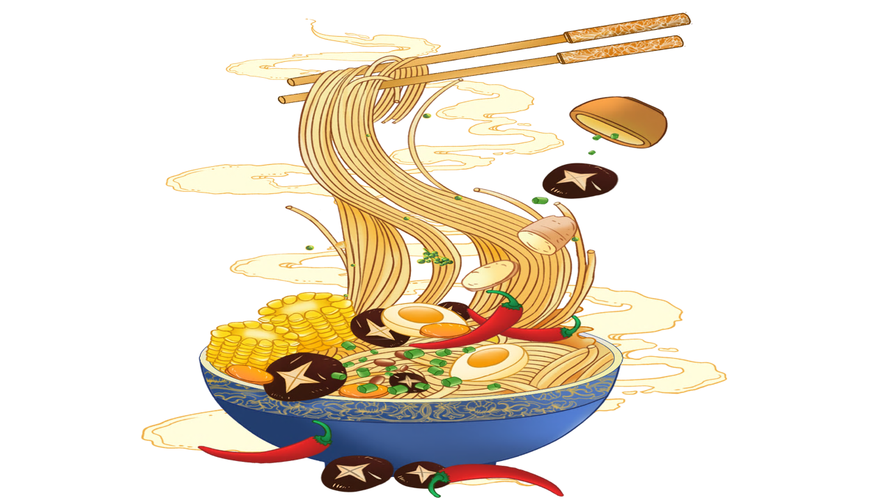
Use new technologies such as the internet and mobile payment to promote Luosifen to a wider group of consumers and provide convenient services such as online ordering and take-out delivery.
Combine Luosifen with local history culture and tourist cultural products and attract more tourists to come to a taste and experience.

Slide 16
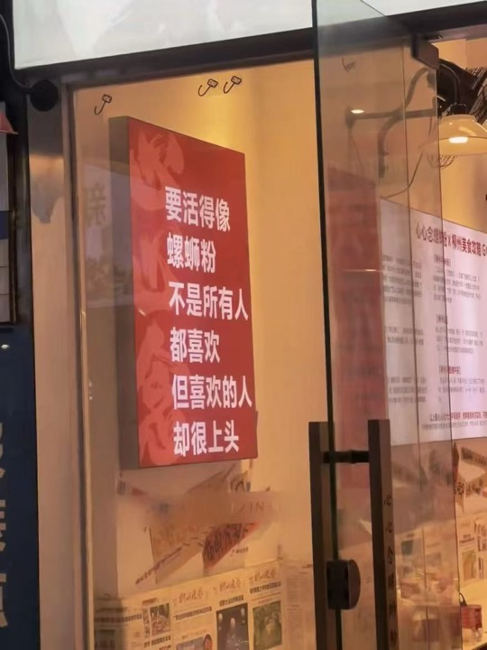
THANKS!

