Slide 1

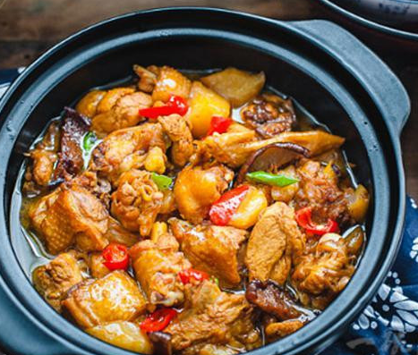
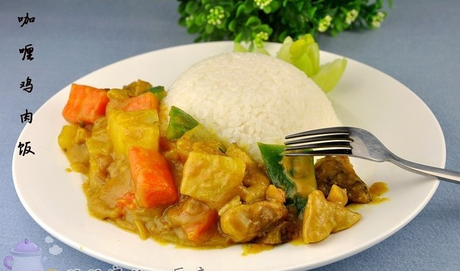
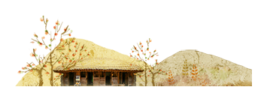
Brised Chicken Rice
vs
Chicken
Curry Rice

Slide 2
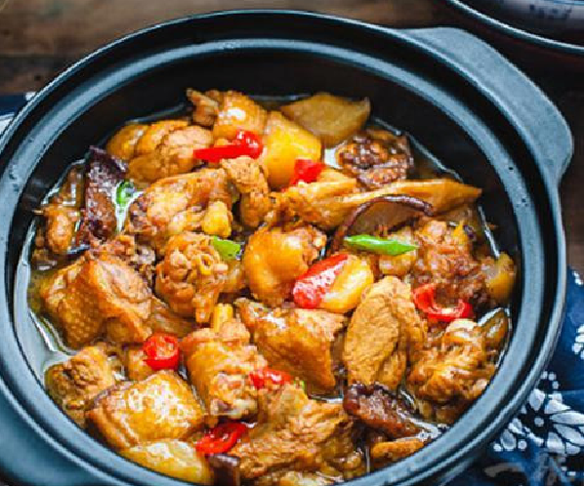

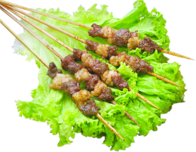
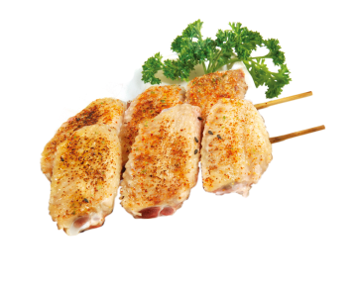
目 录
CONTENTS
01.Origin
02.Development
03.Making Process

Slide 3
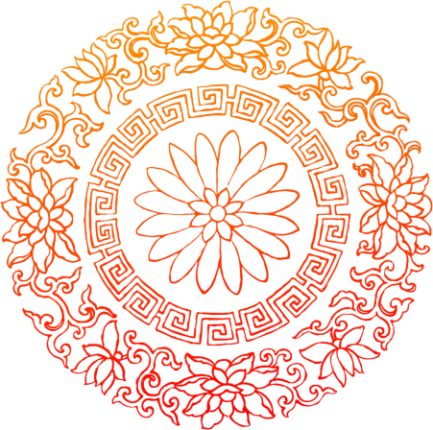
01.Origin

Slide 4

Origin
It is a traditional famous dish originating from Tianqiao District,Jinan City, Shandong Province.
Chicken
Curry Rice
Brised Chicken Rice
Chicken curry originated from the Indian subcontinent

Slide 5
Origin
01
02
Brised Chicken Rice
Chicken
Curry Rice
1. the signature dish of the reknowed Shangdong cuisine restaurant “Jilingyuan” in Jinan.
2.the famous Jinan restaurant “Yanliuyuan”makes it a palace dish.
Curry Chicken curry first originated in northern India, where it was invented by local residents.

Slide 6
02.Development

Slide 7
Development
Brised Chicken Rice
01
2013
02
just a few years
“Yang Mingyu”
national snack

Slide 8
Development
Chicken Curry Rice
01
2600AD
02
18C-19C
03
nowadays
India subcontinent
curry
The British introduce it into Western world.
famous around the world.

Slide 9
The reason
Brised Chicken Rice
Unique texture
and delicious
taste
Affordable
value
Simple
production
process

Slide 10
The reason
Chicken Curry Rice
Rich flavor
and aroma
Adaptable
recipe
Cultural
fusion
and spread

Slide 11
03.Making Process

Slide 12
Making Process

Slide 13
Making Process

Slide 14
Thank you!

