Slide 1

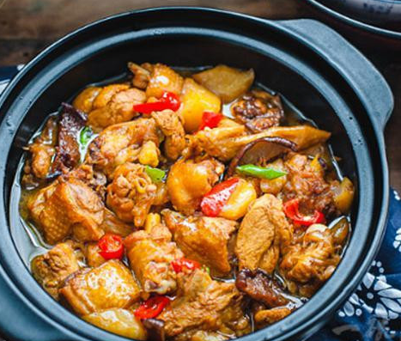
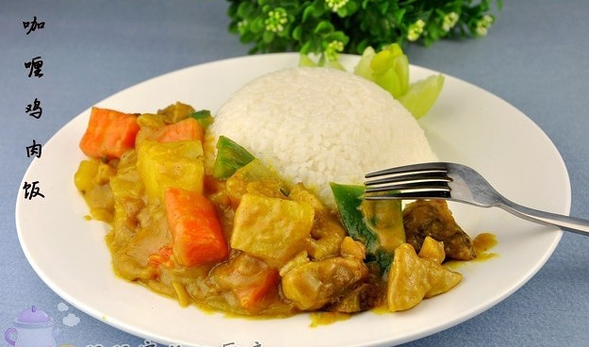

Braised Chicken Rice
vs
Chicken
Curry Rice

Slide 2
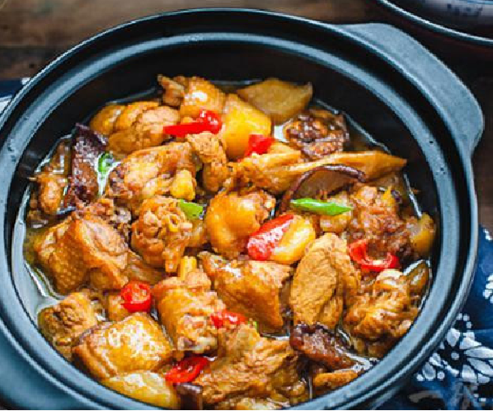
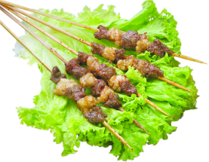

目 录
CONTENTS
This is a good space for a short subtitle
01.Introduction
02.Comparison
03.Foreign perspective
04.Conclusion

Slide 3

01.Introduction

Slide 4

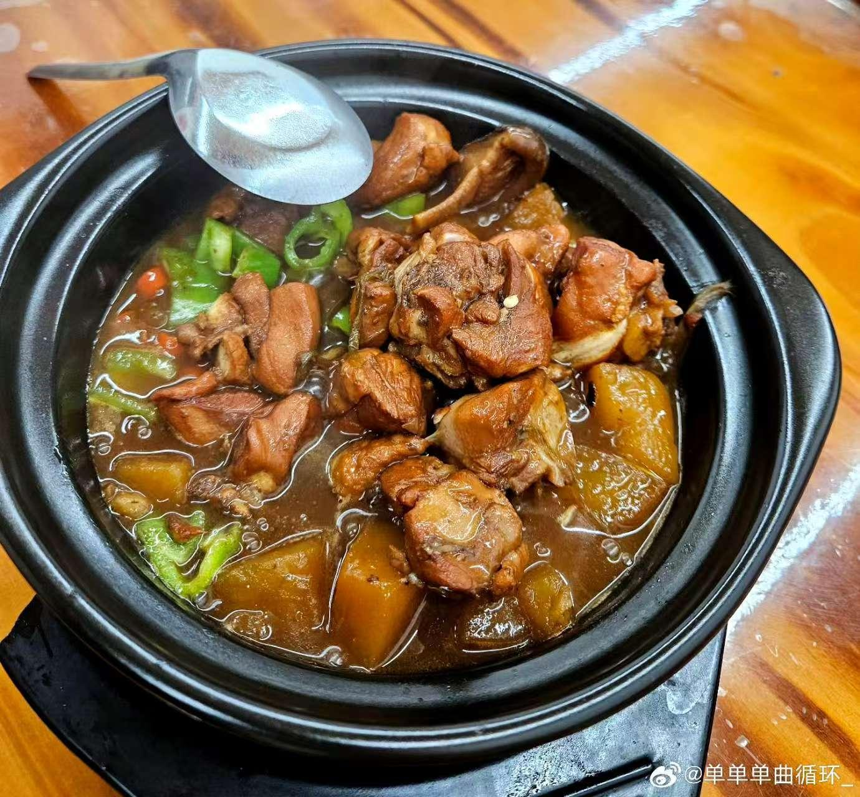
Introduction
Braised Chicken Rice
Fragrant Chicken Pot
Sauce Chicken Pot Rice
Shandong style of
home-cooked dishes
It has won wide spread recognition
and affection across the country

Slide 5
Introduction
Chicken Curry Rice
A flavorful dish
With aromatic curry sauce
Indian subcontinent
It is a globally beloved dish
with significant international influence.

Slide 6
Through the comparison between
Braised Chicken Rice
and
Chicken Curry Rice,
we can have better understand of
the international potential
of
Braised Chicken Rice.

Slide 7
02.Comparison

Slide 8
Origin
It is a traditional famous dish originating from Tianqiao District,Jinan City, Shandong Province.
Chicken
Curry Rice
Braised Chicken Rice
Chicken curry originated from the Indian subcontinent

Slide 9
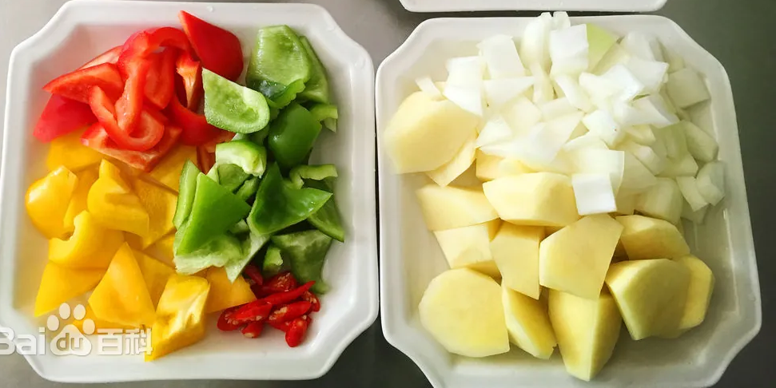
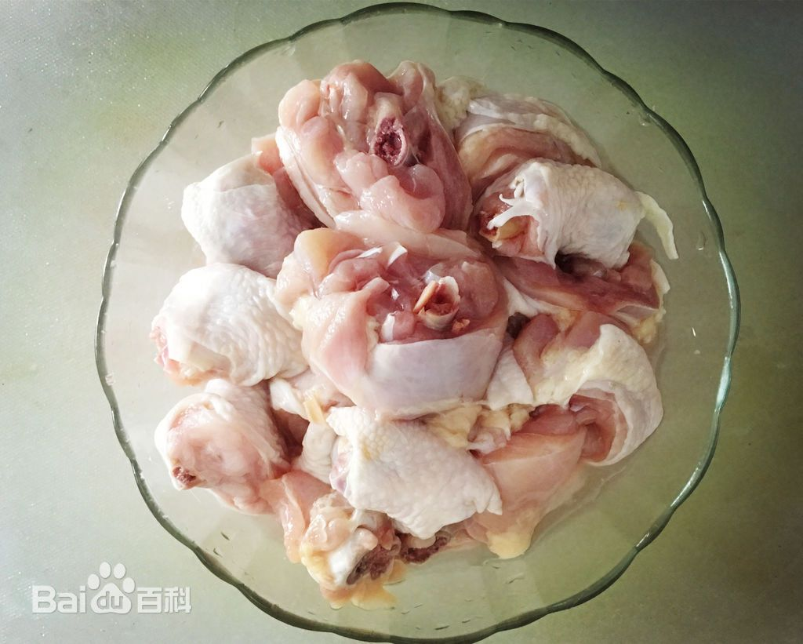


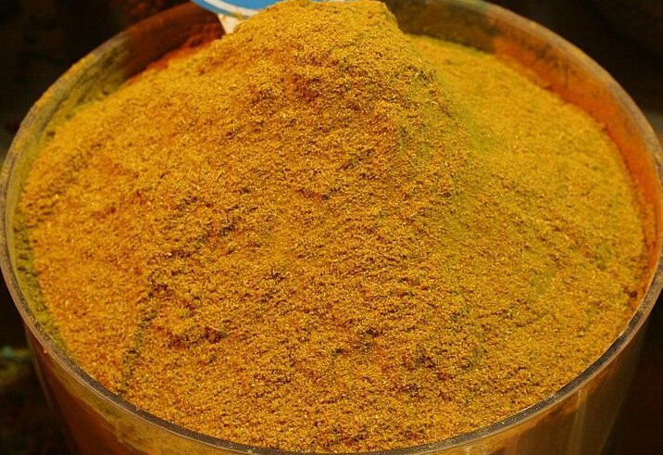
Ingredient
Chicken
Curry Rice
Brised Chicken Rice

Slide 10
Cooking methods
01
02
Braised
Chicken
Rice
Chicken
Curry Rice
After frying and stir - frying, it is braised. The rich sauce is emphasized.
It is marinated with spices and then stewed. The flavor of the spices is complex.

Slide 11

Flavor
Braised
Chicken
Rice
Sour,spicy and aromatic
Savory and rich in sauce flavor
Chicken
Curry Rice

Slide 12
Conclusion
Main comparision points
Cultrual symbol
A traditional
home-style cuisine
Family warnth
and togatherness
A staple of Indian cuisine
Rich spice culture

Slide 13
Conclusion
Main comparision points
Taste preferences and target audience
Suitable for mild palates, with a balanced savory flavor that appeals to a broad audience
spicy and complex flavors,
in regions where
spicy food is
popular.

Slide 14
Conclusion
Main comparision points
Global Popularity and Acceptance
Gained international popularity
a well-known representative of Indian cuisine worldwide
Widely popular in China but has limited
global reach

Slide 15
03.Foreign perspective

Slide 16
Foreign perspective
Possible misunderstanding
Many foreigners find it odd that a restaurant only serves one dish.
Some foreigners have described the taste of Braised Chicken Rice as being like "dog food"
and find its appearance unappealing.
Some foreigners feel that Braised Chicken Rice lacks side dishes or
beverages, making the meal seem incomplete.

Slide 17
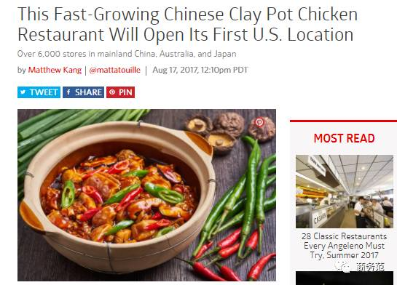
Foreign perspective

Slide 18
04.Conclusion

Slide 19
Strategy
Cultural Promotion
Localization of Taste
family and togetherness
Appealing Names
Social Media Campaigns
Savory Northern
Chinese Braised Chicken

Slide 20

https://www.menti.com/
2216 3682

Slide 21
Thank you

