Slide 1
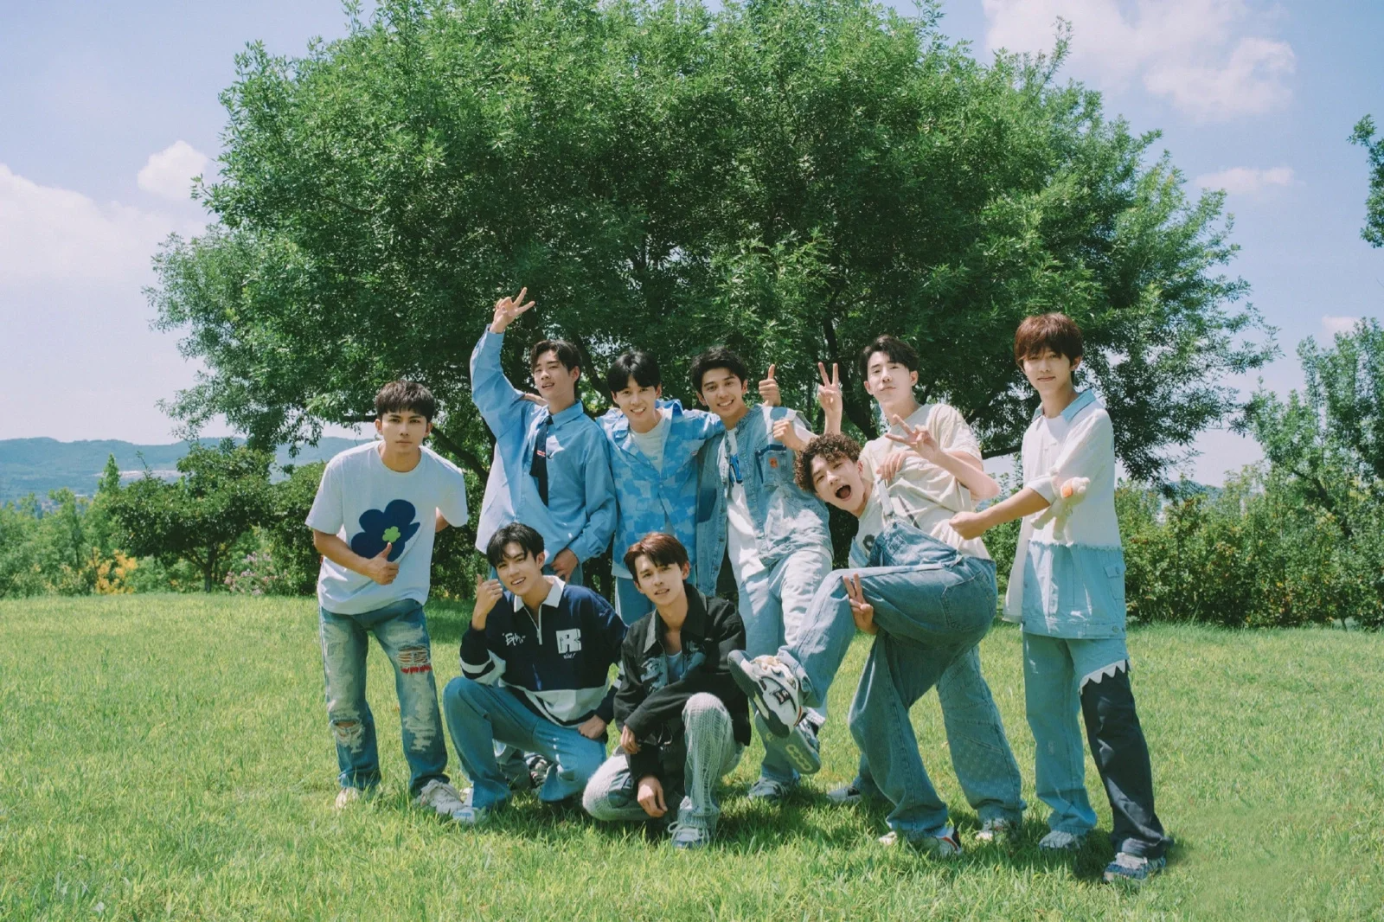

Slide 2

Become a Farmer
—— China’s Variety Show Is Harvesting Success Online

Slide 3
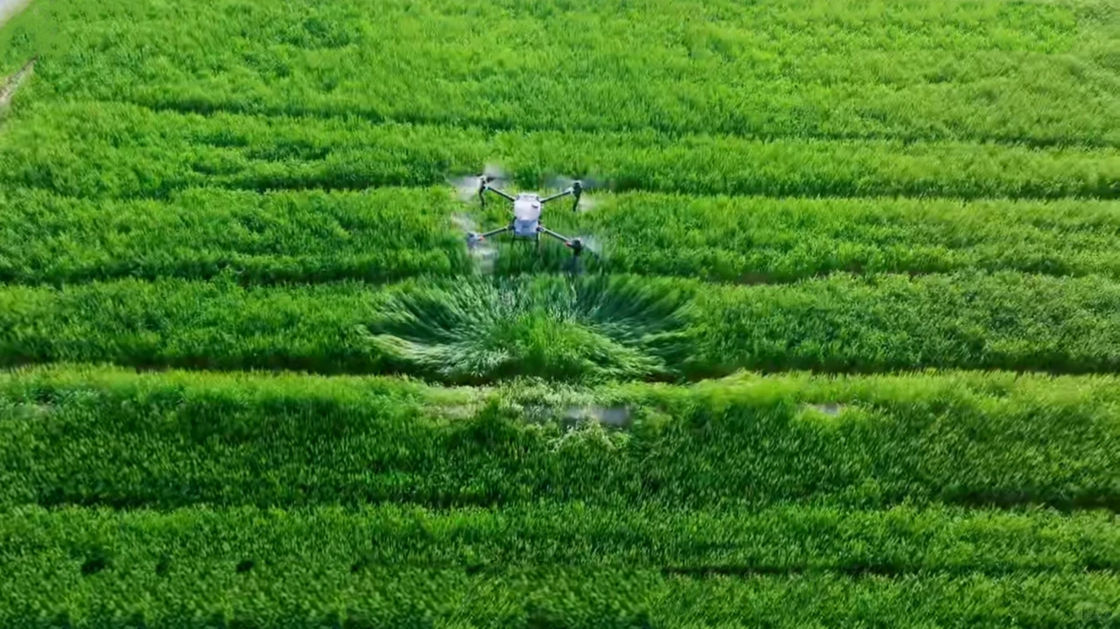

CONTENTS
01/Phenomenon
03/The Reason
02/Introduction
04/My Viewpoint

Slide 4

01
Phenomenon

Slide 5

01/Phenomenon
The Chinese variety show Become A Farmer has achieved tremendous popularity in China.
Become A Farmer recently gained over 4.6 billion views on Weibo through the hashtag #种地吧#.

Slide 6
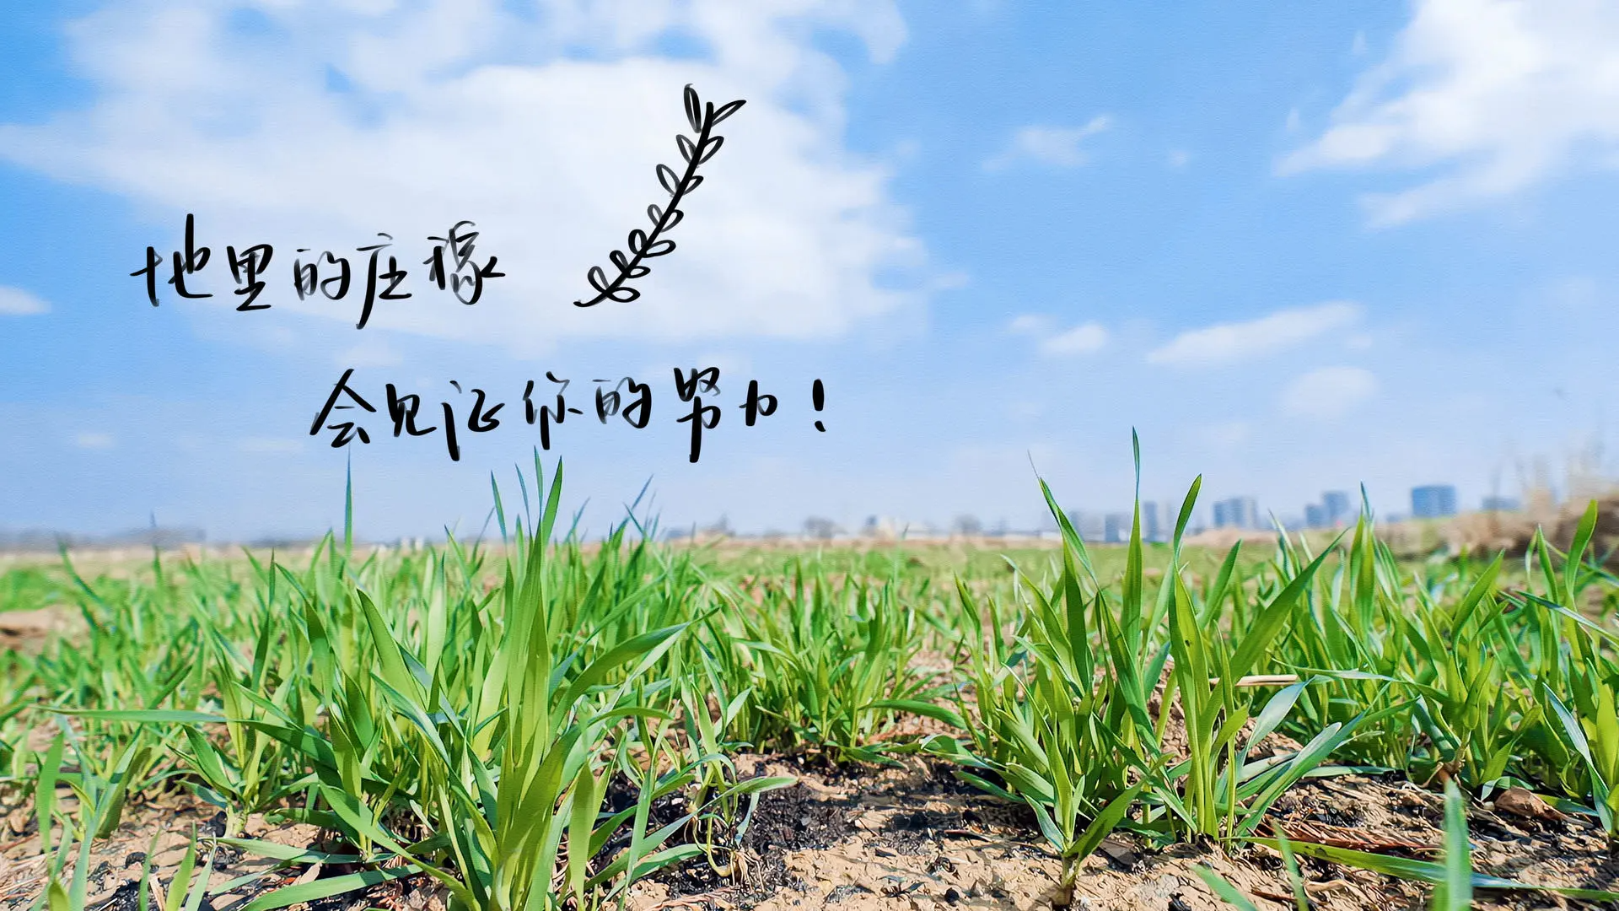
01/Phenomenon
Some audience are attracted by the clumsiness and diligence of urban youth doing farm work; some realize the belief that "one's effort will yield one's harvest"; some marvel at how the grand issues of food security and rural revitalization can be made so vivid and down-to-earth.

Slide 7
02
Introduction

Slide 8

02/Introduction
They actively engaged in every aspect of farm work, starting from planting a single seed and guiding the audience through the complete journey of rice germination, growth, flowering, and ultimately reaping the harvest.

Slide 9






Jiang Dunhao
The "oldest brother" of the group.
Lu Zhuo
Thoughtful and likes to solve problems.
Li Gengyun
Head of construction.
Li Hao
Manages the team’s finances.
Zhao Yibo
The team secretary.

Slide 10





Zhuo Yuan
The general manager
Zhao Xiaotong
Head of logistics
He Haonan
Monitor of the group
Chen Shaoxi
Team’s public relations lead
Wang Yiheng
The team’s safety officer and creative director

