Slide 1



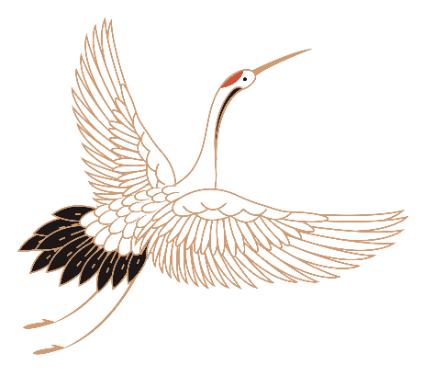





Chinese Mythology
Hunan Normal University
Shu shan & Lu Si

Slide 2

CONTENTS
01
Introduction
02
Creation of humanity
03
Three August Ones and Five Emperors
04
Records of Myths

Slide 3


One
Creation of humanity

Slide 4
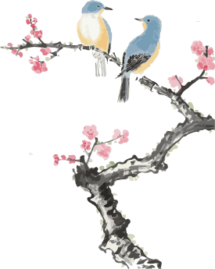
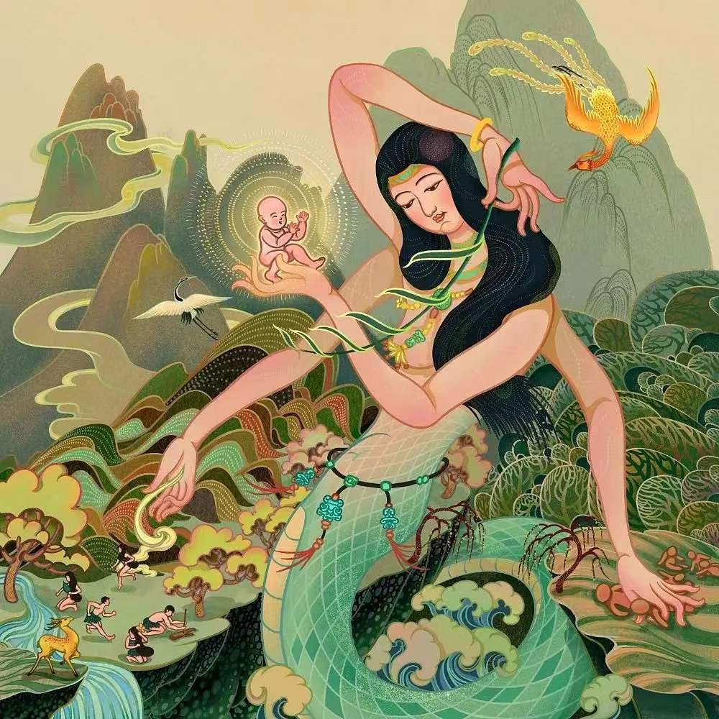
Nüwa created humanity due to her loneliness, which grew more intense over time. She molded yellow earth or, in other versions, yellow clay into the shape of people. These individuals later became the wealthy nobles of society, because they had been created by Nüwa's own hands. However, the majority of humanity was created when Nüwa dragged string across mud to mass-produce them, which she did because creating every person by hand was too time- and energy-consuming.
----Thury, Eva M. (2017). Introduction to mythology : contemporary approaches to classical and world myths.

Slide 5
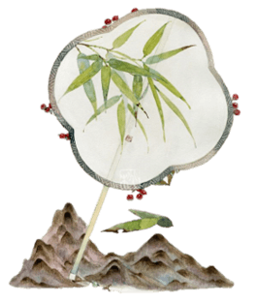
Why Half-snake and half-human?

Slide 6
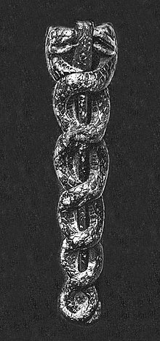
Snake worship is attributed to the Xia clan, which dominated the Northern regions of ancient China in the Yellow River area around 2200 BC. These myths are similar to other creation myths from around the world. In China, over time, the snake became the dragon, which is one of the most enduring symbols of Chinese culture and mythology.
The Caduceus, symbol of God Ningishzida,
on the libation vase of Sumerian ruler Gudea,
circa 2100 BCE.

Slide 7



Snakes symbolism:
Second
Snakes come from water;
Water is the first element from which everything is created and is an old symbol for the womb of the women.
First
Third
Snakes were seen as the holder of renewal because of their molting.
Snakes represent fertility;
Small snakes lay between 10-30 eggs. Large snakes can lay up to 100 eggs.
----J Reprod Infertil.An Evaluation of the Historical Importance of Fertility
and Its Reflection in Ancient Mythology; 2016 Jan-Mar

Slide 8
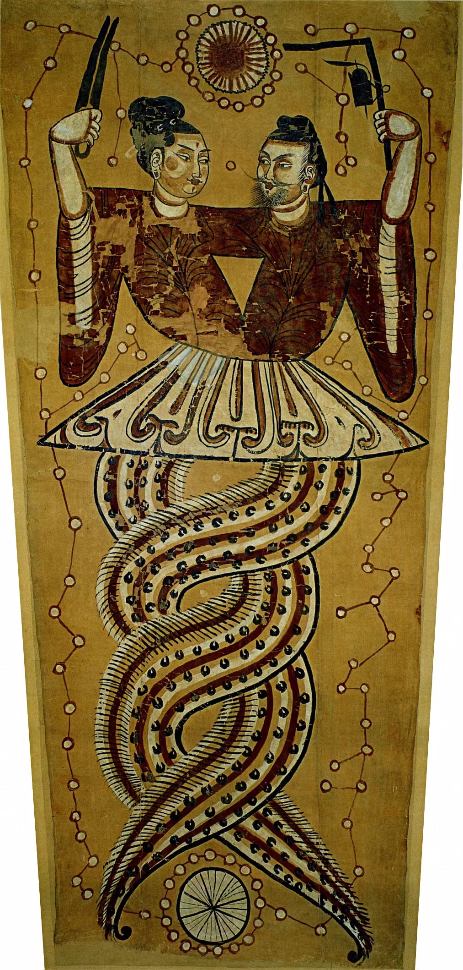
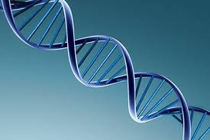
Although Nü Gua originally stood alone, she became paired with Fu Xi, who is identified as her brother, a creator god. This marks the beginning of the suppression of female power in China. This change begins around the time of transition from the early Han to the later Han Dynasties.
Nü Gua and Fu Xi are represented as intertwined snakes, the embodiment of yin and yang. They are depicted holding the instruments of creation, the compass and the square, the tools that were used to take the measurements of the Universe at the founding of a new world following the great flood.
As for the entangled tails of the couple, they look uncannily like the double helix of DNA.

Slide 9

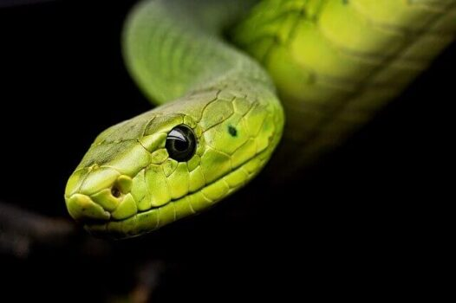
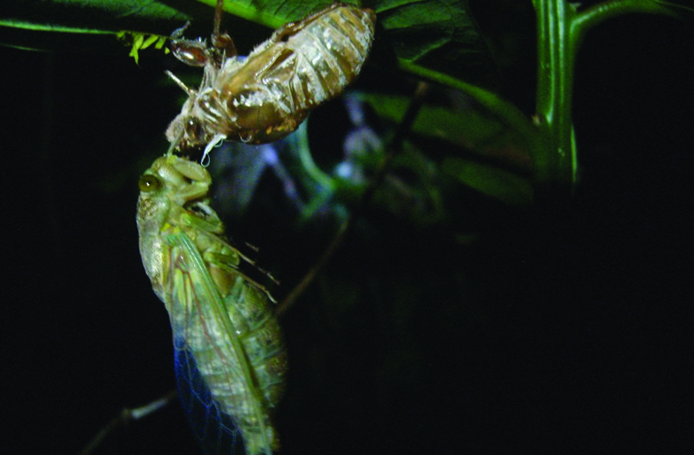
Symbols of rebirth:
Phoenix
Snakes
Cicada

Slide 10

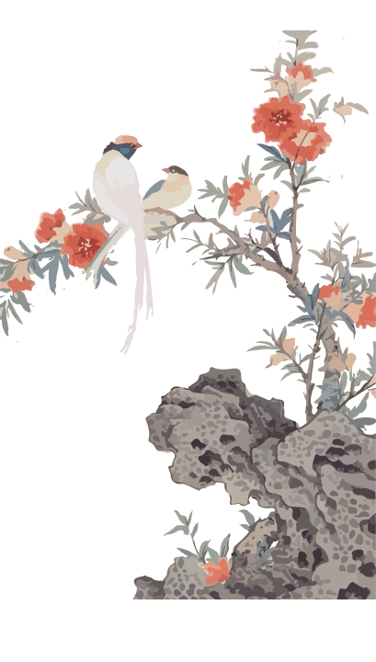
Two
Three August Ones and Five Emperors

Slide 11
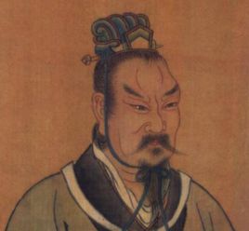
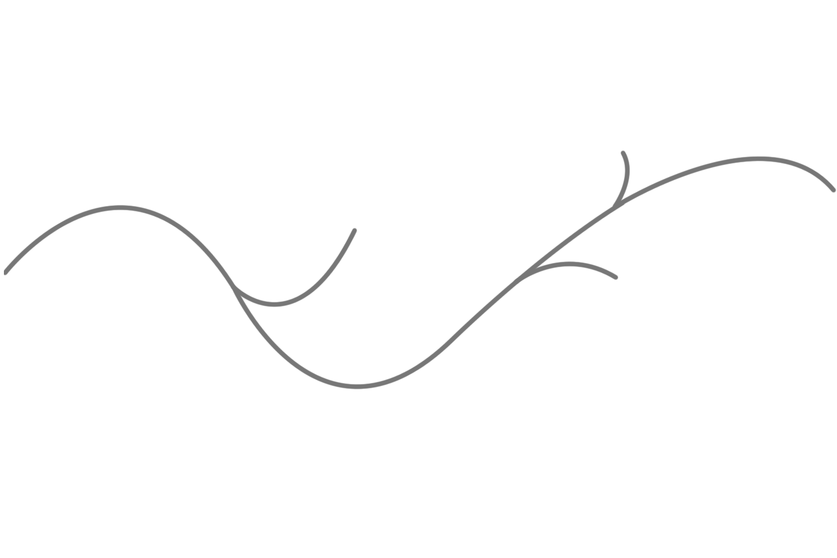
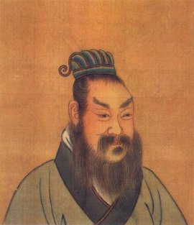
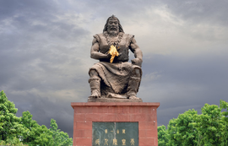

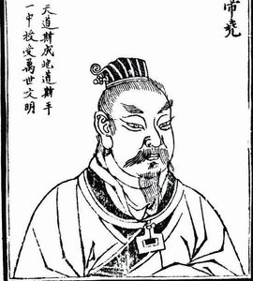

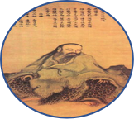



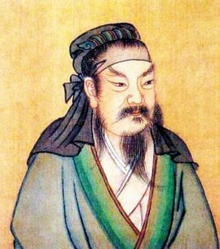


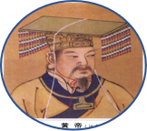
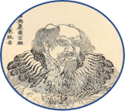
Zhuanxu
Emperor Ku
Yao
Fuxi
Suirenshi
Huang Di
Shennong
Shun

Slide 12
Three
Records of Myths

Slide 13
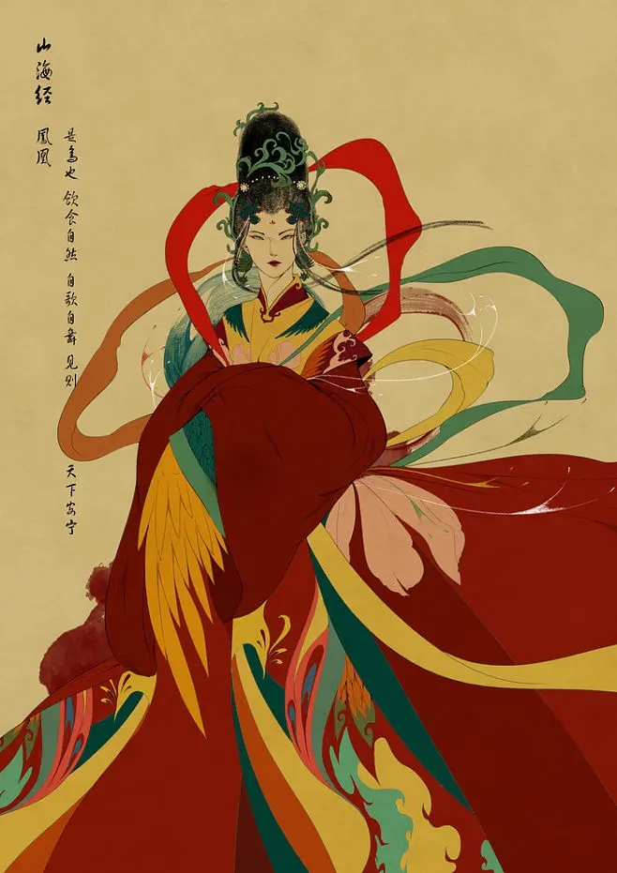
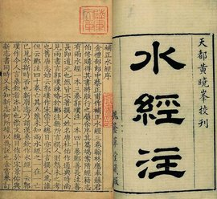
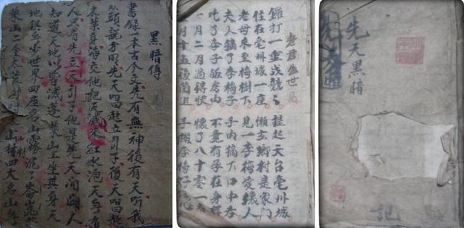
Classic of Mountains and Rivers
Commentary on the Water Classic
The Legend of Dark
Classic of Mountains and Rivers describes the myths，witchcraft，and religion of the ancient China in great details and also has a record of the geography，sea and mountain，history，medicine，customs，and ethnicities in ancient time.
Literally Commentaries on the Water Scroll，this work began as commentaries on the briefer work of the Water Scroll，but became famous of its own accord because of its extensive record of geography，history，and associated legends.
This is the only collection of legends in epic form preserved by a community of the Han nationality of China，namely，inhabitants of the Shennongjia mountain area in Hubei，containing accounts from the birth of Pangu till the historical era.

Slide 14
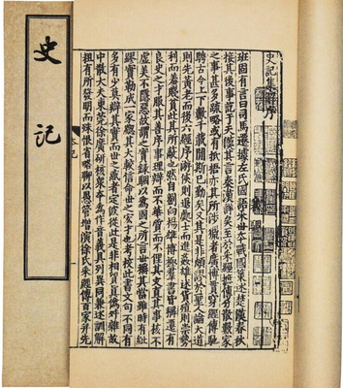
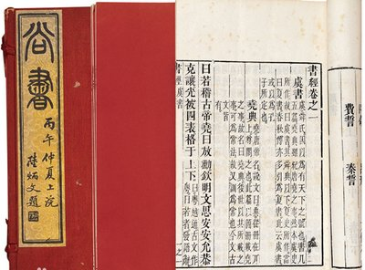
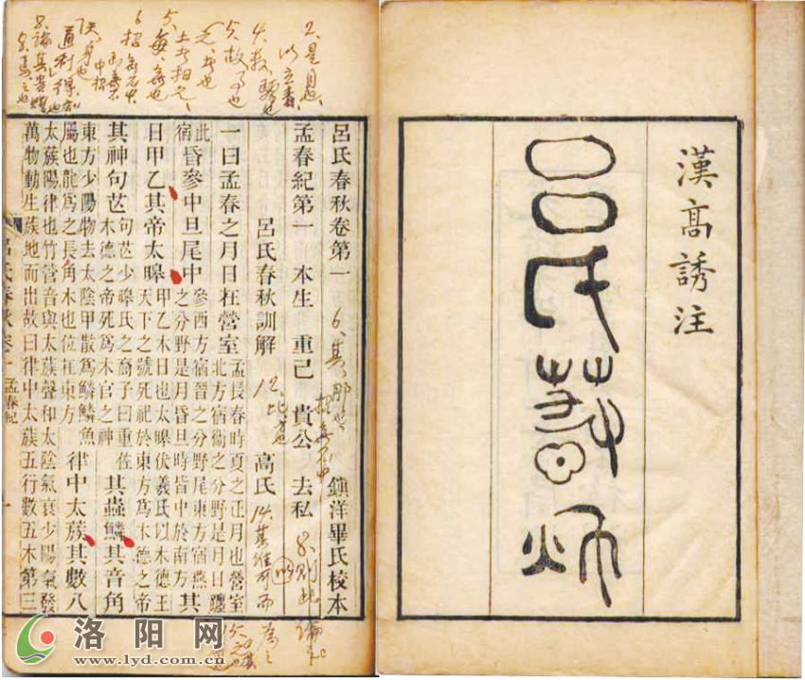
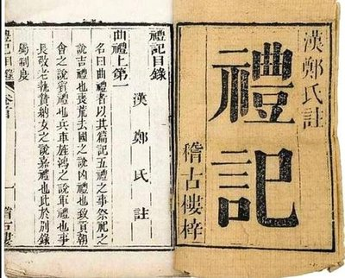
  The Book of History
  Records of the Historian
  Master Lü's Spring and
  Autumn Annals
  The Book of Rites

Slide 15
References：
Birrell, A. (1993). Chinese mythology: An introduction. Baltimore: The Johns Hopkins University Press.
Christie, A. (1983). Chinese mythology. New York: Peter Bedrick Books.
Yang, L. & An, D. (2005). Handbook of Chinese mythology., New York: Oxford University Press.
Schafer, E. H. (1973). The divine woman: Dragon ladies and rain maidens in T’ang Literature. Berkeley: University of California Press.

Slide 16
  THANK YOU

