Slide 1



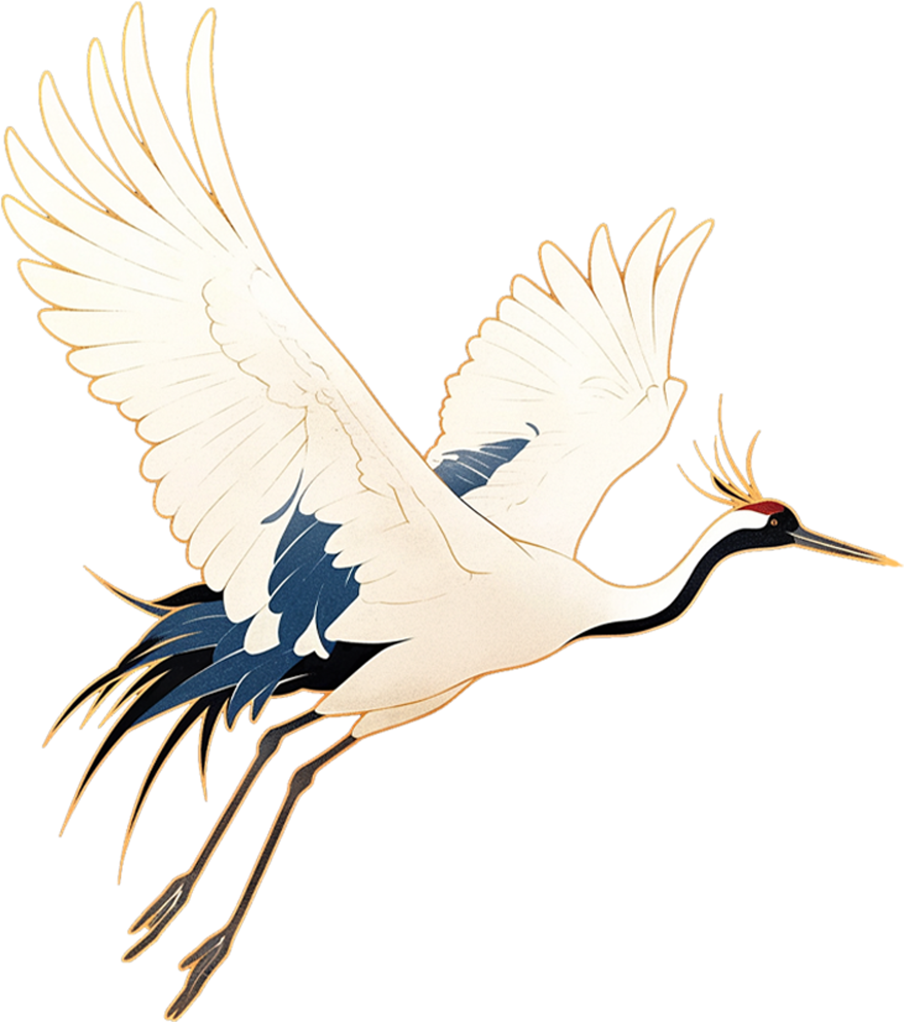
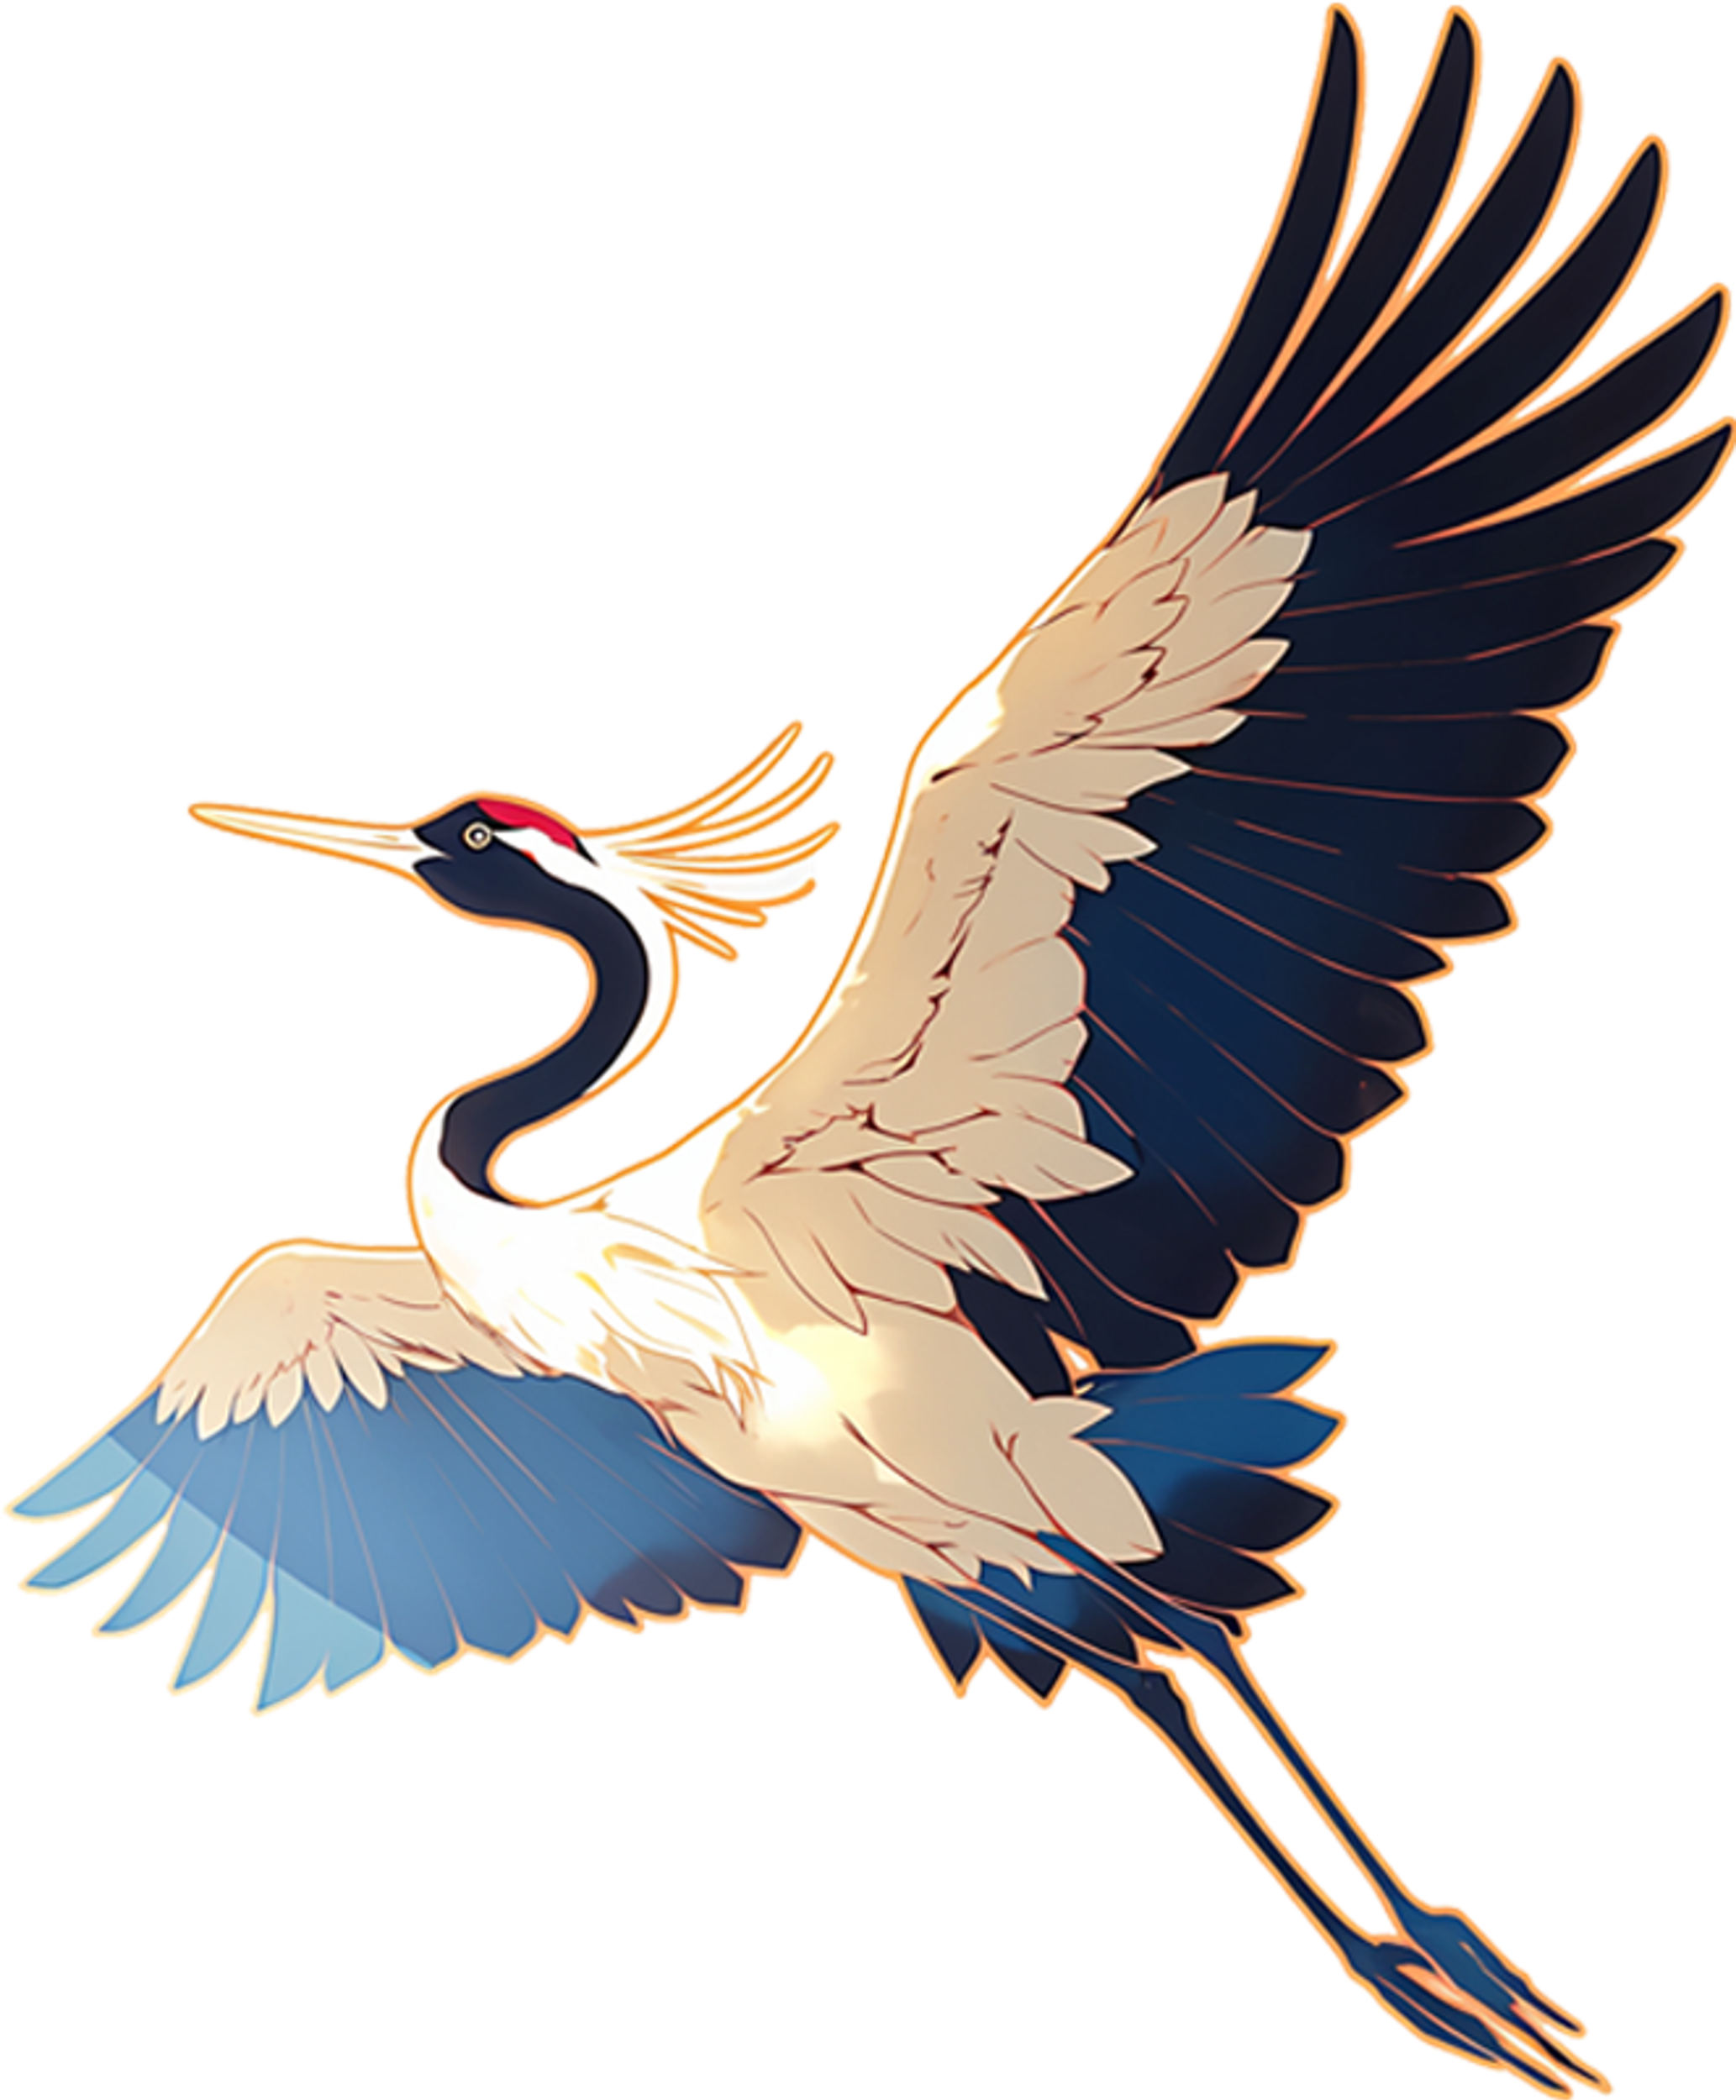

The Culture of Flowers
Chen Weiping

Slide 2
CONTENT
01
The Pragmatic Value of Flowers
02
The Spiritual Value of Flowers
03
Differences between Chinese and Western Culture of Flowers

Slide 3

01
The Practical Value of Flowers

Slide 4
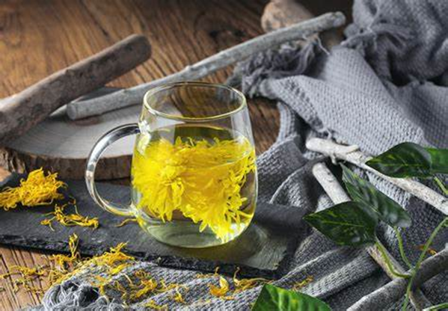
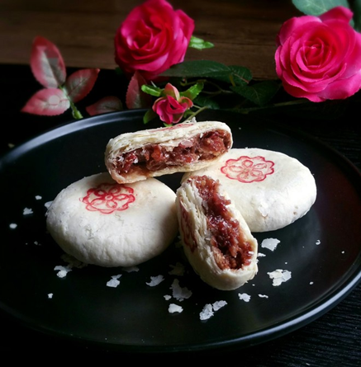
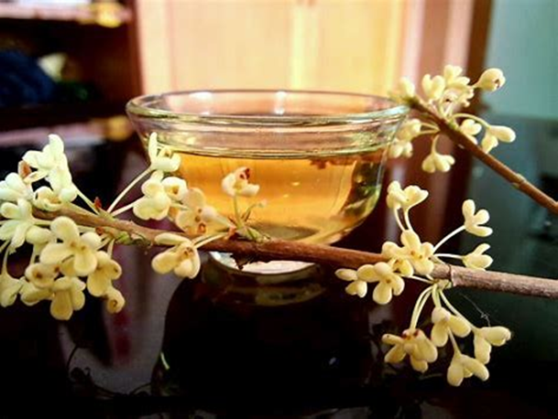
Edible Value
The history of using flowers as ingredients in food in China dates back to the "Book of Songs". Flowers are used in a variety of ways, including raw consumption, stir- frying, boiling, or making into herbal teas. For instance, chrysanthemums are used for chrysanthemum tea, known for their heat- clearing and detoxifying effects. Roses are used to make rose cakes, which are not only visually appealing but also have a captivating aroma. Additionally, osmanthus flowers are used in the making of osmanthus wine, whose unique fragrance and taste leave a lasting impression.
Notes:
Chry/’san/the/mum 菊花
Os/’man/thus 桂花

Slide 5
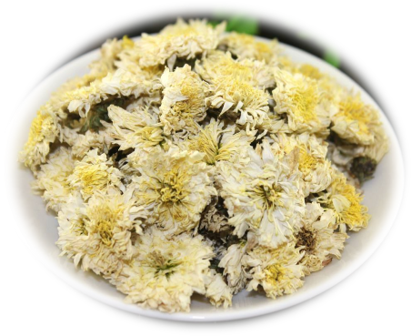
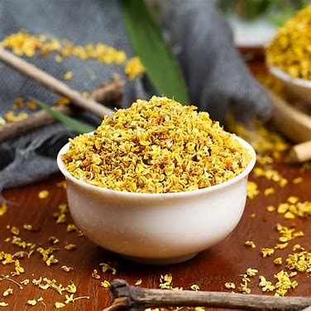
Medicinal Value
Medicinal Components of Flowers
Flowers contain a variety of chemical components beneficial to human health, such as flavonoids in chrysanthemums and aromatic oils in osmanthus. These components have various bioactivities like antioxidant, anti- inflammatory, antibacterial effects, positively impacting human health.
Medicinal Practices of Flowers
In traditional Chinese herbal medicine, a variety of flowers are widely used. For example, roses are used to treat blood circulation issues, and osmanthus is used to improve digestive functions. These flowers are incorporated into daily treatments through decoctions and teas.
Notes:
‘Flavonoid 类黄酮
Aro’matic oil 精油

Slide 6
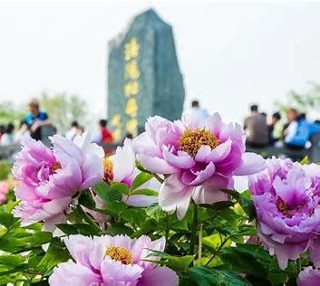
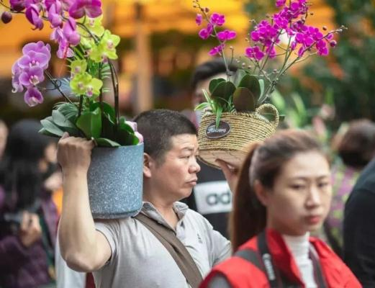
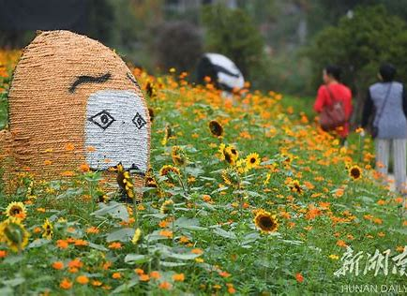
Flower viewing
The Chinese have a long history of viewing flowers, from ancient royal gardens to modern city parks, where flowers have always been an important object of admiration. In modern times, in addition to traditional parks and gardens, flower exhibitions and flower festivals have become important ways for people to view flowers.
History of Floral Appreciation
Luoyang Peony Culture Festival
Guangzhou Flower Street
Hunan Forest Botanical Garden

Slide 7
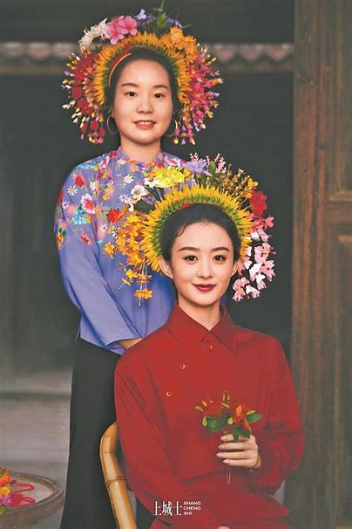
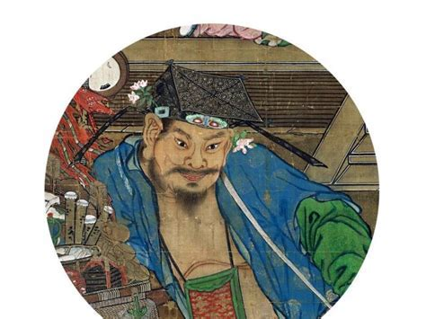
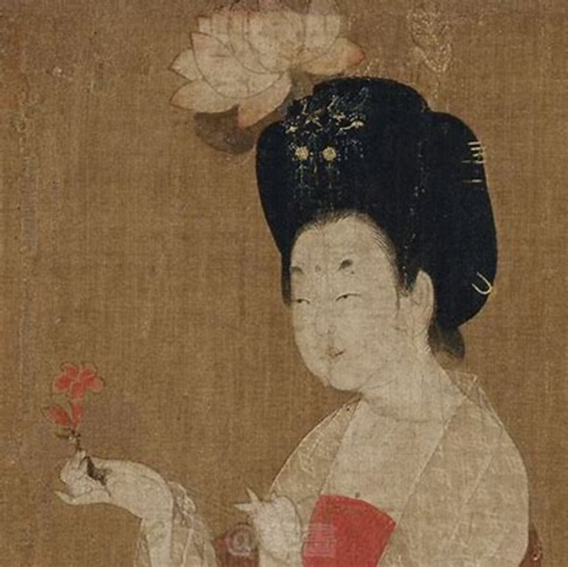
Decorative Uses
Zan Hua (Wearing flowers)
Ikebana Art
Notes:
The history of using flowers as decoration in China can be traced back to ancient times, with rich expressions in floral decorative arts
This practice was not restricted to sex, age, and classes back in ancient China.

Slide 8
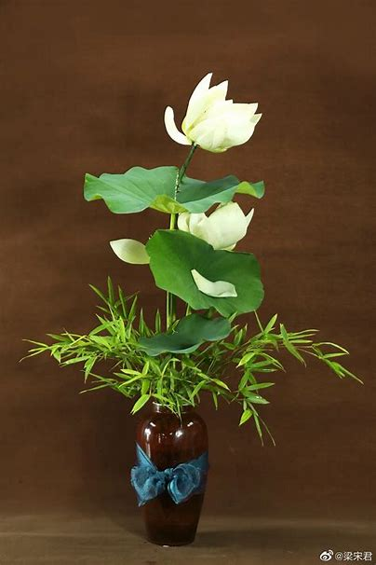
Cha Hua (Flower arrangement)
Chinese flower arrangement, with its roots in ancient China, has a history that spans over thousands of years. It began as a ritual practice in the Tang Dynasty and evolved into an art form during the Song Dynasty. This tradition has been deeply influenced by Chinese philosophy, emphasizing the harmony between humans and nature.
Notes:
It showcases the beauty and vitality of flowers through skillful combination and arrangement. It is not only a form of decoration but also a form of artistic creation.

