Slide 1
Artificial Intelligence in Translation

Slide 2
Automatic translation of text from one language to another using a computer application.
Source analysis Processing Production

Slide 3
A brief history of machine translation
Rule-based Machine Translation
Corpus-based Machine Translation
Neural Machine Translation

Slide 4

AI translation includes:
Text translation Photo translation Document translation

Slide 5
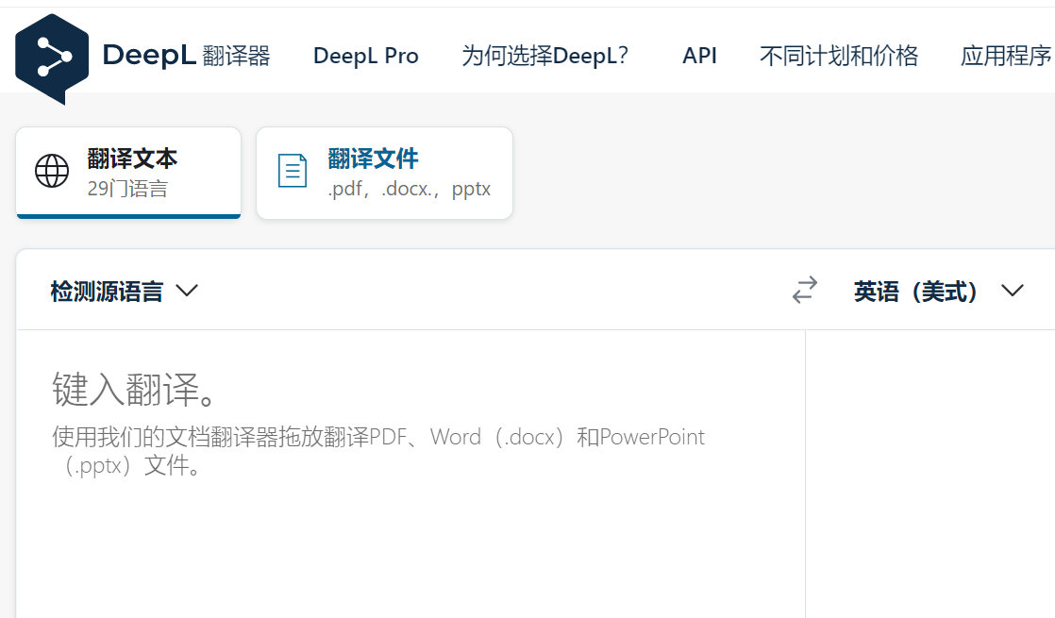
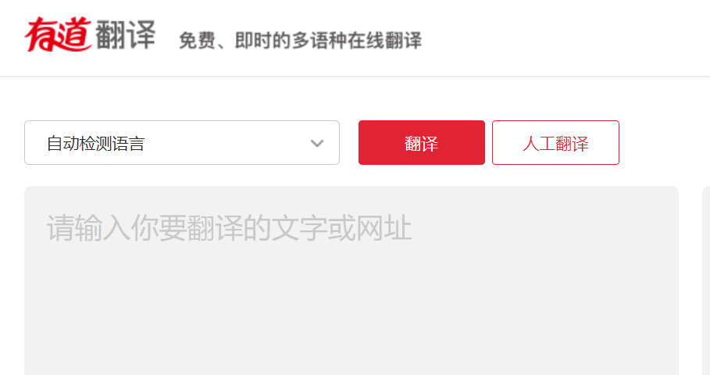
Text translation

Slide 6
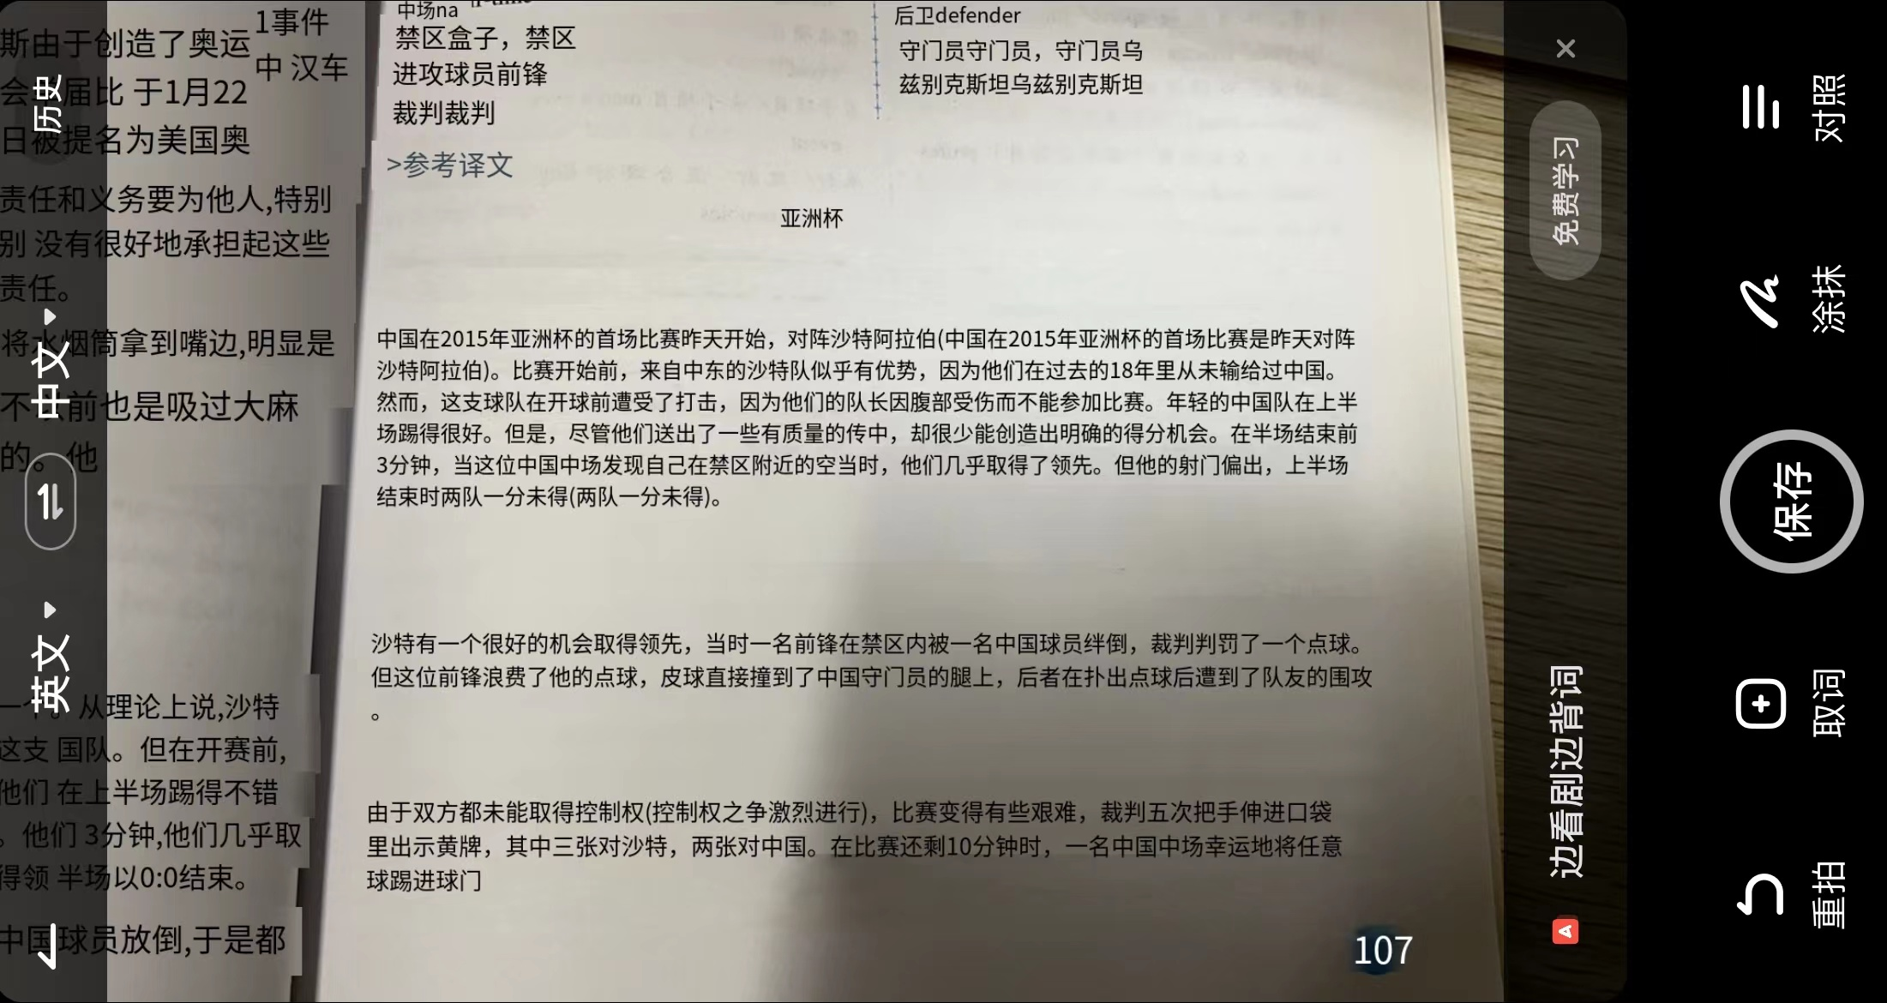
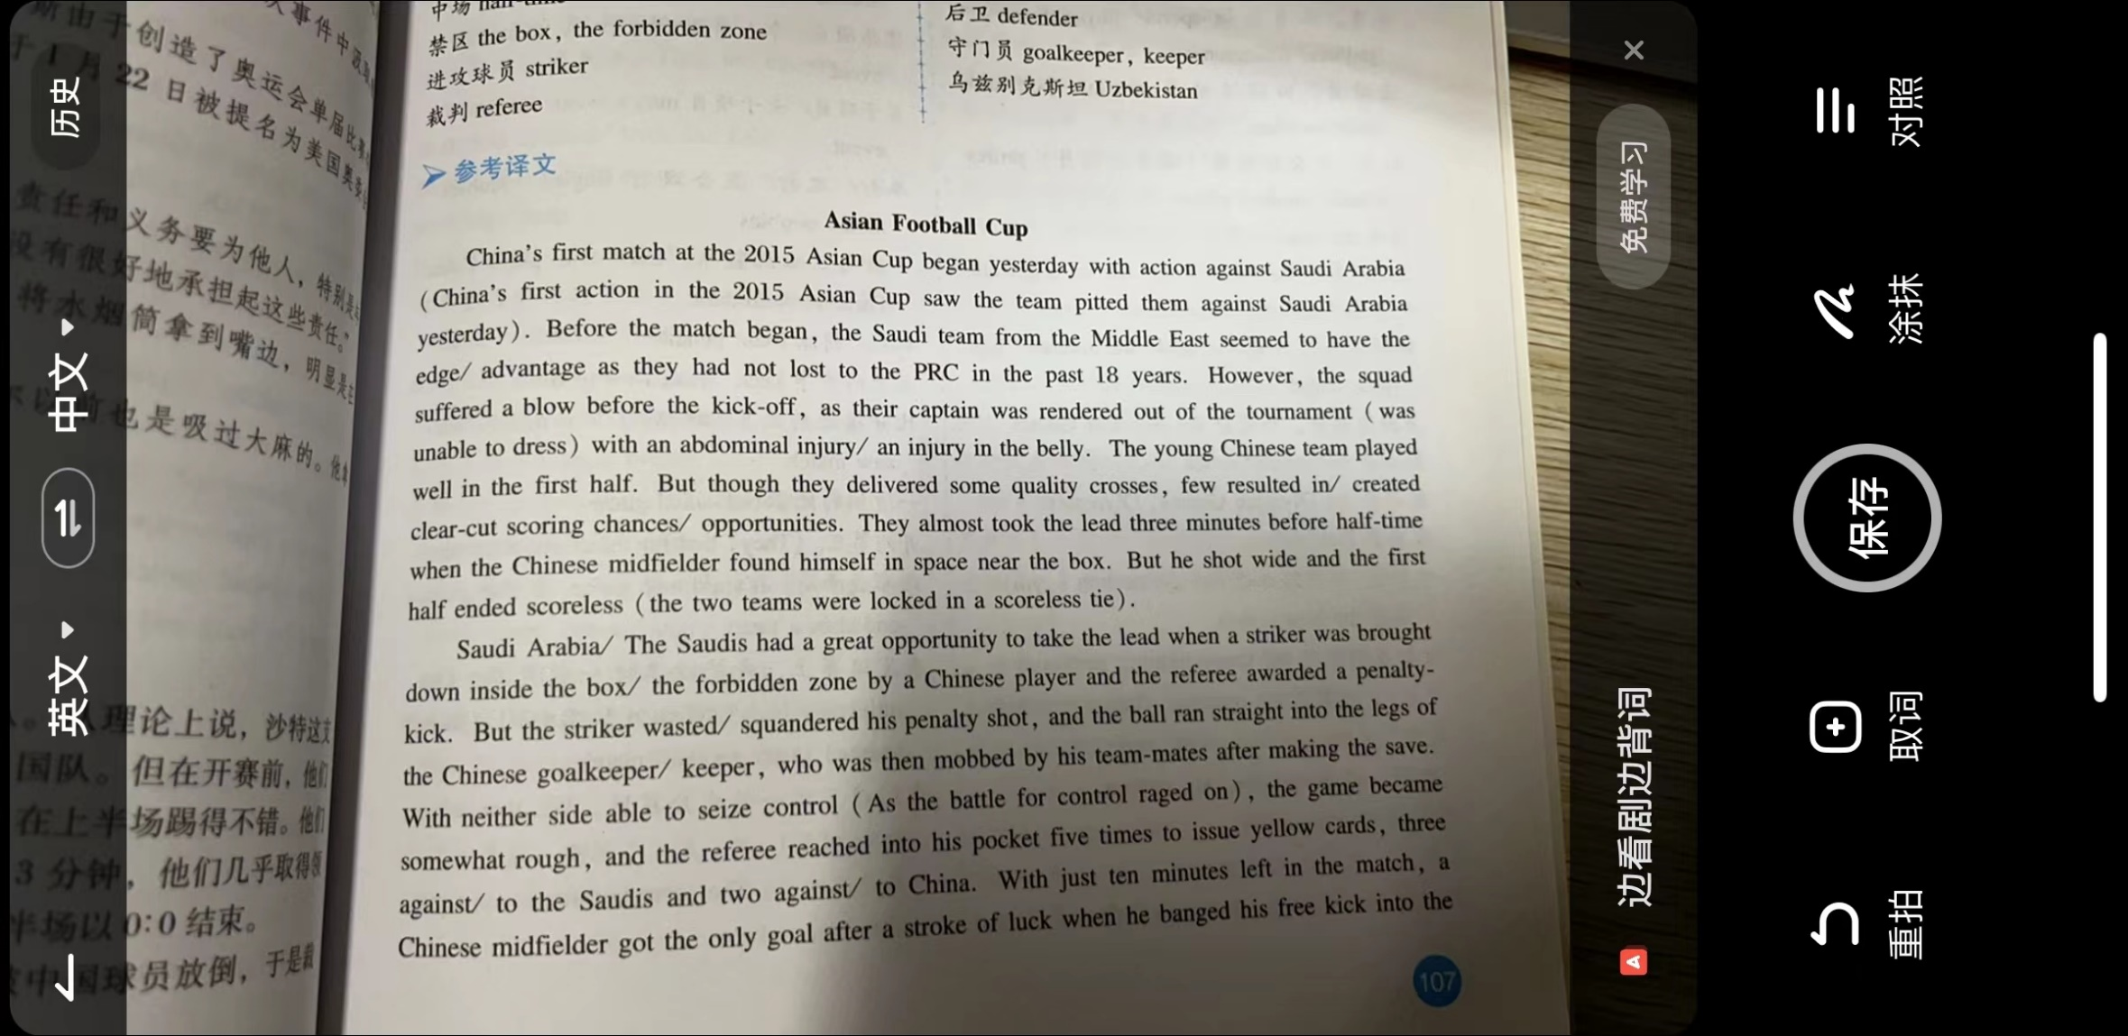
Photo translation

Slide 7
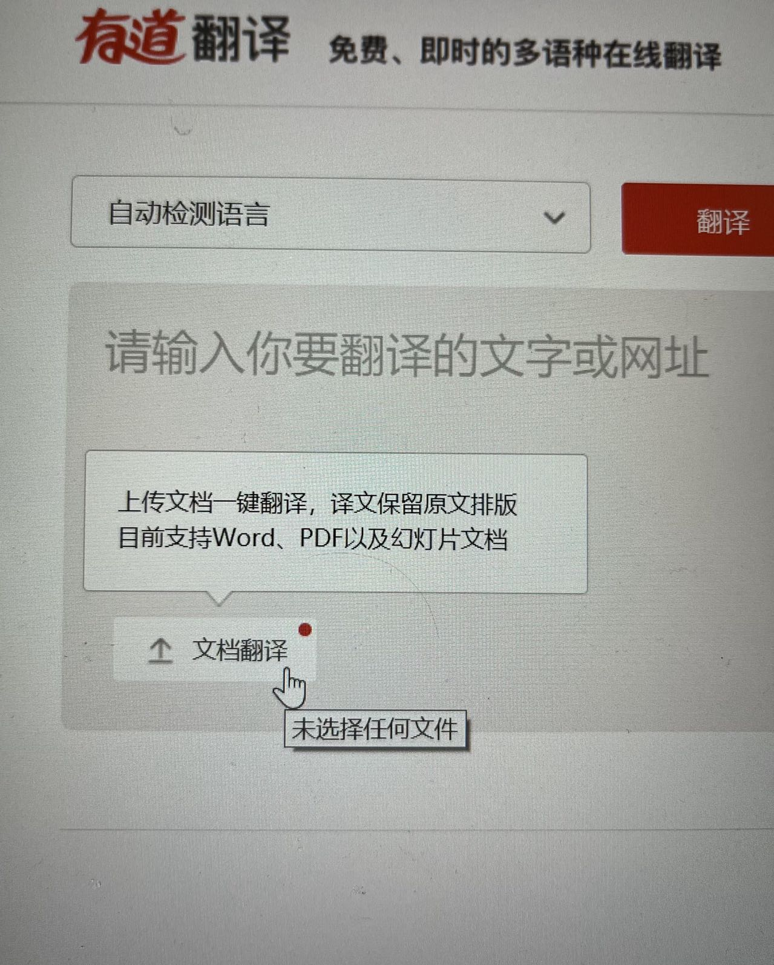
Document translation

Slide 8



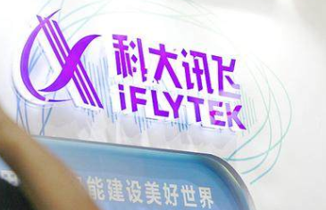

Translation softwares

Slide 9
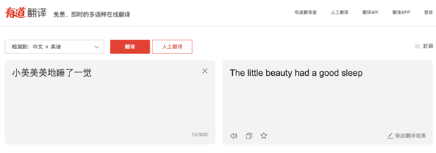
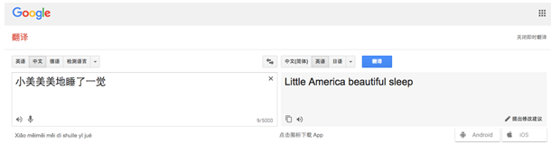
Translate：小美美美地睡了一觉

Slide 10
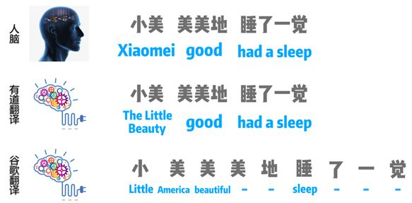
Xiaomei had a good sleep.
The little beauty had a good sleep.
Little America beautiful sleep.

Slide 11
Machine translation:
An auxiliary
A tool to improve translation efficiency

Slide 12
interactive

Slide 13

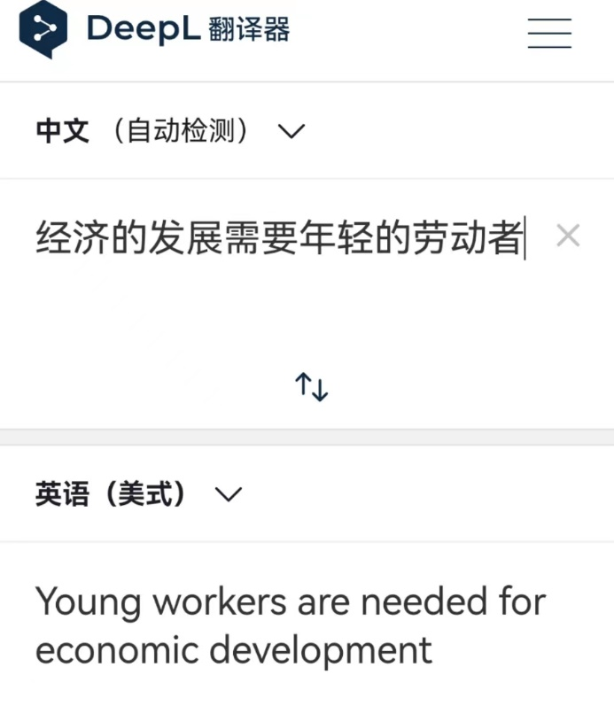
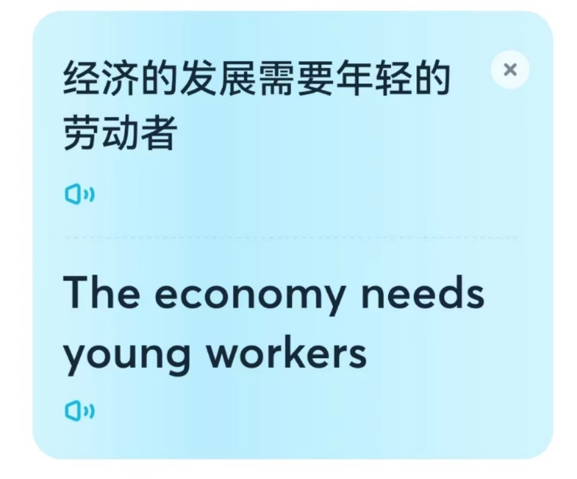
参考译文：
A country's economic development relies on a supply of young workers.

Slide 14
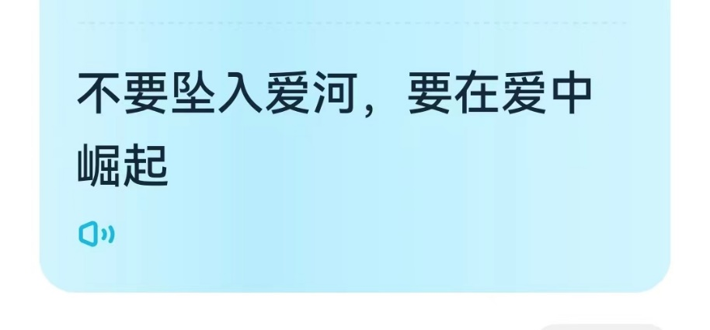
Brain-storming：
Don’t fall in love, Rise in love.
1.爱意不似落日西沉，而似初阳升起。
2.智者不入爱河，寡王一路硕博。
3.不为爱而沉沦，要为爱而闪烁。
4.不在爱中沉没，要在爱中升华。

Slide 15
Thanks

