Slide 1
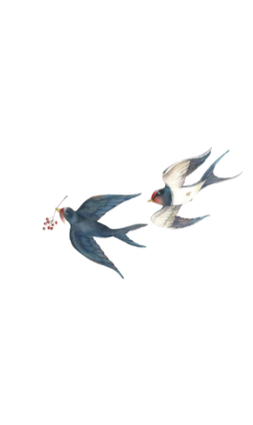
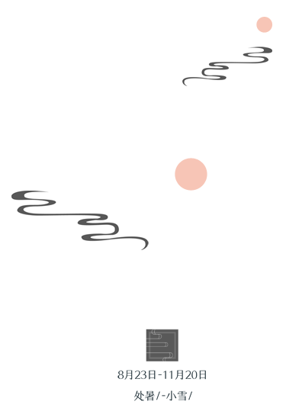




Round Table Culture
Presenter：刘晓宇

Slide 2
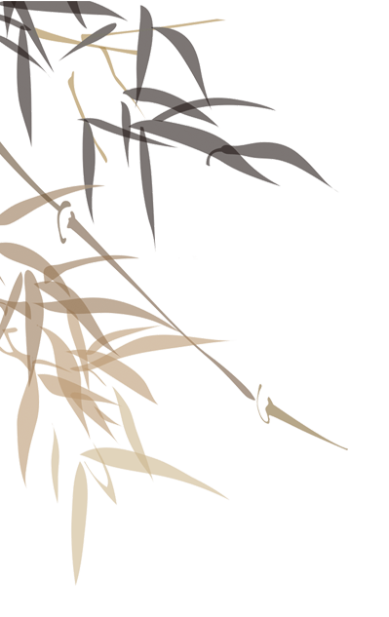
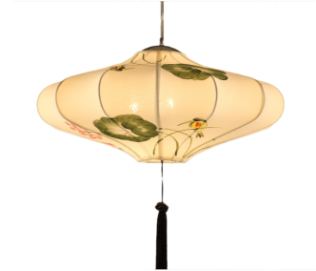


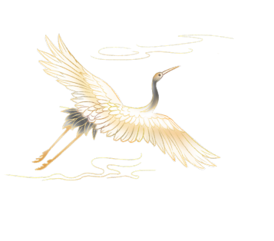
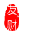

Contents
1.The symbolic meaning of round table
2.The application of round table in China
3.The round table culture in western countries
4.Modern presentations of round table culture
&Critical Thinking

Slide 3
1.The symbolic meaning of round table

Slide 4
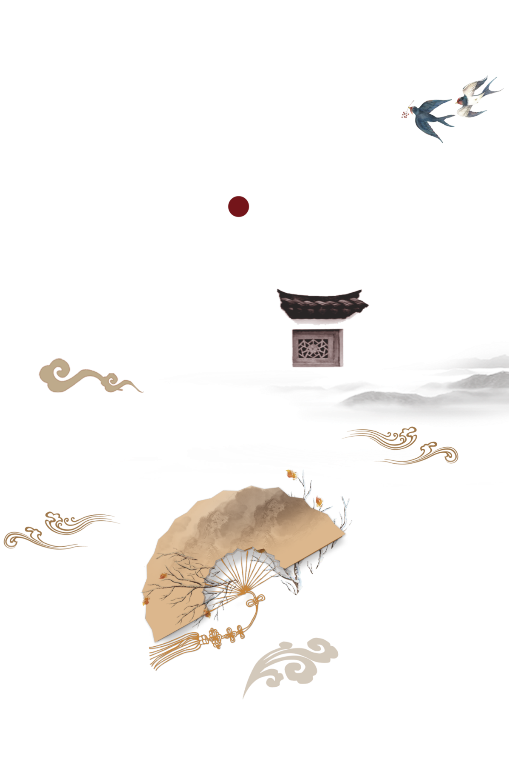

Round
Table
The Shuowen Jiezi annotation states: "A circle represents celestial bodies. It‘s whole, uniform in all directions.
Sphere
《说文解字注》有：“圜者天体。天屈西北而不全。圜而全，则上下四旁如一。是为浑圜之物。”

Slide 5
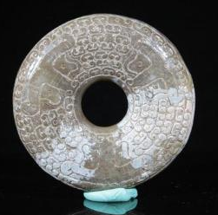
Comprehensiveness and perfection
The Temple of Heaven and jade artifacts
Chinese classical dramas and novels
Round shape
Harmonious and complete "happy ending,"

Slide 6
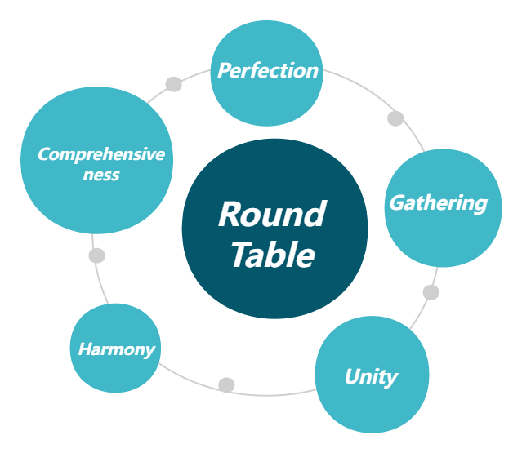
Auspicious
Culture

Slide 7

Does your family eat at a round table？

Slide 8
2.The application of round table in China

Slide 9
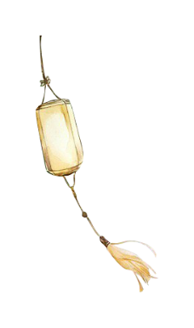
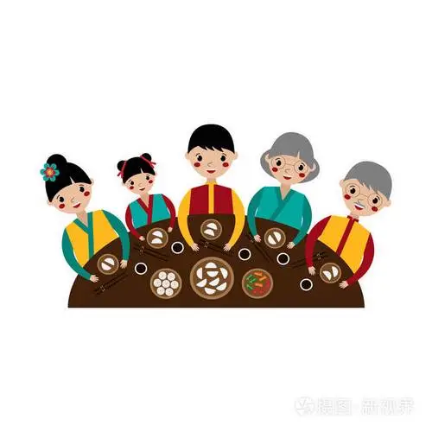
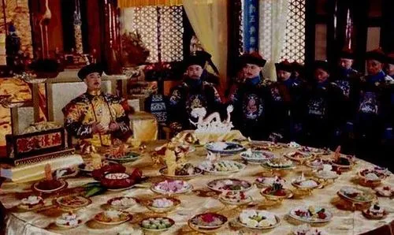
In Ancient China
Family Meals
Official Banquets
The harmony and happiness of the family
The equality and unity between the monarch and his ministers

Slide 10

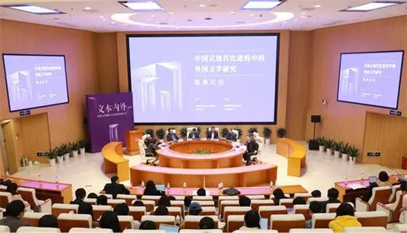

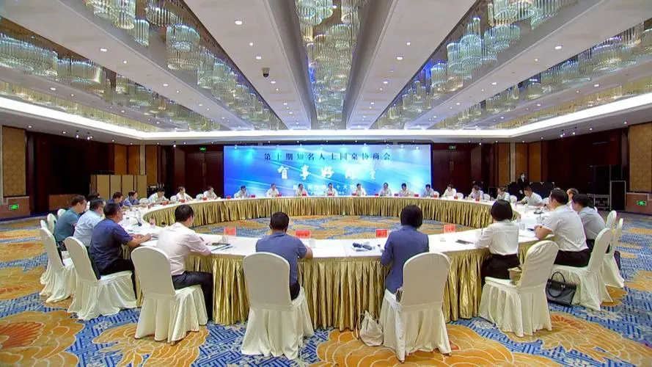
In Modern Society
Business Negotiations
Academic Exchange
Corporate Meetings

Slide 11
3.The round table culture in western countries

Slide 12
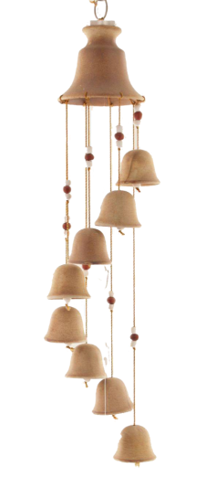
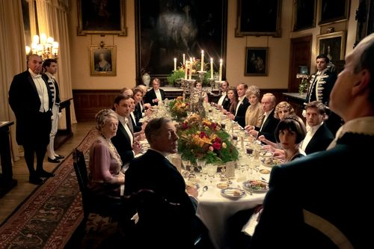
Long Table
Eating
Chating
The separate dining style

Slide 13
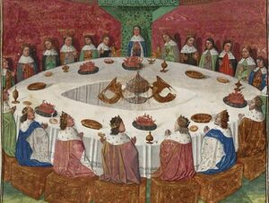

"Round-Table conference”
The story of King Arthur
Everyone who sits around it has equal status.
No edges or corners

Slide 14


4.Modern presentations of round table culture
&Critical Thinking

Slide 15
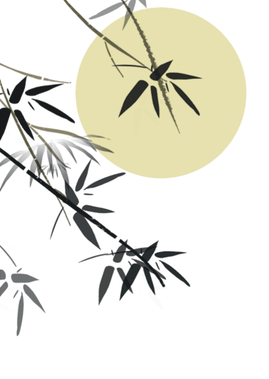
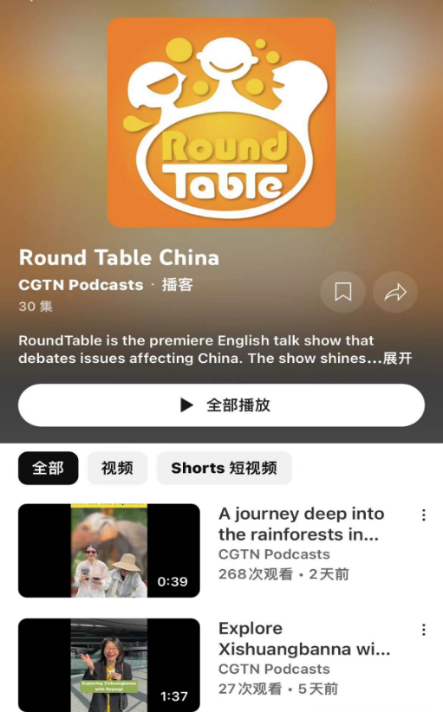
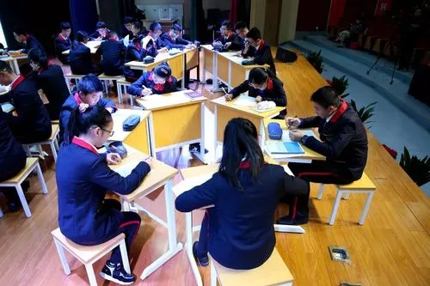
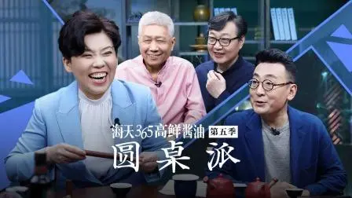
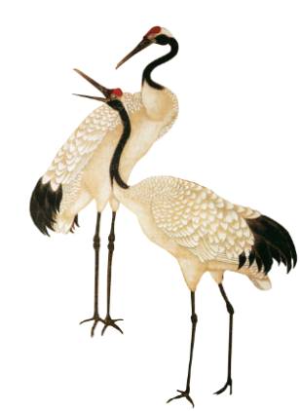

Education
Podcast
TV program

Slide 16
In today's fast-paced society, the interpersonal connections are becoming increasingly faint and the reunion represented by the round table is no longer a necessity.
What do you think about it?
Individual development、 self-realization,
Family structures
Even more precious
significant holidays or family gatherings.
·A crucial bond
·the connection of family members' emotions

Slide 17
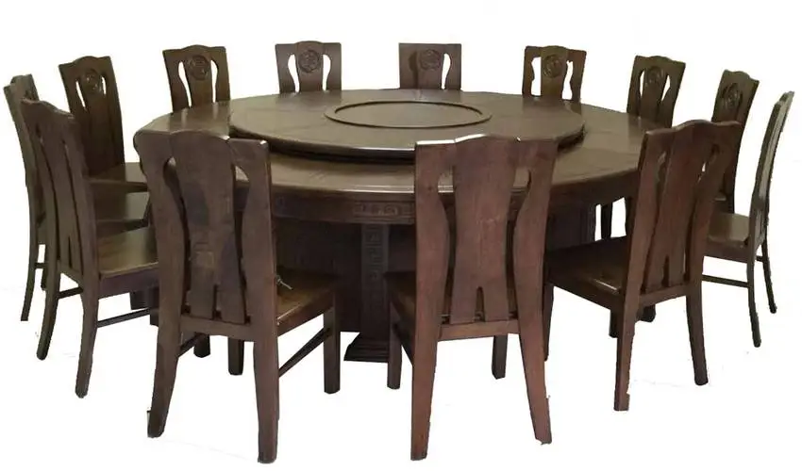
Invariable
Changing
food、 people、 reason
the sensation behind it

Slide 18
Thank you
Reference：
[1].Wang Yan 王嫣. (2021). 中国的象征：我记忆中的圆桌（英文）. 疯狂英语(新读写)(04), 50.
[2].▪Chen Yongjun 陈永军. (2018). 浅谈圆桌文化. 天工(06), 106-107.

