Slide 1
Qingming Riverside Landscape Garden
Reporter: Cai Yingchu/ Rachel

Slide 2
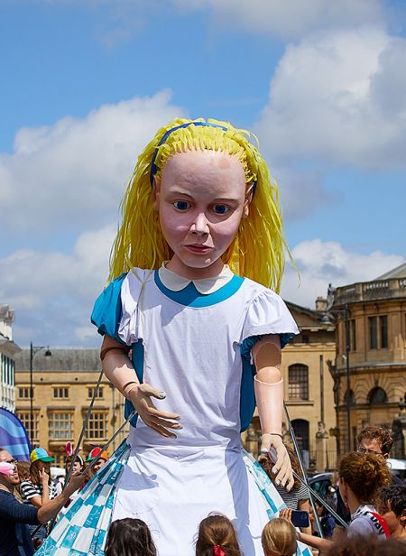
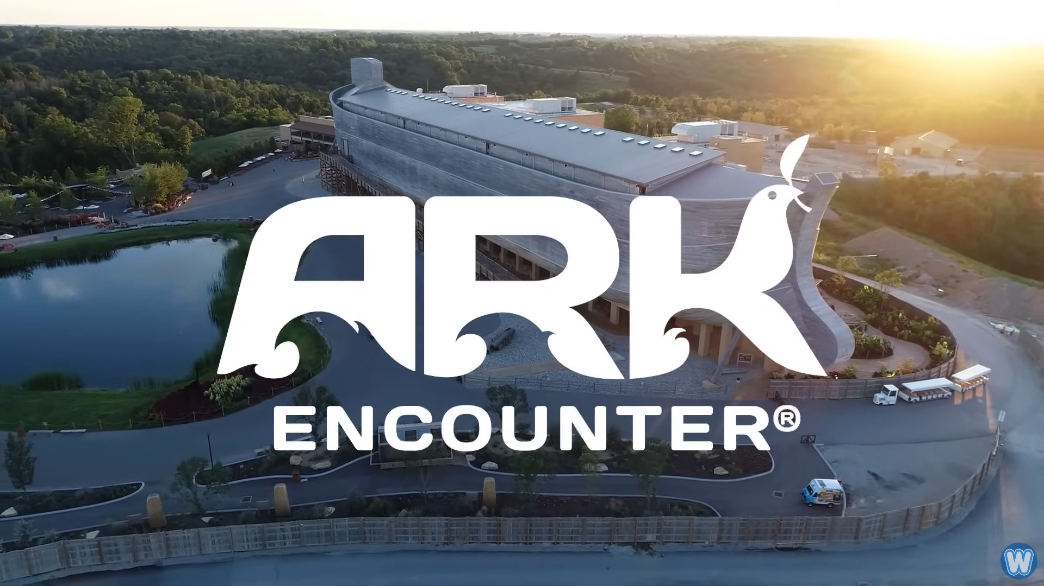
You may know something about:
Noah’s Ark Theme Park (Kentucky, USA)
Alice in Wonderland Adventure Park (Oxford, UK)

Slide 3
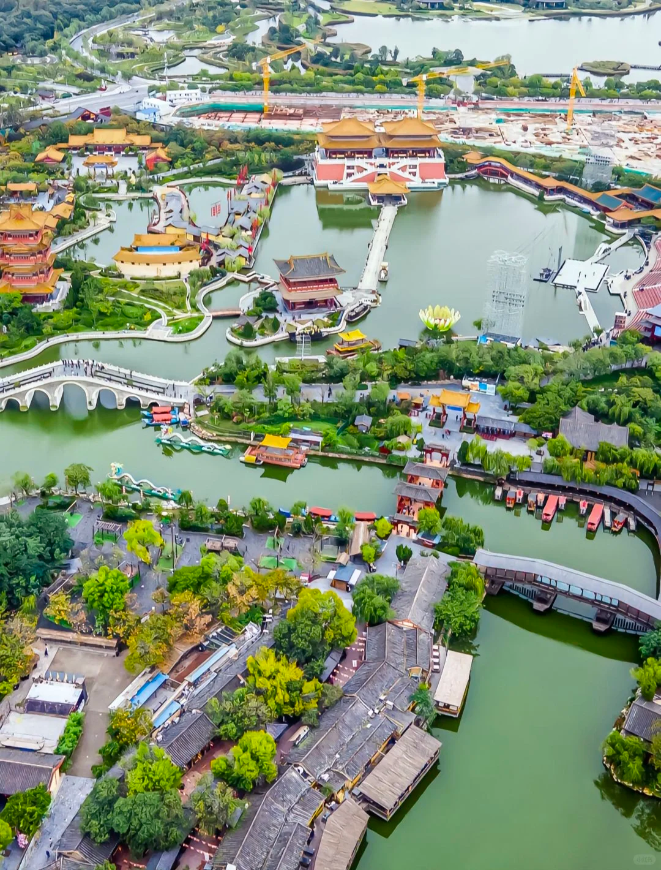
But do you know
Qingming Riverside Landscape Garden
in Kaifeng, Henan province in China

Slide 4
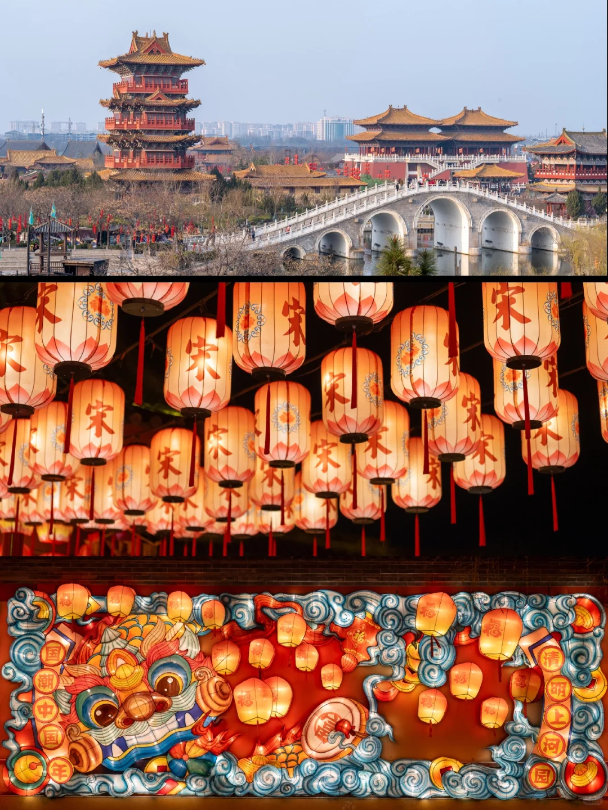
Qingming Riverside Landscape Garden
Based on the famous Chinese painting Along the River During the Qingming Festival
Witnessing the prosperity of Bianjing, the capital of the Northern Song Dynasty

Slide 5
About the painting:
What’s the name of the painting? (Chinese& English)
Who is the painter?
Where is it now?
What kind of story does this painting tell?
What’s in the picture? Can you name some?
https://minghuaji.dpm.org.cn/paint/appreciate?id=592d80e225aac624977fee2e19452c1f
https://www.qingmings.com/map_pano.php

