Slide 1







Striking iron flower 打铁花
汇报人：傅馨可 Finger

Slide 2
CONTENTS
01
The history and background of striking iron flower
02
The showcases of striking iron flower and its cultural meaning
03
The heritage and development of striking iron flower

Slide 3
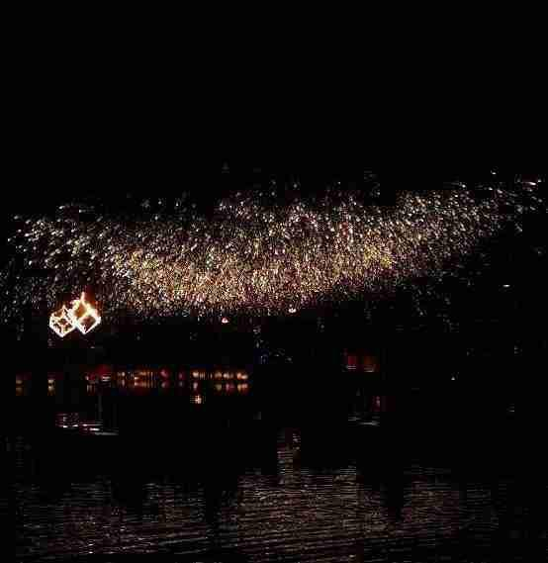

PART
01
The history and background of striking iron flower

Slide 4

A video about striking iron flower

Slide 5
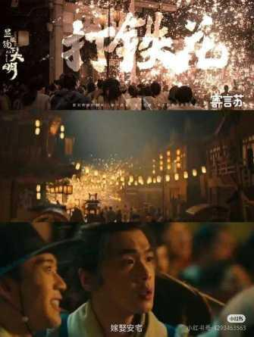
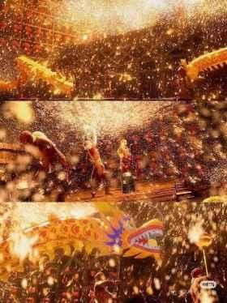
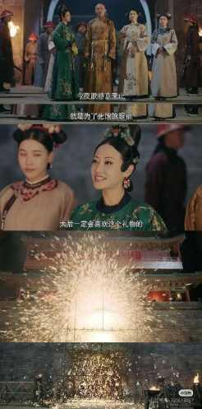
enhance its popularity
&
attract more people
《画江湖之天罡》
《显微镜下的大明》
《延禧攻略》

Slide 6
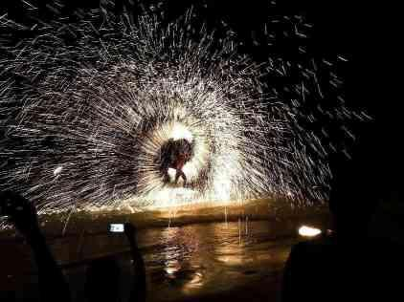
The history of Striking iron flower
The art of Striking iron flower can be traced back as early as the Spring and Autumn and Warring States periods, reaching its peak during the Ming and Qing dynasties. With recorded activities originating in the Northern Song Dynasty, it has been a large-scale traditional folk fireworks activity prevalent in North China regions such as Henan, Shanxi, and Hebei for over a thousand years. It is now recognized as a national-level intangible cultural heritage.

Slide 7
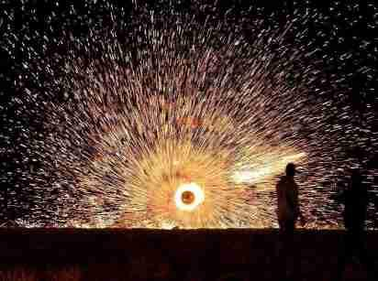
The history of Striking iron flower
Iron flower is originally the alchemy Taoist priest to pray for blessings and avoid disasters, exorcism of evil town house ritual activities, but also the folk gold, silver, copper, iron, tin craftsmen and Taoist priests every year when the Spring Festival opens, together with the Taoist priests to worship the common ancestor — Taishang Laojun（太上老君） and hold a ceremony, with the Taoist mystery and hardware craftsman industry characteristics.

Slide 8

The history of Striking iron flower
Question :
1. When is the practice of "striking iron flower" recorded in history?
A. the Spring and Autumn and Warring States periods
B. the Ming and Qing dynasties
C. the Northern Song Dynasty
2. "Striking iron flower" is a ritual activity performed by alchemist Taoist priests for what purpose?
To pray for blessings and avoid disasters

Slide 9
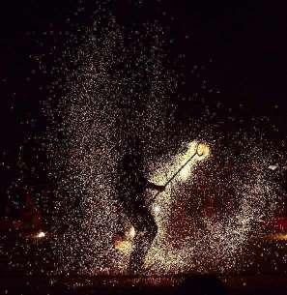
PART
02
The showcases of striking iron flower and its cultural meaning

Slide 10
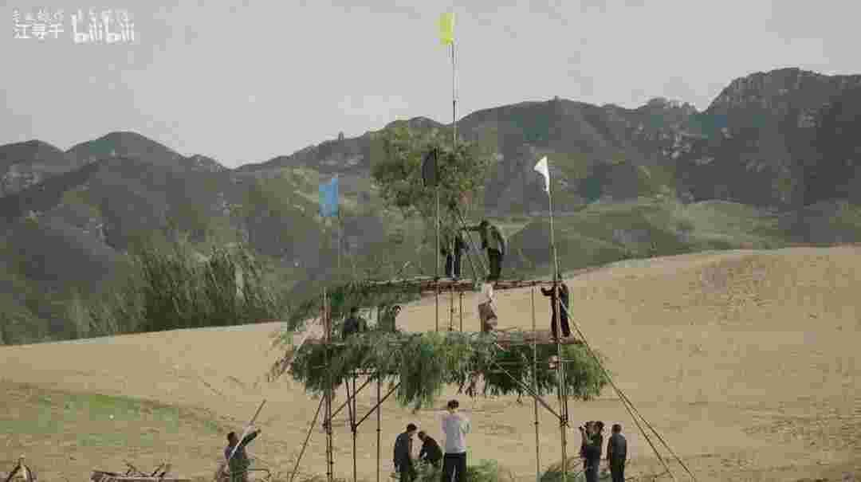
The showcases of striking iron flower
1. an open field
2. six-meter-high double-layer flower trellis
3.fresh willow branches on the top
4. a furnace
The process involves heating iron to temperatures exceeding 1600 degrees Celsius until it becomes molten

Slide 11
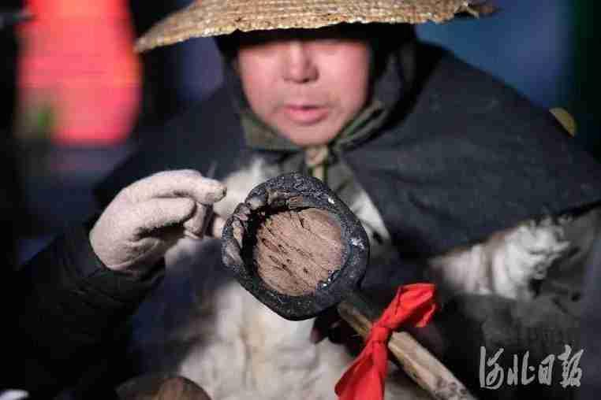


The showcases of striking iron flower

Slide 12
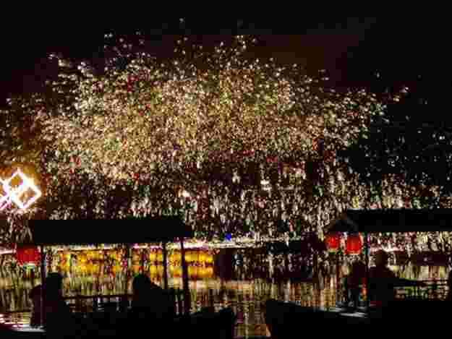
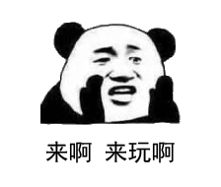
Jigsaw
puzzle
拼图规则：大家有十秒钟可以记住这张图，十秒钟后，将切分为九张小图，能将九张图拼好则为成功！

Slide 13
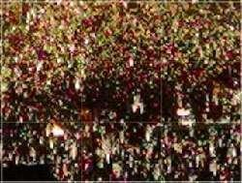
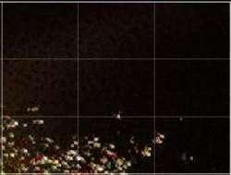
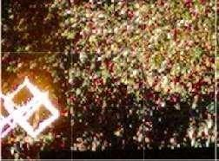

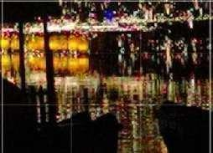
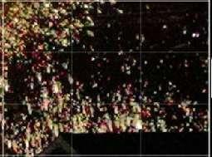
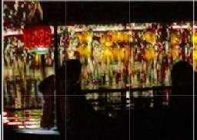
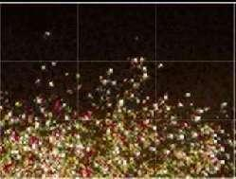
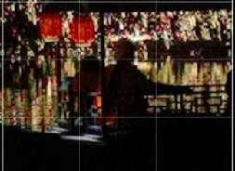
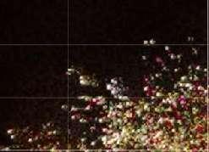
1 | 2 | 3
4 | 5 | 6
7 | 8 | 9

Slide 14

PART
03
The heritage and development of striking iron flower

Slide 15
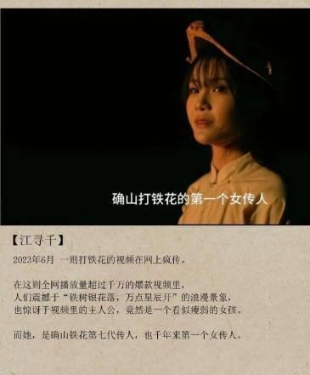
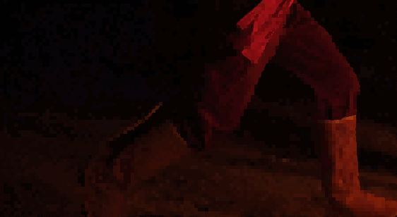
The heritage and development of striking iron flower
Jiang Xunqian/ Jiu Yue
She is the seventh generation of the Queshan Iron Flower and the first woman to do so for thousands of years.

Slide 16

The heritage and development of striking iron flower

Slide 17
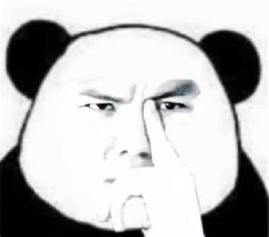
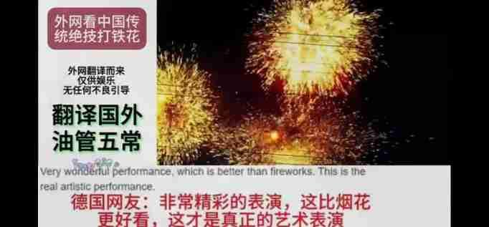
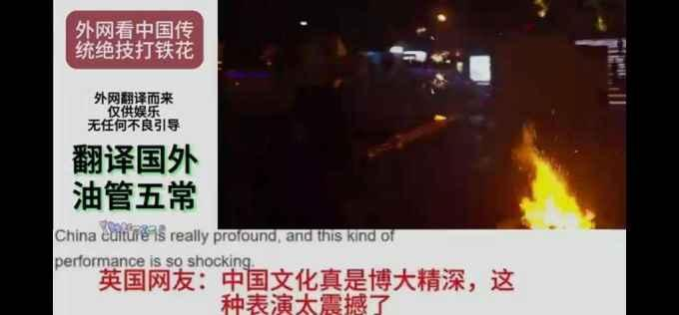
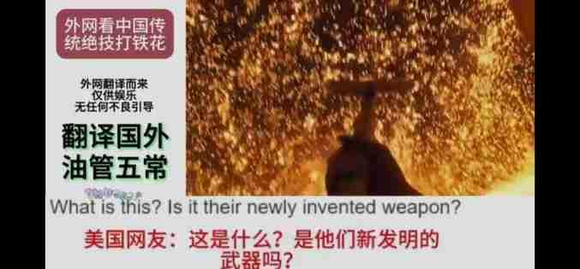
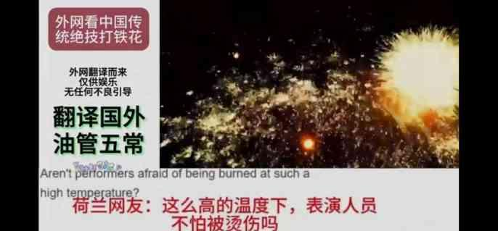
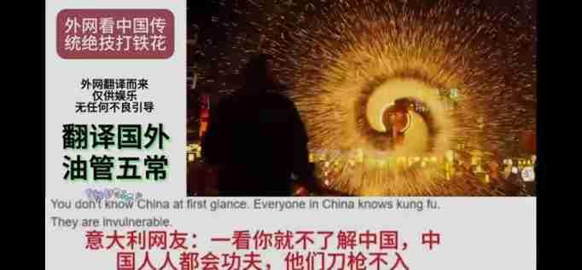
Some very interesting and cute comments about striking iron flower from YouTube.

Slide 18
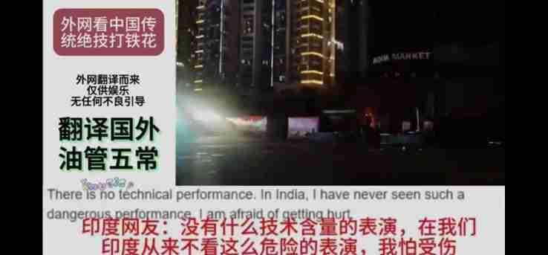
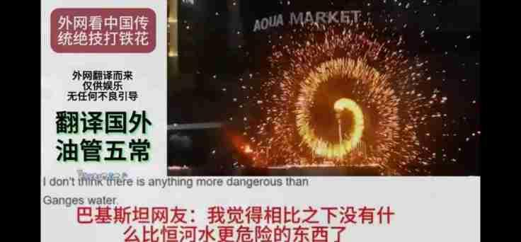
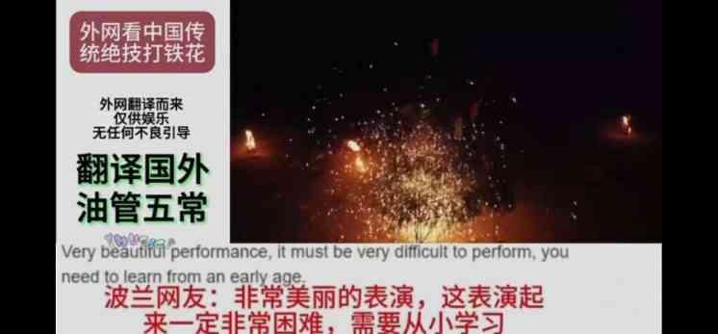

Slide 19
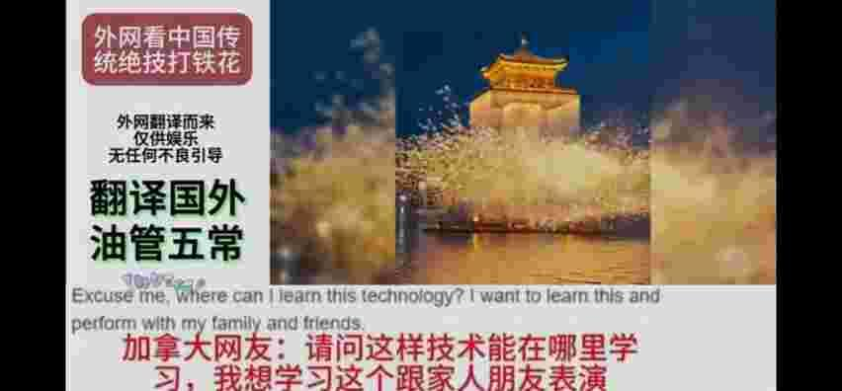
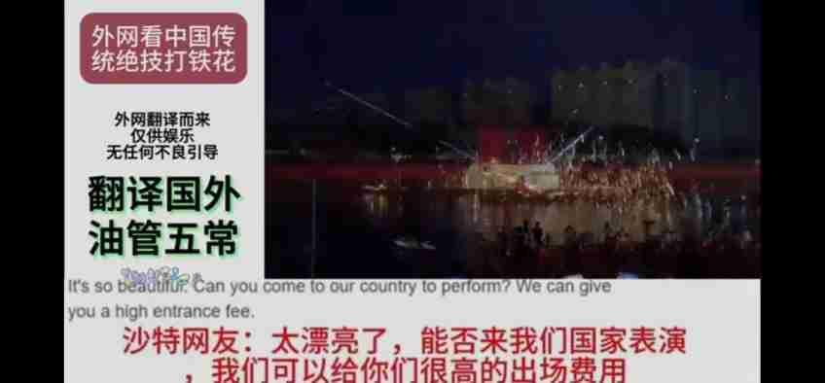
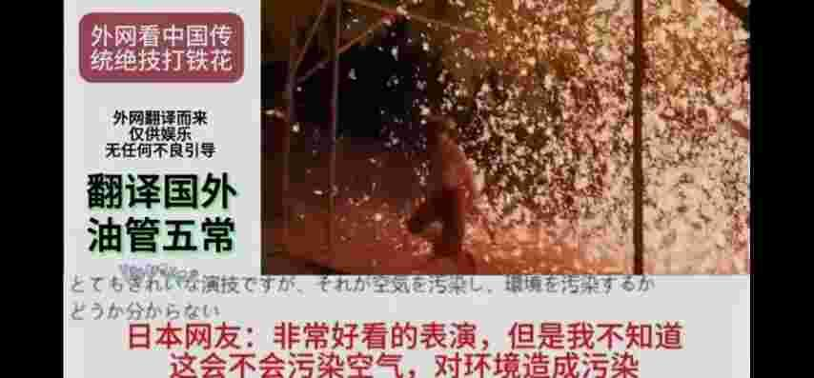
The heritage and development of striking iron flower

Slide 20

The heritage and development of striking iron flower
The value of inheritance
Striking Iron Flower encompasses Taoist culture, business customs, folk crafts and other contents, enriches the treasure house of folk art of the Chinese nation, and plays an important role in enlivening the cultural life of the people, improving national pride and enhancing national cohesion.
Symbolic value
"Striking Iron Flower" is a dazzling golden molten iron that blooms like fireworks in the dark night. In terms of the meaning of the referent, that is, "striking iron flower" takes the beautiful meaning of "iron flower, iron flower, iron will be haired" and "hit the flower, hit the flower, fight more and more", so as to express people's vision of praying for blessings and disasters, praying for blessings and wealth. Through the "striking iron flower", the people pray for good weather and rain, abundant harvests, peace and prosperity in the country, prosperity and auspiciousness in the coming year.

Slide 21

The heritage and development of striking iron flower
Artistic value
The color of the "Iron Flower" is golden yellow, and the shape is scattered like fireworks, giving people a powerful visual feast. At present, "striking iron flower" is more and more well-known, and people appreciate and praise its artistic value.
Environmental value
Unlike gunpowder, the molten iron used in "Striking Iron Flower" does not pollute the air in nature and has the same effect as fireworks.
Business value
"Striking Iron Flower" can lead to the development of local tourism and create commercial value.

Slide 22

Thank you for your listening!
汇报人：傅馨可 Finger

