Slide 1




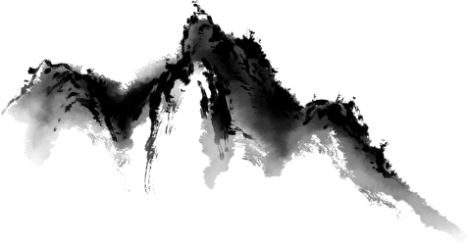
Four Great Folk Stories of Ancient China
汇报人：粟星
2025.5.8

Slide 2

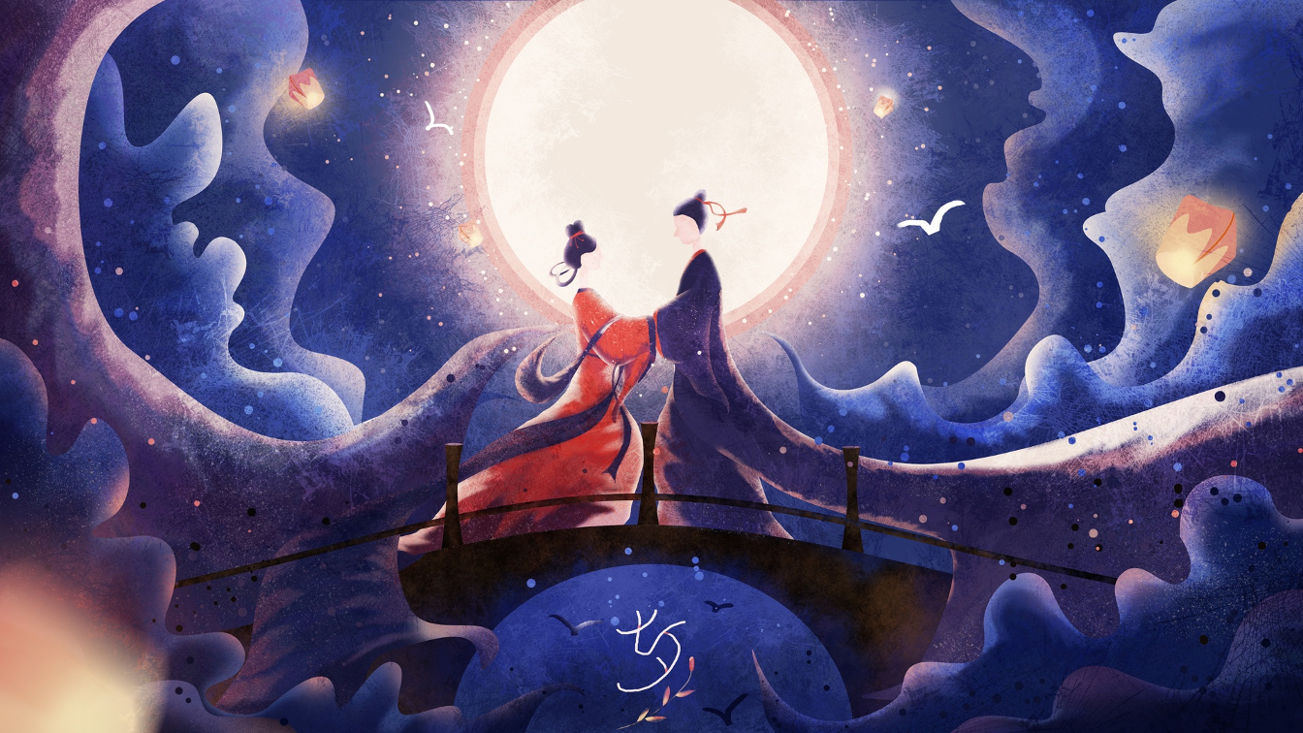
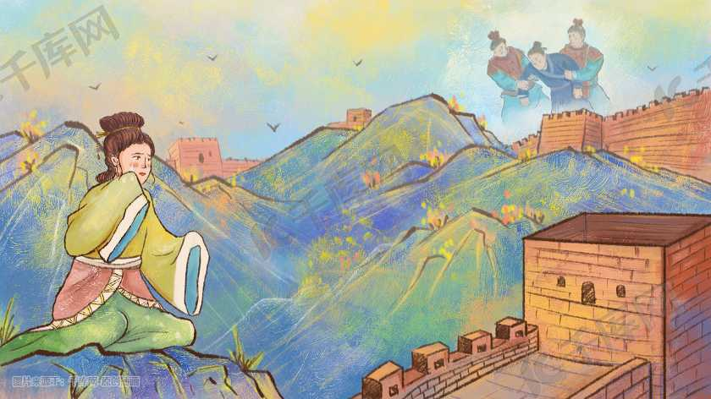
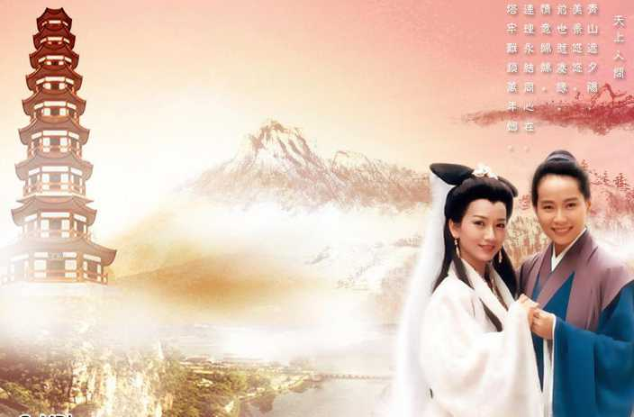
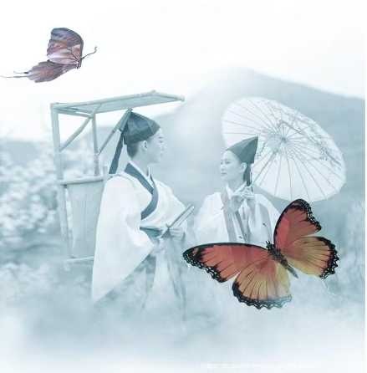
Cowherd and Weaving
Meng Jiangnu Crying on the Great Wall
The Story of the White Snake
Butterfly Lovers

Slide 3
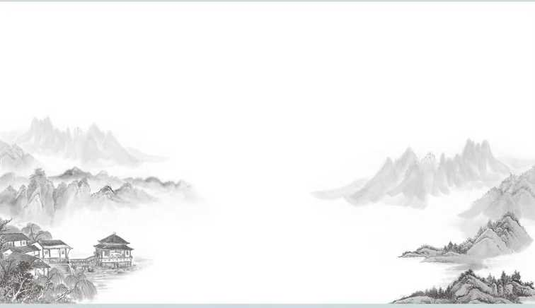
Contents
1.Cowherd and Weaving
2.Meng Jiangnu Crying on the Great Wall
3.The Story of the White Snake
4.Butterfly Lovers

Slide 4
01
Cowherd and Weaving

Slide 5
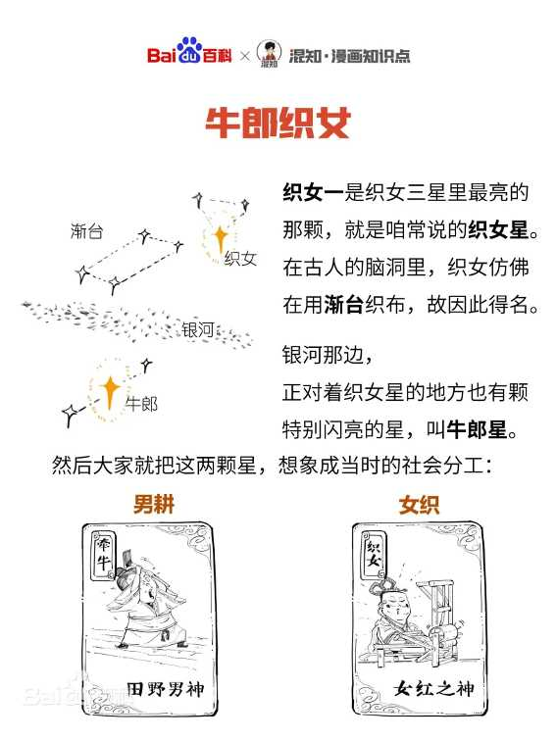
Origin and Evolution
Ancient Beginnings
The story originated in the Western Zhou Dynasty from the stars Vega（织女星） and Altair（牛郎星）.
Weaver Maiden Star
Cowherd Star
A reflection of the social division of labor（社会分工）
with men tilling in the field and women weaving.（男耕女织）

Slide 6
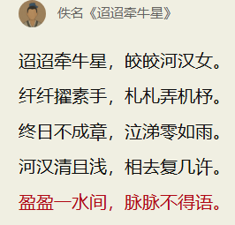
Origin and Evolution
“Nineteen Ancient Poems”
During the Han Dynasty, the stars were anthropomorphized（拟人化） into lovers in poetry.
The Weaver Girl spends her days missing the Cowherd and longing to meet him , but could only gazed at each other across the river and said nothing.
Take on a romantic color

Slide 7
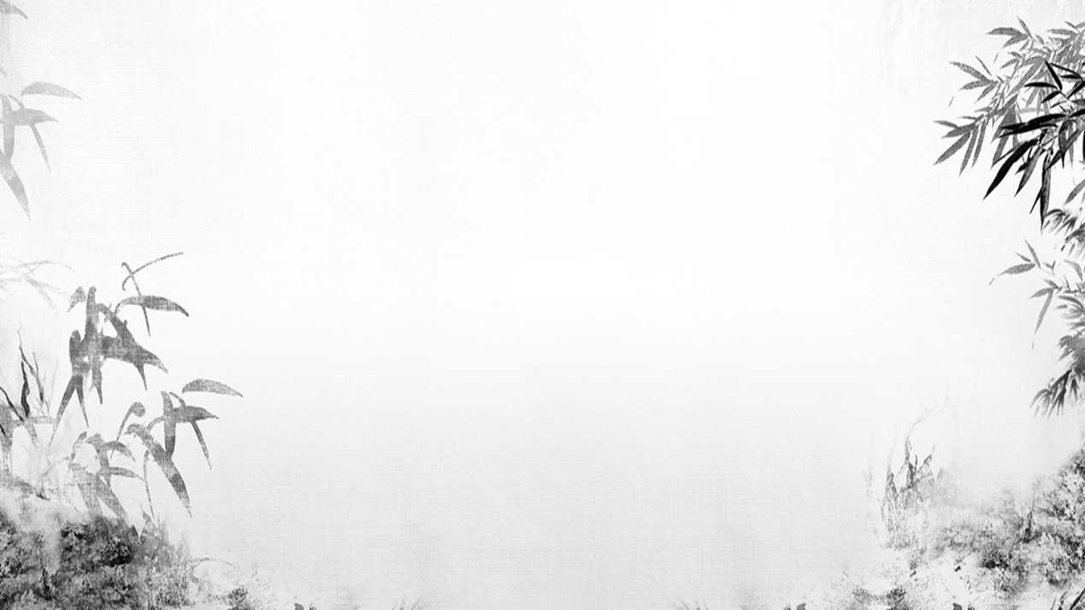

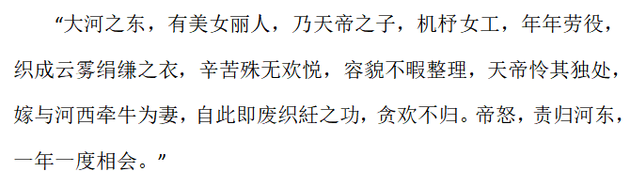
Origin and Evolution
By the Wei, Jin, and Northern and Southern Dynasties（魏晋南北朝）, the basic plot was firstly established .
Accounts of Marvelous
(by Ren Fang of the Southern Dynasties)
This record described that the Heavenly Emperor's daughter , the Weaver girl, lived on the east side of the Milky Way. She was good at weaving but was unhappy, and the Heavenly Emperor married her to the Cowherd on the west side of the river. After marriage, the Weaver Girl neglected her duties, and the Heavenly Emperor was furious, ordering her to return to the east side of the river and allowing them to meet only once a year.

Slide 8
Origin and Evolution
In the Ming and Qing Dynasties, the story became more secularized(世俗化).
the Cowherd's human identity
talking ox
and stolen fairy clothes
add new plots
The Celestial River《天仙配》 in 1915
addding the Magpie Bridge
Queen Mother
Qixi Festival traditions
Adapted by Ye Shengtao in 1955
the story finally became the standard version we know today

Slide 9

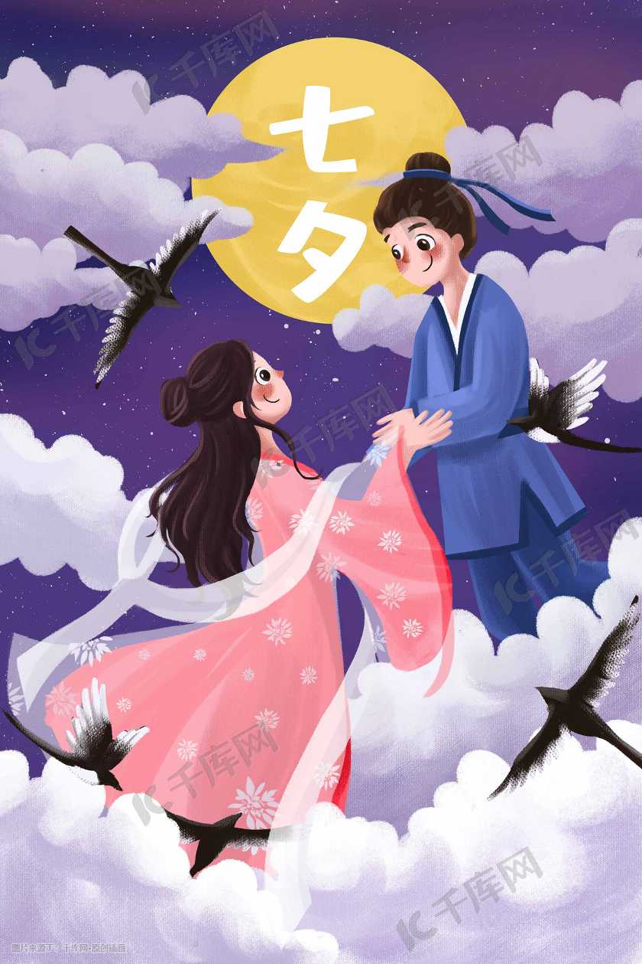
Influence
Qixi Festival gradually became China's Valentine's Day.
On this day, young girls would look up at the starry sky and pray for a happy marriage and beautiful love.
This story reflects the ancients' longing for a harmonious social production and life, the hope of establishing a life of men farming and women weaving, and the indomitable spirit of young men and women in the mortal world to fight for free and happy love.

Slide 10
02
Meng Jiangnu Crying on the Great Wall

Slide 11
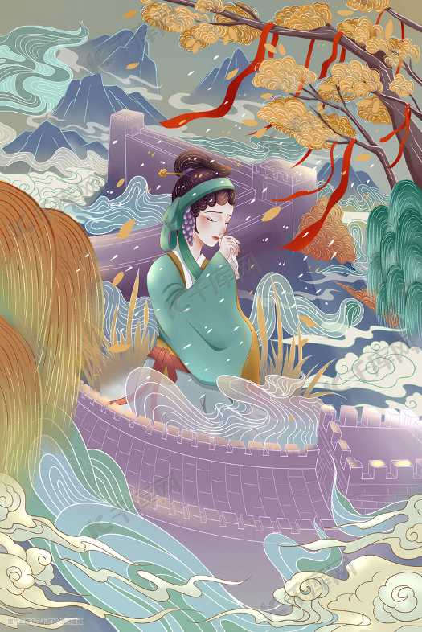
Story content
According to the legend，this story is set in the Qin Dynasty，shortly after Meng Jiangnü and Fan Xiliang were married, Fan was conscripted(被征召入伍) to build the Great Wall.
Soon ,Fan had perished from starvation, cold, and exhaustion, his bones buried beneath the wall.
Overwhelmed by grief and longing, Meng took an arduous journey to the Great wall, she collapsed in despair and wept so bitterly that causing an eight-hundred-li section of the Great Wall to collapse, revealing her husband's bones.

Slide 12
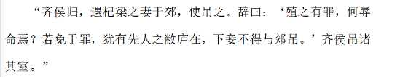
Evolution of the Story
However, modern scholars generally believe that the prototype of the story originates from the wife of QI Liang.
During the Spring and Autumn Period, there was a woman named Qi Liang's wife. Her husband, Qi Liang, was a soldier who died in battle.
When Duke Qi returned from a military campaign, he wanted to offer his condolences to Qi Liang's wife on the suburb.
However, she refused, saying that if her husband was guilty of crimes, why would you demean yourself to mourn him? If he was innocent, he should be mourned at his home, not on the roadside. The ruler respected her wishes and went to her home to offer his condolences.
Qin Shi Huang
the Great Wall

Slide 13
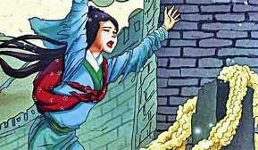
Cultural Significance
①It reflects the tragic plight of ancient laborers under feudal tyranny （封建暴政）and their longing for free and happy lives.
②It also profoundly expresses the working people's condemnation （谴责）of the ruling class's cruel oppression.
③Meng Jiangnu's character also embodies the perseverance and indomitable（不屈） spirit of ancient Chinese people.

Slide 14
03
The Story of the White Snake

Slide 15
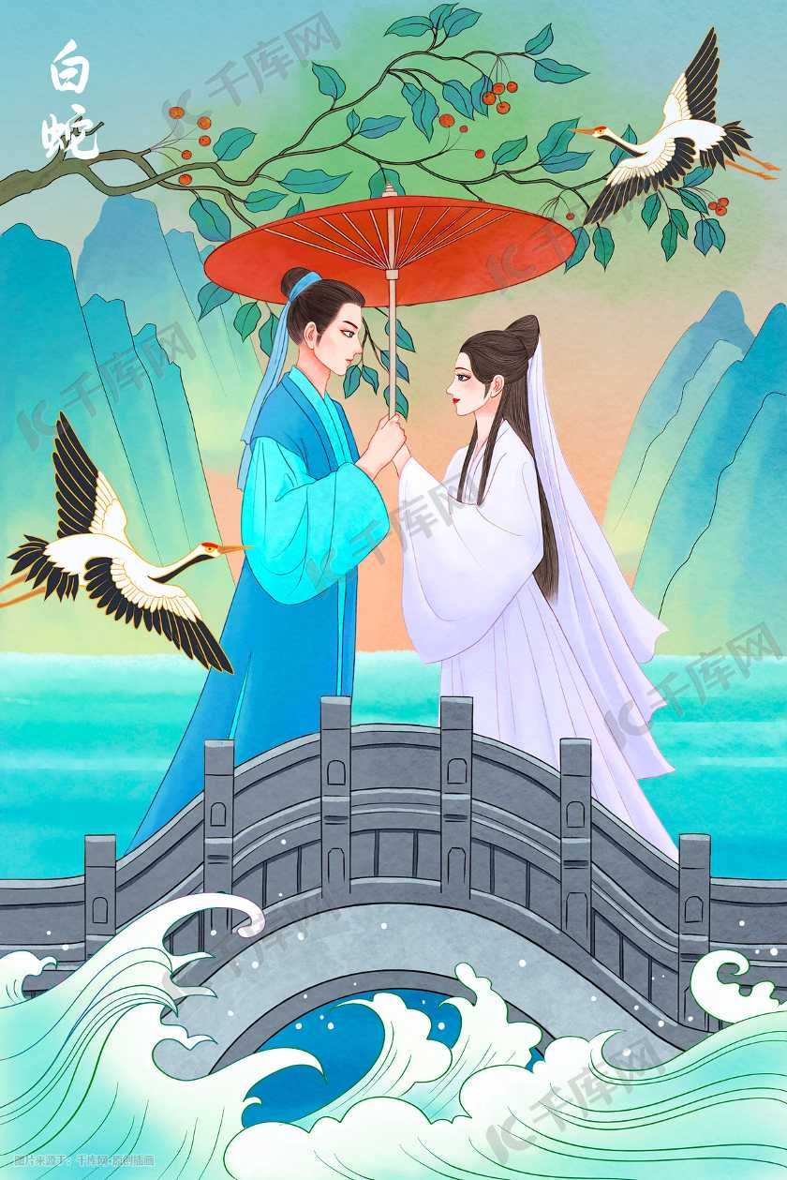
Itroduction
Created in the Southern Song Dynasty and prevailed in the Qing Dynasty
In the book Stories to Warn Man (警世通言)compiled
by Feng Menglong
The White Snake under the Leifeng Pagoda （白娘子永镇雷峰塔）has been acknowledged as the first version of this story.

Slide 16
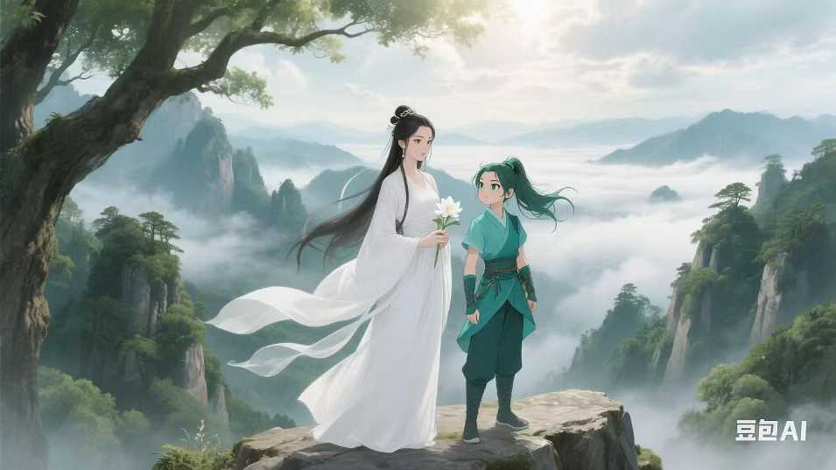
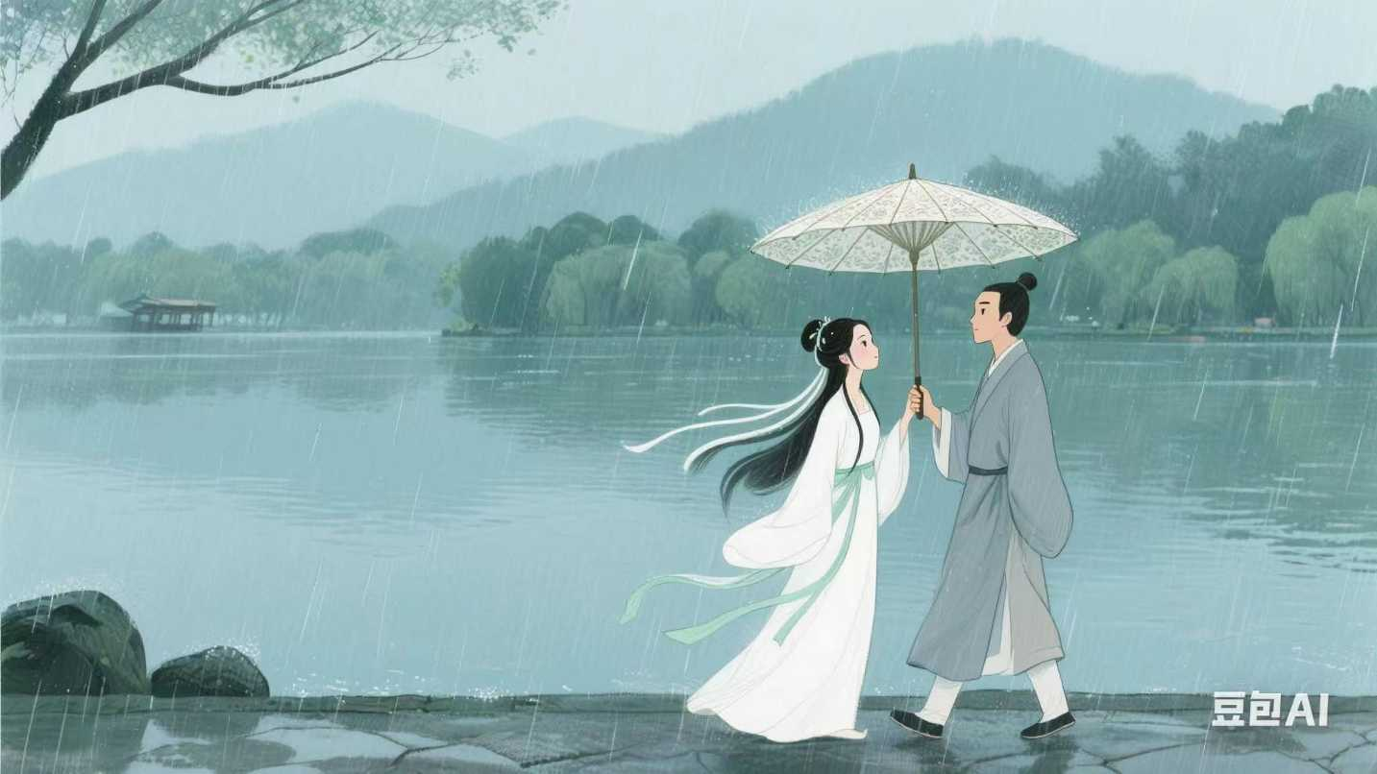
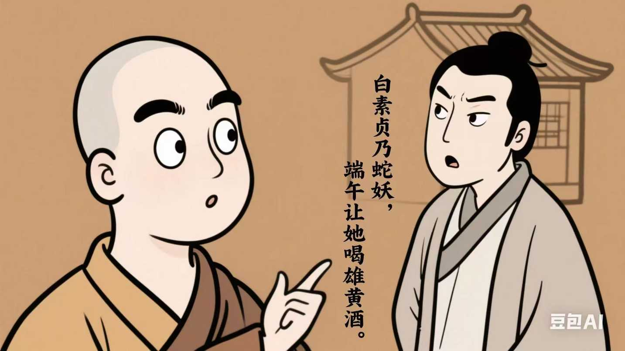
Story content
After thousands of years of practice in Emei Mountain, two snake named Bai Suzhen and Xiaoqing translated into two beautiful girls and came to visit Hangzhou.
After encountering with a young man named Xu Xian in the rain, Bai Suzhen fell in love with him and soon later they get married.
But a monk called Fahai saw through Bai's disguise and thought that it was an intrigue of the white snake to marry a man.
He persuaded Xu Xian to intoxicate his wife with realgar wine （雄黄酒）on the Dragon Boat Festival.

Slide 17
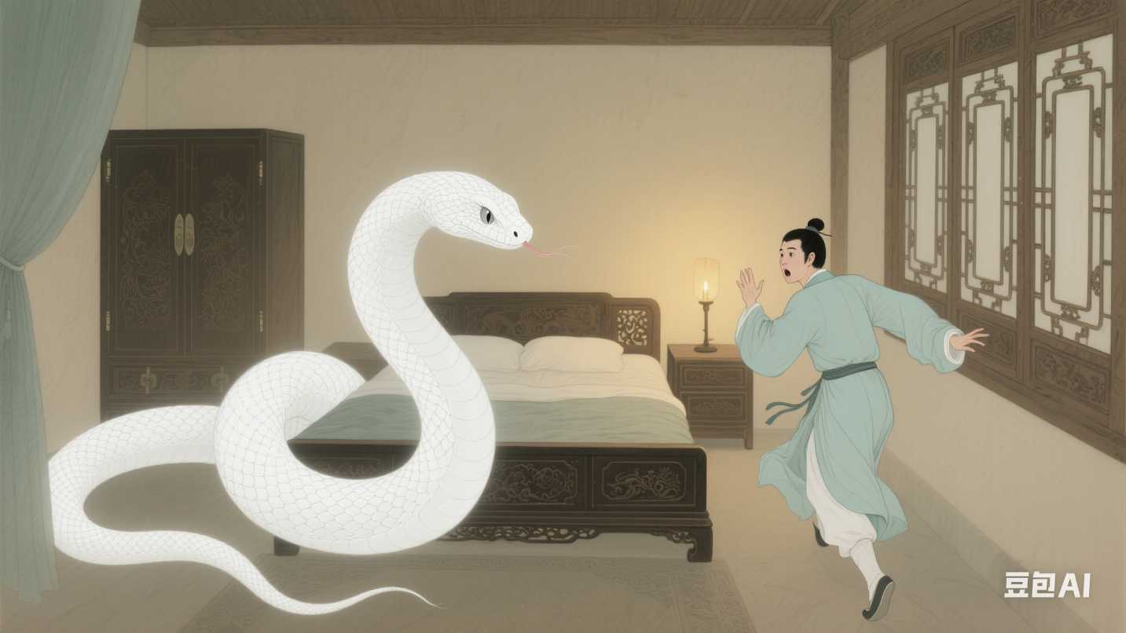
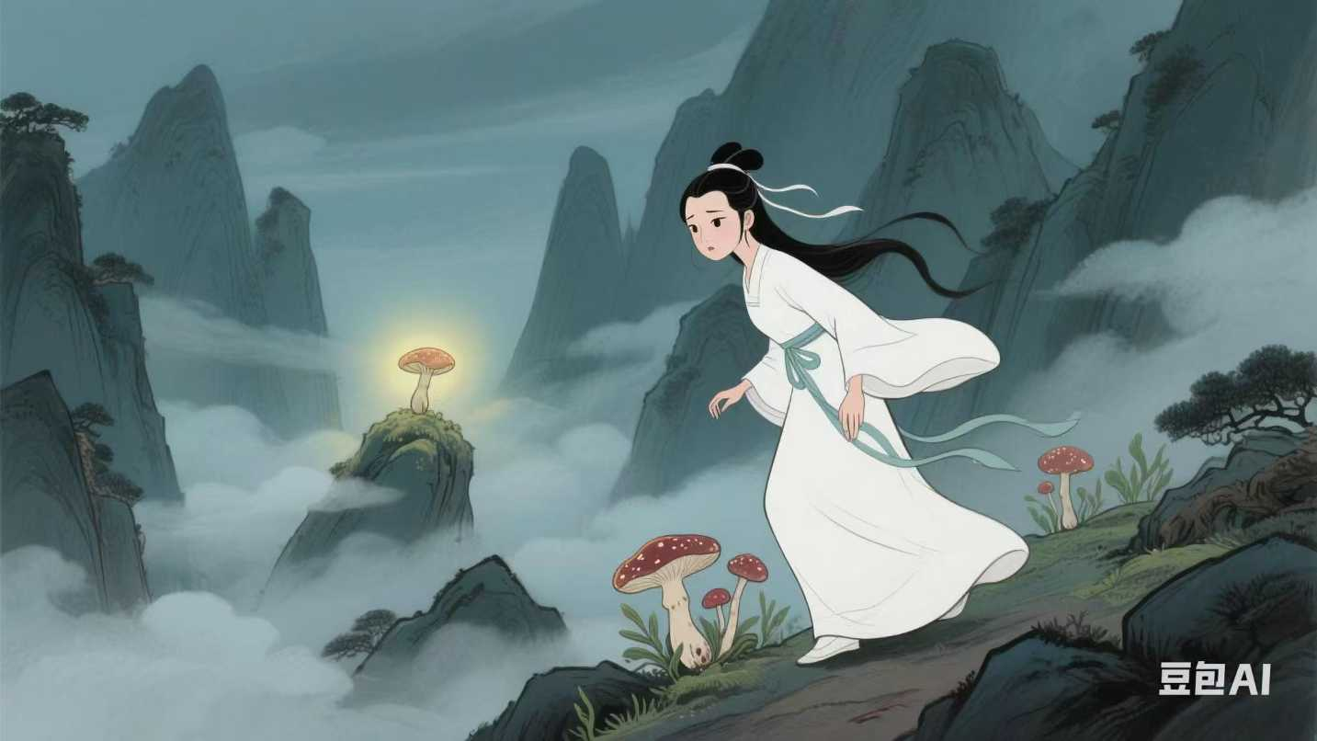
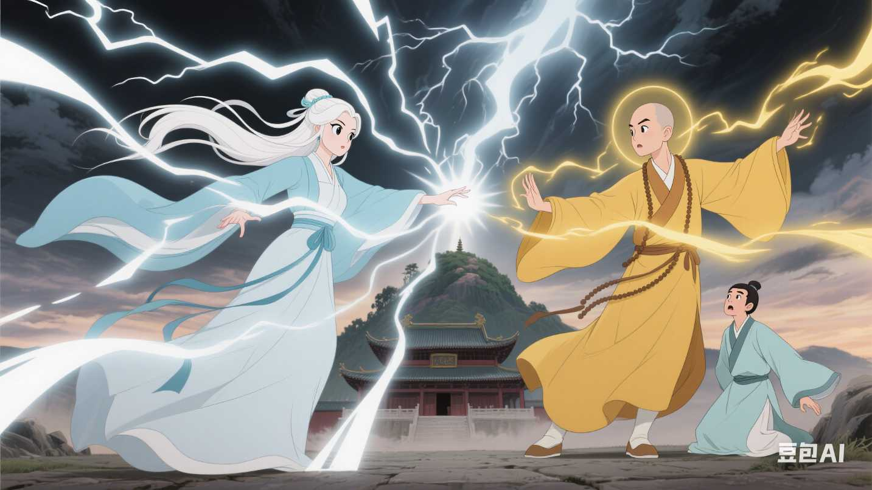
Story content
Regardless of her own safety, Bai Suzhen went through many difficulties and got the magical grass, which finally brought Xu Xian back to life.
Bai Suzhen and Xiao Qing had no choice but to inundate the temple with flood. During the fierce battle, Bai was finally defeated and put into a small bowl under the Leifeng Pagoda.
After being drunk, Bai Suzhen couldn't control herself and showed the shape of a snake, which scared Xu Xian to death.

Slide 18
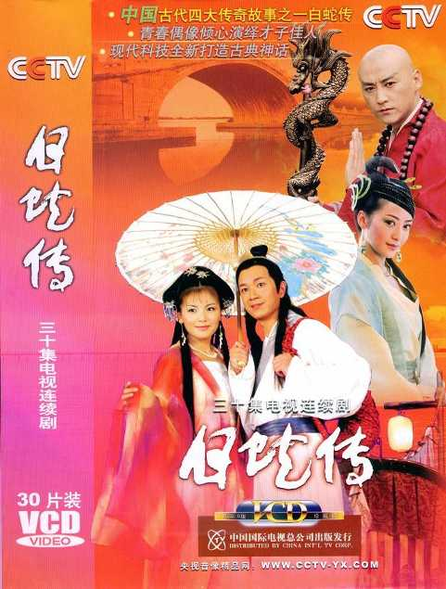
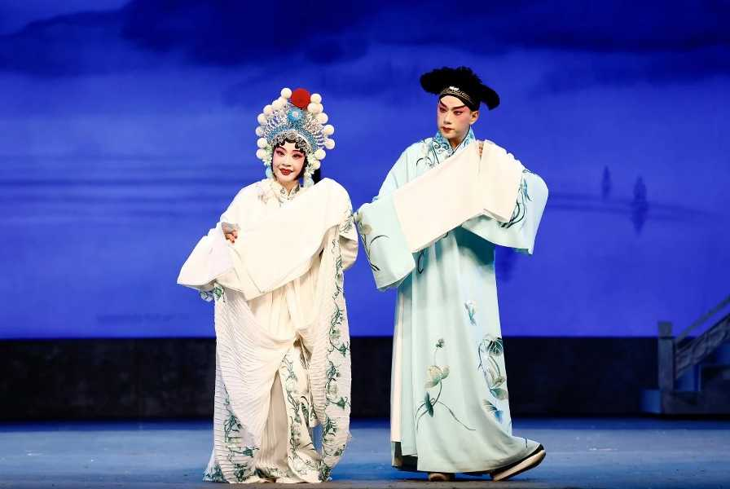
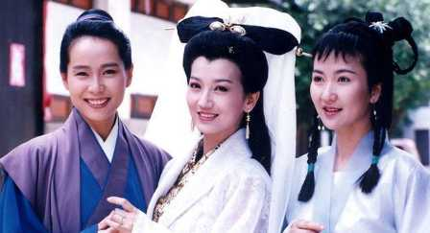
Adaptations and influence
films
television series
operas
Each adaptation brings its own unique interpretation and flair,
yet all share the core themes of love, sacrifice, and the struggle between good and evil.

Slide 19
04
Butterfly Lovers

Slide 20
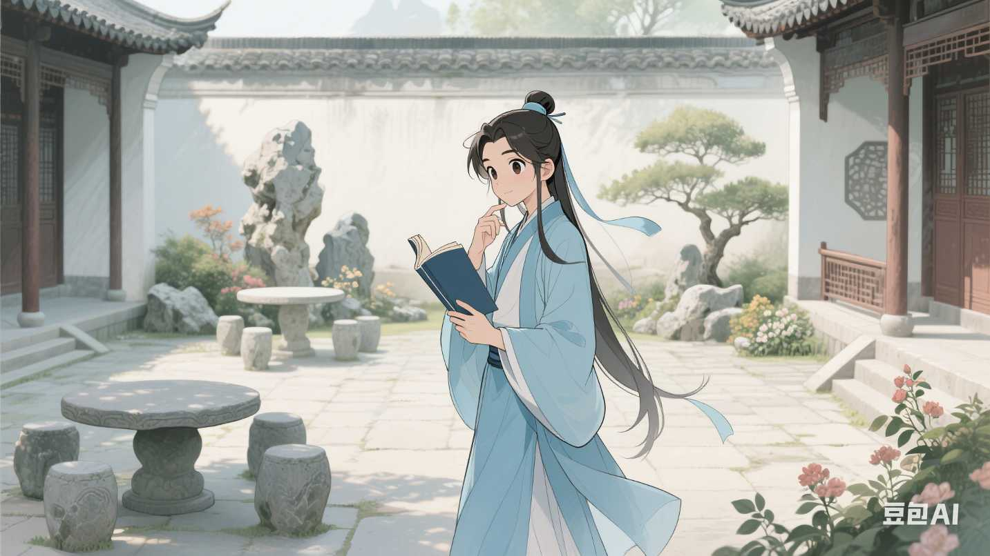
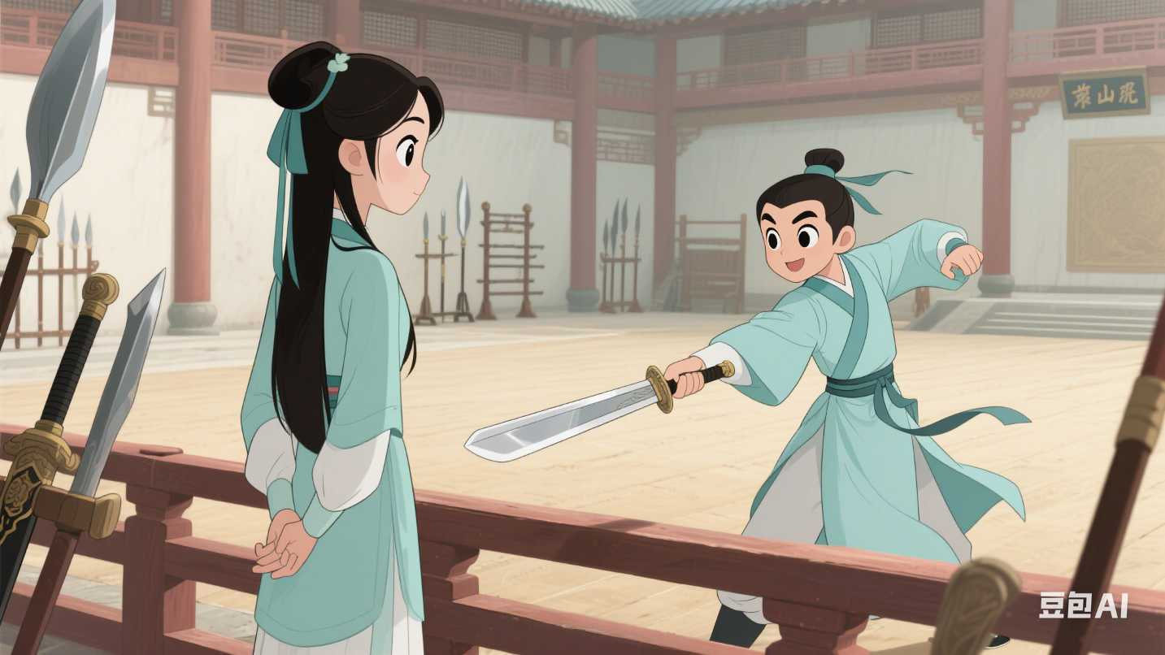
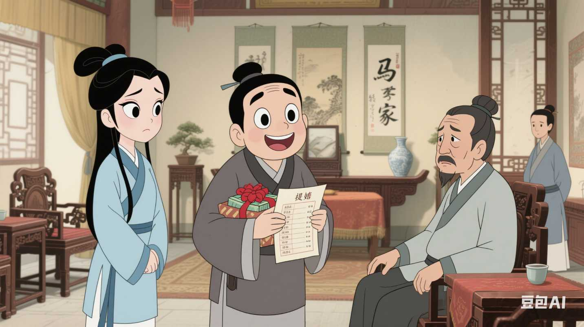
Story content
When Liang went to Zhu's home to propose, he found that Zhu's father had already betrothed her to Ma Wencai.
Heart - broken, Liang became ill and soon died.
In the Eastern Jin Dynasty, Zhu Yingtai, a girl from a wealthy family, was eager to study. Disguised as a man, she went to Hangzhou to pursue her education.
During their three - year study together, Zhu secretly fell in love with Liang, but Liang was too innocent to realize her true identity and feelings.

Slide 21
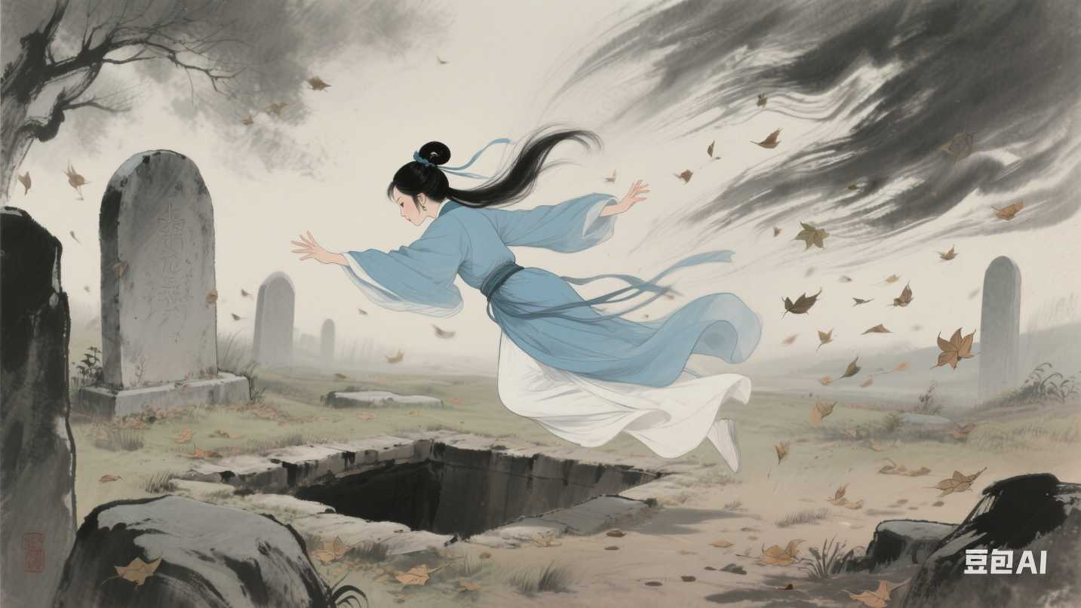
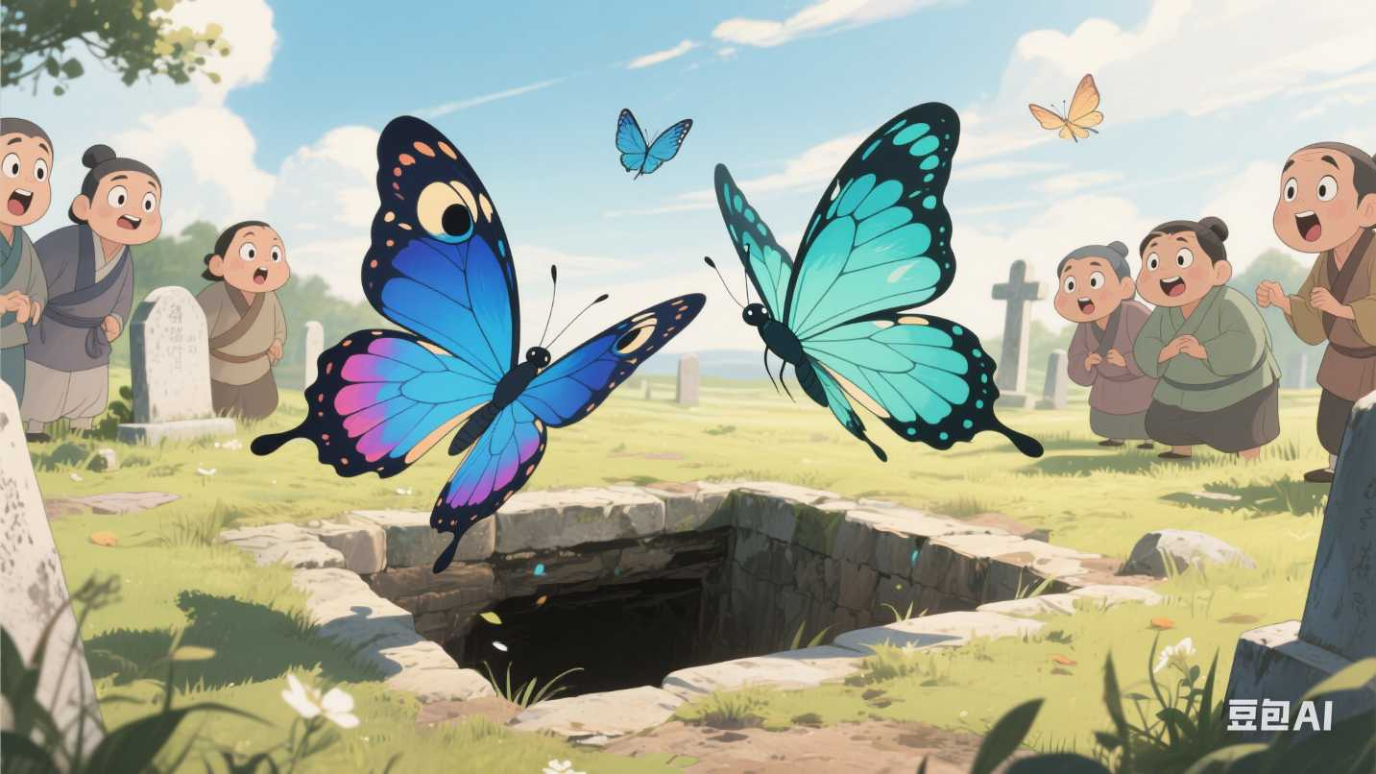
Story content
This story highlights themes of love, sacrifice, and the struggle against societal norms, especially the constraints placed on women and the persecutions of arranged marriages. It has resonated deeply with audiences for centuries, reflecting both the beauty and the tragedy of love.
At her wedding to Ma, Zhu asked to visit Liang's tomb.
When she arrived, the tomb suddenly opened.
Without hesitation, Zhu jumped into it.
Then, two beautiful butterflies flew out of the tomb, symbolizing that Liang and Zhu were finally together in another world.

Slide 22

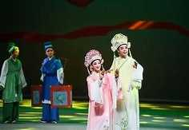
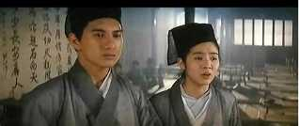
Adaptations and influence
operas
films
violin concerto

Slide 23
Conclusion
All in all , these stories, through the interweaving of love and resistance, reality and fantasy, express a profound rebellion against feudal ethics, class disparities, and the constraints of fate, while conveying an eternal yearning for freedom and the pursuit of beautiful emotions.

Slide 24
Thank you!

