Slide 1
Northeastern Chinese Cuisine – A Taste of Land and Legacy
主讲人：刘抒湉
时间：
2025.5

Slide 2
01
The Roots of Northeast Flavors
content
02
Iconic Dishes: Stories on a Plate
CONTENT
03
Spreading Northeast Flavors Worldwide

Slide 3
01
The Roots of Northeast Flavors

Slide 4
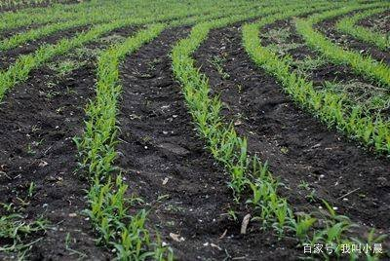
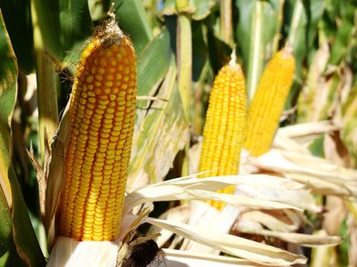
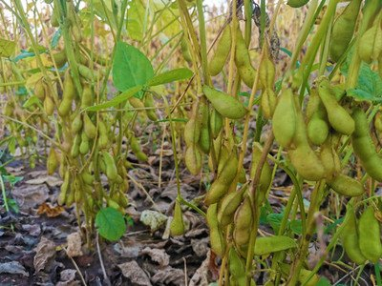
Abundant Local Ingredients
“China’s Breadbasket”

Slide 5
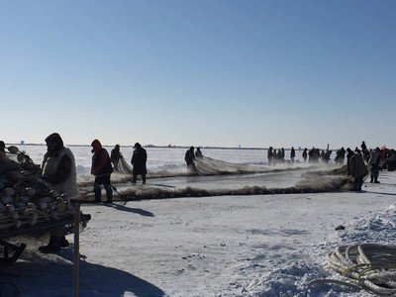
Historical Fusion of Cultures
During the “Great Migration to the Northeast” (闯关东) over a century ago, people from across China settled here, blending their cooking styles.

Slide 6
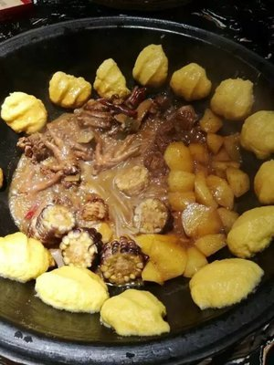
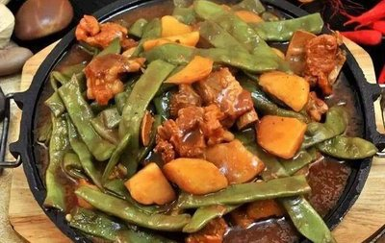
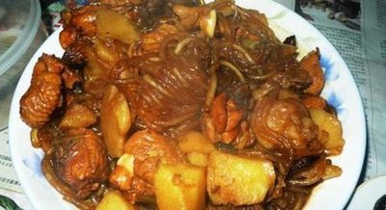
Philosophy of Generosity and Simplicity
Large Portions and Hearty Stews

Slide 7
02
Iconic Dishes: Stories on a Plate

Slide 8
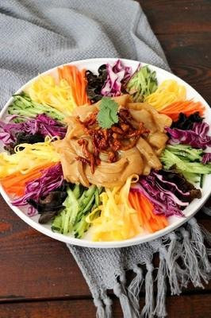
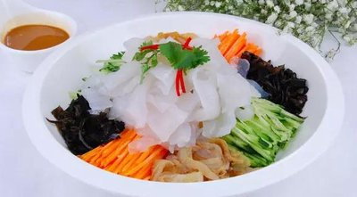
Colorful big lapi

Slide 9
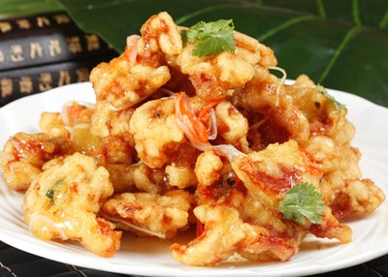
Guobao Rou (Crispy Sweet and Sour Pork)

Slide 10
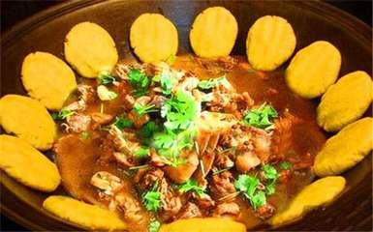
Iron Pot Stewed Goose

Slide 11
03
Spreading Northeast Flavors Worldwide

Slide 12

Viral Social Media Trends
frozen pears

Slide 13
Thanks

