Slide 1
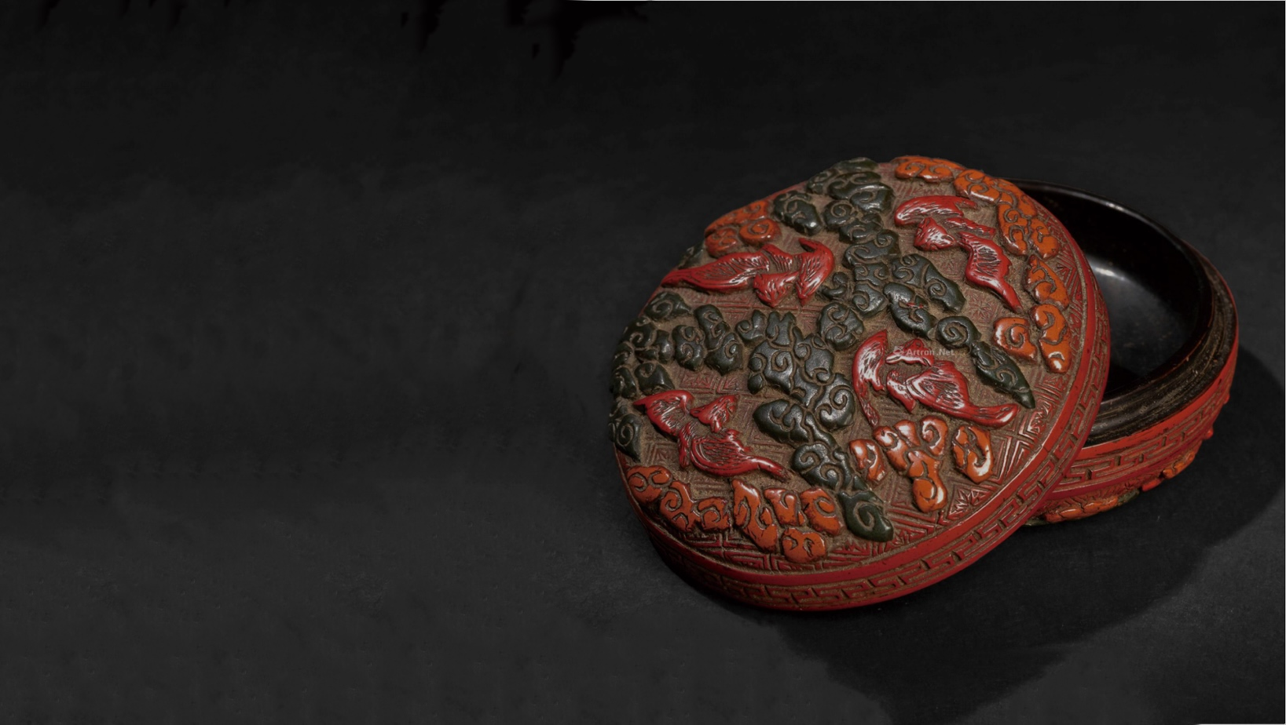

INTANGIBLE CULTURAL HERITAGE: CARVED LACQUER
Carved
lacquer
壹
Historical
Development
叁
Cultural
Significance
Introduction
贰
Artistic Value
肆
Presenter：Liuqi 刘琪
2025.5.6

Slide 2
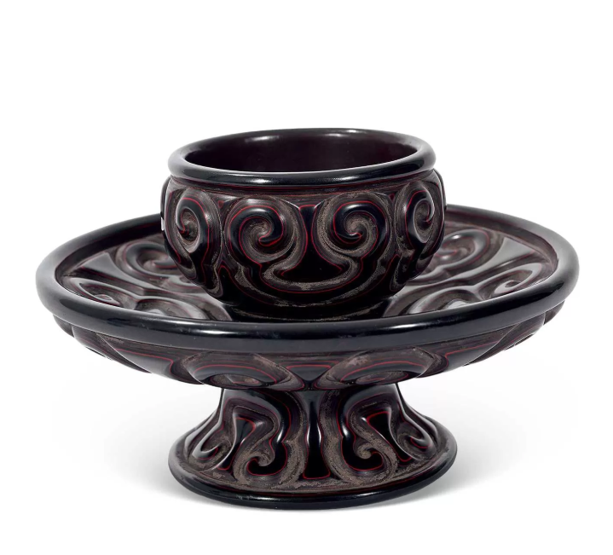
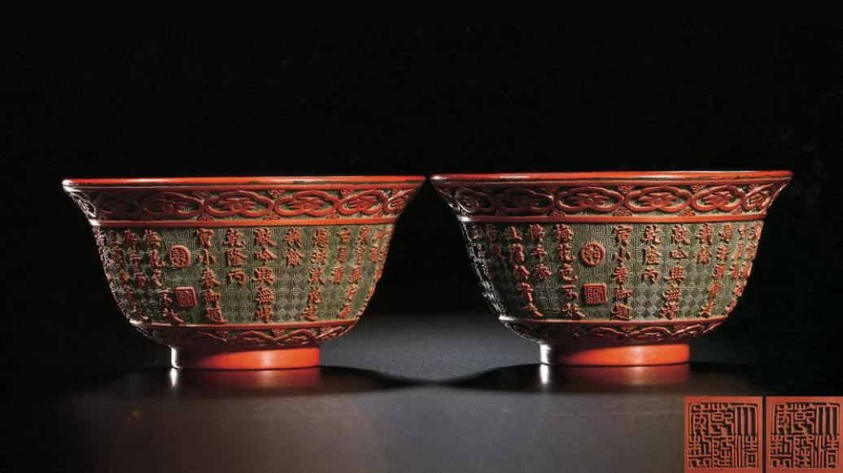
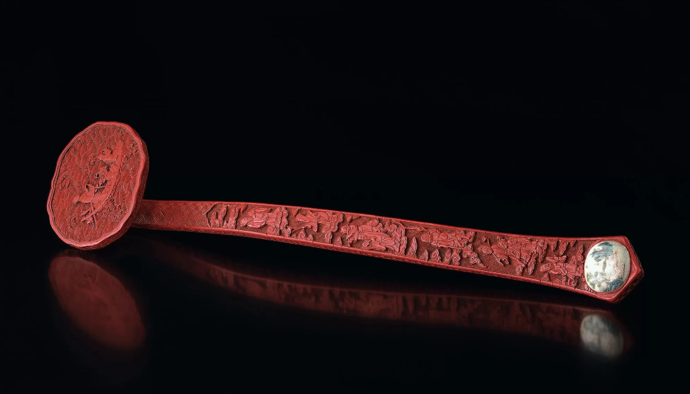
INTANGIBLE CULTURAL HERITAGE: CARVED LACQUER
Definition
Layered natural lacquer carved into relief after shade-drying
History
Originated in Tang Dynasty (618-907 AD), flourished in Ming-Qing imperial courts
Three Styles
▪️ Tihong (Red Carved Lacquer)
▪️ Tihei (Black Carved Lacquer)
▪️ Ticai (Multicolor Layered Carving)
INTRODUCTION

Slide 3
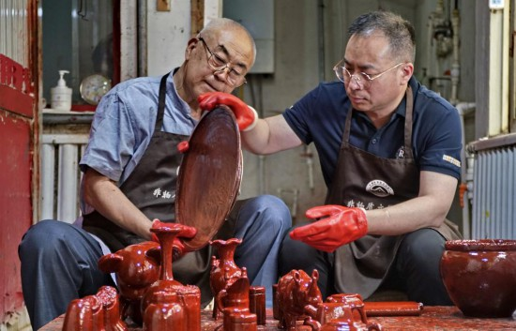
INTANGIBLE CULTURAL HERITAGE: CARVED LACQUER
Carved Lacquer Crafting Process
Artisans layer natural raw lacquer mixed with pigments onto a base. Each thin coating requires 2-3 days of shade-drying in a humid chamber. Repeating this 200-300 times over 3-6 months creates a 5-15mm lacquer base.
Once hardened, patterns are drawn and carved into 3D reliefs using specialized knives, avoiding damage to lower layers. Final polishing with fine sandpaper and soft cloth achieves a jade-like finish.

Slide 4
INTANGIBLE CULTURAL HERITAGE: CARVED LACQUER
Han
Yuan
Ming
Wooden core
Layered vermilion lacquer
Carved after air-drying
Simple cloud motifs
Cun Texture Integration
Rounded Carving with Hidden Edges
Mountain-Rock Textures
Openwork and Hollow Carving Technique
Ultra-Thick Layers
Three-Dimensional Continuous Pattern
Alternating Layers
Contrast Motifs
Multi-Colored
Gold and Silver Substrate
Regal Opulence
Carve-and-Fill and Integration of MultipleTechnique
Gold or Colored Inlay
Multi-Craftsman Collaboration
Tang
Qing
Notes:
模板来自于： 第一PPT https://www.1ppt.com/

Slide 5
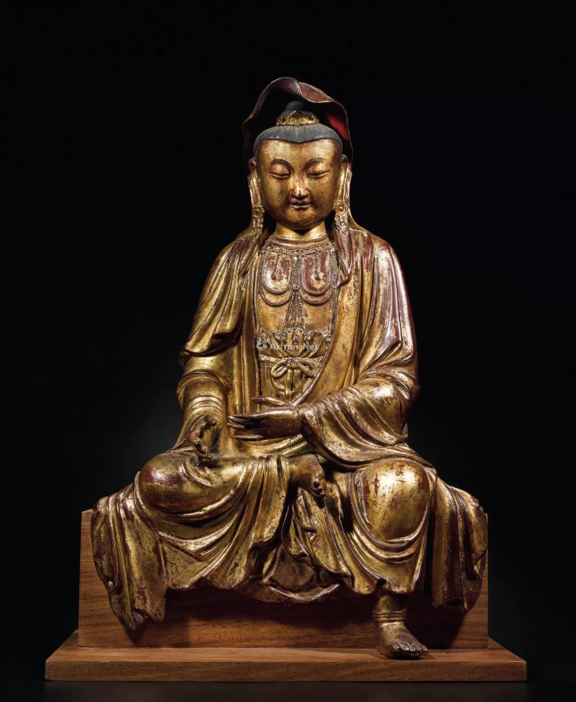
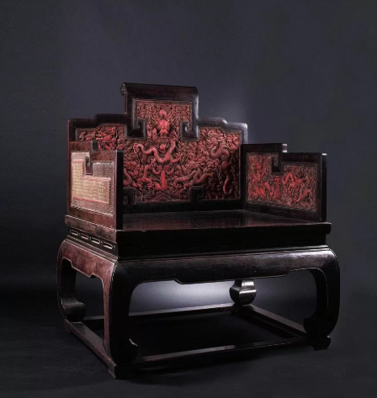
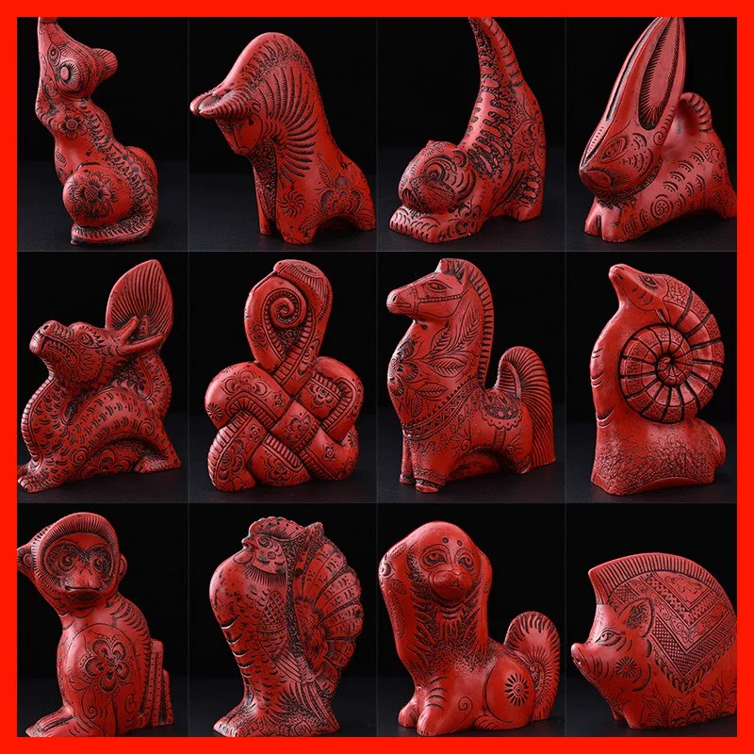
Imperial Throne with Carved Lacquer Cloud and Dragon Motifs on Zitan Wood, Qing Dynasty
Ming Dynasty Gilded Wood Carving of Zizai Guanyin
Carved Lacquer Ornament with Chinese Zodiac Animal Motifs
此处添加标题
此处添加标题
RMB：
20,700,000
RMB:
1,035,000
RMB:
69
Notes:
模板来自于： 第一PPT https://www.1ppt.com/

Slide 6
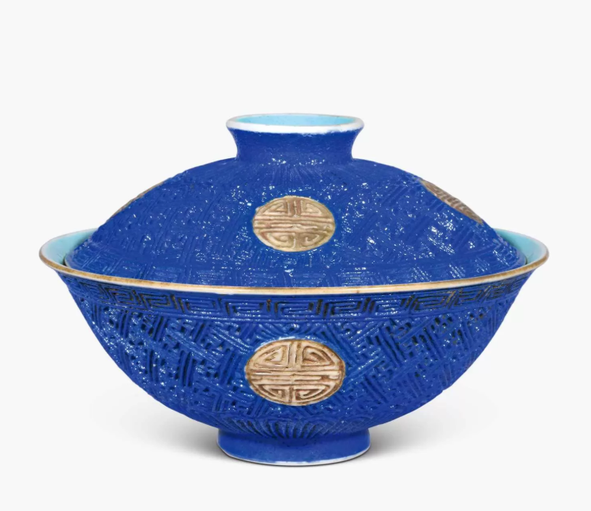
INTANGIBLE CULTURAL HERITAGE: CARVED LACQUER
Antique carved lacquer pieces possess
immense historical and cultural value
Natural lacquer incurs significantly higher
costs compared to chemical/synthetic lacquer
Exquisite carving craftsmanship with
multi-layered textures and intricate patterns

Slide 7
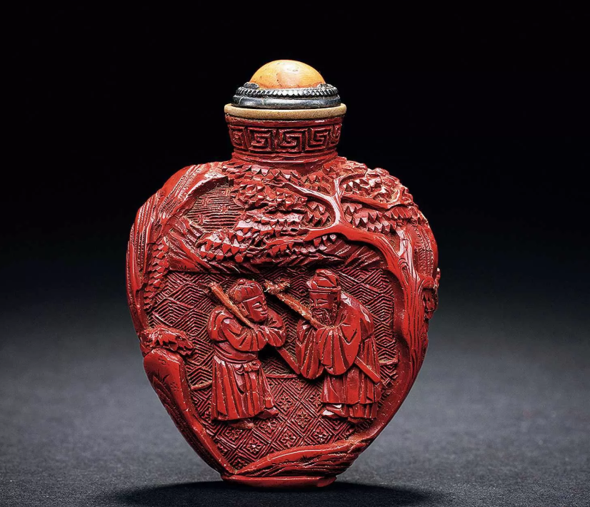
INTANGIBLE CULTURAL HERITAGE: CARVED LACQUER
Antique carved lacquer pieces possess
immense historical and cultural value
Natural lacquer incurs significantly higher
costs compared to chemical/synthetic lacquer
Exquisite carving craftsmanship with
multi-layered textures and intricate patterns

Slide 8
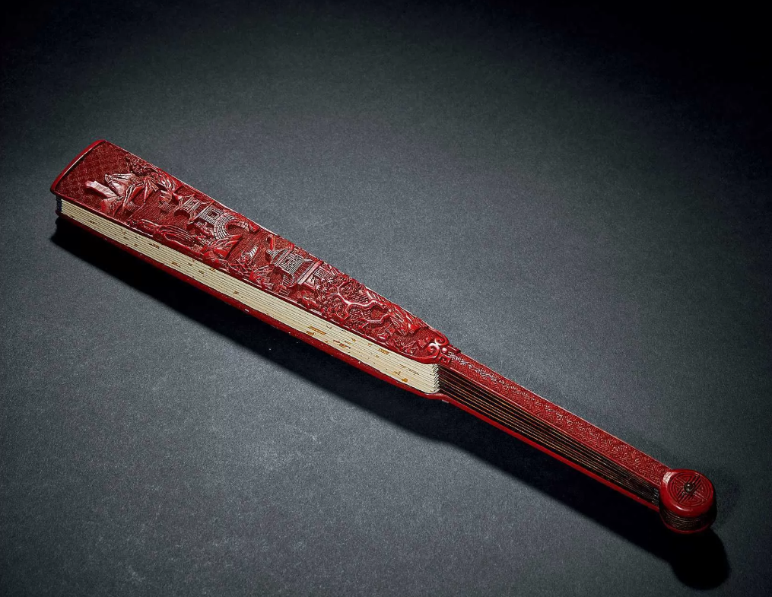
INTANGIBLE CULTURAL HERITAGE: CARVED LACQUER
Every turn of its chisel etches the adaptability and transcendence of Chinese civilization—layer by layer, stroke by stroke.
Our task is not merely to describe, but to make the whispers of lacquer artisans resonate across languages.

Slide 9
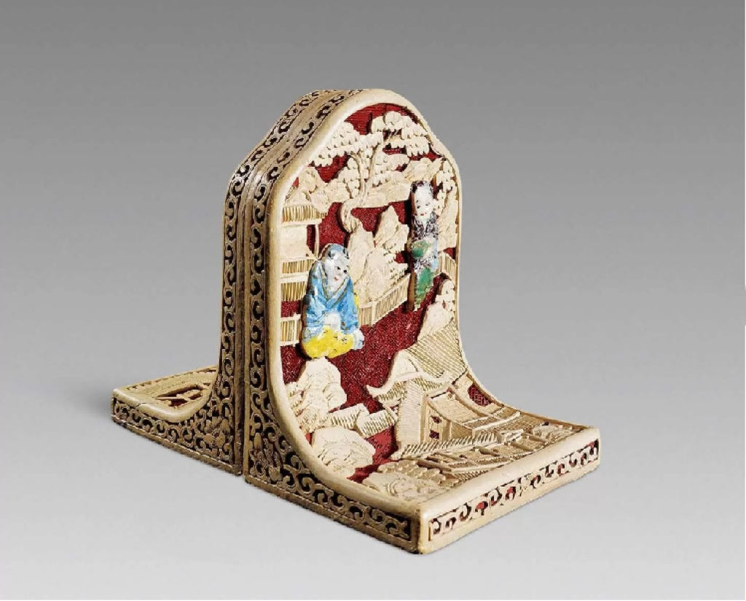
INTANGIBLE CULTURAL HERITAGE: CARVED LACQUER
Every turn of its chisel etches the adaptability and transcendence of Chinese civilization—layer by layer, stroke by stroke.
Our task is not merely to describe, but to make the whispers of lacquer artisans resonate across languages.

