Slide 1
上巳节

Slide 2
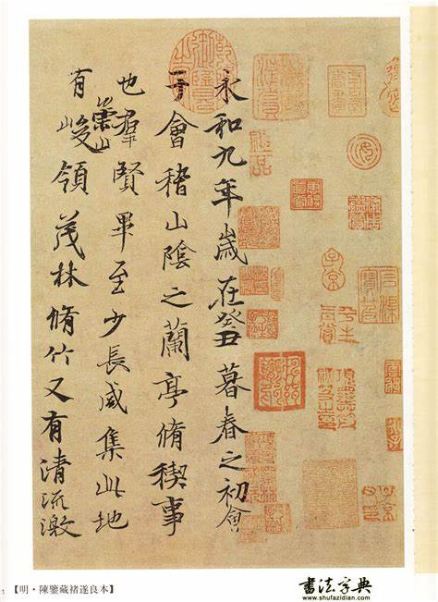
兰亭集序
王羲之（魏晋）
永和九年，岁在癸丑，暮春之初，会于会稽山阴之兰亭，修禊事也。

Slide 3
目录
壹
Origins & History
Origins & History
Traditional Customs
贰
Traditional Customs
叁
Festival cuisine
Festival cuisine
肆
Why did it disappear from our life
伍
Poems involving Shangsi Festival

Slide 4
Origins & History
壹

Slide 5
Origins
The custom of getting rid of evil spirits by bathing in the river;
The possible birthday of the Yellow Emperor, a legendary figure in Chinese history;
"三月三轩辕生" which translates to "On the third day of the third month, the Xuan Yuan (Yellow Emperor) was born" .

Slide 6
Tang Dynasty
History
Wei and Jin periods
Cao Wei period
Pre - Qin period
Song Dynasty

Slide 7
Different Names
The Shangsi Festival is also called the Double Third Festival, Spring Bathing Festival and China's Valentine's Day.

Slide 8
Traditional Customs
贰

Slide 9
【上巳节·曲水流觞，赏心乐事良辰·复原宋-哔哩哔哩】 https://b23.tv/OzGnkhQ

Slide 10
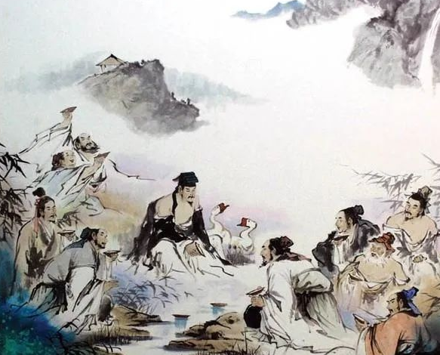
" Fuxi Panyu "（祓楔畔浴）
  " Fu "(祓) refers to eliminating illness and misfortune, while " Xi "(楔) refers to cleansing the body.
  " Panyu "(畔浴) means that people often went to the water's edge on this day to clean their bodies.
  A mixture of fragrant plants, herbs, and dyes, similar to today's bath gels.

Slide 11
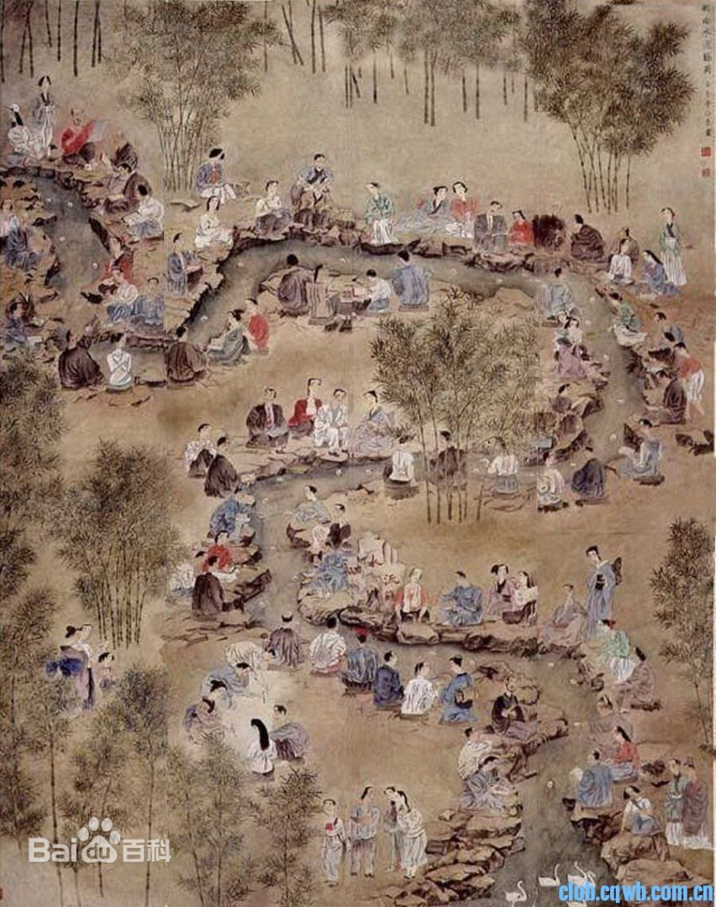
" Qu Shui Liu Shang "（曲水流觞）
  In Chinese ," Qu Shui "（曲水） means the winding stream," Liu "（流） means floating and " Shang "（觞） means that wine cup.
  Whoever had a cup stop in front of them was required to compose a poem on the spot. Failure to do so resulted in a penalty of drinking a cup of wine.

Slide 12
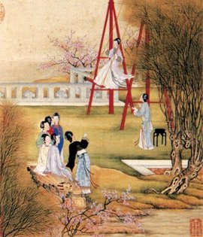
Spring Outings (郊外游春)
  Physical activities: Holding rites and ceremonies, playing with waters, appreciating beautiful flowers, and drinking around winding streams, swinging and jumping rope.
  Opportunities for young men and women to meet.

Slide 13
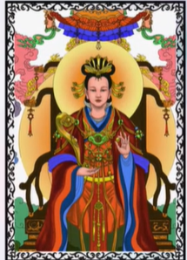
Sacrifices to Gao Mei (祭祀高禖)
"禖" is synonymous with "媒" (matchmaker).
Gao Mei is believed to be the deity in charge of fertility and reproduction.
Initially depicted as a pregnant adult woman, and people conducted sacrifices to Gao Mei to pray to have more children.

Slide 14
Festival Cuisine
叁

Slide 15
【【古相思曲】春三月上巳日，柳枝沾露，祓禊去灾，这种节日会有意义的-哔哩哔哩】 https://b23.tv/jDb7UoF

Slide 16
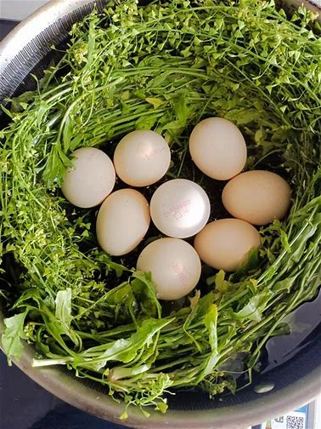
Eggs Boiled with Shepherd's Purse (荠菜煮鸡蛋)
In China, shepherd's purse (荠菜) sound similar to “auspicious vegetables” (吉菜), implying abundant wealth and good fortune. This tradition is still remained in many places today .

Slide 17
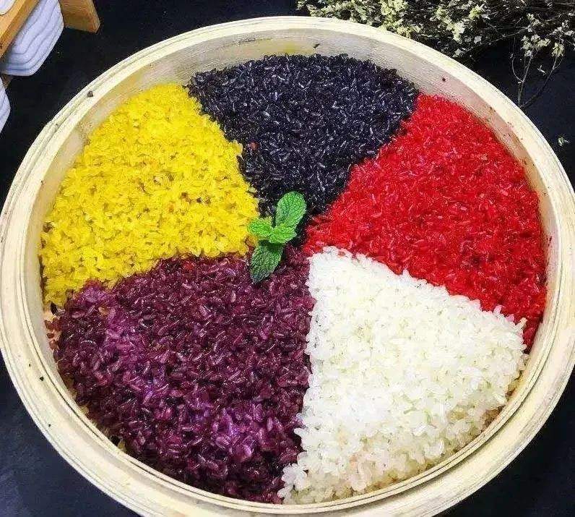
Five-colored Sticky Rice Cake (五色糯米饭)
The multicolored glutinous rice is typically made up of five colors—red, yellow, black, purple, and white—obtained by soaking glutinous rice in natural plant dyes, symbolizing harmony between heaven and earth and a bountiful harvest.

Slide 18
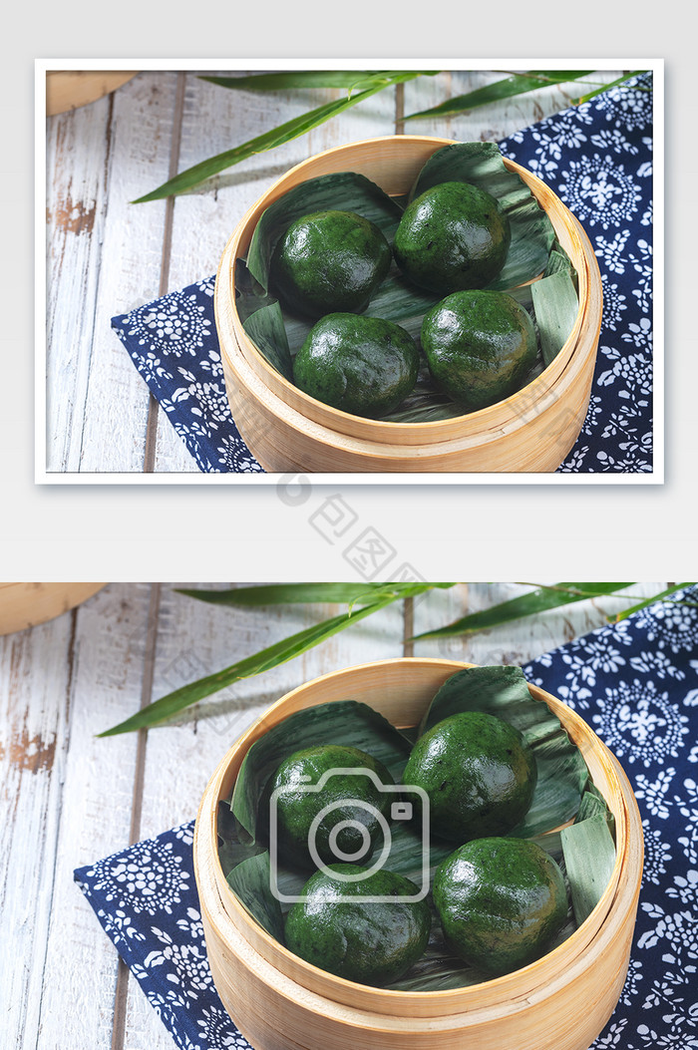
Haozi Ba Ba (蒿子粑粑)
South of the Yangtze River;
Made primarily from haozi (a type of artemisia), Haozi Ba Ba is crafted into a green rice cake-like form;
Carrying the meaning of commemorating the deceased and warding off evil.

Slide 19
Why did it disappear from our life？
肆

Slide 20
Influence of Neo-Confucianism；
Festival Merger；
Climatic Factors；
Despite the gradual disappearance of the Shangsi Festival in the north, in some ethnic minority areas in the south, such as the Zhuang, Dong, Gelao, Bai, Yi, Li, She, Buyi, and others, celebrations are still held on "March 3rd," preserving and continuing some of the customs of the Shangsi Festival.

Slide 21
Poems Involving Shangsi Festival
伍

Slide 22
《鹧鸪天·上巳风光好放怀》
辛弃疾
忆君犹未看花回。
茂林映带谁家竹，曲水流传第几杯。
摛锦绣，写玫瑰。
长年富贵属多才。
要知此日生男好，曾有周公祓禊来。
曲水流传第几杯
周公祓禊
曲水流觞 祓楔畔浴

Slide 23
《丽人行》
杜甫
丽
人
三月三日天气新，长安水边多丽人。态浓意远淑且真，肌理细腻骨肉匀。
绣罗衣裳照暮春，蹙金孔雀银麒麟。
头上何所有？翠微匎叶垂鬓唇。
背后何所见？珠压腰衱稳称身。
长
安
水
边
多
郊外游春

Slide 24
《和春深》
白居易
何处春深好，春深上巳家。
兰亭席上酒，曲洛岸边花。
弄水游童棹，湔裾小妇车。
齐桡争渡处，一匹锦标斜。
兰亭席上酒，曲洛岸边花。
曲水流觞

Slide 25
《破阵子》
赵善扛
柳絮飞时绿暗，荼蘼开后春酣。
花外青帘迷酒思，陌上晴光收翠岚。
佳辰三月三。
解佩人逢游女，踏青草斗宜男。
醉倚画阑阑槛北，梦绕清江江水南。
飞鸾与共骖。
解佩人逢游女，踏青草斗宜男。
郊外游春

Slide 26
谢谢

