Slide 1
ROUND TABLE CULTURE
汇报人: 吴佳婷（Wu Jiating）

Slide 2
目录
壹
The feature
贰
The symbols
叁
The sitting rules

Slide 3
The feature
第一章

Slide 4
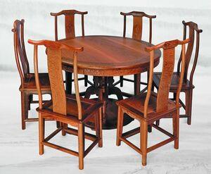
The feature
The most distinctive feature of a round table is the roundness.
“Round” is an omnipresent, universal symbol with extensive meanings.
“Round”, a typical totem of Chinese traditional culture, mainly represents perfection and wholeness and has always been advocated by Chinese people.

Slide 5
The symbols
第二章

Slide 6
Harmony
With no sides or corners, a round table avoids bumps.
According to Chinese traditional geomatic omen theory, a circle is more capable of gathering human beings than a square. It also dissolves a disharmonious magnetic field and make things harmonious.
Chinese devote particular care to “harmony”and has pursued relentlessly peaceful and harmonious family environment.

Slide 7
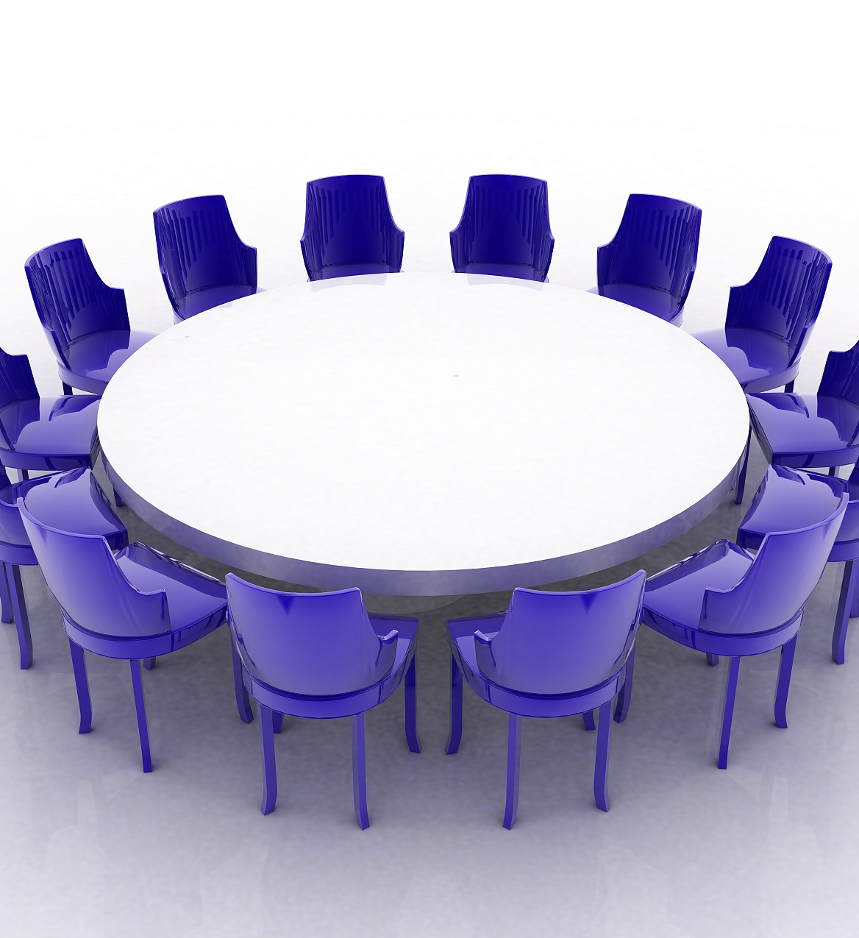
Equality and Tolerance
The distance between each of us will be technically equal, and our status will be equal.
we start to look for things that we have in common instead of things that separates us.

Slide 8
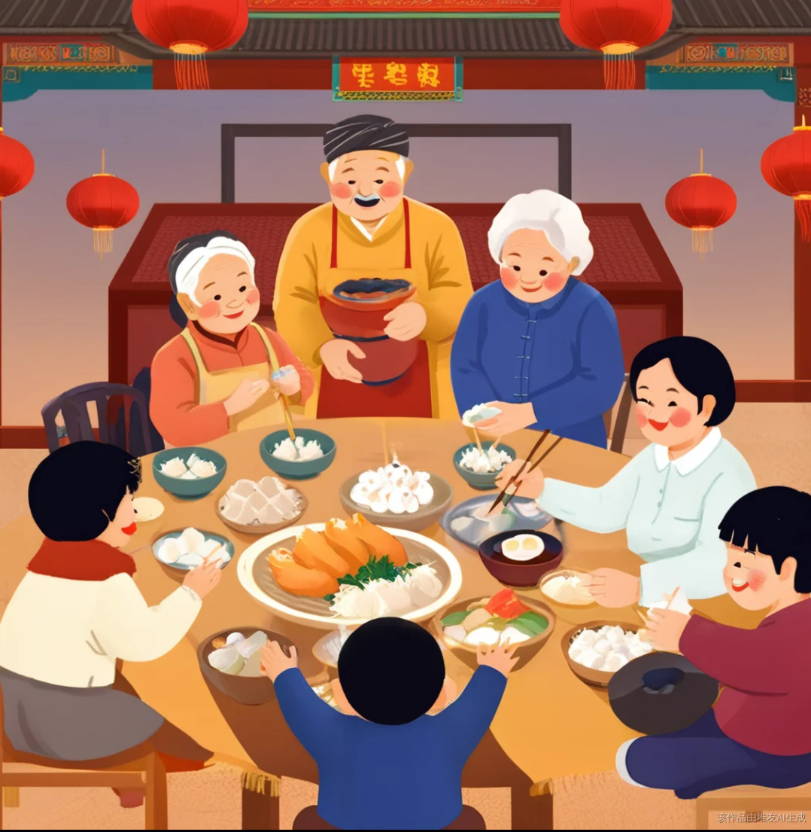
Reunion
Families will reunite to have dinner at round tables.
While the grown-ups are discussing something, kids will be scuttling around or even crouching under the table to play hide and seek.

Slide 9
The sitting rules
第三章

Slide 10
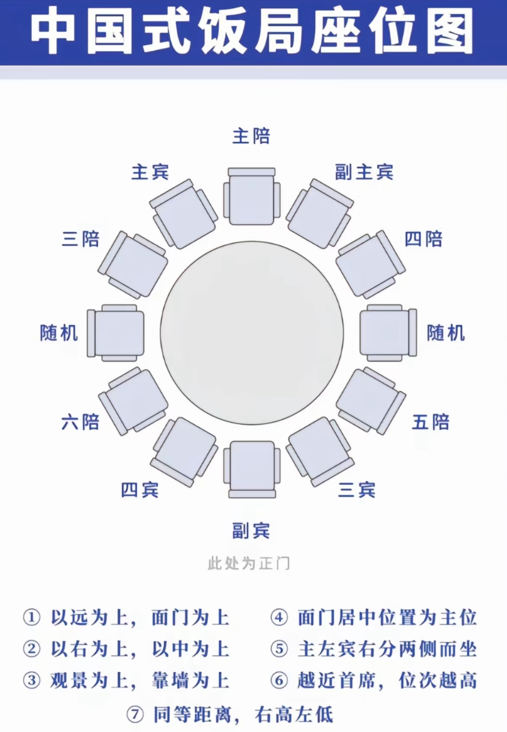
The sitting rules
The one facing the door is the host and guest.
The one on the left side is the second, fourth, sixth, etc.
The one on the right side is the third, fifth, seventh,etc.

Slide 11
MERCI
汇报人: 吴佳婷（Wu Jiating）
2025/03/14

